Slide 1
Fast Imputation Using Medium- or Low-Coverage Sequence Data

Slide 2
Topics
Cost of chip vs. sequence data
Chips: Nonlinear increase with SNP density
Sequence: Linear increase with read depth
Imputation methods for sequence data
Few programs designed for low read depth
Value of including HD chip in sequence data

Slide 3
Analysis of chip vs. sequence data
Chip data | Sequence data
Genotypes are observed | Genotype probabilities
AA, AB, BB (2, 1, 0) | Counts of A, counts of B
Exact data, SNP subset | Approximate data, all SNP
Impute only missing data | Impute all genotypes
3K, 6K, 50K, 77K, 777K | 30 million SNPs + CNVs
Error rate < 0.05% | Error rate 0.5% to 10%
Computation important | Computation is crucial

Slide 4
Imputation algorithm (findhap v4)
Prior allele probabilities = pop’n frequency
Compute Prob(nA, nB | genotypes, errate)
Test ancestor haplotype likelihoods first
Find most likely 2 haplotypes from library
Compute haplotype posteriors from priors
Test long, then medium, then short segments

Slide 5
Data sets and imputation tests
Data category / parameter | Levels tested
Simulated sequenced bulls | 250, 500, 1,000, 10,000
Read depths | 1, 2, 4, 8, 16
Error rates | 0%, 1%, 4%, 16%
Include HD chip in sequence | Yes or no
SNPs in sequence and HD | 30 million and 600,000
Human chromosome 22 | 1,102 actual genomes
SNPs in sequence and HD | 394,724 and 39,440

Slide 6
Computation required
Bulls: 250 sequenced + 250 HD, 1 chromosome
Time (10 processors): findhap 10 min, BeagleV4 3 days
Memory: findhap 5 Gbytes, Beagle <5 Gbytes
Input data: findhap 0.5 Gbytes, Beagle 5 Gbytes
findhap: 2 bytes / SNP [A, B counts stored as hexadecimal]
Beagle: 20 bytes / SNP [Prob(AA), Prob (AB), Prob(BB)]
Output data: findhap 1 byte vs. Beagle 20 bytes / SNP

Slide 7
Accuracy of Findhap vs. Beagle
 |  | Sequence + HD |  | Impute from HD
Program | Depth | Correct | Corr’n | Correct | Corr’n
Findhap | 8X | 98.7 | 0.981 | 95.0 | 0.926
 | 4X | 95.8 | 0.939 | 93.1 | 0.897
 | 2X | 91.3 | 0.879 | 89.2 | 0.837
Beagle | 8X | 99.0 | 0.984 | 97.1 | 0.956
 | 4X | 95.0 | 0.918 | 78.2 | 0.582
 | 2X | 79.5 | 0.602 | 63.5 | 0.100
250 bulls had sequence + HD, 250 others were imputed from HD

Slide 8
Accuracy from HD for bulls * depth
Sequenced Bulls | Depth | Total Depth | Correct | Corr’n
250 | 8X | 2,000X | 95.0 | 0.926
500 | 4X | 2,000X | 96.7 | 0.954
1,000 | 2X | 2,000X | 96.5 | 0.951
10,000 | 1X | 10,000X | 95.8 | 0.939
Sequences had 1% error, HD imputed using findhap

Slide 9
Accuracy including HD in sequence
 | Sequenced bulls |  | Bulls with HD only
Read | HD in sequence? |  | HD in sequence?
Depth | No | Yes | No | Yes
16X | .999 | .999 | .977 | .977
8X | .985 | .988 | .970 | .974
4X | .920 | .958 | .906 | .954
2X | .847 | .919 | .831 | .917
1X | .788 | .878 | .753 | .853
Correlations of estimated with true genotypes for
500 bulls sequenced with 1% error and 250 bulls with HD only

Slide 10
Imputation from 10K, 60K, 1X, or 2X
Reference population is 500 bulls, 8X read depth, 1% error

Slide 11
Sequenced human read depth * error
 | Correct genotypes % |  |  |  | Genotype correlation
Read | Error rate |  |  |  | Error rate
Depth | 0% | 1% | 4% | 16% | 0% | 1% | 4% | 16%
16X | 1.000 | .999 | .998 | .989 | .999 | .997 | .989 | .947
8X | .996 | .994 | .990 | .981 | .982 | .968 | .952 | .904
4X | .986 | .983 | .979 | .969 | .929 | .915 | .896 | .840
2X | .970 | .969 | .964 | .951 | .853 | .841 | .817 | .749
1X | .951 | .951 | .945 | .932 | .754 | .745 | .718 | .647
884 humans sequenced for 394,724 SNPs on chromosome 22

Slide 12
Software at http://aipl.arsusda.gov
Simulate genotypes (programs written 2007)
pedsim.f90, markersim.f90, genosim.f90
Simulate A and B counts, Poisson plus error
geno2seq.f90
Impute using haplotype likelihood ratios
findhap.f90 version 4

Slide 13
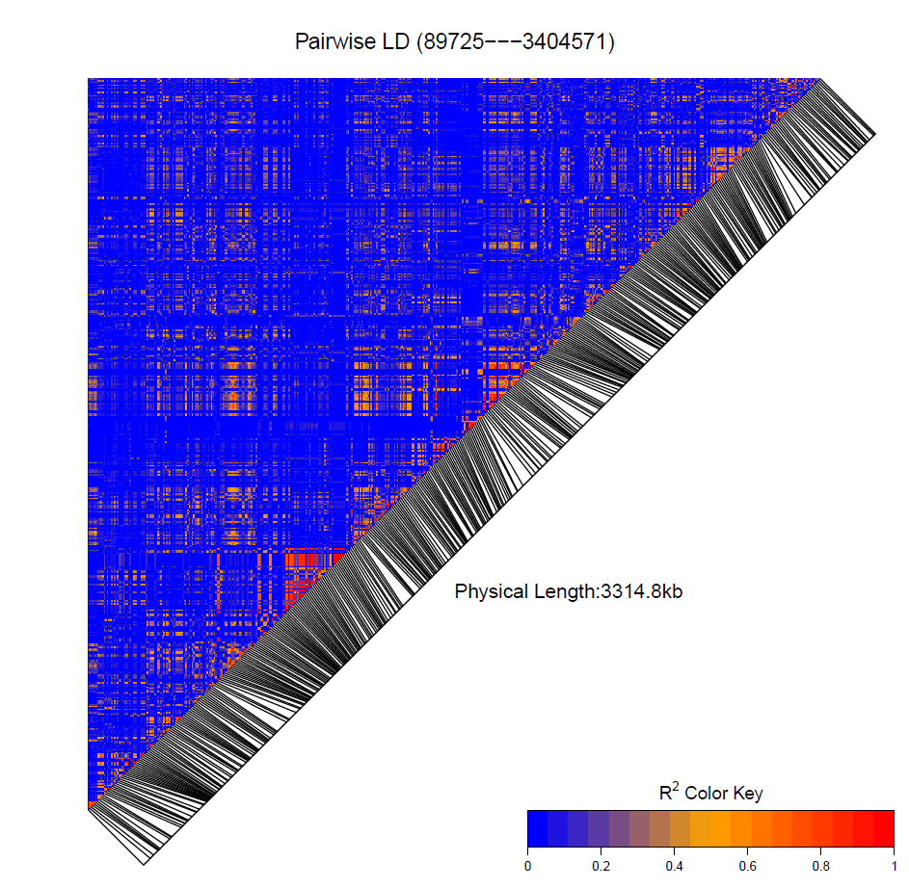
Actual HD genotype correlations²

Slide 14
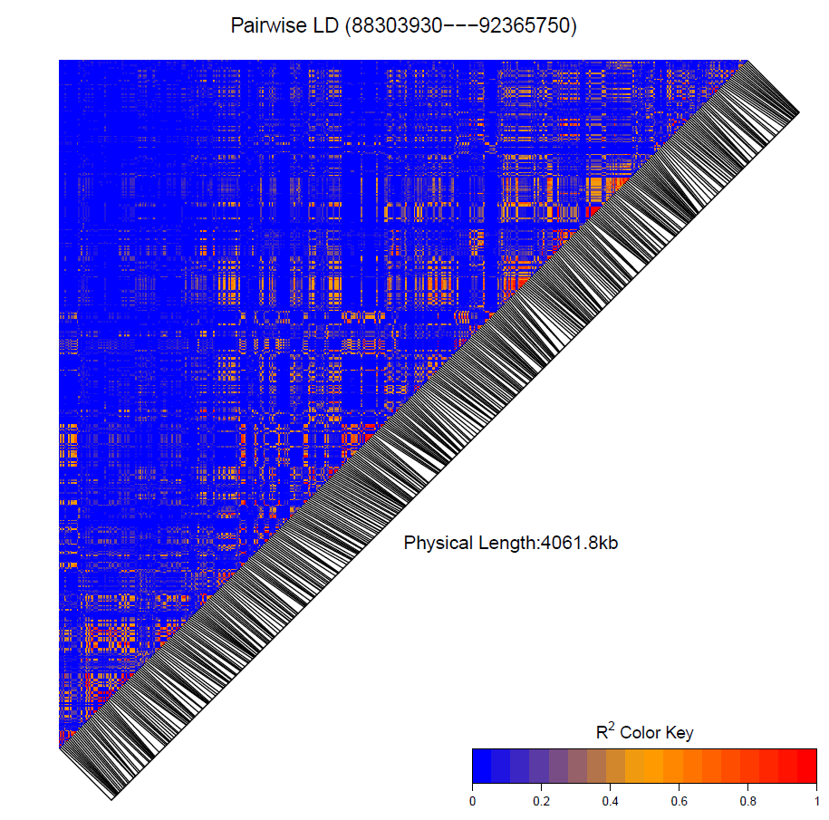
Simulated HD correlations²

Slide 15
Conclusions
High read depth is expensive (linear cost)
Low read depth requires additional math
Haplotype probabilities | (A B counts, error)
Imputation improved with findhap version 4
Up to 400 times faster than Beagle
findhap more accurate for low coverage
Some gain from including HD in sequence

Slide 16
Acknowledgments
Jeff O’Connell and Derek Bickhart provided helpful advice on sequence analysis and software design and testing

