Slide 1

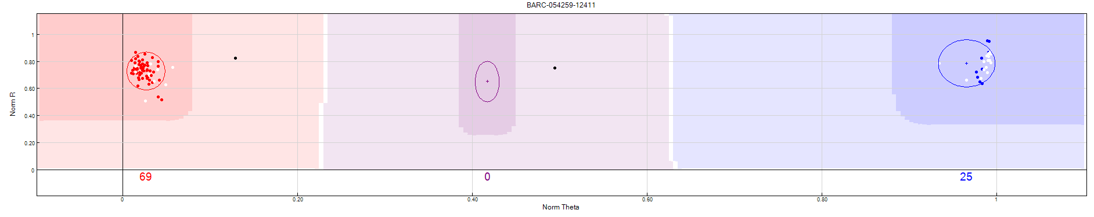
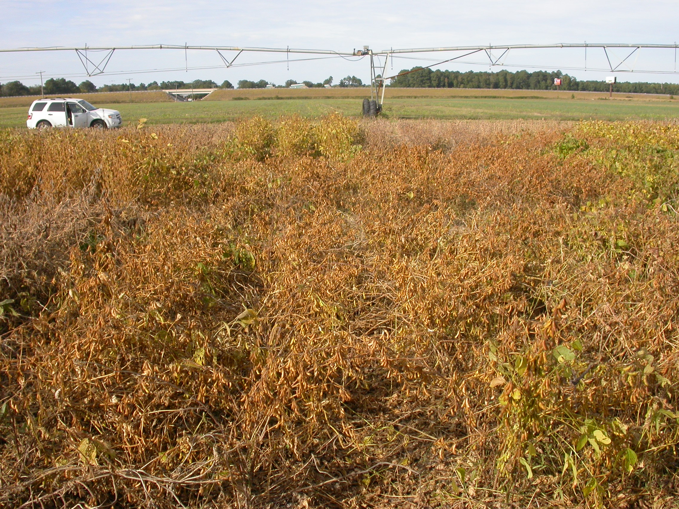
Phenotypic and Genetic Similarity Between the Soybean Cultivars CNS, Punjab-1, and Nanking 332
Andrew Scaboo*, Thomas Carter, Margarita Villagarcia, Lilian Miranda, and Joseph Burton
USDA-ARS Soybean and Nitrogen Fixation Unit
Raleigh, NC
Abstract
The soybean cultivars CNS and Punjab-1 are dominant and important ancestors in the genetic base of current southern United States and Indian soybean cultivars, respectively. The objective of this research was to attempt to determine their origin by evaluating agronomic and molecular marker characteristics. A total of 30 cultivars were grown in a randomized complete block design (RCBD) with three replications at Sandhills, NC during 2005, 2006, 2007, and 2008. Selection of the most similar cultivars led to a follow-up test of 10 cultivars grown in a RCBD with four replications at three locations in North Carolina during 2009 and 2010. The genetic distance values for Punjab-1, Punjab No. 1, and No. 373 were 0, indicating that these varieties are identical based on SNP markers. This is also true for the varieties Nanking 332 and No. 332. The variety CNS also clusters closely to the Punjab and Nanking types. This is convincing evidence that the variety Punjab-1 was a selection out of the Nanking type No. 373. These data also show that the Punjab types, Nanking types, and CNS are closely related compared to all other germplasm collected prior to 1950. These results suggest there is a strong link between the soybean genetic base in North America and India.
Materials and Methods
DNA from all 26 soybean varieties, as well as 70 other breeding lines and varieties from within the North Carolina USDA breeding program, was isolated from root tips and extracted using the Qiagen DNeasy Plant Mini Kit protocol. Samples were then sent to the USDA genotyping facility at Beltsville, MD for screening with the 1536 single nucleotide polymorphism (SNP) chip using the Illumina GoldenGate Assay referenced by Hyten et al. (2008). Allele calling was done at Raleigh, NC using the Genome Studio software. Varieties and breeding lines were assumed to be true breeding, so no heterozygotes were called during this analysis (Figure 2). A total of 1312 SNP markers were found to be polymorphic among these varieties and breeding lines.
Figure 2. Allele calls for SNP marker BARC-054259-12411 using Genome Studio software. Clusters on the right and left represent homozygous forms of the respective allelic marker.
Results
Table 3. Genetic distance (Euclidean) values for Nanking, Punjab, and CNS type soybean varieties based on 1312 single nucleotide polymorphic markers. Roanoke is included to represent the most distant variety, in this experiment, from these three types.
Figure 3. Scatter plot of multidimensional scaling analysis of genetic distance in 26 soybean varieties collected (or selected within) from the Jiangsu Province in China prior to 1950.
Variety | Nanking 332 | No. 332 | Punjab-1 | Punjab No. 1 | No. 373 | CNS | CNS 4 | Roanoke
Nanking 332 | 0
No. 332 | 0 | 0
Punjab-1 | 0.197 | 0.199 | 0
Punjab No. 1 | 0.197 | 0.199 | 0 | 0
No. 373 | 0.197 | 0.199 | 0 | 0 | 0
CNS | 0.241 | 0.241 | 0.299 | 0.298 | 0.299 | 0
CNS 4 | 0.404 | 0.404 | 0.434 | 0.434 | 0.433 | 0.374 | 0
Roanoke | 0.631 | 0.631 | 0.629 | 0.629 | 0.629 | 0.639 | 0.645 | 0
Introduction
In 2004, we made the observation that the varieties CNS and Punjab-1 were strikingly similar for many visual traits including: maturity group (VII), flower color (purple), pubescence color (tawny), minimal shattering, and resistance to bacterial pustule. This combination of traits is extremely rare in germplasm collected before 1950. Upon further investigation, we realized that both CNS and Punjab-1 were selections from a Nanking type variety, although it is not certain which type. The objective of this research is determine the origin of CNS and Punjab-1 and determine how closely they are related. Considering the prominence of CNS and Punjab in the United States and Indian soybean genetic base, this research will help breeders better understand the underlying commonality between U.S. and Indian gene pools.
The phrase ‘Nanking (aka Nanjing or Jin Da) type’ is related to a collaborative soybean evaluation project in the 1920’s between the College of Agriculture of Nanking University, the University of Nanking, the Chinese government, and Cornell University (Love and Reisner 1963). Approximately 10,000 landraces were collected and named in a series as Nanking 1 - 10,000 and evaluated agronomically. In 1927, C.M. Helm worked at the University of Nanking and sent several hundred landraces, numbered 1 to at least 417, to the U.S.A. Only 19 of the accessions exist in the USDA collection today. Nanking (aka Nanksoy and Jin Da) 332 is the first soybean variety released from China as a result of that screening effort (Love and Reisner 1963). It is not clear from the literature as to which Nanking type is the ancestor of CNS and Punjab-1.
The variety CNS is referenced by Hartwig and Lehman (1950) as a ‘selection from PI 71569 from Nanking, China’. The variety Clemson is also referenced by the Germplasm Resources Information Network (GRIN) as a selection out of PI 71569. There are many soybean accessions in the USDA soybean germplasm collection today which appear related to, or a part of, the Nanking series of accessions collected in China during the mid- and late-1920’s.
The variety Punjab-1 is referenced by Satyavathi et al. (2006) and Tiwari (2001) as a ‘selection from Nanking’. At least three accessions from the 19 USDA accessions were in the Indian collection at PUSA and transferred to the Indian NBPGR collection in 1949 and called Nanking.
The plant introductions from the USDA germplasm collection that were collected from Jiangsu province prior to 1950, and submitted by C.H. Hehm, Y.S. Tsiang, and A.K. Smith, were included with CNS, Punjab-1, and Nanking 332 in a field test to asses agronomic and seed quality data for a direct comparison.
Results
Table 1. Mean agronomic performance of 26 soybean varieties collected (or selected within) from the Jiangsu Province in China prior to 1950 and grown at Sandhills, NC with three replications during 2005, 2006, 2007, and 2008.
Table 2. Mean agronomic performance of Nanking, Punjab, and CNS type soybean varieties grown at Plymouth, Clayton, and Kinston, NC with four replications during 2009 and 2010.
Variety | Flower Color | Pubescence Color | Height (cm) | Lodging (1-5) | Oil (%) | Protein (%) | Seed Size (g) | Maturity (Oct. 1 =1) | Yield (bu/ac)
No. 151 | P | T | 42 | 3.1 | 17.3 | 43.1 | 15.5 | 33 | 22.1
No. 157 | P | T | 39 | 2.1 | 16.9 | 44.4 | 13.6 | 28 | 25.0
No. 165 | P | G | 51 | 4.1 | 17.5 | 43.8 | 11.3 | 21 | 22.6
Great White | W | G | 34 | 1.9 | 18.6 | 41.5 | 25.1 | 32 | 29.2
No. 2236 | P | T | 42 | 4.3 | 14.0 | 43.6 | 6.0 | 30 | 14.7
No. 373 | P | T | 29 | 2.0 | 17.2 | 44.3 | 14.6 | 19 | 34.4
Liuchow B | P | T | 46 | 3.9 | 18.0 | 43.6 | 12.3 | 26 | 22.0
Hayseed | W | T | 50 | 4.5 | 17.7 | 45.4 | 11.5 | 15 | 17.6
Georgian | P | T | 45 | 3.6 | 15.9 | 45.9 | 14.4 | 24 | 22.5
Clemson | P | T | 39 | 2.5 | 16.9 | 44.5 | 14.1 | 27 | 28.6
Palmetto | P | T | 58 | 2.8 | 16.9 | 45.3 | 12.4 | 21 | 21.8
Monetta | P | T | 41 | 3.2 | 15.5 | 43.9 | 14.0 | 17 | 21.0
Creole | P | T | 50 | 2.9 | 17.6 | 43.4 | 15.3 | 26 | 24.0
Charlee | P | T | 50 | 3.8 | 16.3 | 44.5 | 12.1 | 27 | 28.3
Missoy | P | T | 54 | 4.0 | 16.4 | 44.0 | 12.4 | 27 | 25.9
Nanking No. 417 | P | T | 48 | 4.2 | 16.6 | 44.4 | 10.2 | 28 | 19.7
Nanking 332 | P | T | 32 | 2.9 | 18.2 | 43.6 | 14.2 | 25 | 30.4
No. 332 | P | T | 30 | 2.9 | 17.3 | 44.9 | 14.9 | 23 | 29.1
Punjab-1 | P | T | 29 | 2.0 | 17.8 | 43.1 | 15.0 | 21 | 32.5
Punjab No. 1 | P | T | 28 | 2.1 | 17.6 | 44.5 | 15.0 | 20 | 35.7
CNS 4 | P | T | 33 | 2.5 | 17.1 | 45.2 | 15.0 | 29 | 32.1
CNS | P | T | 32 | 3.1 | 17.6 | 45.0 | 13.3 | 25 | 31.7
S-100 | W | G | 37 | 1.8 | 17.9 | 45.3 | 14.0 | 3 | 23.3
Lee | P | T | 28 | 1.3 | 19.7 | 43.7 | 14.6 | 18 | 32.6
Roanoke | W | G | 37 | 2.0 | 19.9 | 41.9 | 15.7 | 26 | 28.7
NC-Roy | W | G | 41 | 2.3 | 19.3 | 41.0 | 11.8 | 24 | 37.4
NC-Raleigh | W | T | 39 | 2.2 | 20.7 | 39.2 | 13.1 | 30 | 41.2
LSD (0.05) | - | - | 2.9 | 0.4 | 1.3 | 1.6 | 0.6 | 1.7 | 3.8
Materials and Methods
A total of 26 soybean varieties collected (or selected within) from the Jiangsu Province in China prior to 1950, and currently available in the USDA germplasm collection, along with four check varieties were grown in a randomized complete block design (RCBD) with three replications at Sandhills, NC during 2005, 2006, 2007, and 2008. Selection of the most similar cultivars led to a follow-up test of 10 varieties grown in a RCBD with four replications at three locations in North Carolina during 2009 and 2010 (Figure 1). Protein and oil content was measured via near-infrared spectroscopy at the USDA facility in Peoria, IL and seed size (g) was obtained from weighing 100 randomly selected seeds. Height (cm), lodging (1 = erect, 5 = prostrate), and maturity (Oct 1 = 1) were measured in the field in each year and location.
Statistical analysis were performed using SAS v9.0. Analysis of variance and means were calculated using the PROC GLM and PROC MEANS procedures. Euclidean genetic distance values were calculated using matching coefficients with the PROC DIST procedure and dimension coordinates were obtained by multidimensional scaling (MDS) using the PROC MDS procedure in SAS.
Figure 1. Photograph of the field test grown in Plymouth, NC during 2009. Plots consist of three 6.1 m long rows, with the center row being evaluated for agronomic traits and end-trimmed for harvest of seed yield.
Conclusions
Analysis of agronomic data revealed there were no significant differences, for the traits measured, between the varieties Punjab-1, Punjab No. 1, and No. 373 averaged over all locations (1) and years (4) and there were no significant differences for the varieties Nanking 332 and No. 332 except for seed size and protein (Table 1). This data supports the idea that these varieties are highly related, respectively. The varieties CNS, CNS 4, and Nanking No. 417 showed significant differences from the Punjab and Nanking varieties for most traits (Table 1 and Table 2). These data suggest that while the CNS, Punjab, and Nanking type varieties appear closely related, there are significant agronomic differences between these types resulting from the initial selection. The genetic distance values for Punjab-1, Punjab No. 1, and No. 373 were 0, indicating that these varieties are identical based on SNP markers (Table 3). This is also true for the varieties Nanking 332 and No. 332. The variety CNS clusters closely to the Punjab and Nanking types (Figure 3).
This is convincing evidence that the variety Punjab-1 was a selection out of the Nanking type No. 373. These data also show that the Punjab types, Nanking types, and CNS are closely related compared to all other germplasm collected prior to 1950. Although the Punjab types and CNS are closely related to the Nanking types, they appear to be related to the Nanking types in different genetic directions. This may be due to the selection taking place on different continents (India and North America, respectively). These results suggest there is a strong link between the soybean genetic base in the United States and India.
Nanking 332
Punjab-1
Variety | Height (cm) | Lodging (1-5) | Oil (%) | Protein (%) | Seed Size (g) | Maturity (Oct. 1 =1) | Yield (bu/ac)
Nanking No. 417 | 48 | 3.7 | 15.7 | 42.9 | 10.5 | 30 | 20.5
Nanking 332 | 38 | 3.5 | 16.7 | 42.8 | 13.0 | 26 | 22.9
No. 332 | 40 | 3.2 | 17 | 42.3 | 13.1 | 27 | 24.5
Punjab-1 | 36 | 2.8 | 17.9 | 41.5 | 13.3 | 26 | 27.5
Punjab No. 1 | 37 | 3.0 | 17.0 | 42.7 | 13.5 | 25 | 27.1
CNS 4 | 38 | 3.0 | 16.3 | 42.9 | 12.9 | 30 | 26.3
CNS | 39 | 3.2 | 16.6 | 43.5 | 11.8 | 26 | 23.6
NC-Roy | 33 | 1.5 | 18.6 | 42.1 | 13.7 | 23 | 41.2
NC-Raleigh | 32 | 1.5 | 21.4 | 39.7 | 15.0 | 28 | 45.5
LSD (0.05) | 2.0 | 0.2 | 0.5 | 0.6 | 0.4 | 0.7 | 2.2
No. 332
CNS
References
Hartwig, E.E. and S.G. Lehman. 1950. Inheritance of resistance to Bacterial Pustule disease in soybeans. Crop Sci. 226-228.
Hyten, D.L., Q. Song, I.Y. Choi, M.S. Yoon, J.E. Specht, L.K. Matukumalli, R.L. Nelson, R.C. Shoemaker, N.D. Young, and P.B. Cregan. 2008. High-throughput genotyping with the GoldenGate assay in the complex genome of soybean. Theor. Appl. Genet. 116:945–952.
Love, H.H. and J.H. Reisner. 1963. The Cornell-Nanking Story. The Department of Plant Breeding, Cornell University. Ithaca, New York.
Satyavathi, C.T., K.V. Bhat, C. Bharadwaj, S.P. Tiwari, and V.K. Chaudhury. 2006. AFLP analysis of genetic diversity in Indian soybean [Glycine max (L.) Merr] varieties. Genetic Resources and Crop Evolution. 53:1069-1079
Tiwari, S.P. 2001. Introduction, Diversity and Enhancement of Soybean Gentic Resources in India. National Research Centre for Soybean, Indian Council of Agriculture. Indore-452 017, India

