Slide 1
SMAP Data Products
5th Interagency Surface Dynamics Working Group Meeting
Tucson, Arizona
March 3, 2011
Copyright 2011 California Institute of Technology.
Government sponsorship acknowledged.
Pre-decisional – for Planning and Discussion Purposes Only

Slide 2
Presentation Outline
Overview of proposed SMAP Data Products
Data product content
Data Product format and design
SMAP project plans to generate and provide data products

Slide 3
Proposed SMAP Data Products
Data Product Short Name | Description | Data Resolution | Grid Spacing | Granule Extent
L1B_S0_LoRes | Low Resolution Radar σ_{o} in Time Order | 5x30 km (10 slices) | 5x30 km (10 slices) | Half Orbit
L1C_S0_HiRes | High Resolution Radar σ_{o} on Swath Grid | 1-3 km | 1 km | Half Orbit
L1B_TB | Radiometer T_{B} in Time Order | 36x47 km | 36x47 km | Half Orbit
L1C_TB | Radiometer T_{B} | -- | 36 km | Half Orbit
L2_SM_A | Radar Soil Moisture | -- | 3 km | Half Orbit
L2_SM_P | Radiometer Soil Moisture | -- | 36 km | Half Orbit
L2_SM_AP | Active-Passive Soil Moisture | -- | 9 km | Half Orbit
L3_FT_A | Daily Global Composite Freeze/Thaw State | 3 km | 3 km | North of 45° N
L3_SM_A | Daily Global Composite Radar Soil Moisture | -- | 3 km | Global
L3_SM_P | Daily Global Composite Radiometer Soil Moisture | -- | 36 km | Global
L3_SM_AP | Daily Global Composite Active-Passive Soil Moisture | -- | 9 km | Global
L4_SM | Surface & Root Zone Soil Moisture | -- | 9 km | Global
L4_C | Carbon Net Ecosystem Exchange | -- | 9 km | North of 45° N

Slide 4
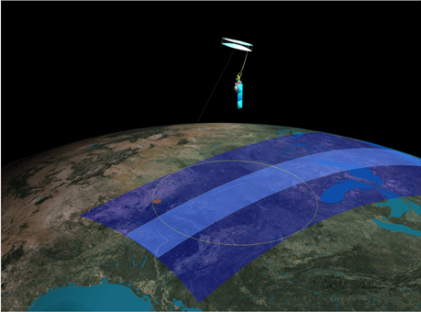
Proposed SMAP Measurement Approach
Orbit:
Sun-synchronous orbit
6 am local time descending
6 pm local time ascending
685 km altitude
Global coverage once every three days
Mission Operations:
3-year baseline mission
Instruments:
Radar: L-band (1.26 GHz)
High resolution, moderate accuracy soil moisture
Freeze/thaw state detection
SAR mode: 3 km resolution
Real-aperture mode: 30 x 6 km resolution
Radiometer: L-band (1.4 GHz)
Moderate resolution, high accuracy soil moisture
40 km resolution
Shared Antenna
6-m diameter deployable mesh antenna
Conical scan at 14.6 rpm
Constant incidence angle: 40 degrees
1000 km-wide swath

Slide 5
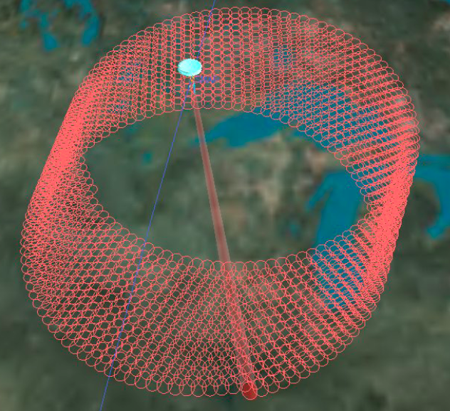
Data Acquisition Plan
Radiometer data:
Continuous collection over the entire orbit and entire 360 degree antenna scan
Capable of periodic “cold sky” looks
High-resolution Synthetic Aperture Radar (SAR) data:
Collection over the entire 360 degree antenna scan over land and coastal water during the AM orbit
Collection over the forward portion of the antenna scan over land and coastal water North of 45 degrees North latitude during the PM orbit.
Low-resolution, real aperture radar data
Continuous collection over entire orbit and entire antenna scan

Slide 6
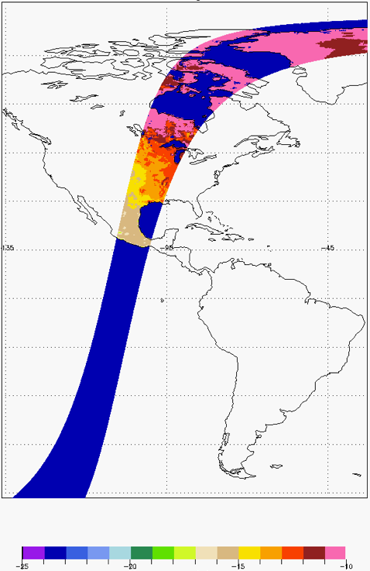
Level 1B Radar Product
Level 1B radar coverage continuous over all surface types.
To contain Earth-located, calibrated radar backscatter measurements for co-pol and cross-pol data in time-order.
Estimated Kp errors assigned to each measurement.
Forward looking and aft looking measurements stored separately.
To include spacecraft orbit and attitude information and instrument pointing geometry.
To provide calibrated backscatter measurements for approximately ten range-resolved “slices” of the full radar FOV footprint. ( ~30 km by 5 km. )
Sigma0 VV (dB)

Slide 7
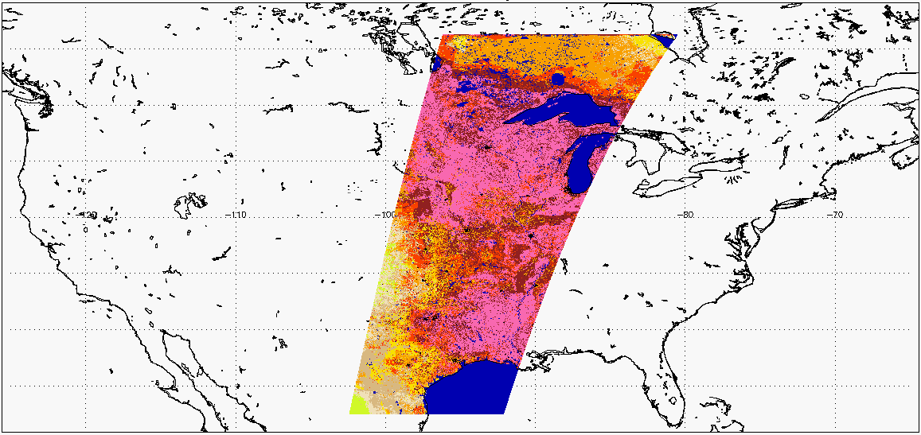
Level 1C High Resolution Radar Product
L1C Hi-Res radar coverage restricted to land and coastal water.
To include spacecraft orbit and attitude information and instrument pointing geometry.
SAR to provide high-resolution single-look measurements. Resolution would vary from ~400 m at the swath edge to about 1.2 km at 150 km from the nadir sub-track. Nadir looks are thin slices as wide as the beam footprint.
Calibrated forward looking and aft looking measurements stored separately.
H-pol, v-pol and cross-pol backscatter measurements multi-looked separately.
Data posted in a 1 km grid cells in an along track /cross track swath grid.
Product would provide reference to global and polar 1 km EASE grid coordinates.
Sigma0 VV (dB)

Slide 8
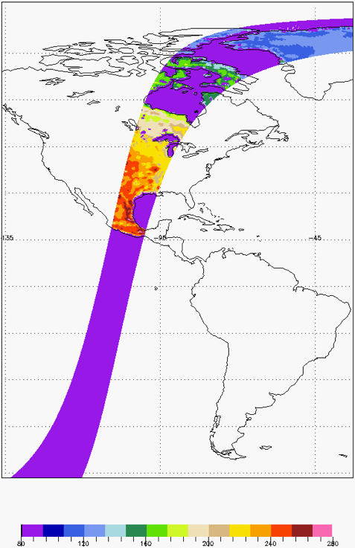
Level 1B Radiometer Product
L1B radiometer coverage continuous over all surface types.
To include spacecraft orbit and attitude information and instrument pointing geometry.
To contain time ordered Earth-located, calibrated brightness temperatures for each FOV footprint.
Forward looking and aft looking measurements stored separately.
Each footprint includes H-pol, V-pol and unpolarized Tb measurements.
Footprint resolution to be approximately 40 km.
Unpolarized Tb used to infer Faraday rotation corrections for the H –pol and V-pol Tb measurements.
Product would provide reference to cylindrical and polar 36 km EASE grid coordinates for each footprint.
L1B Time-ordered H-pol TB (K)

Slide 9
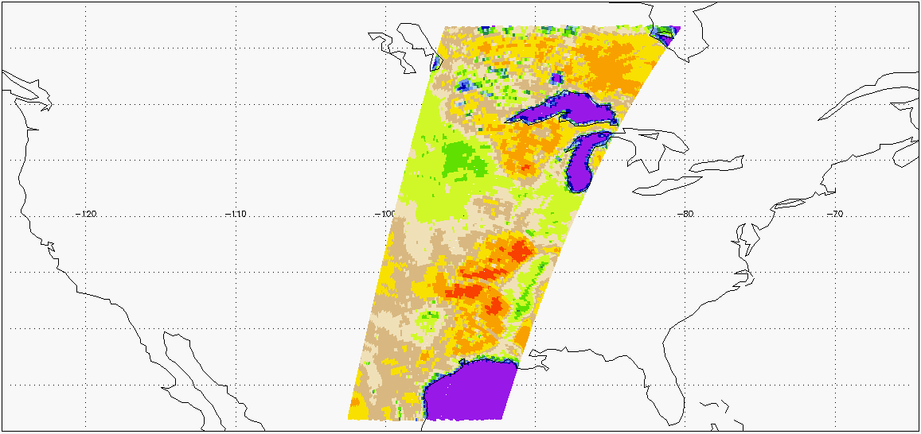
Level 1C Radiometer Product
Level 1B Radiometer data gridded on a 36 km cylindrical Earth-fixed grid.
Forward looking and aft looking observations stored separately.
Input to Level 2 Radiometer 40 km soil moisture and Level 2 active/passive soil moisture processing.
L1C Earth-fixed H-pol TB (K)

Slide 10
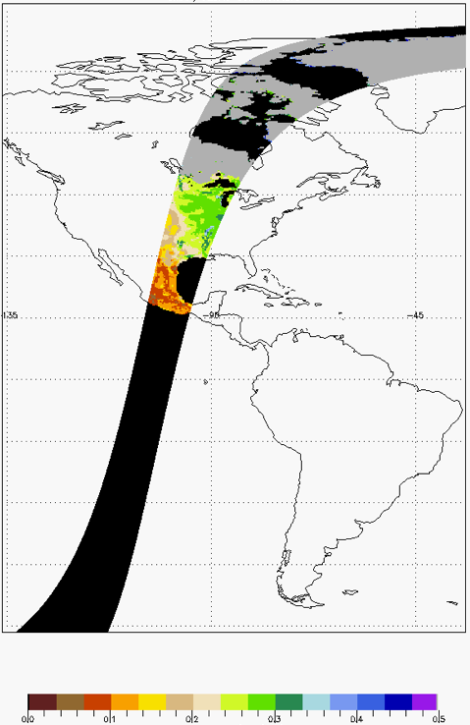
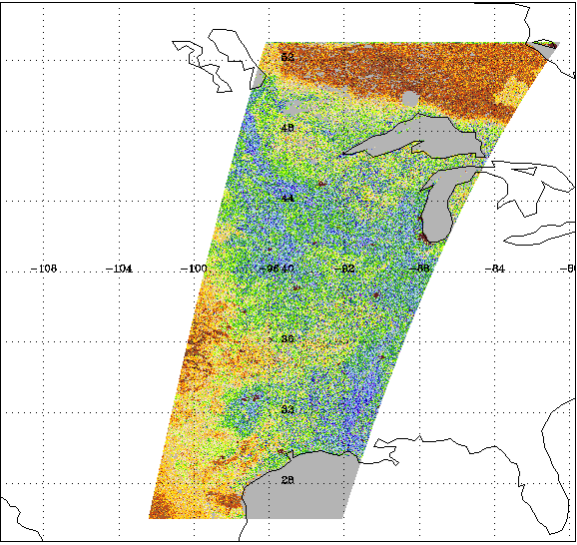
Level 2 High Resolution Radar 3 km Soil Moisture Product
PM Product to cover entire Earth land mass, AM product restricted to land north of 45 North Longitude
AM data acquired specifically for freeze-thaw retrievals.
To employ 1 km High Resolution radar L1C data averaged over 3 km cylindrical EASE grid cells to reduce Kp noise.
Soil moisture retrievals to use snapshot and/or time-series algorithms.
Depending on the terrain classification, multiple optional models/algorithms may be employed for retrieval.
Would provide scene heterogeneity information for the the Level 3 AP algorithm processing.
Would provide freeze-thaw state and transient water body information that the other Level 2 soil moisture processes require.
To include quality masks for urban areas, mountainous terrain, dense vegetation, snow and ice.
Volumetric Soil Moisture (cm³/cm³)

Slide 11
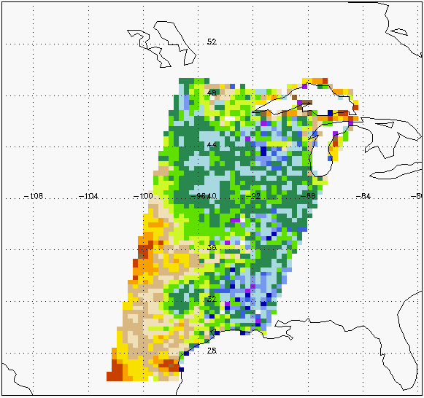
Level 2 Radiometer 36 km Soil Moisture Product
Designed to:
Provide retrieved soil moisture over land with 4% accuracy for low-to-moderately vegetated areas.
Low to moderate vegetation definition is vegetation_water_content <= 5 kg/m2.
Post on 36 km cylindrical EASE grid cells.
Depend upon transient water body and freeze-thaw state retrievals based on High Resolution radar.
Estimate soil moisture based on AM observations.
Include quality masks for urban areas, mountainous terrain, dense vegetation, precipitation, snow and ice.
Volumetric Soil Moisture (cm³/cm³)

Slide 12
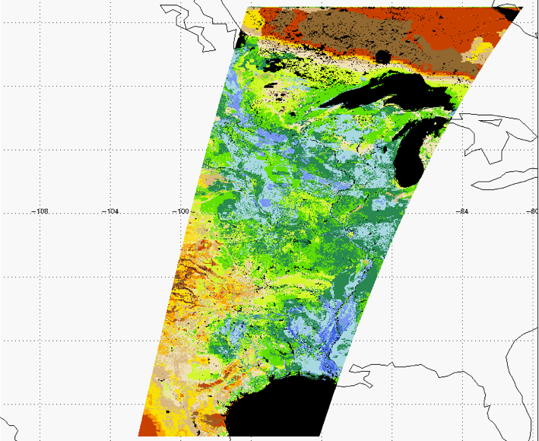
Level 2 Active/Passive 9 km Soil Moisture Product
Designed to:
Merge radar and radiometer channels using a time series algorithm and spatial heterogeneity of L1C radar product.
Provide retrieved soil moisture over land with 4% accuracy for low-to-moderately vegetated areas.
Low to moderate vegetation definition is vegetation_water_content <= 5 kg/m2.
Post on a 9 km cylindrical EASE grid cells.
Employ transient water body and freeze-thaw state retrievals from High Resolution Radar processing.
Include quality masks for urban areas, mountainous terrain, dense vegetation, precipitation, snow and ice.
Input to Level 4 soil moisture processing.
Volumetric Soil Moisture (cm³/cm³)

Slide 13
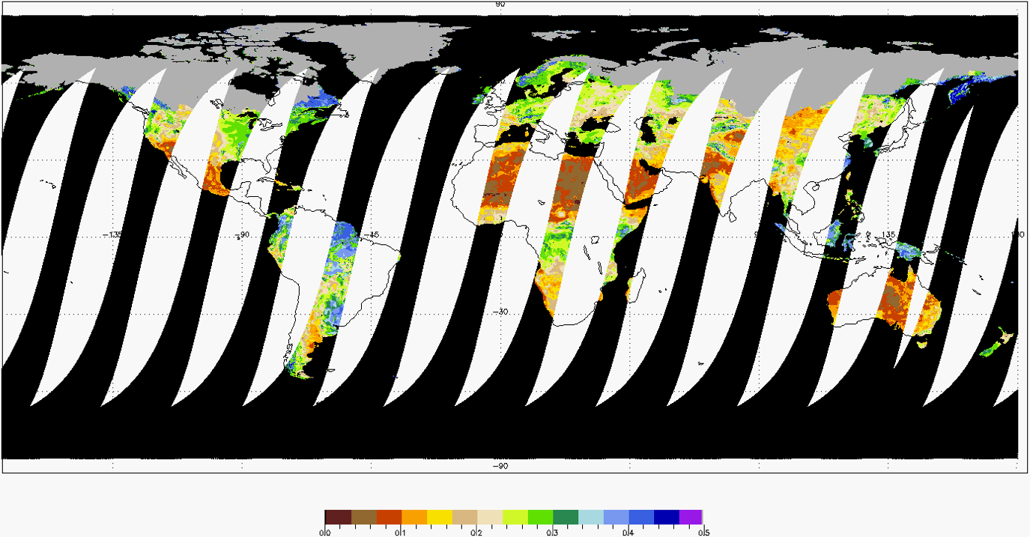
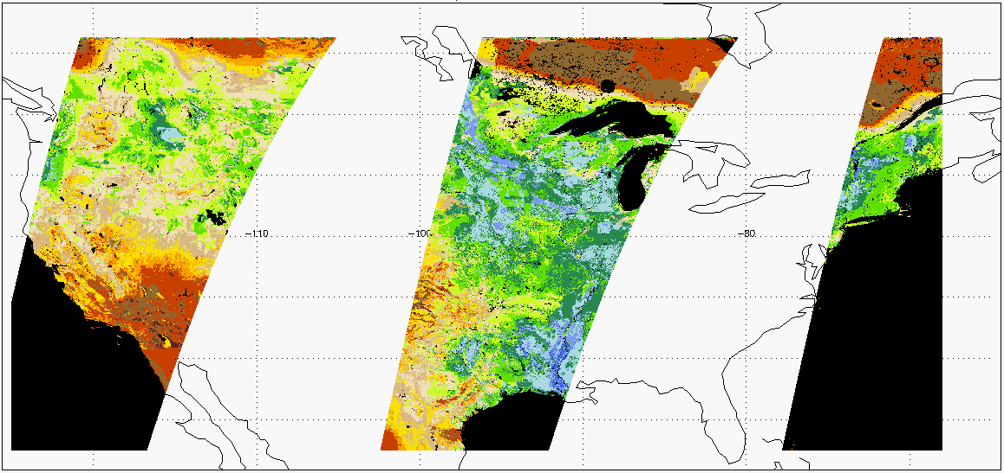
Level 3 High Resolution Radar 3 km Soil Moisture Product
Composite of all Radar Level 2 half orbit products acquired during the same UTC day.
Multiple measurements may overlap at high latitudes. Algorithm to select measurements acquired closest to 6 AM solar time.
Posted on cylindrical 3 km EASE grid cells.
Soil moisture retrievals use snapshot and/or time-series algorithms.
Depending on the terrain classification, multiple optional models/algorithms may be employed for retrieval.
Based exclusively on AM data.
Volumetric Soil Moisture (cm³/cm³)

Slide 14
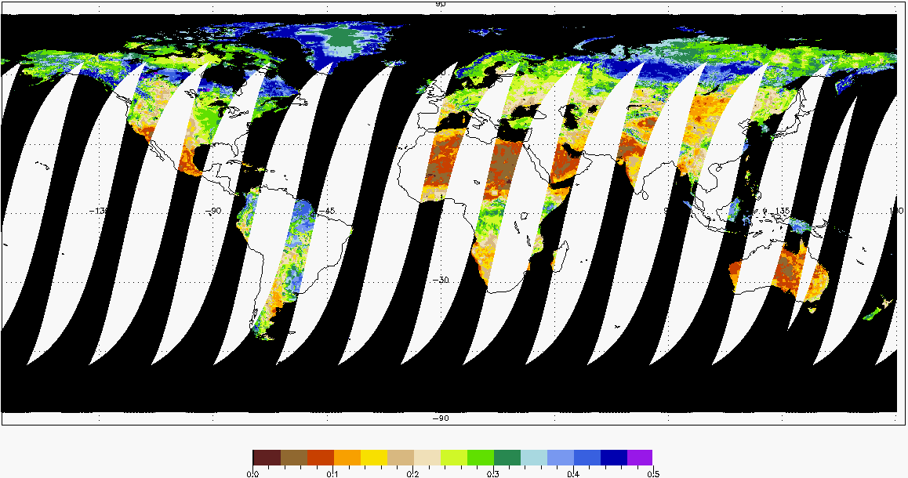
Level 3 Radiometer 36 km Soil Moisture Product
Composite of all Radiometer Level 2 half orbit products acquired during the same UTC day.
Multiple measurements may overlap at high latitudes. Algorithm to select measurements acquired closest to 6 AM solar time.
Posted on 36 km cylindrical EASE grid cells.
Would provide retrieved soil moisture over land with 4% accuracy for low-to-moderately vegetated areas.
Low to moderate vegetation definition is vegetation_water_content <= 5 kg/m2.
Based exclusively on AM data.
Volumetric Soil Moisture (cm³/cm³)

Slide 15
Level 3 Active/Passive 9 km Soil Moisture Product
Composite of all Active/Passive Level 2 half orbit products acquired during the same UTC day.
Multiple measurements may overlap at high latitudes. Algorithm to select measurements acquired closest to 6 AM solar time.
Posted on 9km cylindrical EASE grid cells.
Would provide retrieved soil moisture over land with 4% accuracy for low-to-moderately vegetated areas.
Low to moderate vegetation definition is vegetation_water_content <= 5 kg/m2.
Based exclusively on AM data.
Input to Level 4 soil moisture processing.
Volumetric Soil Moisture (cm³/cm³)
Volumetric Soil Moisture (cm³/cm³)

Slide 16
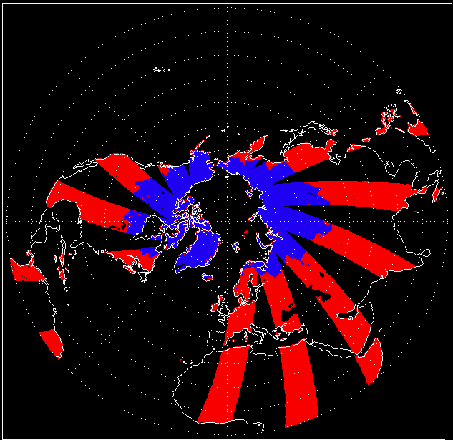
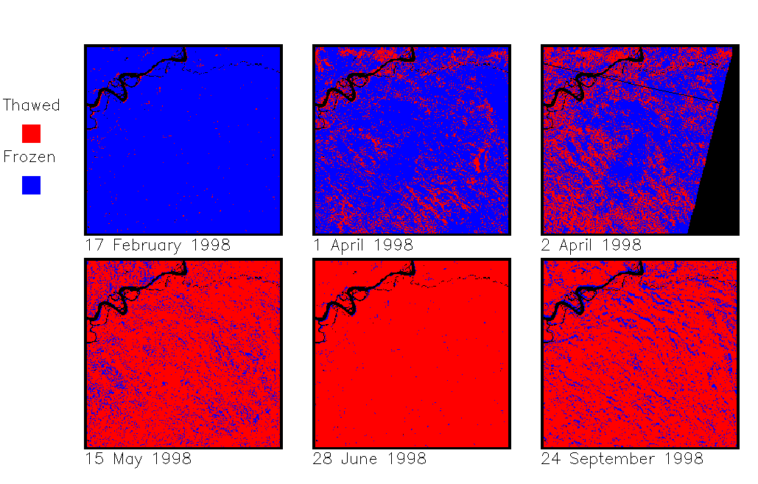
Level 3 Freeze/Thaw Product
Would quantify daily freeze/thaw state as a binary condition for land surface.
Would employ the 1 km Level 1C High Resolution Radar data and a time-series change detection algorithm to infer freeze/thaw state.
Would provide 80% freeze/thaw state accuracy
Would represent 2 day average temporal intervals for regions North of 45°N.
Each product would represent a single calendar day UTC.
Posted to a 3 km polar EASE grid with 1 to 3 km spatial resolution.
Daily Freeze/Thaw State

Slide 17
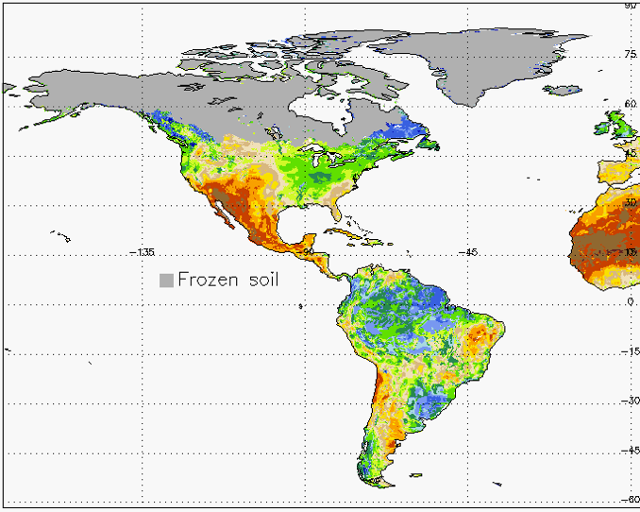
Level 4 Surface and Root-Zone Soil Moisture Product
Assimilate SMAP data into a state-of-the-art land surface model to derive global estimates of root-zone moisture.
Would use L1C Radiometer, Level 3 High Resolution Radar Soil Moisture, and Level 3 Freeze/Thaw.
Global output would represent 3 hour intervals at 9 km resolution with 7-day latency.
Volumetric Soil Moisture (%)

Slide 18
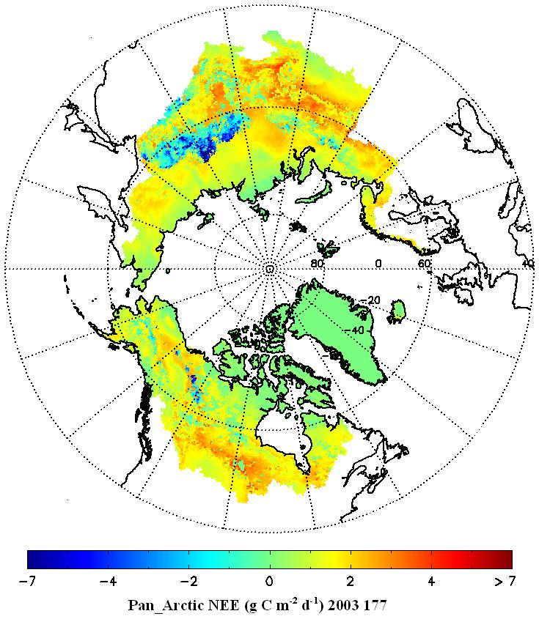
Level 4 Carbon Product
Mean Daily net CO₂ Exchange
Would quantify the net carbon flux in boreal landscapes
Would reduce uncertainty regarding missing carbon sink on land.
Applies a soil decomposition algorithm driven by SMAP L4_SM and Gross Primary Production (GPP) inputs to compute net land-atmosphere CO₂ exchange (NEE).
Would produce daily global maps of NEE at 9 km resolution with a 14-day latency.
Accuracy commensurate with tower based CO₂ observations. (RMSE ≤ 30 g C m⁻² yr⁻¹).
>7 4 2 0 -2 -4 <-7
NEE (g C m⁻²) DOY 177, 2004

Slide 19
Data Product Design Drivers
Data design must balance requirements of the mission Science Team with the needs of the User Community
All Data Products must:
Conform with mission requirements
Provide users with the information they need
Have a consistent format and architecture
Contain adequate self descriptive information
Be easy to use

Slide 20
Product Generation Practice
Within the project - Algorithm Development Team and Science Data System Team collaborate to generate design
Develop a complete product design that would include essential data as well as valuable ancillary data
Coordinate product content to ensure that data required in subsequent processes are documented and available
Coordinate naming conventions so that elements that represent same measures have the same or very similar names
Ensure that the products provide the data that the science community needs
Within the larger community – SMAP Science Data System (SDS) team is actively involved with NASA Earth Science Data Systems Software Process Group (SPG)
Ensure that standards are endorsed by the SPG
Ensure that products contain essential metadata so that requisite data could be located on multiple systems including the Data Centers and ECHO
Track upcoming technologies, incorporate features that would enable adoption of those technologies as they become more widespread

Slide 21
Product Format Hierarchical Data Format (HDF5)
HDF5 combines a robust data model with a file format and a user library
Major object components:
Datasets – major product content
Dataspace – description of product content shapes
Datatypes – flexible means to type data
Groups – flexible means to group data
Attributes – descriptive elements
Supports a large variety of platforms and common software languages
IDL and Matlab both have well defined and easy to use HDF5 interfaces
Has considerable heritage – introduced in 1999-2000
Provides a highly flexible architecture to read, extract and write data
Operates efficiently with very large data sets
Large numbers of new technology data service providers function well with HDF5
Support available through the HDF Group.
Website at http://www.hdfgroup.org/

Slide 22
SMAP Data Product Design A Consistent and Simple Standard
Data product types or collections
Set of files with conformant output generated using the same Science Processing Software (SPS)
All data product types should employ a single standard format
Data granule or file
An instance of a data product type
Product data
Includes both algorithmic output as well as valuable ancillary data
Separated into distinct groups of arrays
Arrays within each group are conceptually related
Within each group, arrays have the same or very similar dimension shapes
Within each group, array elements with the same dimension indices apply to the same measurement or retrieval instance
Metadata
Product metadata – applies to the entire content of a data granule
Local metadata – applies to a particular element in the product

Slide 23
Data Correlation in SMAP Product Design
Three data groups appear in the prototype Radar Level 1B Product design:
Attitude and Ephemeris Group
Each of the arrays in this group contains one representative element for each antenna rotation. The following array elements are examples of spacecraft positions and attitudes with a representative time at antenna_scan_time_utc[1000]:
sc_nadir_lon[1000]
y_pos[1000]
Sigma0 Data Group
Each of the arrays in this group contains one representative element for each low resolution sigma0. The following array elements are examples of measurements for the low resolution sigma0 with a representative time at sigma0_time_utc[20000] :
antenna_boresight_azimuth[20000]
sigma0_hh[20000]
Sigma0 Slice Data Group
Each of the arrays in this group contains one representative element for a slice in each low resolution sigma0. The following array elements are examples of measurements for the 7th slice of the low resolution sigma0 with a representative time at sigma0_time_utc[20000]:
Slice_slant_range[20000][6]
slice_sigma0_vv[20000][6]

Slide 24
Metadata Categories and Coverage
Product metadata – applies to the entire content of a data granule
Mission specific information
Spatial and time boundary information
Data version information – algorithm, Science Processing Software (SPS), Science Data System (SDS) release, HDF5 version
Granule pedigree or lineage
Lists of the input that were used to generate a data granule
Technical parameters that apply to the entire data granule
Orbit mechanical data
Instrument specific information
Small tables of calibration and/or algorithmic coefficients
Algorithmic parameters and options
Data quality and completeness
References to related documentation
Local metadata – applies to particular arrays in the product.
Maxima, minima, units, dimension definitions, identification of statistical methods

Slide 25
Quality Information
Product metadata – covers the content of the entire product
Overall quality information for entire product content
Completeness – fraction of expected data that appears in the product
Range Check – fraction of data pixels that fall within an acceptable range
Quality Check – fraction of data pixels that are deemed acceptable quality
Associated with each pixel – enables users to assess quality of each individual element
Quantitative error bar whenever possible
Bit flags for qualitative information
Individual bits flag individual conditions
In general, ‘0’ indicates desirable conditions, ‘1’ represents questionable or undesirable conditions
When the overall bit flag value is zero, the data are clean

Slide 26
Ancillary Data in SMAP Products
SMAP processing algorithms plan to use a considerable amount of ancillary data. Some examples are:
Meteorological data from ECMWF
Surface information from MODIS
Digital Elevation Map based on multiple sources
The proposed SMAP strategy for inclusion of ancillary data is:
Dynamic ancillary data needed for algorithmic use would appear in SMAP products
Static ancillary data needed for algorithmic use may appear in distributable tables rather than in the data products
The project to provide these tables to Early Adopters before launch
Data Center to provide tables after launch

Slide 27
Proposed SMAP Data Product Structure
…….
…….
Product Metadata – Stored in attributes in the HDF5 Metadata Group.
HDF5 Data Group 1 – One of multiple HDF5 groups.
All data sets in this group have corresponding array indices.
…..
…..
HDF5 Data Set 1 – Array of Product Data
Local Metadata – Max, min, units, dimension sizes, statistical methods, etc. – CF compliant
HDF5 Data Set J – Array of Product Data
Local Metadata – Max, min, units, dimension sizes, statistical methods, etc. – CF compliant
HDF5 Data Group N – All data sets in this group have corresponding array indices.
HDF5 Data Set M – Array of Product Data
Local Metadata – Max, min, units, dimension sizes, statistical methods, etc. – CF compliant

Slide 28
SMAP Product Development Plan
Data Product Availability and Volumes
Generation of Model SMAP Products
Current Data Product Simulation

Slide 29
Proposed SMAP Data Product Availability
Data Product Short Name | Description | Initial Availability After Launch | Latency after Acquisition
L1B_S0_LoRes | Low Resolution Radar σ_{o} in Time Order | 6 months | 12 hours
L1C_S0_HiRes | High Resolution Radar σ_{o} on Swath Grid | 6 months | 12 hours
L1B_TB | Radiometer T_{B} in Time Order | 6 months | 12 hours
L1C_TB | Radiometer T_{B} on Earth Grid | 6 months | 12 hours
L2_SM_A | Radar Soil Moisture on Earth grid | 6 months | 24 hours
L2_SM_P | Radiometer Soil Moisture on Earth Grid | 6 months | 24 hours
L2_SM_AP | Active-Passive Soil Moisture on Earth Grid | 6 months | 24 hours
L3_FT_A | Daily Freeze/Thaw State on Earth Grid | 9 months | 49 hours
L3_SM_A | Daily Radar Soil Moisture on Earth grid | 9 months | 49 hours
L3_SM_P | Daily Radiometer Soil Moisture on Earth Grid | 9 months | 49 hours
L3_SM_AP | Daily Active-Passive Soil Moisture on Earth Grid | 9 months | 49 hours
L4_SM | Surface & Root Zone Soil Moisture on Earth Grid | 9 months | 7 days
L4_C | Carbon Net Ecosystem Exchange on Earth Grid | 9 months | 14 days

Slide 30
Anticipated SMAP Data Product Volumes
Data Product Short Name | Description | Daily Volume (GBytes) | Yearly Volume (TBytes)
L1B_S0_LoRes | Low Resolution Radar σ_{o} in Time Order | 9.002 | 3.288
L1C_S0_HiRes | High Resolution Radar σ_{o} on Swath Grid | 45.281 | 16.539
L1B_TB | Radiometer T_{B} in Time Order | 1.607 | 0.587
L1C_TB | Radiometer T_{B} on Earth Grid | 0.270 | 0.099
L2_SM_A | Radar Soil Moisture on Earth grid | 2.132 | 0.779
L2_SM_P | Radiometer Soil Moisture on Earth Grid | 0.014 | 0.005
L2_SM_AP | Active-Passive Soil Moisture on Earth Grid | 1.004 | 0.367
L3_FT_A | Daily Freeze/Thaw State on Earth Grid | 2.331 | 0.569
L3_SM_A | Daily Radar Soil Moisture on Earth grid | 9.958 | 3.637
L3_SM_P | Daily Radiometer Soil Moisture on Earth Grid | 0.037 | 0.014
L3_SM_AP | Daily Active-Passive Soil Moisture on Earth Grid | 0.578 | 0.552
L4_SM | Surface & Root Zone Soil Moisture on Earth Grid | 0.604 | 0.220
L4_C | Carbon Net Ecosystem Exchange on Earth Grid | 17.331 | 6.331

Slide 31
SMAP Product Simulations
The team is currently generating simulated data products
Contents are not complete, but are adequate to test algorithms
The project processes these simulated data sets into HDF5 format that conforms with SMAP product design
Project places these model products on a data server, along with plots and descriptive information
Use of HDF5 products enables users to:
Generate software now that would function after launch
Provide feedback about product format and design
The following data sets are currently on the server:
One year of SMAP L2_SM_P data – all of calendar year 2003
Two months of SMAP L2_SM_A data – March 14, 2003 to May 17, 2003
Two months of SMAP L2_SM_AP data – March 14, 2003 to May 17, 2003
Seven SMAP_L3_FT_A files – seven representative dates in spring 2003
Project would make the above products available to early adopters

Slide 32
SMAP Data Simulation Plans
GloSim1 data are available now
Combines 0.01 degree North American dataset with a 0.25 GLDAS dataset.
Radiometer soil moisture data available for year
Radar soil moisture data available for 10 weeks
GloSim2 Plans
These data would enable end-to-end tests into Level 4 modeling, and thus provide more realistic scientific results
Team goal is to generate these data by the end of the September
Would generate Radar Level 1C and Radiometer Level 1B Products based on these simulations as well
Preparation is dependent on the receipt of land surface model

Slide 33
To Gain Access to Simulated Data Products
Access to simulated data products would be limited to members of the SMAP Science Definition Team and Early Adopters
Currently available on the web server
After a Data Center is selected, and the project reaches an agreement with that Data Center, they would provide model data products
Susan Moran distributed a template Memorandum of Agreement for Early Adopters
Once that agreement is complete, the SMAP SDS encourages Early Adopters to submit an E2190 form.
Required to get a JPL username and password.
Given the JPL username and password, the SDS would provide new users with instructions to access data on the web server
Contacts for E2190 include:
Robert.D.Toaz@jpl.nasa.gov, Jennifer.W.Cruz@jpl.nasa.gov, Barry.H.Weiss@jpl.nasa.gov

Slide 34
Backup

Slide 35
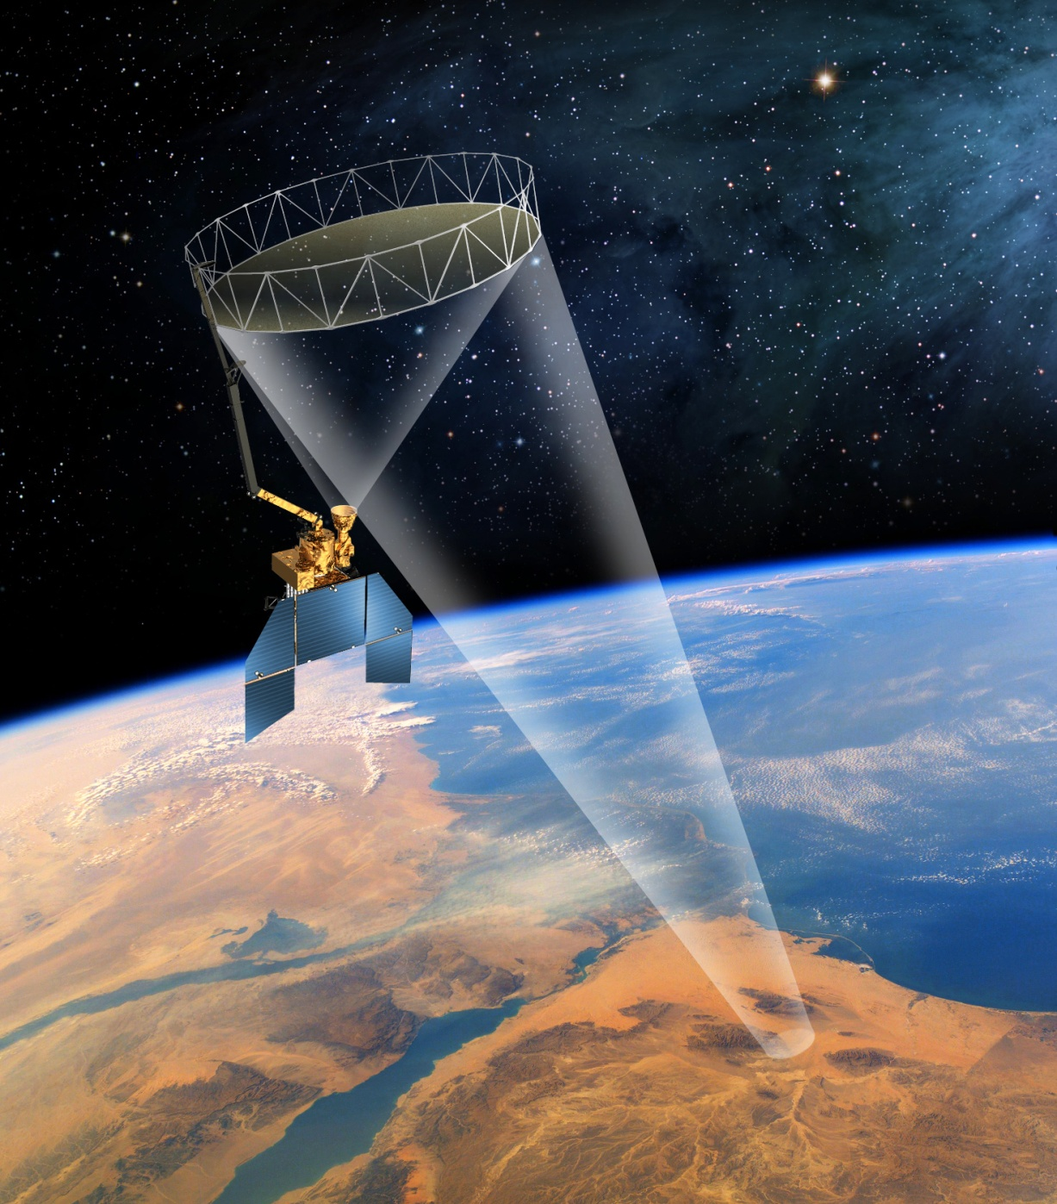
Mission Overview
The proposed SMAP mission was in the first tier recommended by 2007 NRC Earth Science Decadal Survey
Primary Science Objectives :
Global, high-resolution mapping of soil moisture and its freeze/thaw state to:
Link terrestrial water, energy and carbon cycle processes
Estimate global water and energy fluxes at the land surface
Quantify net carbon flux in boreal landscapes
Extend weather and climate forecast skill
Develop improved flood and drought prediction capability
Proposed Mission Implementation:
Observatory Features:
Partners | • JPL (project & payload mgmt, science, spacecraft, radar, mission operations, science processing) • GSFC (science, radiometer, science processing)
Risk | • 7120.5D Category 2; 8705.4 Payload Risk Class “C”
Launch | • Nov. 2014, Launch Vehicle is TBD
Orbit | • Polar sun synchronous; 685 km altitude
Duration | • 3 years
Payload | • L-band SAR (JPL) • L-band radiometer (GSFC) • Shared 6m rotating (15 rpm) antenna (JPL)
3-axis stabilized spacecraft with zero momentum biased attitude control
Single string avionics and power control/distribution electronics
Selected redundancy in ACS sensors, actuators, and telecom radios
Deployable fixed solar array
Command Telemetry & Doppler via S-band to NEN & SN
Science data return at 130 Mbps via an X-band link to the NEN
Hydrazine blow-down propulsion

Slide 36
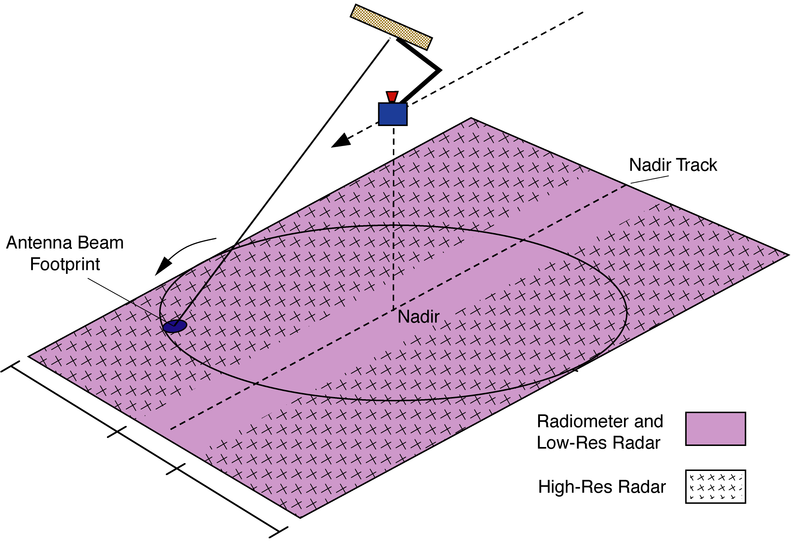
Instrument Key Features
To meet requirement for 3-day revisit time at AM local time…
1000 km swath at 670 - 685 km dawn/dusk sun-synchronous orbit.
For wide measurement swath of combined L-Band active and passive measurements…
Conically scanning reflector antenna.
To achieve L-Band passive resolution of 40 km and and active resolution of 3 km …
6 meter aperture antenna
14.6 rpm rotation rate
Real-aperture radiometer
Synthetic-aperture radar processing
Incidence angle
Near-constant 40 deg incidence angle
1000 km

Slide 37
Science Objectives
The proposed SMAP mission plans to acquire global soil moisture and freeze thaw data to enhance the capability of science applications developers to:
1. Understand the processes that link the terrestrial water, energy and carbon cycles
2. Estimate global water and energy fluxes at the land surface
3. Quantify net carbon flux in boreal landscapes
4. Enhance weather and climate forecast skill
5. Develop improved flood prediction and drought monitoring capability

Slide 38
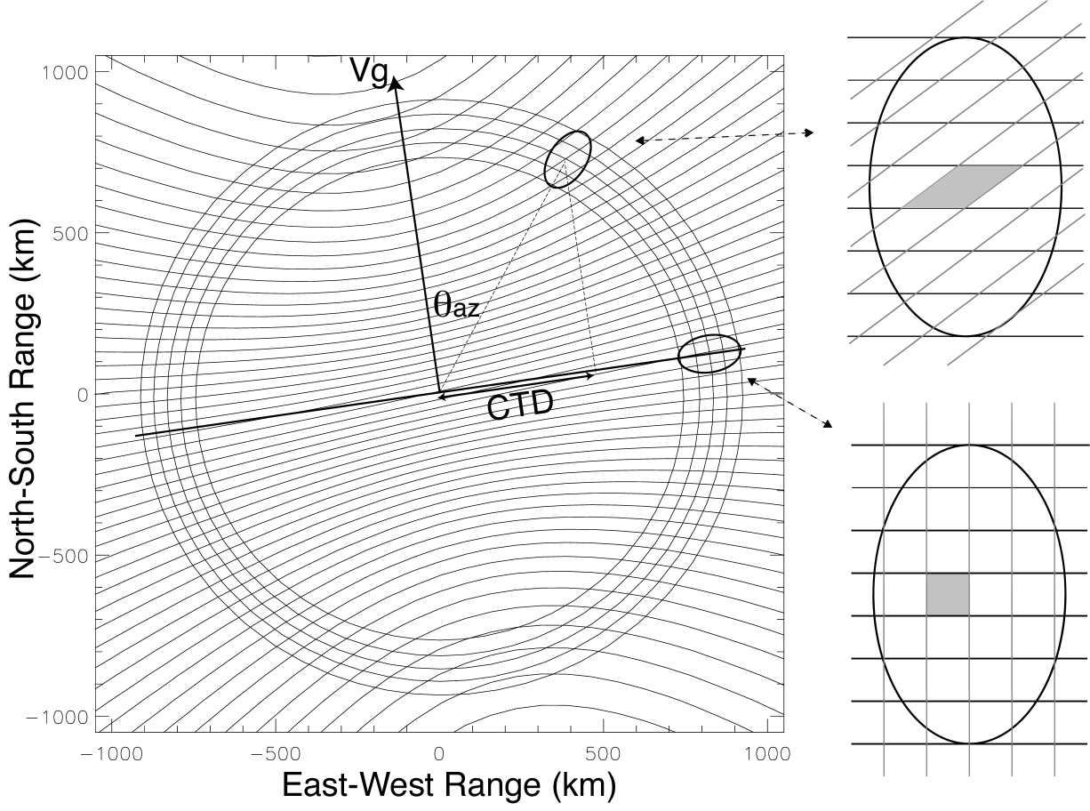
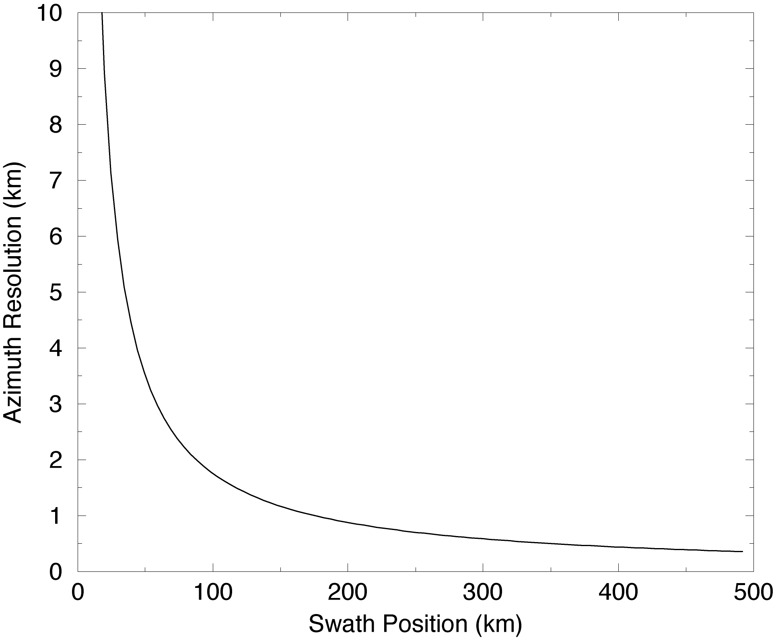
Radar Resolution Approach
Unfocused SAR processing.
Azimuth resolution, and number of azimuth looks, driven by unique scanning geometry.
High-resolution SAR data that can meet the proposed science requirements for resolution and accuracy appears over outer 70% of the measurement swath.

Slide 39
Radar Measurement Geometry

Slide 40
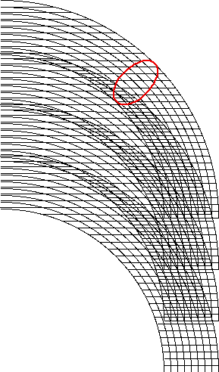


Radar Data Products
Single-Look, Time-Ordered Data
Native resolution: 250 m in range, 400+ m resolution in azimuth.
Each resolution element constitutes one independent “look” at surface.
1 km Gridded, Re-Sampled Data
Data resampled and posted on 1 km grid, resolution may still be > 1 km near nadir.
Each resolution cell now has multiple “looks” at surface, decreased measurement variance.
3 km Averaged Data
1 km posted product can be averaged up to 3 km, 10 km, etc. by investigators.
Improved number of looks (and hence precision) at expense of spatial resolution.

Slide 41
Proposed Science Data System (SDS) Operations Architecture
SDS
SDS
GSFC
5550/5870
JPL
Div 33
Ground System
Network
L1A
Radiometer
SPS
L1B
Radiometer
SPS
L1C
Radiometer
SPS
L4 _SM SPS
L4_C SPS
GSFC
GMAO
JPL
Div 38
- S/C HK & Engr. data
- Science TLM
- Tracking Data
JPL
Div 32
External
- S/C HK, Engr. data
- Ephemeris
- Time Correlation
L0A
L1A
L1A
L1B
L1B
L1C
L1,
L2/3
L4
GDS
Science Process and Data Management (SPDM)
All Products
Project and Science Team Users
L0a Radar
L0a Radiometer
Validated
Products
SMAP Data Center (DAAC)
L0A
L1A
L1A
L2/3
L1,
L2/3,
L4
Performance
Reports
Ground truth
Ancillary data
L1B/C
L1
Remote Data Sites
L1A
Radar
SPS
L1B/C
Radar
SPS’s
L2/3
Science
SPS’s
Science Data Analysis
Distributed
Users
Cal/Val Responsibilities
SPS – Science Production Software
Div. 33: L1 Radar
Science: L1C2/3/4
GSFC: L1 Radiometer
Notes:
Oct. 23, 2008
41

Slide 42
Global Metadata Classification
The region within the Catalog Metadata and the Granule Metadata that are not Core Metadata are Product Specific Metadata.
Catalog metadata versus File metadata
Catalog metadata are stored in a database
For file reference, lookup and automated processing
Metadata elements required by the Data Center and ECHO
File metadata are listed in each product granule
Metadata elements may belong to both the catalog class and the file class
Core metadata versus Product Type Specific metadata
Core metadata appear in all SMAP product types
Product Type Specific metadata appear in one or many product types
Core metadata and Product Type Specific metadata are mutually exclusive
Granule
Metadata
Catalog Metadata
Core
Metadata

Slide 43
Proposed Metadata Requirements
The metadata shall provide users with adequate self descriptive information to enable an assessment of the content, the quality and the algorithmic conditions associated with any SMAP data product.
The metadata shall enable users to locate specific and appropriate sets of data that they need for their investigation.
The metadata shall enable users to correlate, interoperate and integrate SMAP data products with those generated by disparate sources, within and outside of NASA.

Slide 44
Global Metadata – ISO 19115
“Geographic Information - Metadata” from the International Organization for Standardization
Provides a standardized means to describe Earth data
Provides a means to make products “self descriptive and independently understandable”
Incorporates all of the major categories required for a complete set of global metadata for each product granule
Incorporates all of the major categories required to generate a complete set of collection metadata.
Enables fulfillment of the requirement “to correlate, interoperate and integrate SMAP data products with those generated by disparate sources”.
Uses XML representation to ease portability to the wider user community

Slide 45
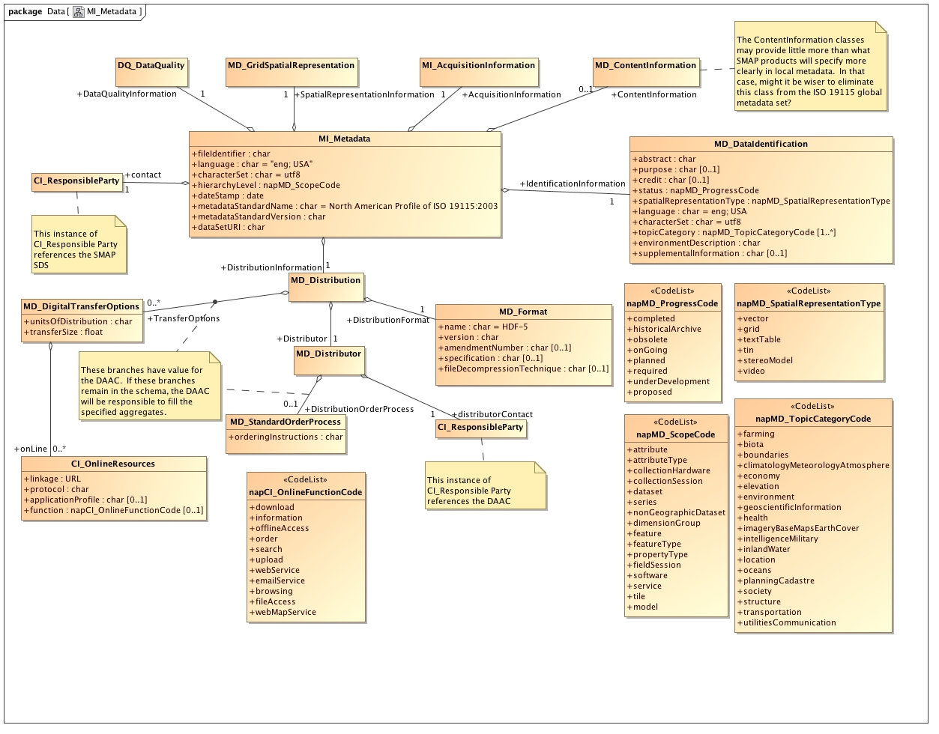
Proposed Top Level ISO Metadata Model

Slide 46
CF Convention – Local Metadata
The Climate and Forecast (CF) is a highly descriptive metadata convention with a widespread science user community
CF designed specifically designed to fit within attributes in netCDF files.
CF is based upon the Cooperative Ocean/Atmospheric Data Service (COARDS) standard
The CF convention includes:
A standard to provide descriptive names for each variable in the product
Standards for the specification of data units for each variable in the product
UDUNITS provides a list of supported unit names
Standards for fill values for each variable in the product
Standards to express the range of data for each variable in the product
Standards to express bit flag definitions and define flag values
Standards to specify relationships between spatial and time coordinates for each variable in the product
Indicates which particular spatial or temporal coordinates correspond with which dimension axes and indices of a data variable.
Standards to specify statistical methods that were used to calculate each variable in the product
Clarifies temporal or spatial intervals that were used to provide statistical results.

Slide 47
CF Global Metadata
Five standard elements for description of the entire product
Title
Institution
Source
History
References
Each of the above five elements are character free-form stings, with no specification about content.

Slide 48
Metadata Use Recommendation
The ISO 19115 provides ample metadata to cover the proposed SMAP requirements for granule and collection metadata
The CF conventions provide detail required for local metadata that describe individual arrays in each product
The small number of global elements that are required in the CF convention presents a minor issue:
Could SMAP ignore the small number of CF global elements, and remain “CF compliant”?
Is there some means to map the CF global elements into ISO?

Slide 49
SMAP WIKI Access
The SMAP SDS Wiki is open to any member of the SMAP Project who is interested in retrieving information about Science Data System activities. All members of the Science Definition Team (SDT) and the Applications Early Adopters Group (AEG) can gain access to the Wiki. If associates of either the SDT or the AEG wish to gain access, they need to complete a short request form that specifies the following information:
A statement of the purpose for accessing the SMAP SDS Wiki
The specific information available on the Wiki that is needed to perform their job
Any Wiki content that the user intends to modify or contribute
Regardless of Project category, all non-JPL personnel will need to submit the E2190 form in order to receive a JPL username and password, which is a prerequisite to gaining access to the Wiki.

Slide 50
Data Product Access
For those who already have a JPL user account, the following information is readily available
Most recent data product descriptions are in spreadsheet form on the SMAP WIKI at:
http://smap-sds-web.jpl.nasa.gov/confluence/display/SMAPDataProducts/SMAP+Data+Products
Model data products in HDF5 format are available on the SMAP Data Server at the following URL:
http://smap-sds-web.jpl.nasa.gov/samples
The data server also includes:
Descriptive information in README files
Plots of soil moisture for each soil moisture product
Plots of freeze-thaw condition for each freeze-thaw product
Model IDL code that reads and plots HDF5 products in directory software/IDL
The model products on the data server contain a subset of the full metadata and data elements described in the product spreadsheets

Slide 51
Model Soil Moisture and Freeze Thaw Data Products
The model products are in HDF5 format
The model products display the planned product design
“Metadata” Group contains product metadata
“Soil_Moisture_Retrieval_Data” Group contains the data arrays
Some products may have additional groups
The model data products contain a subset of the data and metadata that will appear in the products the SMAP project will distribute after launch.
At the very least, all of the Soil Moisture products contain the following:
Latitude
Longitude
Soil Moisture or Freeze/Thaw
Additional data elements appear that may contain fill values
In most cases, null values are currently NaN
The project will generate a standard for null values, and use them in all data products
The project will document the specific null value in the product metadata as well as product documentation

