Slide 1
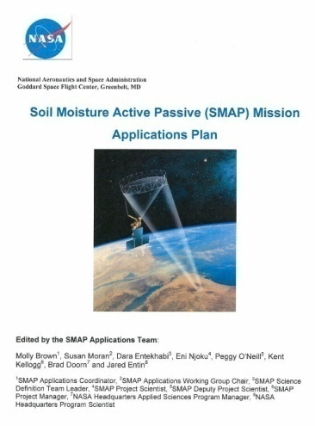
SMAP
Applications
Plan
Molly Brown
SMAP Applications Coordinator
Susan Moran
Chair, SMAP Applications Working Group
Vanessa Escobar
SMAP Support Scientist
“This plan provides an implementation strategy for promoting applications research and engaging a broad community of users in SMAP applications.”

Slide 2
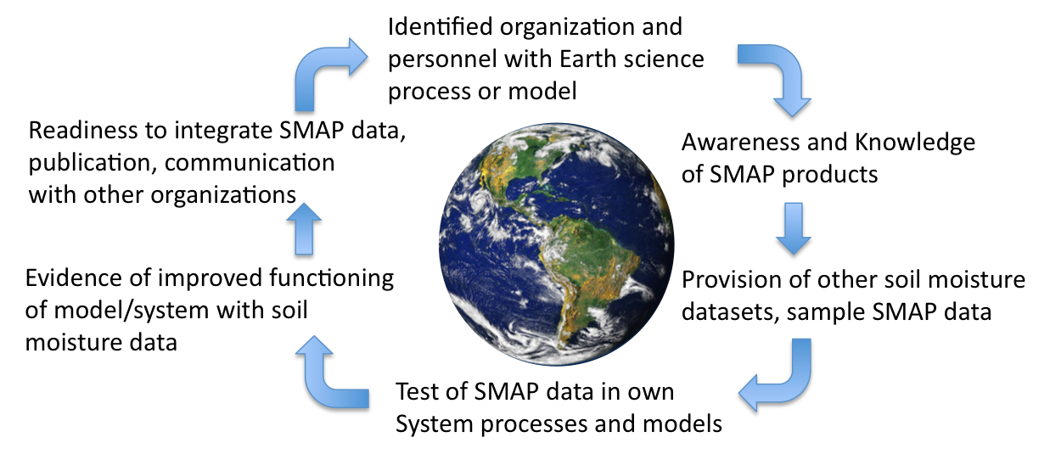
The SMAP Approach to Engagement

Slide 3

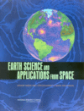
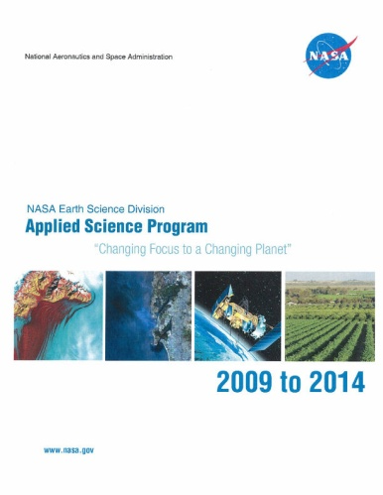
Why does the SMAP Mission have an Applications Plan?
NASA Authorization Act of 2005 (P.L. 109-155)
SEC. 313. PILOT PROJECTS TO ENCOURAGE PUBLIC SECTOR APPLICATIONS
“The Administrator shall establish a program of grants for competitively awarded pilot projects to explore the integrated use of sources of remote sensing and other geospatial information to address State, local, regional, and tribal agency needs.
Sec. 314(a): The Administrator shall establish an advisory committee, consisting of individuals with appropriate expertise in State, local, regional, and tribal agencies, the university research community, and the remote sensing and other geospatial information industries, to monitor the program established under section 313.”
National Research Council Decadal Survey Report
EARTH SCIENCE AND APPLICATIONS FROM SPACE
“A fundamental challenge for the coming decade is to ensure that established societal needs help to guide scientific priorities more effectively and that emerging scientific knowledge is actively applied to obtain societal benefits. New observations and analyses, … broadened community participation and improved means for dissemination and use of information are all required.”
NASA Earth Sciences Division
APPLIED SCIENCES PROGRAM STRATEGIC PLAN
Goal to “evaluate the potential for current and planned NASA missions to meet societal needs through applied sciences participation in mission science teams” and provide Mission applications support to “integrate applications needs into mission planning.”
Notes:
This slide shows that incorporating applications into mission plans is not optional, but rather 1) mandated from Congress with the NASA authorization act, 2) recommended as a requirement from NRC, 3) a part of the NASA ASP strategic plan and 4) a core commitment by SMAP through the Applications Plan.

Slide 4
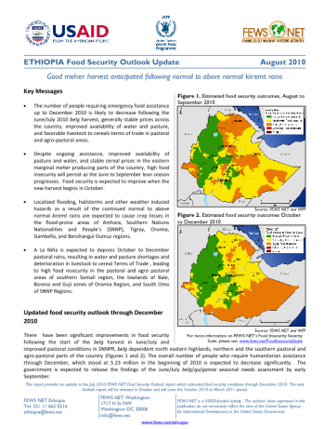
What is a SMAP Application?
Applications are defined as innovative uses of SMAP data products in decision-making activities for societal benefit.
Applications research will provide fundamental knowledge of how SMAP data products can be scaled and integrated into users’ policy, business and management activities to improve decision-making efforts.
Users include
individuals or groups
in the public or private sectors
with national or international applications
at local to global scales.
e.g., USAID makes decisions based on crop models that rely on high quality precipitation information in countries with poor local ground observations.
Notes:
There are some key components of applications: operational, decision-making activities, societal benefit. NOTE – the word Operational is not required – many decisions are not made every day – think water resource planning… zoning, etc
Applications research provides “fundamental knowledge”, no different from any other research
“Users” are inclusive – small, large, public, private, national, international, local, global
Define verbally what ‘Early Adopters’ and Community of potential are

Slide 5
Examples of SMAP Applications Research
This figure illustrates an objective evaluation of improved surface fluxes on numerical weather predictions by operational implementation of a new land surface scheme with improved soil moisture initial conditions (Bélair et al., 2003).
Results in this figure indicate the relative improvement in root-zone soil moisture retrievals when surface soil moisture information was included in soil water balance models (Bolten et al., 2009).
Notes:
The key point here is that applications research provides quantiative metrics – model improvements, higher retrieval accuracy, etc.

Slide 6
Applications Readiness Level | Description http://esto.nasa.gov/ASPinput/TRLA_Definitions.html
ARL-1 | Basic research
ARL-2 | Applications concept
ARL-3 | Proof of applications concept
ARL-4 | Initial integration and verification in a laboratory environment
ARL-5 | Validation in relevant environment
ARL-6 | Demonstration in relevant environment
ARL-7 | Application of prototype in partners’ operational decision making
ARL-8 | Application completed and qualified
ARL-9 | Approved, operational deployment, and use in decision-making
The SMAP applications program will be considered a success if we can describe, document and verify the benefits of SMAP data in at least:
2 applications at the TRL-A Level 7-9
2 applications at the TRL-A Level 4-6
2 applications at the TRL-A Level 1-3
In addition, funds permitting, we will conduct one comprehensive study enabling quantification and monetization of the benefits of at least one application by the end of the first two years after launch.

Slide 7
Applications Plan Implementation Strategy
Two engagement levels:
  Community of Practice
  Community of Potential
Implementation Strategy
  1) Engagement with Early Adopters
  2) Promotion of Community of Potential
  3) SMAP Applications Research, possibly
  funded by ROSES call
  4) Coordination with SMAP Cal/Val
  5) Coordination with other DS Missions
Notes:
This slide leads into the next slides giving detail on each of the 5 components of the implementation strategy.

Slide 8
1) Engagement with Early Adopters
What is an Early Adopter?
Early Adopters are defined as those groups or individuals who have a clearly defined need for SMAP-like soil moisture or freeze/thaw data and who have sufficient interest and personnel to demonstrate the utility of SMAP data for their particular application.
Recall that applications are defined as innovative uses of SMAP data products in decision-making activities for societal benefit.
Why are we engaging Early Adopters?
To conduct pre-launch applications research to accelerate the use of SMAP products after the launch of SMAP
How are we engaging Early Adopters?
MOA (unfunded, immediate)
ROSES RFP (funded in late 2012)
Notes:
Implementation Strategy #1 – Engage early adopters

Slide 9
Memorandum of Agreement with Early Adopters (unfunded, immediate)
SMAP commitment
  Provide simulated SMAP data products
  Provide access to cal/val data
Early Adopter commitment
  Conduct applications research
  Join the SMAP Applications Team
  Attend SMAP Applications Workshops to report results
ROSES RFP (under construction)
$150K 18-month studies to be completed before the launch of SMAP
Timeline
  Work out RFP details over next 12 months
  RFP announced Jan 2012
  Projects funded October 2012
  SMAP launch November 2014

Slide 10
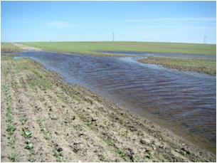
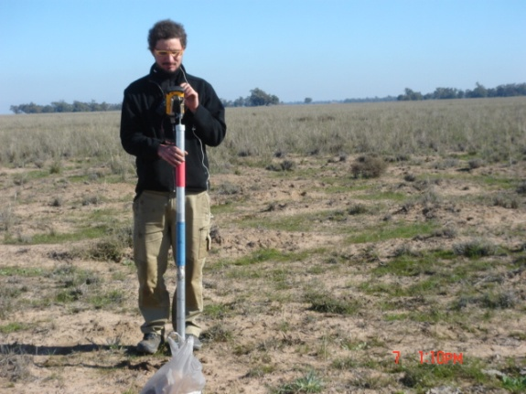
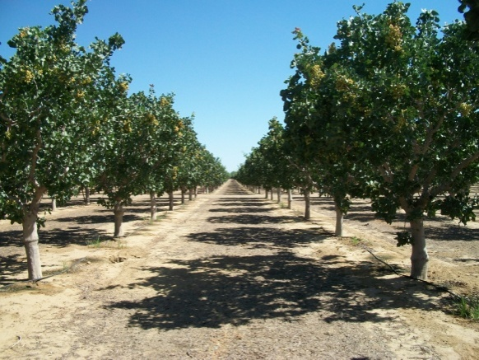
4) Coordination with SMAP Cal/Val
The 2nd SMAP Cal/Val Workshop is planned for May 3-5, 2011 Oxnard, CA USA
The next Cal/Val Experiment: SMAPEx-3: September, 2011, Melbourne, Australia
SMAPEx will utilize airborne radar and radiometer data replicating the SMAP configuration in terms of frequency, viewing angle and resolution ratio, as well as supporting ground data on soil moisture, vegetation properties, soil temperature and surface roughness.
CanEX (wet) – June 2010
SMAPEx-1 (winter) – July 2010
SJV (orchards) – Summer 2010
Notes:
I think the emphasis on this slide is “where to go from here”. Not much has been done and we have many options on how to proceed.

Slide 11
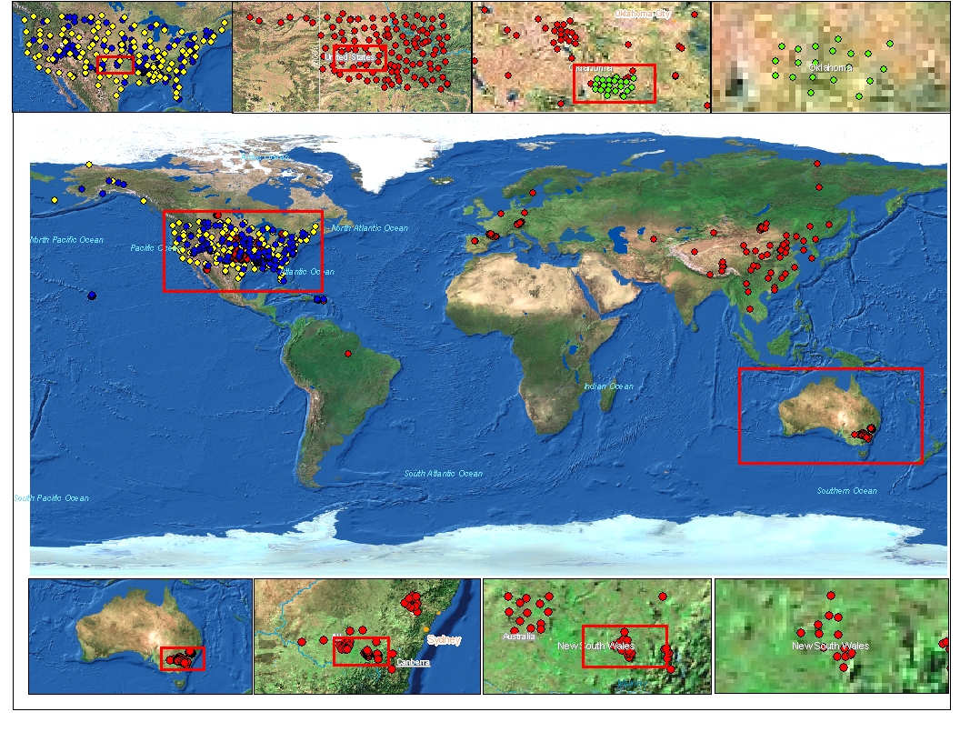
Soil Moisture Cal/Val
• High Priority Candidates
– Compatible with validation requirements, parallel programs, partnerships with formal commitments, strength of supporting program
– Canada, Australia, SMOS Core Sites (Valencia, Danube), Mongolia (GCOM-W)
• Next Priority Candidates
– Data sparse regions, would require more significant efforts to use in
validation, some level of common interest
– Africa, Argentina, Brazil, Asia Water Cycle
• Low Priority Candidates
– High latency, sparse, unverified, no infrastructure support

Slide 12
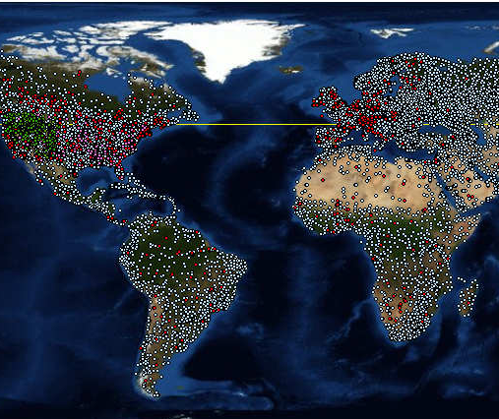
Freeze/Thaw
Cal/Val
Yellow: Alectra
Pink: USDA-SCAN
Green: NRCS-Snotel
Red: Fluxnet
White: WHO

Slide 13
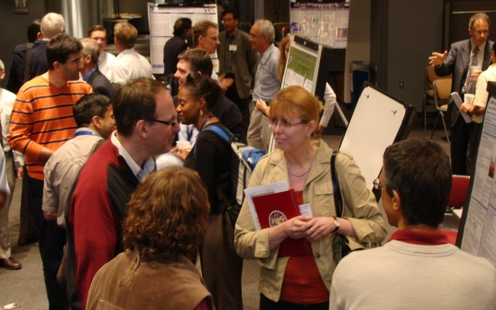
1st SMAP Applications Workshop, NOAA, September 9-11 2009
2nd Annual SMAP Applications Workshop, USDA, October 12-14 2011

Slide 14
Additional Applications Identified at the 1st SMAP Applications Workshop (Sept 2009 at NOAA SMC)
Area | Likely Mission Applications | Potential Mission Applications
Weather | More accurate weather forecasts; prediction of severe rainfall; operational severe weather forecasts; mobility and visibility | Improved regional weather prediction
Natural Disasters | Drought early warning decision support; key variable in floods and landslides; operational flood forecast; lake and river ice breakup; desertification | Fire susceptibility; global flood mapping; heat-wave forecasting
Climate Variability and Change | Extend climate prediction capability; Linkages between terrestrial water, energy, and carbon cycles; land / atmosphere fluxes | Long term risk assessments
Agriculture and Forestry | Predictions of agricultural productivity; famine early warning; Monitoring agricultural drought | Crop management at the farm scale; Input to fuel loading models
Human Health | Landscape epidemiology; heat stress and drought monitoring; insect infestation; emergency response plans; Heat waves | Disease forecasting and risk mitigation; early warning decision support
Ecology | Carbon source/sink monitoring; Ecosystems forecasts; monitoring vegetation and water relationships over land | Monitoring wetlands resources and bird migration
Water Resources | Global water balance; estimates of streamflow & river discharge; more effective management; | Monitoring variability of water stored in lakes, reservoirs, wetlands and river channels
Ocean Resources | Sea-ice mapping for navigation, especially in coastal zones; temporal changes in ocean salinity | Provision of ocean wind speed and direction, related to hurricane monitoring
Insurance Sector | More accurate weather forecasts; prediction of severe rainfall; operational severe weather forecasts; mobility and visibility | Crop insurance programs; flood insurance programs; tourism and recreation
Coastal Inundation | Input to sea level rise products | Maps of coastal inundation; Monitoring ocean winds for hurricane monitoring
Drought | Soil moisture is a key variable; Early warning decision support; desertification
Flood | Improved forecasts; flood mapping; protect downstream resources; soil infiltration conditions; predict ice breakup;
Human Health | Soil moisture is a key variable in monitoring vector population dynamics; decision support for malaria and other waterborne diseases
Ecosystem Health | Monitoring of vegetation health & change; ecosystem dynamics | Monitoring wetlands and bird migration
Landslides / Debris Flow | Soil moisture is a key variable; better prediction through consistent observations in mountainous regions
Wildfires |  | Improved fuel loading models, especially for non-heavily forested areas

Slide 15

Upcoming Workshop Goals
Report progress from 1st Applications Workshop
Engage AppWG members in SMAP Cal/Val plans
Connect with the Community of Potential
Encourage more international participation in AppWG
Share lessons learned from applications research by SMAP Early Adopters
  Thus, encourage more Early Adopters
Facilitate feedback from AppWG to SMAP Mission
Notes:
Here are the goals for the 2nd SMAP Applications Workshop. Please edit.

Slide 16
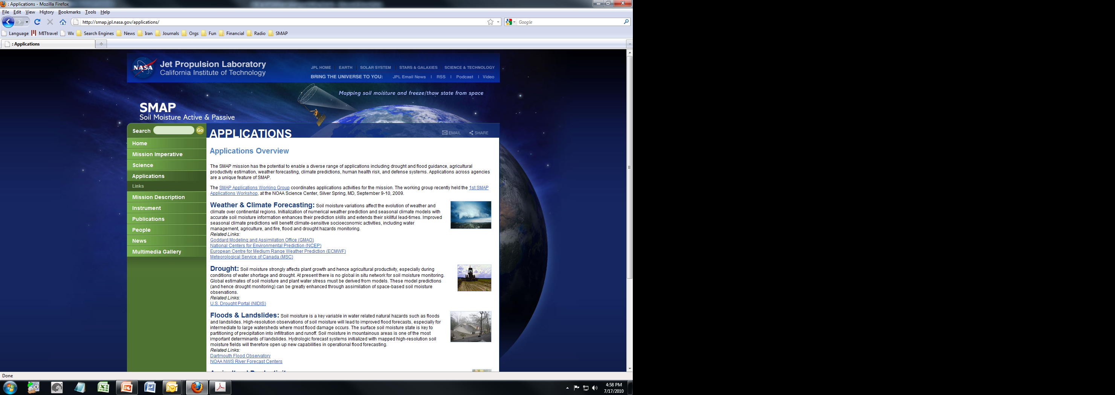
Interested in joining the SMAP Applications Working Group?
Sign up at http://smap.jpl.nasa.gov/science/applicWG
Email molly.brown@nasa.gov susan.moran@ars.usda.gov
    Call Molly Brown (301) 614-6616
    Susan Moran (520) 670-6380 X171

