Slide 1
Modeling Surface Energy Balance Using the MEP Method
Jingfeng Wang¹ and Rafael L. Bras^{1,2}
¹University of California at Irvine
²Georgia Institute of Technology
5th Interagency Surface Dynamics Working Group Meeting 1 - 3 March 2011
USDA Southwest Watershed Research Center, Tucson, AZ

Slide 2
Land Surface Energy Budget
Partition of net radiation R_{n} into the fluxes of latent heat E, sensible heat H and ground heat G.
R_{n} = E + H + G

Slide 3
MEP Theory
Maximum Entropy Principle (MaxEnt): a general method to assign probability distribution. The concept of entropy is introduced as a quantitative measure of information (or lack of it).
Maximum Entropy Production Principle (MEP): an application of MaxEnt to non-equilibrium systems with macroscopic transport of energy and matter.

Slide 4
MaxEnt Formalism
Assigning probabilities p_{i} of x_{i} by maximizing the information entropy S_{I} under generic constraints F_{k},

Slide 5
Dissipation function or entropy production function, D, is defined as,
satisfying the orthogonality condition, according to MaxEnt,

Slide 6
D is maximized under a (nonlinear) constraint,
D is minimized under a (linear) constraint,

Slide 7
MEP Method
Formulate a dissipation function or entropy production function in terms of the heat fluxes,
2. Find the stationary point of the dissipation function under the constraint of conservation of energy,
3. Solve the heat fluxes.

Slide 8
An Example
R₁
I₁
I₀ = I₁+I₂
R₂
I₂
Formulate the dissipation function of the system in terms of the electric currents,

Slide 9
2. Find the stationary point of the dissipation function under the constraint of conservation
of electric charges,
Lagrangian multiplier
3. Solve the currents,

Slide 10
Physical Meaning of D
thermal dissipation
thermodynamic entropy production
Voltage

Slide 11
MEP Formalism of Heat Fluxes
A dissipation function or entropy production function is formulated as [Wang and Bras, 2011];,
I_{s}=thermal inertia of conduction =
I_{a}=thermal inertia of sensible heat transfer =
I_{e}=thermal inertia of latent heat transfer (to be defined)

Slide 12
Formulation of I_{a}
Based on the Monin-Obukhov similarity theory [Wang and Bras, 2010];,
α,β,γ₂ are universal
empirical constants
[Businger et al, 1971].

Slide 13
Formulation of I_{e}
1. I_{e} is related to I_{a} due to the same turbulent
transport mechanism for heat and water vapor;
2. I_{e} is a function of surface soil temperature and
soil moisture as E depends on the two variables;
3. Water vapor right above the evaporating surface
is in equilibrium with the liquid water at the soil
surface.

Slide 14
I_{e} is postulated based on the above propositions:
T_{s} = surface (skin) soil temperature,
q_{s} = surface (skin) specific humidity,
λ = latent heat of vaporization,
c_{p} = specific heat of air at constant pressure,
R_{v} = gas constant of water vapor,

Slide 15
MEP Model of E, H, G

Slide 16
Input of the MEP Model
surface
temperature
surface
humidity
surface
soil moisture
net radiation
R_{n}, T_{s}, q_{s} or θ_{s}
E, H, G

Slide 17
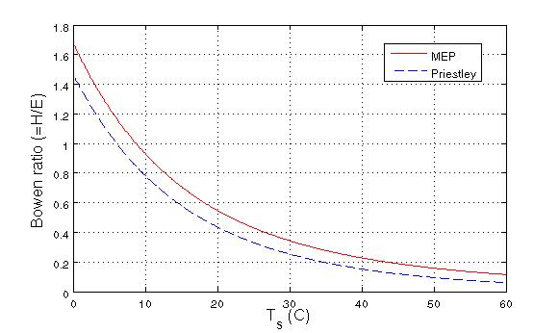
Properties of the MEP Model
Over a dry soil (σ = 0, hence E = 0), the MEP model for the dry case is retrieved [Wang and Bras, 2009];
Over a saturated soil, the MEP Bowen ratio, B⁻¹(σ), reduces to the classical equation [Priestley, 1959, p.116],

Slide 18
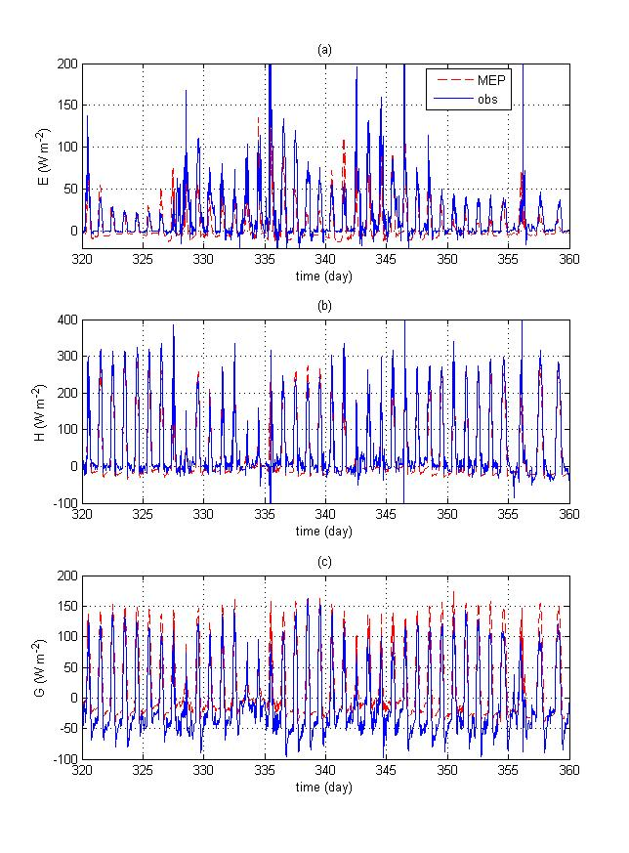
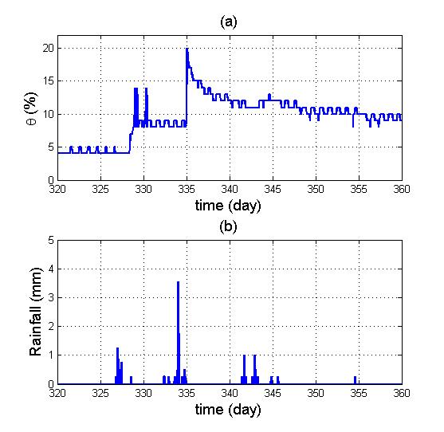
Lucky Hills site of the Walnut Gulch Experimental Watershed during 11/16 – 12/26, 2007.

Slide 19
MEP Model of Transpiration
Over a canopy when I_{s}=0 (hence G=0), the MEP model gives explicit expressions of transpiration E_{v} and H,

Slide 20
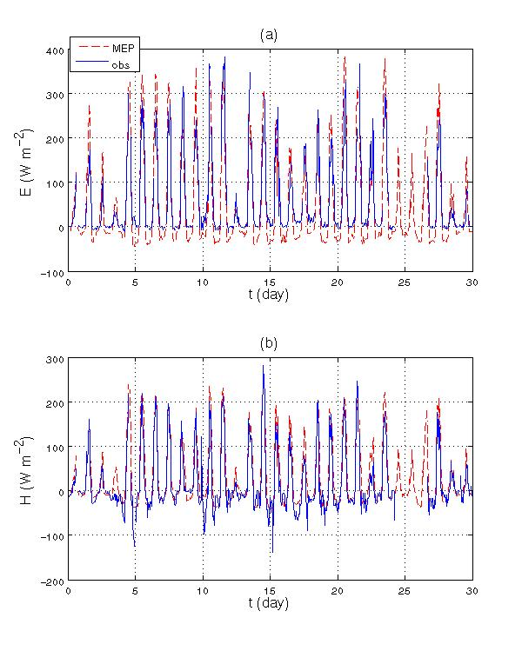
Harvard Forest site during 19 August - 18 September 1994.

Slide 21
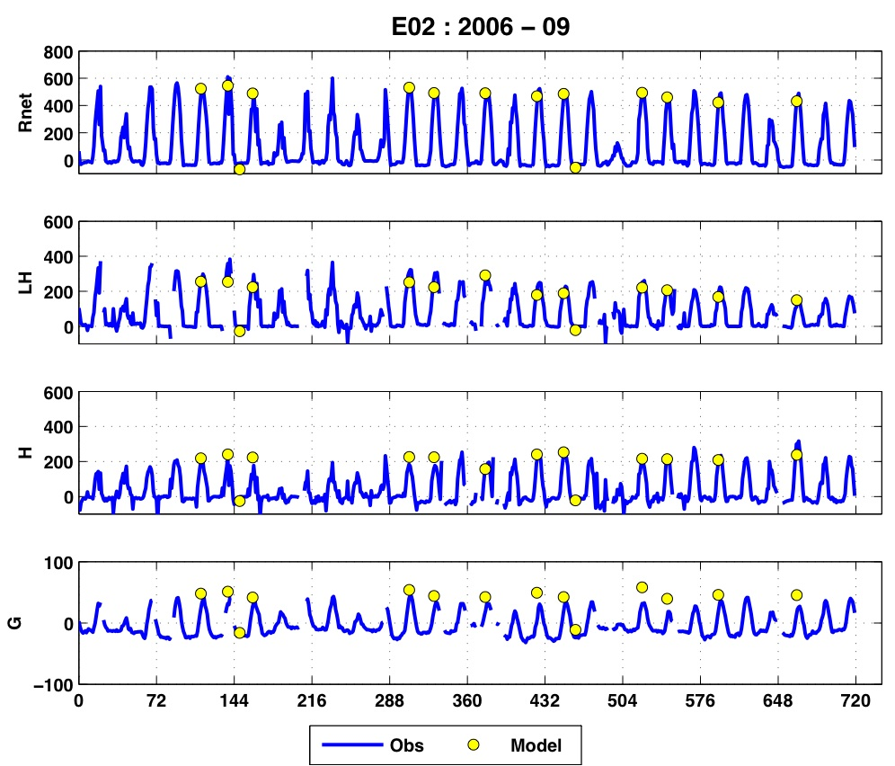
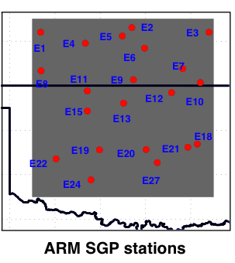
Remote Sensing Application
MODIS-Terra for Sept., 2006
Remotely sensed MEP model input R_{n}, T_{s}, and q_{s} (T_{d}) from MODIS on Terra satellite over Oklahoma [Bisht and Bras, 2010]. The heat fluxes are in W m⁻² and time in hours.
September 2006

Slide 22
Conclusion
The MEP model provides an effective tool to estimate
evapotranspiration (together with sensible and ground
heat fluxes) using field and remotely sensed surface
variables as model input.
Acknowledgment: This study is sponsored by ARO grant W911NF-10-1-0236 and NSF grant EAR-0943356.

Slide 23
References
Bisht, G., and R. L. Bras (2010), Estimation of net radiation from the MODIS data under all sky conditions: Southern Great Plains case study, Remote Sens. Environ., 114, 1522-1534.
Businger, J. A., J. C. Wyngaard, Y. Izumi, and E. F. Bradle (1971), Flux-profile relationships in the atmosphere surface layer, J. Atmos. Sci., 28, 181-189.
Dewar, R. C. (2005), Maximum entropy production and fluctuation theorem, J. Phys. A: Math Gen., 36, L371-L381.
Priestley, C. H. B. (1959), Turbulent Transfer in the Lower, The University of Chicago Press, Chicago, 130pp.
Wang, J., and R. L. Bras (2009), A model of surface heat fluxes based on the theory of maximum entropy production, Water. Resour. Res., 45, W11422.
Wang, J., and R. L. Bras (2010), An extremum solution of the Monin-Obukhov similarity equations, J. Atmos. Sci. 67(2), 485-499.
Wang, J., and R. L. Bras (2011), A model of evapotranspiration based on the theory of maximum entropy production, Water. Resour. Res., in press.

