Slide 1
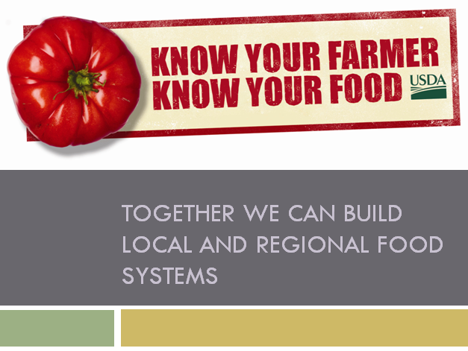
December 5, 2012 – ARS Administrators’ Council

Slide 2

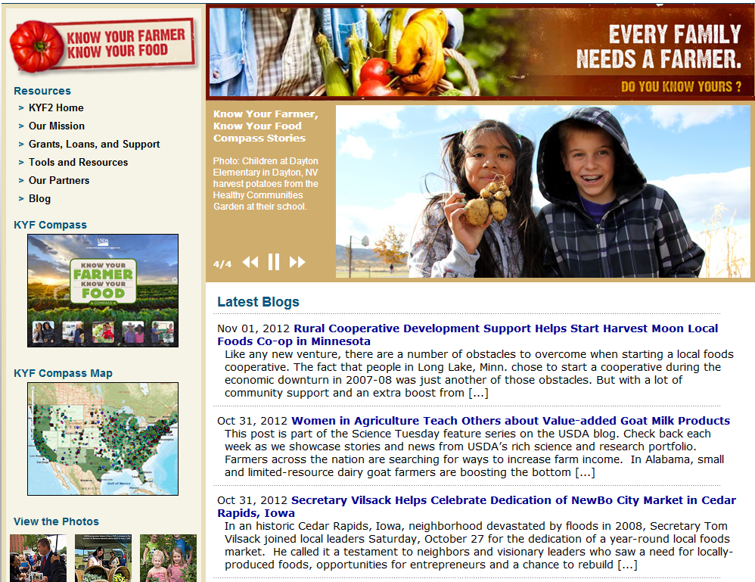
The Know Your Farmer, Know Your Food Initiative
Inter-Agency Coordination
Publicity for USDA Resources and Research
Stronger Collaboration to Describe and Support Local/Regional Food Systems
www.usda.gov/knowyourfarmer
Notes:
KYF initiative – its structure and purpose

Slide 3
Know Your Farmer, Know Your Food Subcommittees:
Research & Data
Field Outreach
Local Meat
Farm to Institution
Healthy Food Access
Small and Beginning Farmers and Ranchers
Waste Management
Notes:
KYF Subcommittees follow the chapters of the Compass, and there is a new subcommittee on Waste Management.

Slide 4
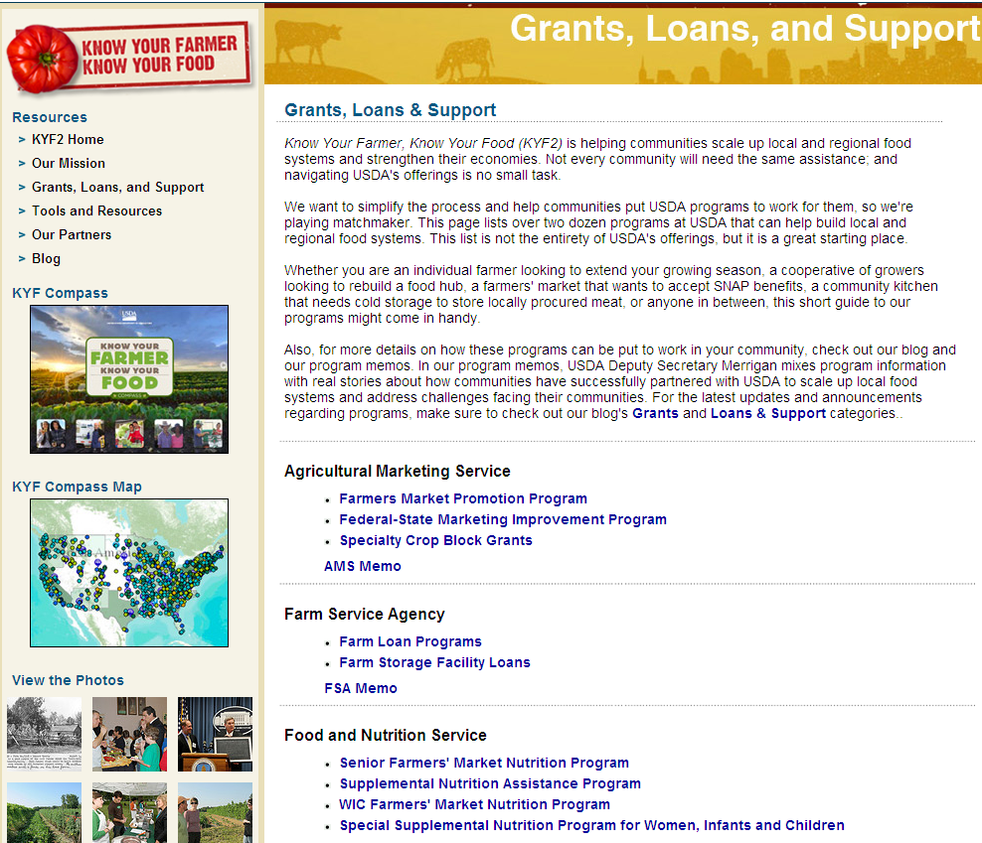
Resources for Producers, Researchers, Retailers, and everyone
in between
Notes:
Resources: The KYF website is a one-stop shop for information on USDA grant and loan programs that can support local food systems.

Slide 5
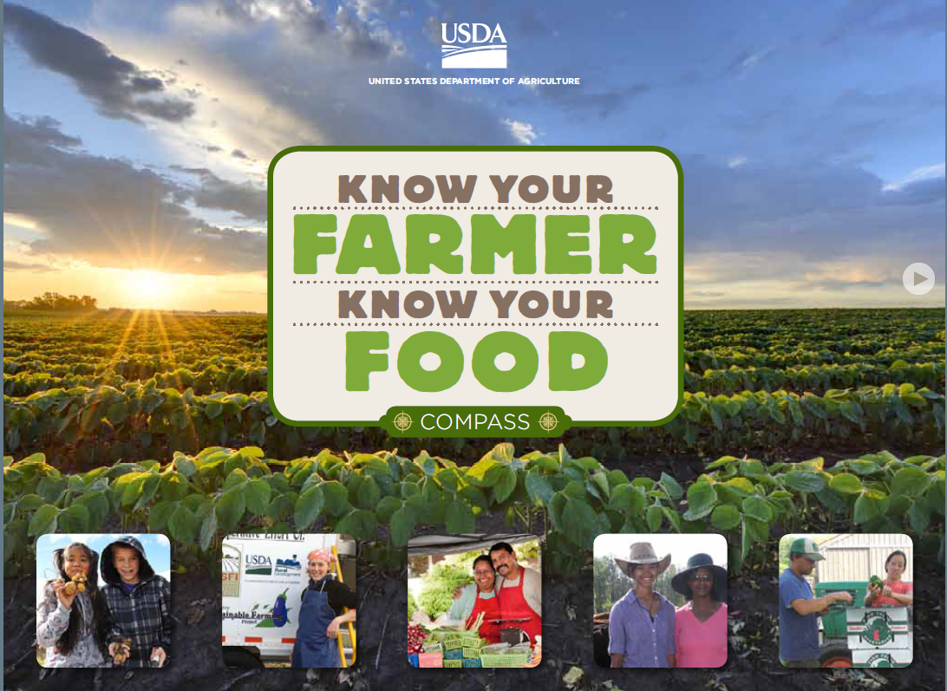
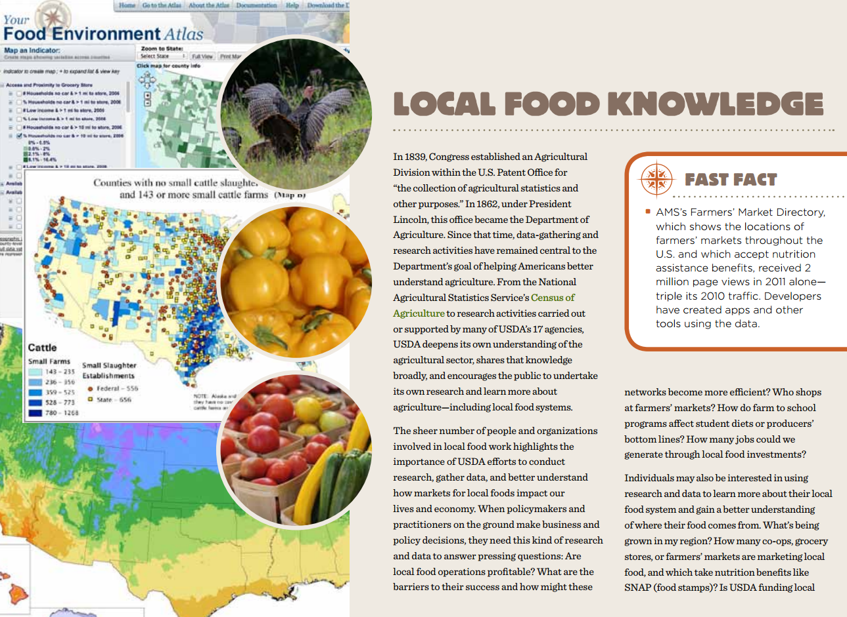
The KYF Compass:
Stories of USDA Resources At Work
www.usda.gov/kyfcompass
Notes:
Resources: The Compass tells the story of how these programs are being put to use in the field. The chapter on Local Food Knowledge details our work and resources related to research and data-gathering on local food systems.

Slide 6
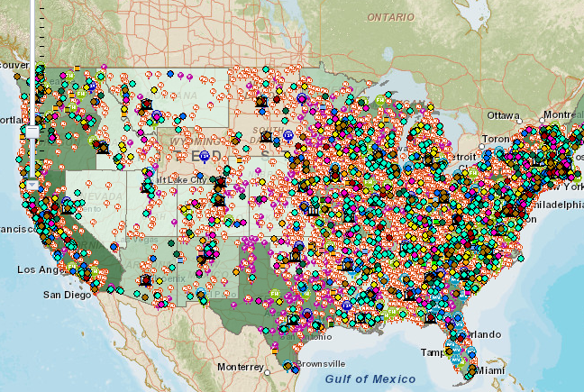
The Landscape of Local Food Systems
Includes data layers on:
  Funded local food projects
  FSA state office locations
  “Context data” gathered by USDA agencies
10/12: Added projects and resources from 9 other federal agencies
www.usda.gov/kyfcompass
Notes:
Resources: We also developed a companion map, and it’s one of the most exciting web tools in the federal government right now. We gathered data from those grant and loan programs and mapped the projects that USDA has funded since the initiative began. We also added “context data” – farmers markets, meat processors, food hubs, and other points on the local-food landscape.
You can sort the projects by theme, by the USDA program that provided the funding, or by the type of recipient.
And we just added data from 9 other federal agencies so that users can find resources outside USDA.

Slide 7
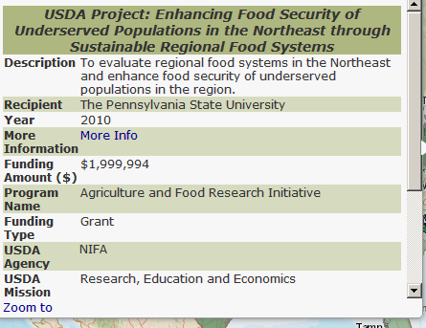
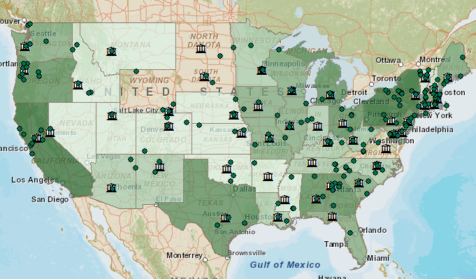
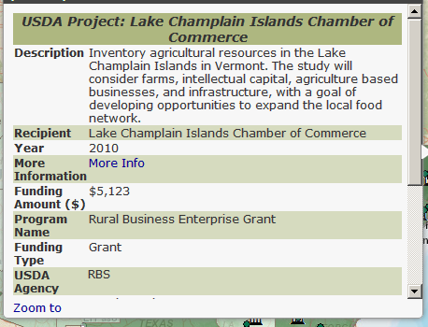
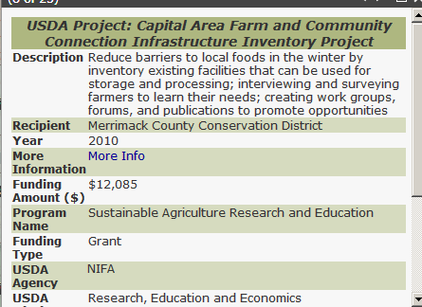
Local Food Knowledge is On the Map
www.usda.gov/kyfcompass
Notes:
How can ARS use the map?
Use the map to identify trends that can inform future research. What’s being funded and where? Where are the holes?
You can also explore your region on the map to find other relevant projects and partners. For example, this slide shows the projects on the map with a focus on what we call “local food knowledge”. I’ve highlighted the New England AFRI grant that I mentioned before. You’ll see there’s also a SARE grant inventorying existing facilities in New Hampshire that can be used for storage and processing, and a Rural Development grant inventory of agricultural resources in Vermont. It’s important that these projects know about each other – there’s potential to share findings and learn from each other.

Slide 8
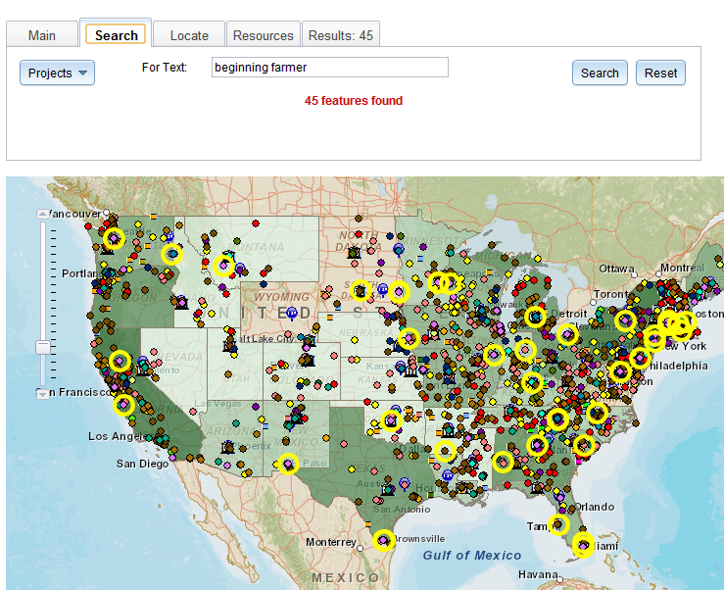
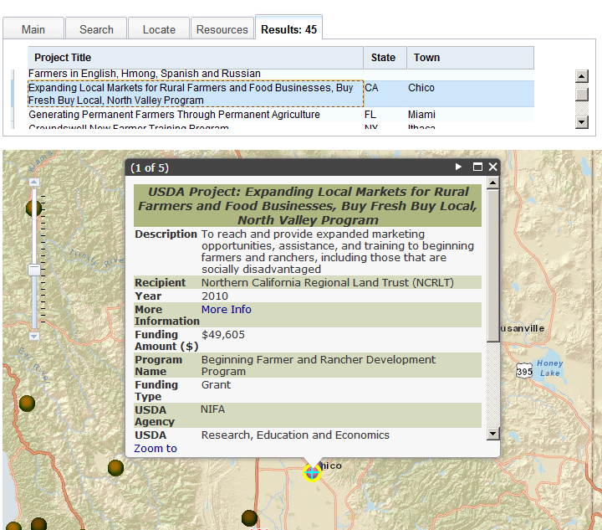
Search the Map for Connections Across the Country
Notes:
You can also search the map by keyword or within a specific radius of a zip code. For example, if you’re interested in disseminating research to networks that reach beginning farmers, search that term on the map and you’ll get a list of funded projects from around the country to train beginning farmers.

Slide 9
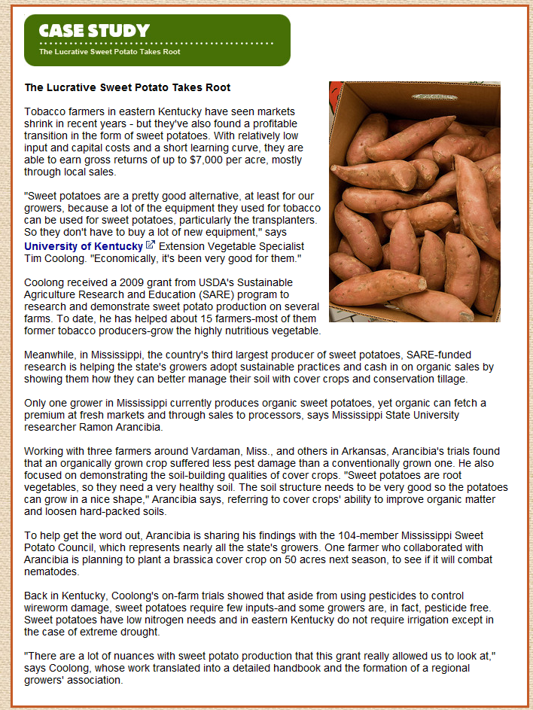
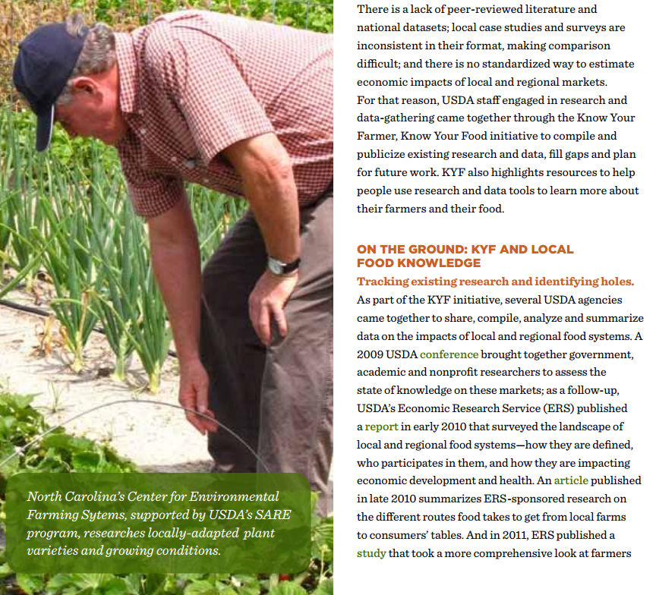
The KYF Compass:
A Resource for Sharing Projects, Outcomes and Accomplishments
Notes:
Share your research and projects with us to be profiled in the Compass.

Slide 10
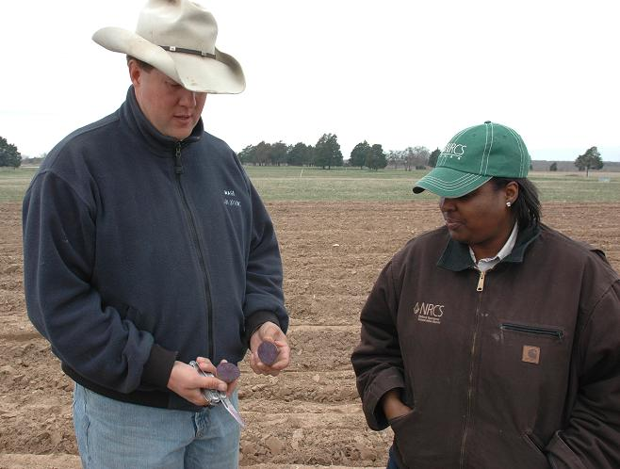
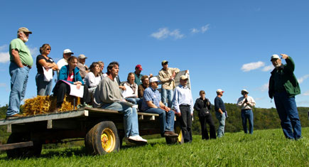
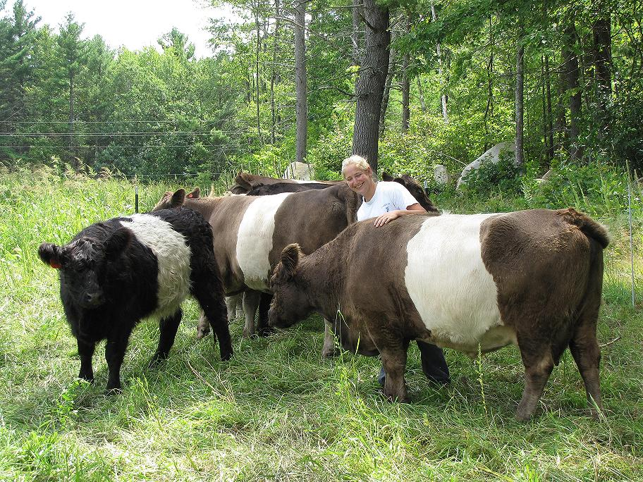
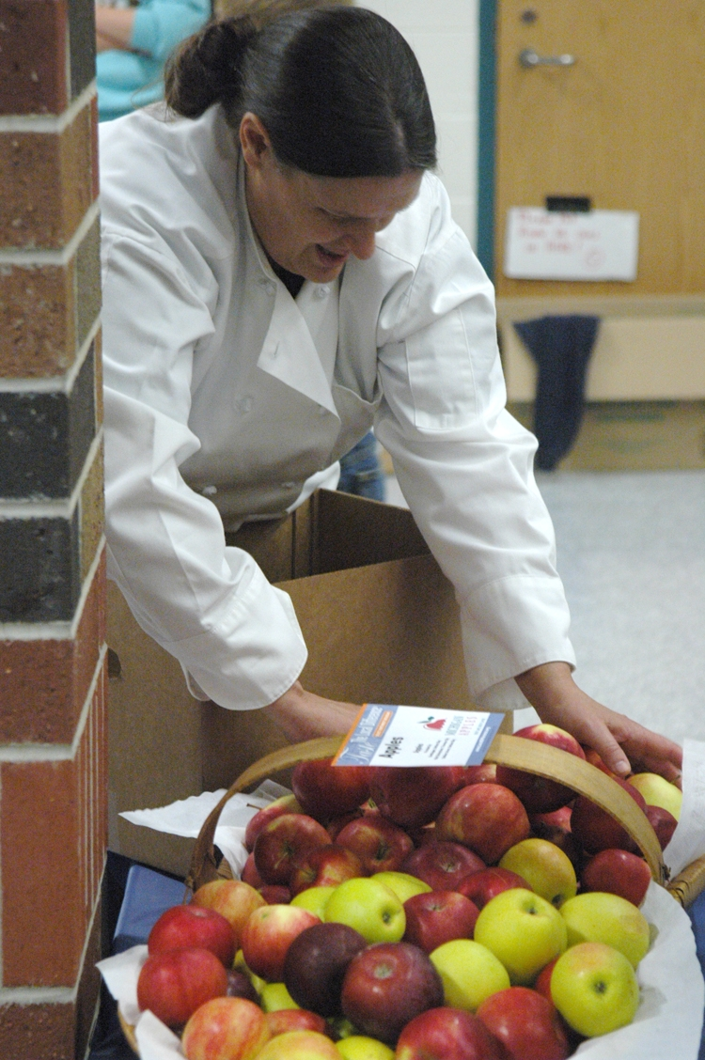
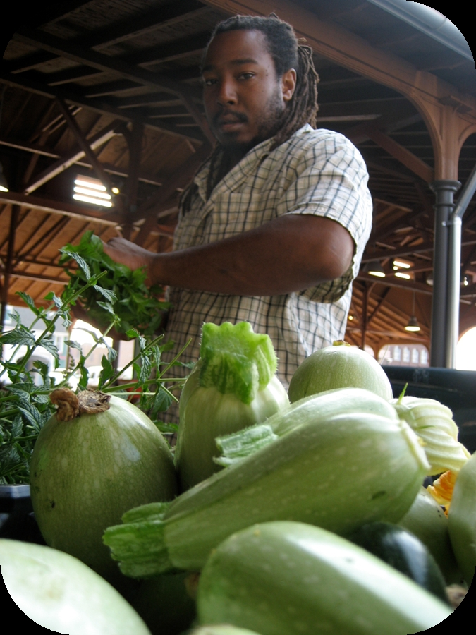

Explore Future Research Opportunities
knowyourfarmer@usda.gov

