Slide 1


Putting big data to work: Prediction-enabled plant breeding
5 December 2012
Jean-Luc Jannink

Slide 2
Outline
What is genomic selection?
How does GS put big data to work?
Some empirical examples
Some future implications

Slide 3
Genomic selection: Prediction using many markers
Training Population
Genotyping & Phenotyping
Train GS Model
Breeding Material
Calculate GEBV
Make Selections
Genotyping
Meuwissen et al. 2001 Genetics 157:1819-1829

Slide 4
Statistical modeling: The two cultures
Nature
X
Observed inputs
Observed responses
Y
Can we understand Y?
Can we predict Y?
Identify causal inputs
X
Y
Regression
?
X
Y
Regression
Decision trees
Whatever works
Breiman 2001 Stat. Sci. 16:199-231

Slide 5
The end result
Observation
Prediction

Slide 6
Problems with phenotypic selection
Slow
Many plants in a plot
High level of inbreeding
Late in plant life cycle
Expensive
Requires replication
Solve by predicting phenotype from genotype
Propagate
Cross
Phenotype
Select

Slide 7
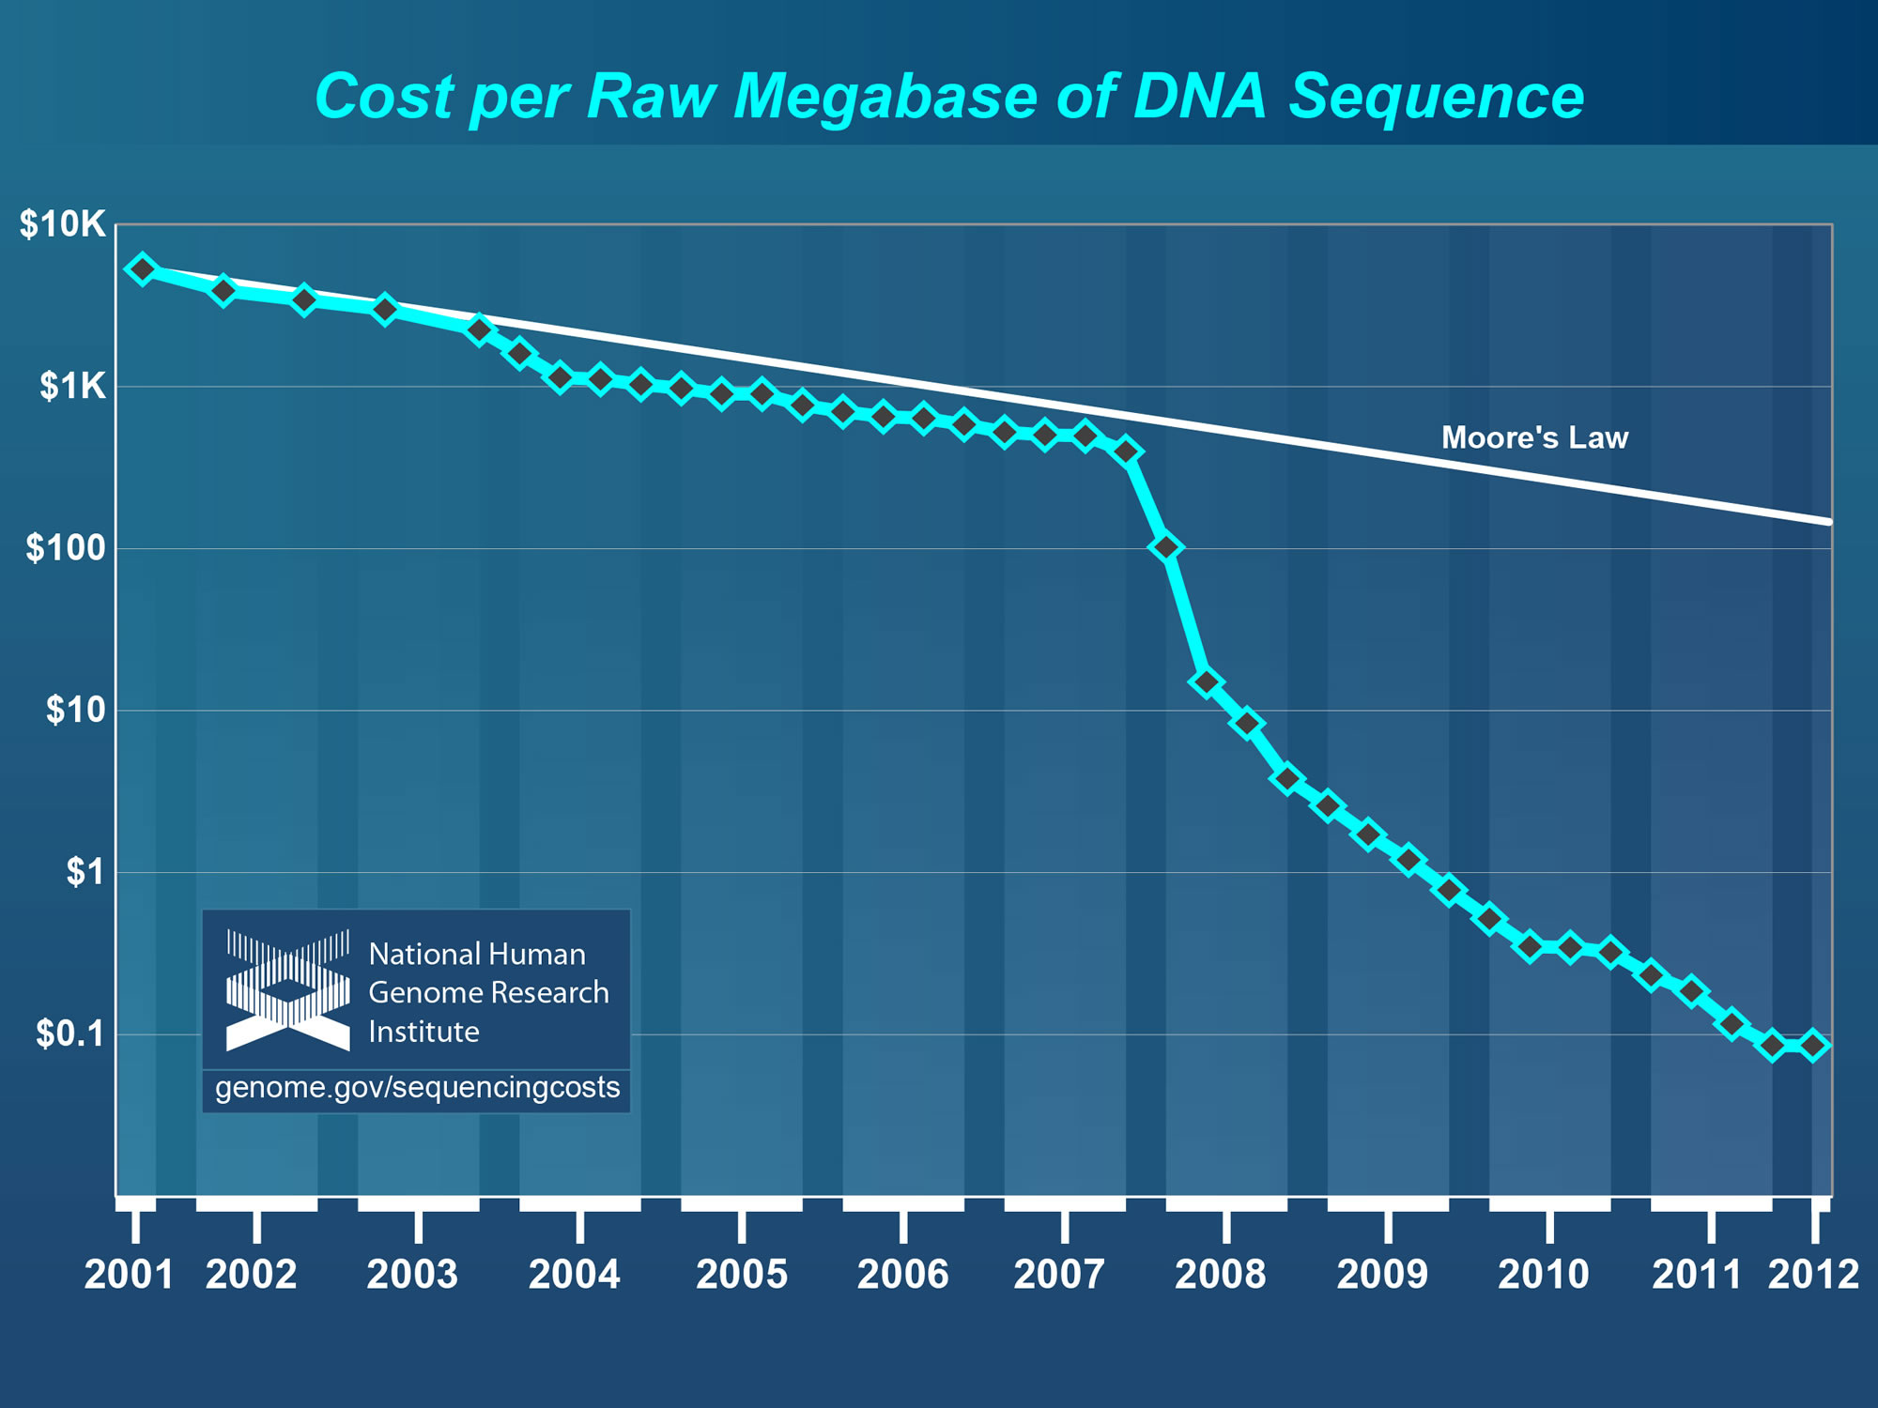
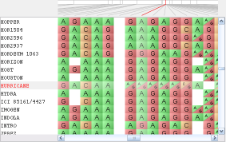
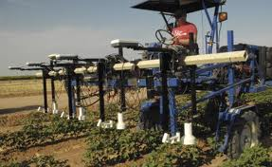

How does GS put big data to use?

Slide 8
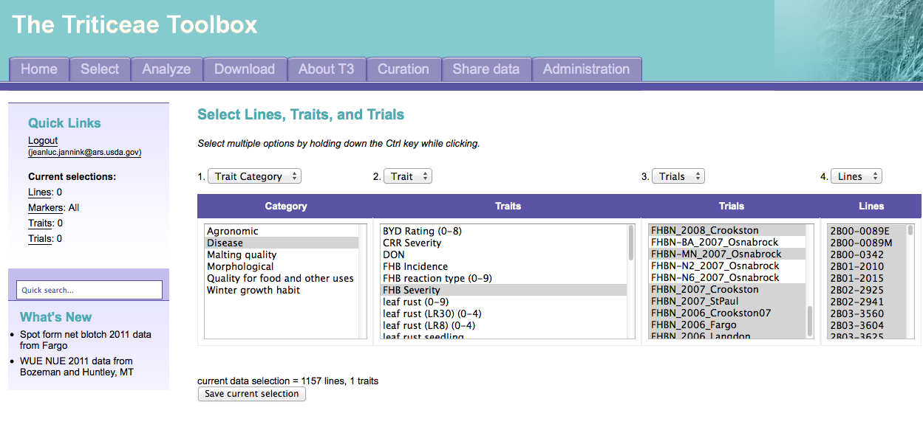




Construct a dataset in T3

Slide 9
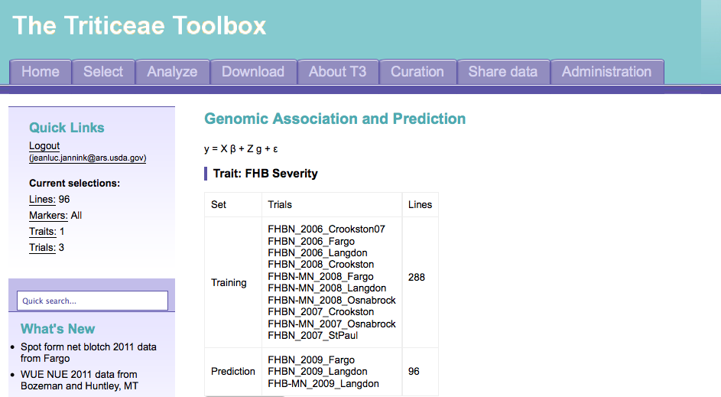
Use server-based analysis tools

Slide 10

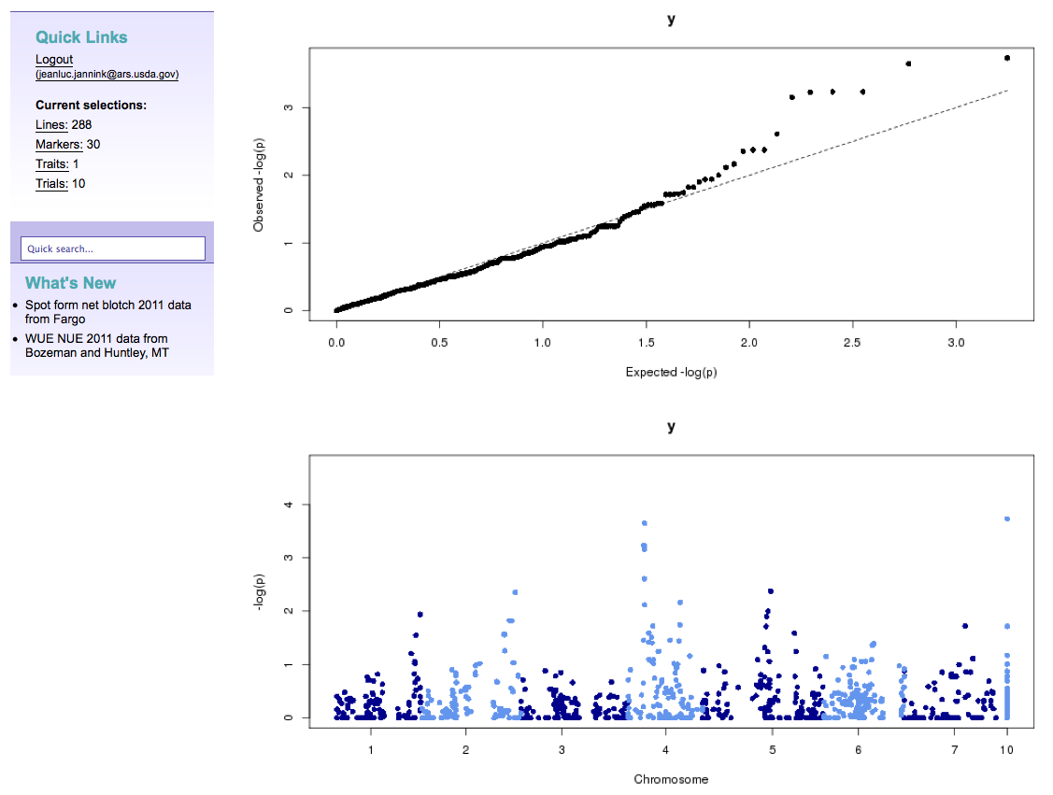

Slide 11
Add weather data to GS predictions
Model allele x environment interaction
Assess the relevance of a trial
Predict into a climate-changed future
Challenge
Many components and time-resolution of weather
Correlated predictors each explain little variance

Slide 12
Physiological integration of weather data
Water excess
Drought
Winter frost
Ear frost, flowering frost
Nitrogen
Diseases
Low light
Hot temperatures
Lodging
Sowing
00
Emergence
7
Start tillering
21
Pseudo stem erection
30
Male Meiosis
39
Flowering
65
Maturity
92
Half-filling stage
75

Slide 13
Empirical examples: oat beta-glucan
Elite Panel ➔ One-year breeding cycles :
Phenotypic selection
Marker-assisted selection
Genomic selection
Notes:
Best-practice BLUP methods using pedigree-based relationship matrix
Six markers from association study as fixed effect + pedigree-based relationship matrix
ridge regression ⬄ marker-based relationship matrix

Slide 14
Three Selection methods, each replicated twice
Pheno
MAS
GS

Slide 15
Top 10 in BG content

Slide 16
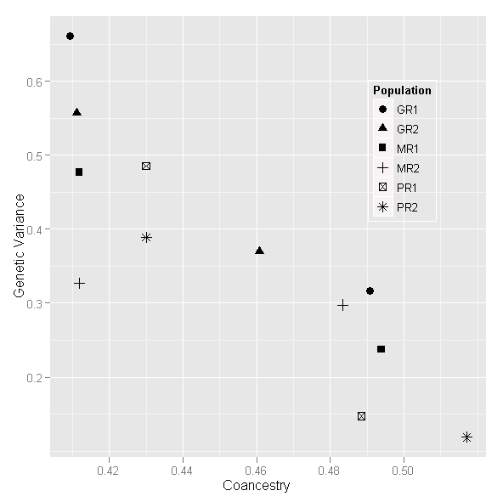
Phenotypic selection left less variance

Slide 17
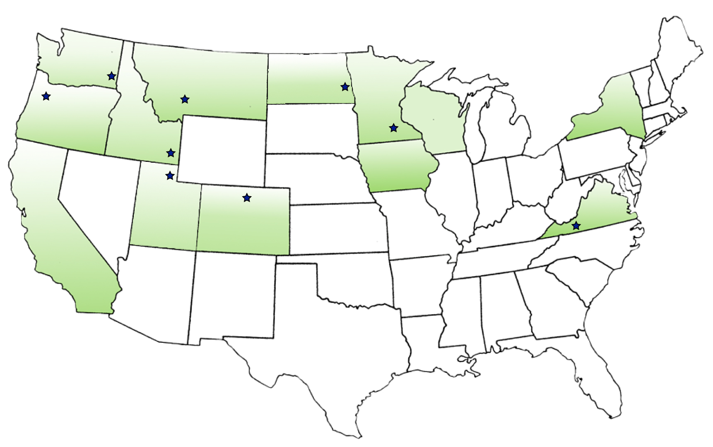

Barley Fusarium head blight
Three breeding programs
1500 SNPs
685 barley lines
Three years, 2 locations
Select among 1440 progeny from 60 crosses

Slide 18
Get to evaluation more quickly
Crossing
A x B
F1
Yr 1
Inbreeding
F2
Crossing
A x B
F3
F1
Yr 1
Yr 2
F4 Winter Nursery
Inbreeding
F2
Genomic Selection
Phenotypic Selection
F4:5
Plant Rows
F3
F4 Winter Nursery
Yr 2
Yr 3
Evaluation
Evaluation

Slide 19
Selected progeny
FHB
Yield
99.7
Phenotypic
90.6
86.2
Genomic
100.7

Slide 20
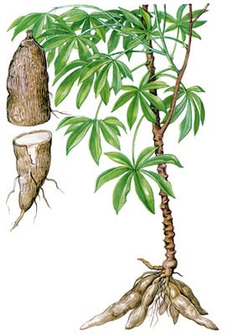
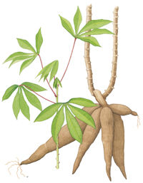
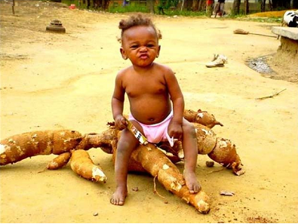

Cassava
Root and leaves a staple in sub-Saharan Africa
Small farmers produce half world’s cassava
500 Million Africans eat it daily
Notes:
Cassava is clonally propagated, so that obtaining sufficient clones for replicated phenotyping is slow. Five years of propagation and evaluation are needed prior to final selection.

Slide 21








Next Generation Cassava Breeding
6 Months
Seedling Genotyping
Selection
Year 2
Seedling disease screening
Genotyping
Selection
6 Months
Crossing
Year 1
Crossing
Year 2 –>
Multiplication, testing, release
Notes:
Our aim is to cut the breeding cycle time from about six years to one year.

Slide 22
Comparison to phenotypic accuracy
DM
CGM
RTNO
HI
DYLD
FYLD
CMD
RTWT
VIG
CBBS
TYLD
SPROUT
ROTNO
SHTWT
NKLGT
CBBI
Notes:
Each point in the graph is a cassava trait and it shows that accuracy from genomic prediction is competitive, at least with simple phenotyping, with some exceptions.

Slide 23
The big picture
Test varieties and release
Advance lines informative for model improvement
Advance lines with highest GEBV
Phenotype (lines already genotyped)
Model Training Cycle
Updated
Model
Genomic Selection
Line Development Cycle
Make crosses and advance generations
Train prediction model
Genotype
New Germplasm
For a century, plant breeding has focused on better ways to evaluate lines. Henceforth it will focus on how to improve a model.

Slide 24
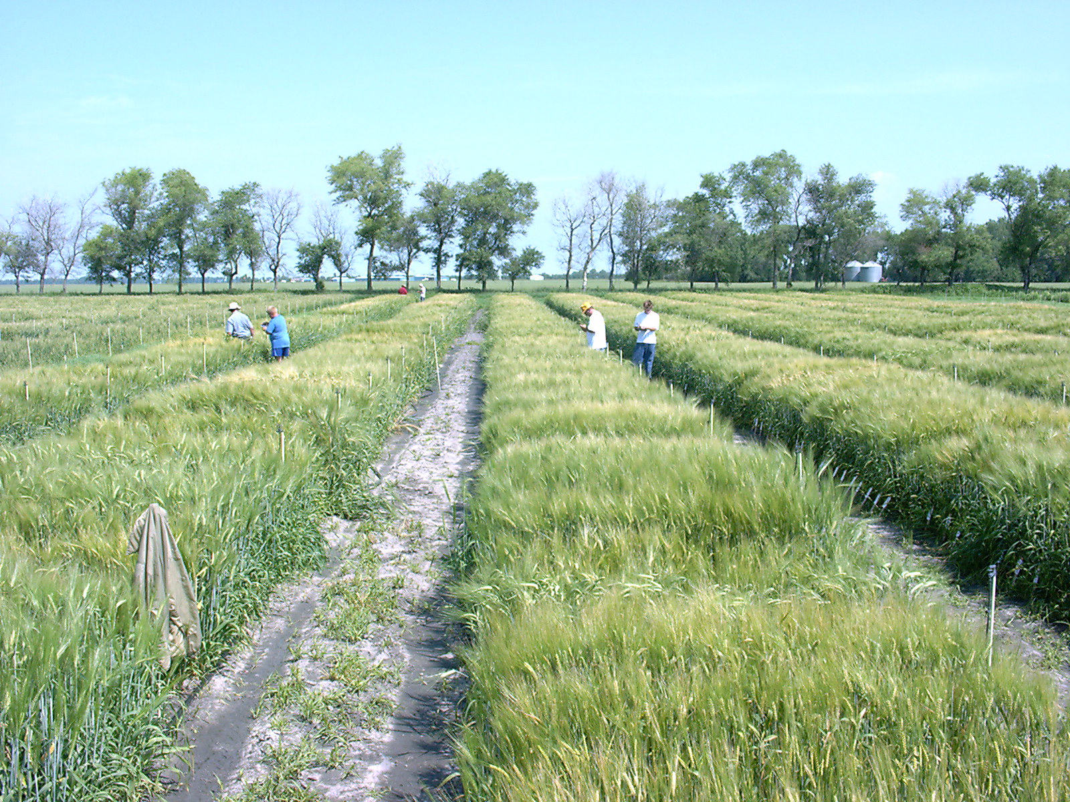
Marker Assisted Selection

