Slide 1
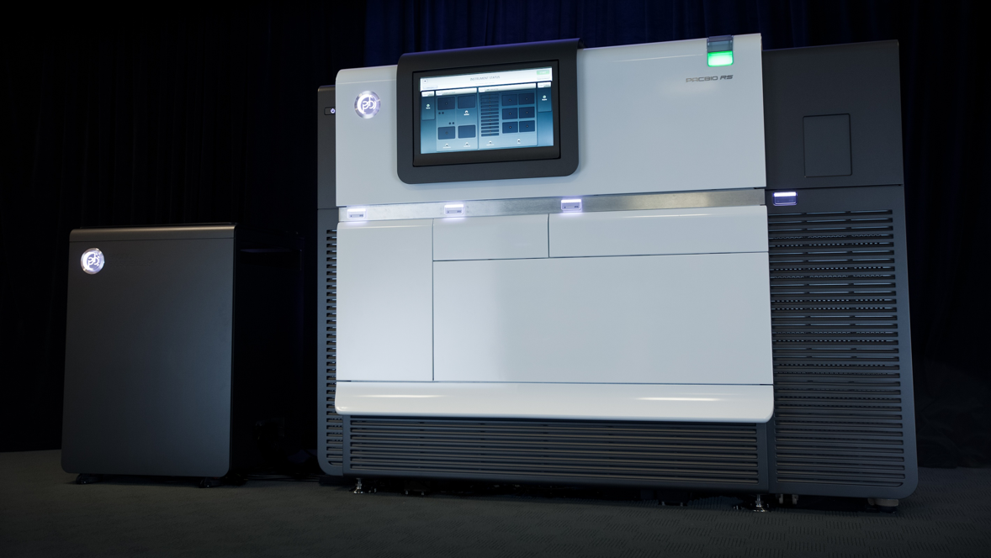

Phylogenetic classification of Shiga toxin-containing Escherichia coli
Dr. Jim Bono
Microbiologist
USDA, ARS, US Meat Animal Research Center
Meat Safety and Quality Research Unit
Notes:
I would like to thank the organizer's of the workshop for inviting me to present my research. I have changed the title of my talk to be more specific about what I am going to talk about

Slide 2

Acknowledgments
Other Collaborators
Washington State University
Dr. Tom Besser
University of Münster
Dr. Martina Bielaszewska
Dr. Helge Karch
Centers for Disease Control and Prevention
Dr. Peter Gerner-Smidt
Dr. Nancy Strockbine
ARS/Western Regional Research Center
Dr. Robert Mandrell
ARS/Eastern Regional Research Center
Dr. Pina Fratamico
Food and Drug Administration
Dr. Shaohua Zhao
Dr. Errol Strain
Dr. Marc Allard
Public Health Agency of Canada
Dr. Roger Johnson
Food and Environmental Research Agency
Robert Stones
Battelle National Biodefense Institute
Dr. Adam Phillippy
Dr. Sergey Koren
USMARC
Dr. Greg Harhay
Dr. Mike Clawson
Dr. Tim Smith
Dr. Jim Keen
Sandy Fryda-Bradley
Bob Lee
Renee Godtel
Steve Simcox
Linda Flathman
Kris Simmerman
Randy Bradley
Jim Wray

Slide 3
STEC
EHEC
Nomenclature Shiga-toxigenic E coli Enterohemorrhagic E coli
Source Non-human esp ruminants Human clinical
Virulence stx1, stx2, hly, eae,tir Same, others?
Serotypes Many O157:H7/NM
O111:H8
O26:H11
O103:H2
O145:H28
O121:H19
O45:H2
EHEC = STEC subset infecting humans
Non-O157
Clinical Manifestations
Non-bloody diarrhea
Bloody diarrhea
Resolution
or
Hemolytic uremic syndrome

Slide 4

Shiga toxin-containing Escherichia coli (STEC)
Zoonotic foodborne human intestinal pathogen
Normal, transient, non-pathogenic bovine intestinal microflora
Cattle implicated as direct & indirect human infection source
Bovine feces assumed to be primary human and bovine contamination & infection source
2/3 of STEC Isolates were O157:H7
1/3 of STEC isolates were non-O157
70% of non-O157 isolates are from the “Top 6”

Slide 5
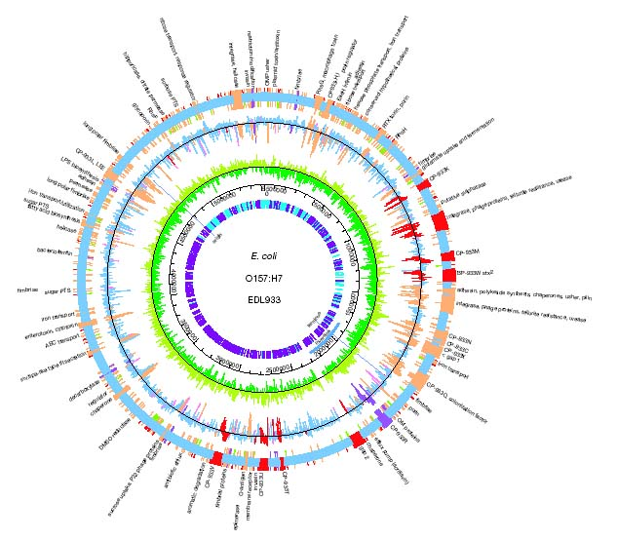
A bacterial genome is a “playbook” that describes its potential
Two-deep zone
Jail break blitz
Base defense
Ferment sorbitol
Shiga toxin
Type III secretion system
Methylase

Slide 6
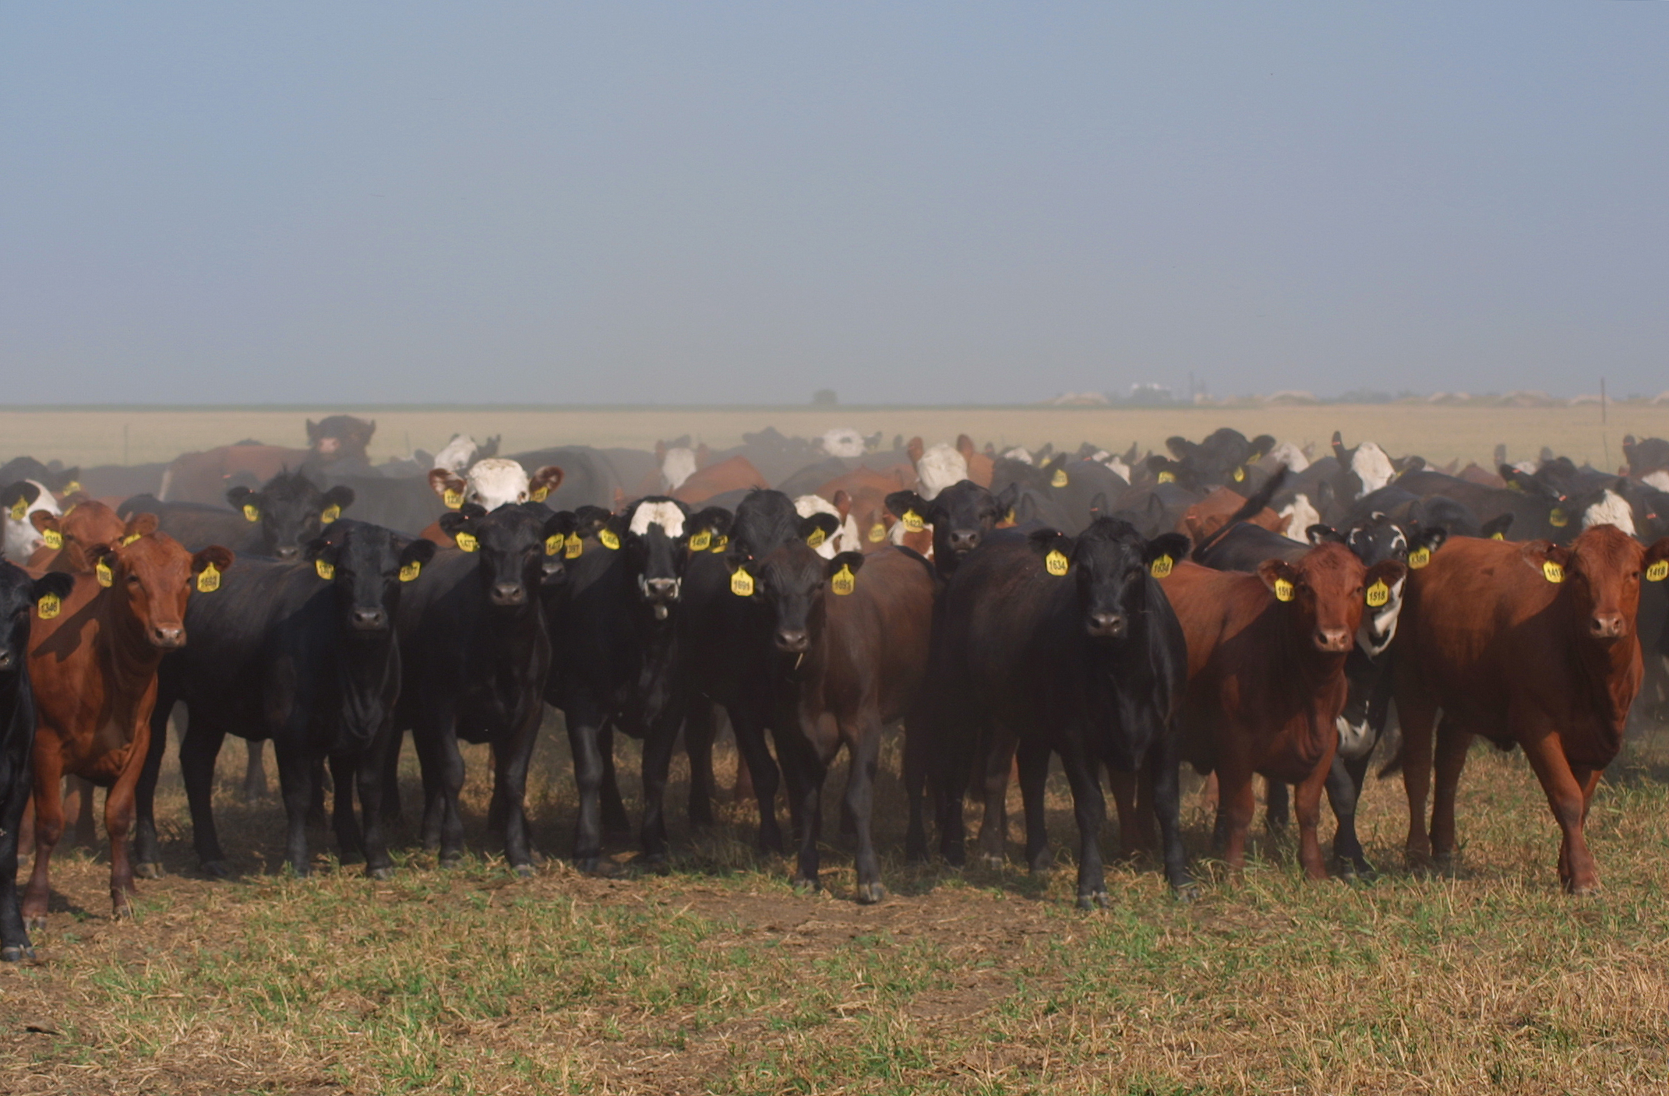
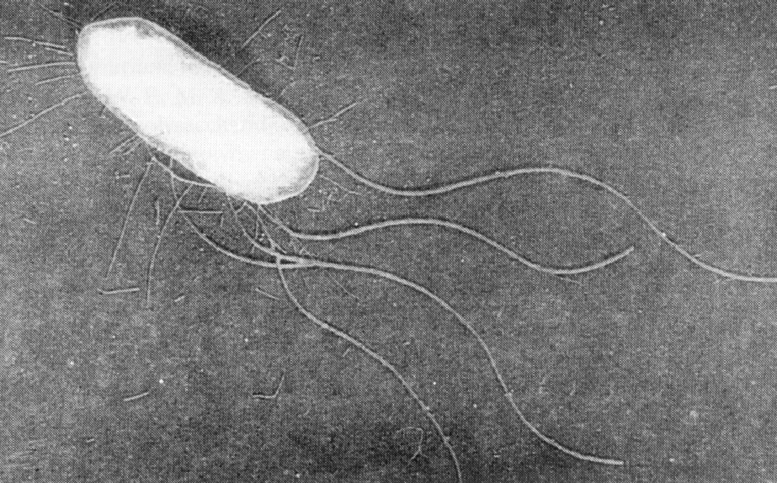


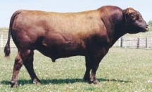

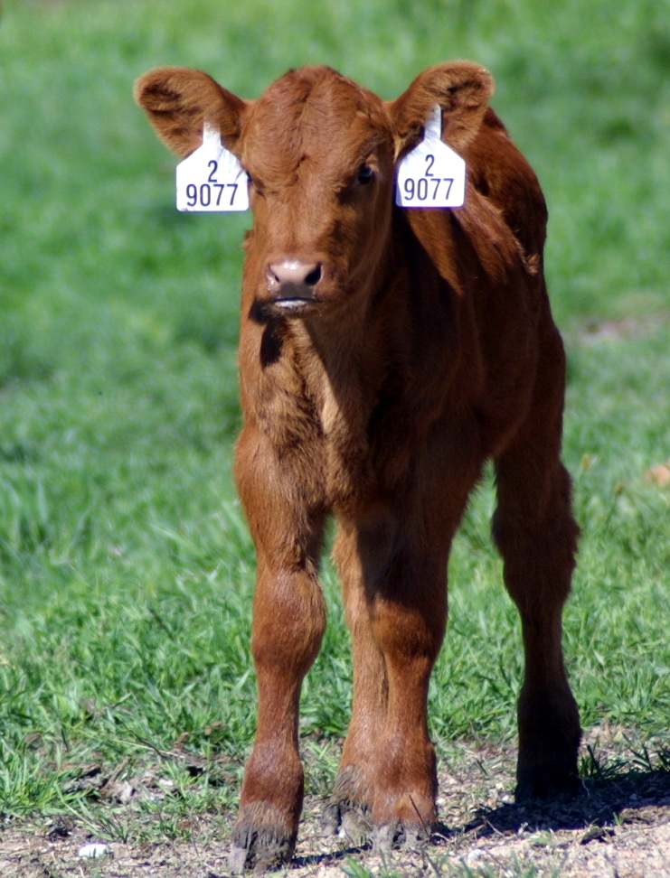

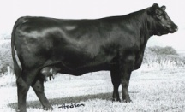

Family Tree
Notes:
The goal of functional genomics with regard to improving animal health
[next]
is to read an animal’s DNA sequence and estimate its susceptibility or resistance to disease.
[wait]
[next]

Slide 7
Goals for genomic sample sequencing of STEC serotypes and isolates
Identify genomic targets to use for developing tests for Shiga toxin-containing Escherichia coli (STEC) serotypes.
Identify nucleotide polymorphisms within STEC serotypes to use for developing a typing method that can be used for determining strain relatedness and epidemiological studies.

Slide 8
A problem with multiplex PCR
Target
Product
E. coli O157:H38
E. coli O157:H7
fliC_{H7} 625 bp
stx2 482 bp
E. coli O5:H7
E. coli O157:H7
eaeA 368 bp
E. coli O111:NM
rfb_{O157} 292 bp
E. coli O157:H7
stx1 210 bp
Mixed E. coli culture
E. coli O157
monoculture
No single DNA target.
In food & fecal microflora, E. coli can possess O157, H7, eae,
shiga-toxin, or hlyA genes (etc) alone or in combination.
Only strain isolation will confirm that all genes detected in
multiplex PCR are present in the same strain.

Slide 9
E. coli O157 Detection Kit
48
46
44
42
40
* purified bacterial DNA
used as test sample
38
36
34
cycle threshold (C_{t})
(C_{t} cutoff : ≥ 35)
32
30
28
26
24
22
STEC O157
(n=72)
EHEC O157
(n=26)
Non-STEC
O157 (n=9)
Non-O157
STEC (n=16)
Other bacteria
(n=86)

Slide 10
Schematic of O-Antigen Operon
Bos taurus
Escherichia coli
Breed
Serotype

Slide 11
Example of identifying SNPs by O-antigen sequencing
Non-STEC
SNPs specific for STEC
STEC

Slide 12
Genome comparison for serotype specific SNPs
48 draft or complete genomes
O121
9 draft genomes from USMARC
SNPs at node are specific for serotypes.
Not all SNPs were specific because discover population was to small
O26
O111
O103 & O45
O145

Slide 13
Phylogeny of 192 E. coli strains
O55:H6 EPEC
Tree of 192 E. coli strains
14 genomes from USMARC
22 genomes in progress
O26:H11 & O111:H11 STEC
O111:H21 EPEC
STEC H11 serogroup clade
O26:H11 STEC
O111:H8 STEC
STEC H2 serogroup clade
O103:H2 & O45:H2 STEC
O128:H2 STEC
O111:H2 EPEC
O128:H7 STEC
O128:H21 STEC
O121:H19 STEC
O157:H43 ETEC
O111:H12 EPEC
O145:NM STEC
O157:H7 tir T STEC
O157:H7 tir A STEC
O157:NM sor+ gud+
O55:H7 EPEC

Slide 14
Accomplishments
O-antigen operons have SNPs that can be used to differentiate STEC from non-STEC strains.
Serotype specific SNPs can be identified through genome comparison.
Impact
Serotype specific SNPs from the O-antigen sequencing project have been licensed and are being used in a STEC detection and identification system. This system was recently award a letter of no objection by FSIS, which allows companies to use this system to comply with recently implemented regulations regarding testing for 6 STEC non-O157 serogroups, in addition to STEC O157:H7.

Slide 15
Goals for genomic sample sequencing of STEC serotypes and isolates
Identify genomic targets to use for developing tests for Shiga toxin-containing Escherichia coli (STEC) serotypes.
Identify nucleotide polymorphisms within STEC serotypes to use for developing a typing method that can be used for determining strain relatedness and epidemiological studies.

Slide 16
An example of PFGE versus SNP genotyping
PFGE
Identity by state
SNP
Identity by decent

Slide 17
All E. coli O157:H7 are not the same
Don’t cause disease in humans
Cause disease in humans
Notes:
Neighbor-Joining tree of full length concatenated STEC-O157 polymorphism genotypes. Bullets represent bootstrap values equal or greater to 80% (n=1000 bootstraps). Number in bold correspond to genotype numbers. Italicized numbers in parentheses represent clade frequencies in the human strains. The light blue color represents strains that are sorbitol negative and have Tir T. The light yellow represents strains that are sorbitol negative and have Tir A. The light green color represents strains that are sorbitol positive and have Tir T. The scale bar represents substitutions per site.

Slide 18
How did cattle acquired STEC O157?
n=2
n=15
Lineage VII
Lineage VI
Cattle clade
n=88
Human
Lineage V
Cattle
n=84
Lineage II
n=1
Lineage III
n=185
Lineage I
n=12
Lineage IV
Lineage VIII
Human clade
n=32
0.01
STEC O55:H7
Notes:
This tree begs an interesting question, How did cattle acquire STEC O157? I don’t have the answer to that question. We do know that cattle are not a reservoir for STEC O55:H7 or Lineage VIII. That is not to say that you don’t find O55 E coli or the sorbitol fermenting STEC of lineage VIII in cattle if you look long enough hard enough or deep enough. You will, but they are very rare. In contrast, STEC O55:H7 are commonly found in humans and are a major source of infantile diarrhea world wide,,,,and the sorbitol fermenting STEC O157 have caused human outbreaks. So, humans, not cattle represent the base of this tree. Since cattle harbor Lineages I-VII, it is possible that STEC O55:H7 gave rise STEC O157 in humans, and that cattle acquired an early line of STEC O157 from humans which then went on to evolve into the later lineages, with transmission back to humans from cattle. I think that this is a possibility. However, it is also possible that cattle once were a reservoir for STEC O55 and Lineage VIII, and then lost the ability to harbor those lines and retained the ability to harbor lineages I-VII,,,Or that cattle acquired STEC O157 from a source other than humans. STEC O157 have been found sporadically in domestic animals, syanthropic rodents, birds, amphibians, fish, insects and mollusks. What we can say with greater confidence is that human pathogenesis appears ancestral in STEC O157 evolution, as STEC O157 evolved from a human pathogen and the earliest lineages of STEC O157 evolution are represented by strains originating from clinically-ill humans. If the ancestor was not a human pathogen, we would have to invoke multiple gains and/or losses of human virulence to explain this evolutionary tree. This indicates that lineage V may have become specialized to cattle by evolving away from an association with human disease.

Slide 19
All E. coli O26:H11 are not the same
Stx1, cattle and humans
EPEC
ETEC
Stx2, cattle and humans
Increase patients with HUS

Slide 20
Accomplishments
A set of nucleotide polymorphisms has been developed for detecting STEC O157 and O26 genetic subtypes through identity-by descent.
STEC O157 evolution has been redefined with this set of polymorphisms.
This is the first large scale SNP discovery and analysis of relatedness for serogroup O26
Impact
CDC is using STEC O157 SNPs in forming a group of SNPs to genotype EHEC O157 strains.

Slide 21
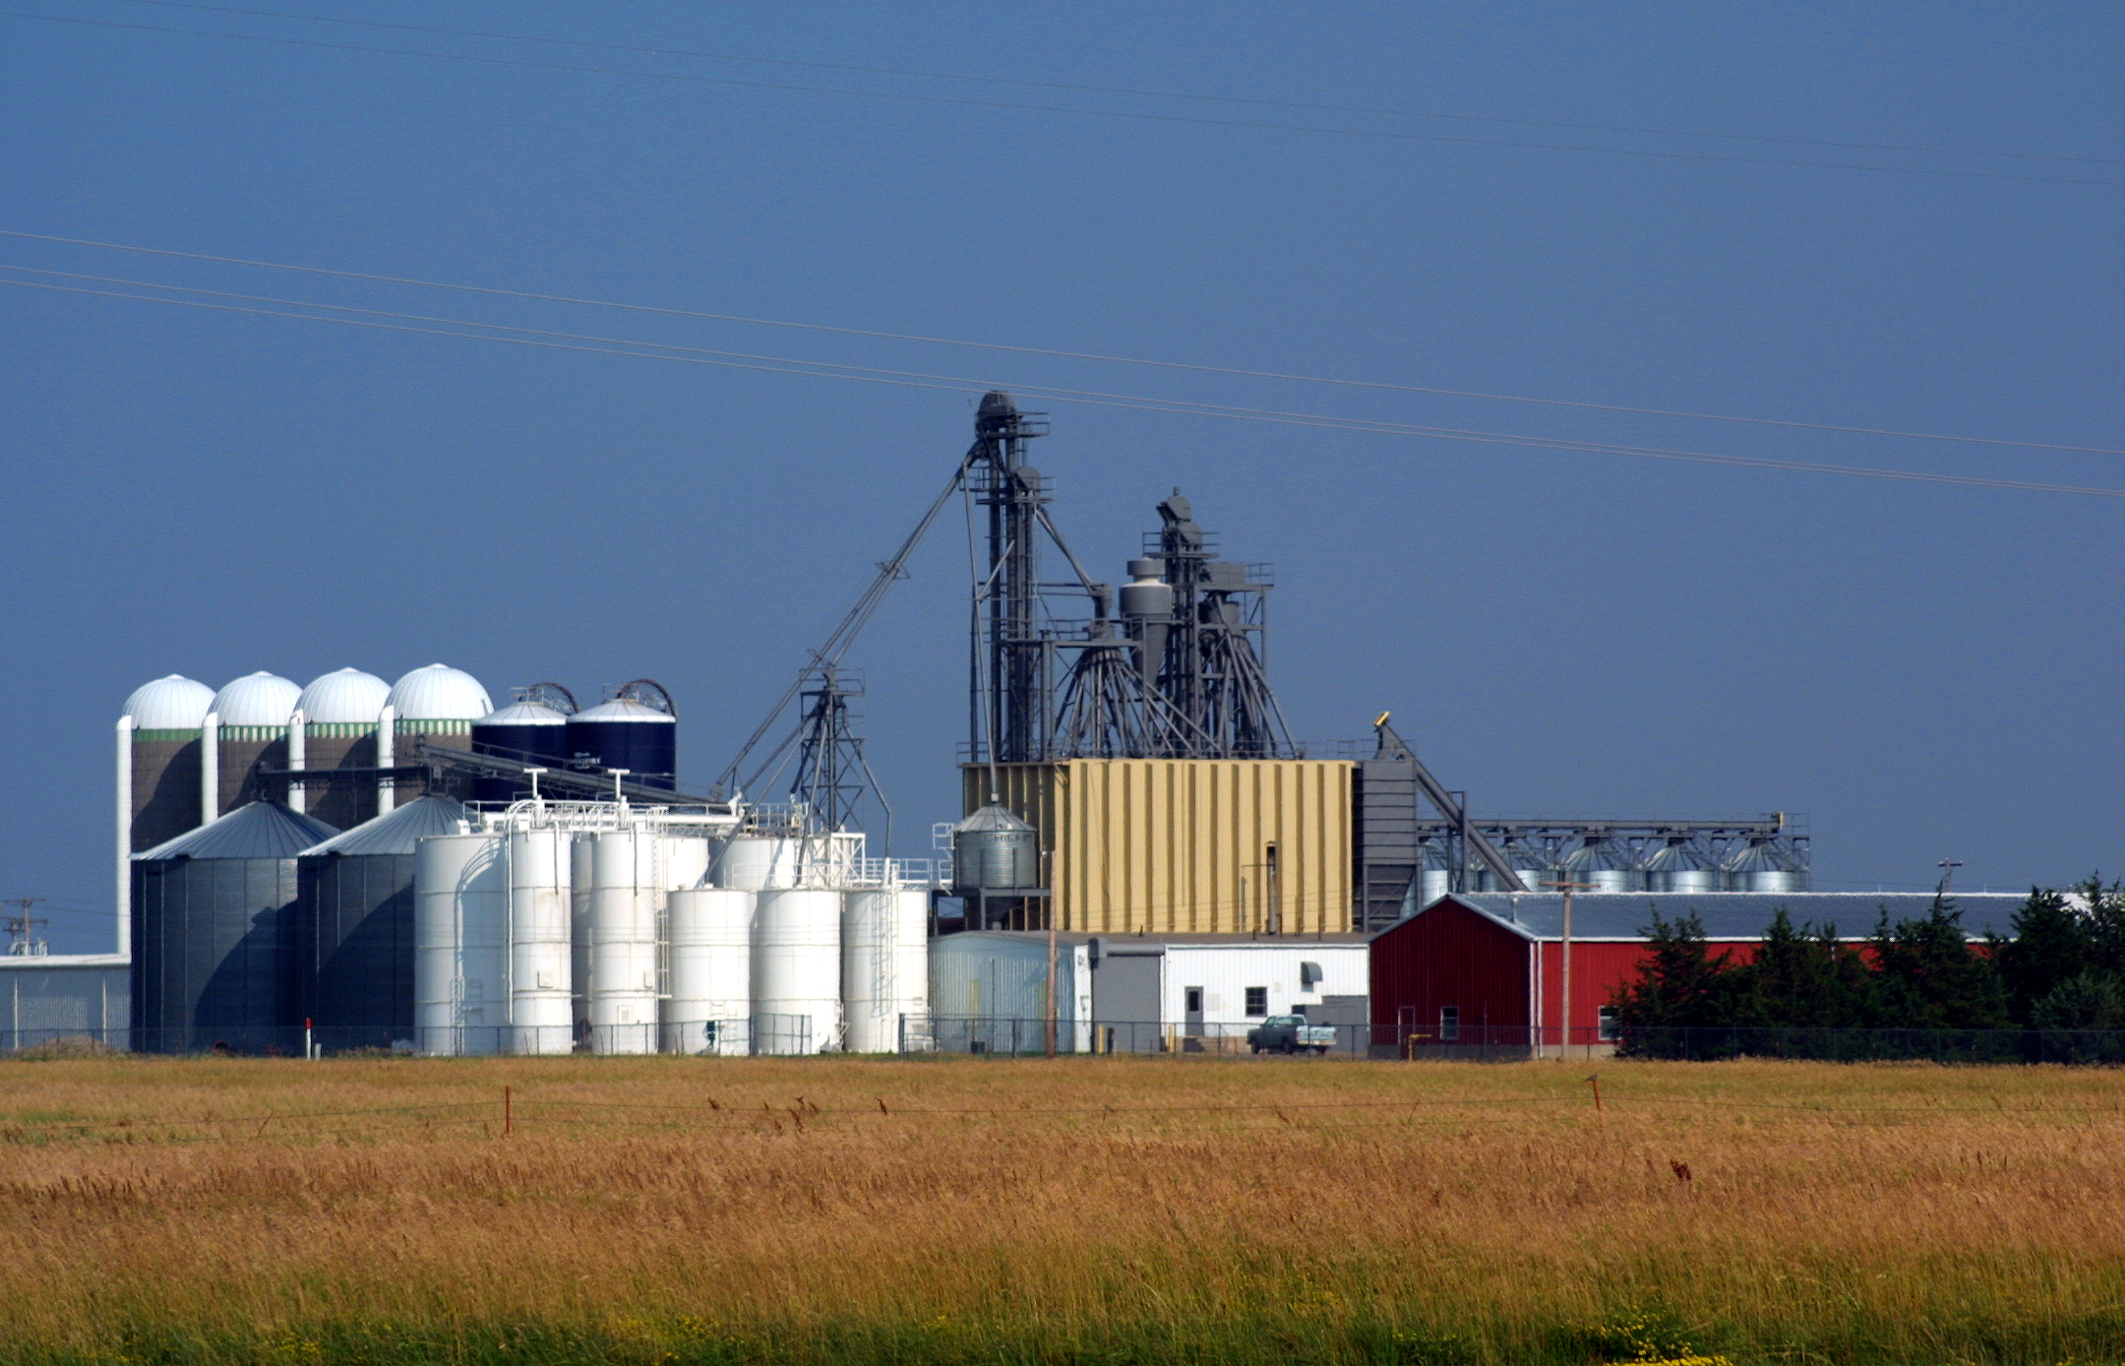
Questions?

