Slide 1
Modeling identical animals and clones in genetic evaluations
Paul VanRaden¹, Gary Fok¹, Sajjad Toghiani¹, and Ezequiel Nicolazzi²
¹USDA, Agricultural Research Service, Animal Genomics and Improvement Laboratory, Beltsville, MD, USA.
²Council on Dairy Cattle Breeding, Bowie, MD, USA.
paul.vanraden@usda.gov

Slide 2
Why model clones?
Clones of elite cows can multiply their contribution:
Top ranked heifer had 29 progeny; her 3 clones had 151, 59, and 27 progeny
Her dam had 329 progeny; clone of dam had 16 progeny
Clones of many elite bulls are now marketed (but not yet in EU)
Top proven HO has 2 clones with 1,233 and 1,025 progeny
His sire had 3 clones with 3,470, 220, and 92 progeny
His 3rd great grandsire ManOMan’s clone had 12,608 progeny
U.S. Food and Drug Administration approved cloning in 2008

Slide 3
Birth codes in USA data
Multiple birth codes:
4,762 pairs of natural identical twins (code 2 and verified by genotype)
1,776 split embryos (code 4)
530 nuclear transfer clones from embryos, calves, or adults (code 5)
From about 7 million animals
Code | Birth description
1 | Single
2 | Multiple birth (not from embryo transfer)
3 | Birth from embryo transfer
4 | Split embryo (artificially)
5 | Clone from nuclear transfer
6 | Embryo pedigree (implantation date stored as birth date)

Slide 4
Grand Champion in 2011, Clone beat her in 2013
Apple – 2011 World Dairy Expo
Photo:
https://rzbderboven.de/apple/
Apple had 361 progeny.
Apple-3 – 2013 World Dairy Expo
Photo and story:
https://www.thebullvine.com/donor-profile/khw-regiment-apple-red-beauty-performance-record-accomplishments/
Malcolm, D. 2019. KHW Regiment Apple-Red-ET – Everything and more. Photo by The Bullvine.
Apple’s 9 clones added 325 more progeny.

Slide 5
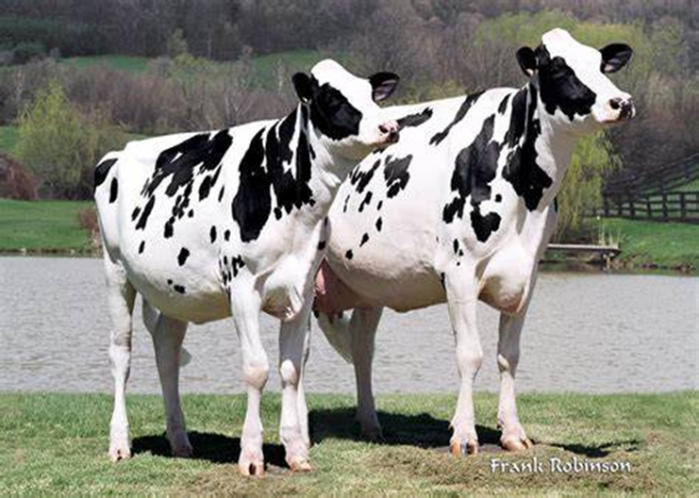
Example cow and clone
Holstein cow and her clone
Nelsons Estimate Liz
Nelsons Estimate Liz-2
Liz was Junior All-American Winter Yearling, 2001
Liz-2 was Junior Champion at World Dairy Expo in 2004
75 progeny of Liz, 20 of Liz-2
Photo © Frank Robinson, Lodi, CA, USA
Nauman, D. 2011. Commitment got Nelsons Pronto Liz across.
http://www.dairyagendatoday.com/News.aspx?nid=5557

Slide 6
Revised genetic evaluation model
Pedigree relationship matrix treated clones as full sibs but had >7,000 copies of another animal’s DNA
Store a source animal for each identical group
For progeny of clones, switch their sire or dam ID to source ID
Remove IDs of clones from the pedigree file
Keep a separate permanent environment effect for each clone
After computing the EBVs:
Copy the source EBV back to the clones
Report the original pedigree in the public formats

Slide 7
Benefits of the new model
A and G matrices match better
Genetic evaluations more precise for clones and progeny
Genomic evaluations now have identical polygenic effects
Identical EBVs in more trait groups such as type and calving
Combined progeny counts for cloned bulls instead of reporting (since 2008) the daughter count of the clone with the most
More exact pedigree inbreeding coefficients for descendants of clones
Improved ancestor discovery

Slide 8
Example results
Calf born in 2020 (HO840003218920809)
Maternal great grandsire was a clone of the paternal 2nd great grandsire (ManOMan and ManOMan2)
Pedigree inbreeding of 9.8% corrected to 10.6%
Genomic inbreeding was 13.5%
Split embryo bulls (HOUSA000056264513 and HOUSA000056264515)
One had 43 daughters and the other had 2,972 daughters
Combined EBV mostly derived from second bull

Slide 9
Implementation
National evaluation
GEBV changes small because genotypes already identical
MACE evaluation
Separate EBVs not too useful treating clones as full sibs
Send results from new model to Interbull August test run
Only send source animal to avoid double-counting clones
Most programs ready for December implementation

Slide 10
Do clones (ETN) perform as expected?
Trait | Mean | Genetic SD | Clones | Effect | Effect/SD | Effect/Mean
Milk | 28,071 | 1134 | 472 | +18 | 0.0 | +0%
Fat | 1,077 | 50 | 467 | -8 | -0.2 | -1%
Protein | 871 | 30 | 467 | +7 | 0.2 | +1%
SCS (or SCC) | 200k | 0.28 | 460 | +0.34 | 1.2 | +27%
Productive life | 25 | 3.4 | 119 | -3.3 | -1.0 | -13%
Dtr. pregnancy rate | 27 | 2.8 | 354 | -5.0 | -1.8 | -19%
Heifer conc. rate | 45 | 2.6 | 37 | -5.5 | -2.1 | -12%
Cow conc. rate | 41 | 3.2 | 123 | -8.3 | -2.6 | -20%
Age at first calving | 831 | 2.1 | 115 | +17.0 | -8.1 | +2%
Cow livability | 97 | 3.2 | 423 | -7.3 | -2.3 | -8%

Slide 11
Import / export rules?
More countries are adopting the Cartagena protocol
Clones and gene edits are not “genetically modified”
Guidelines proposed to the EU parliament were not adopted
Private companies enforce cloning rules that do not exist
Holstein USA must issue “clone-free” pedigrees for export
All generations are inspected to discover any clone
May affect ~0.1% of USA HO today but >3% in 5 generations and >50% in 10 generations (about 20 years)

Slide 12
Conclusions
Genetic evaluations can account for identical animals:
Link progeny of clones to the source sire or dam
Remove clone copies from the pedigree before analysis
Restore clone IDs and copy EBVs from the source animal
Milk production was as expected but some other traits lower.
Many Holsteins may soon have clones in their pedigrees.
Cloning techniques also enable gene editing.
Models may need revision again for that technology.

Slide 13
Clones and identical twins in team sports
Polo team from Argentina: All 6 horses
are clones of a previous favorite champion
horse.
Currently #2 polo team in the world.
Photo and story:
Six cloned horses help rider win prestigious polo match | Science | AAAS
Tennis doubles team: More titles than any other doubles pair - 1 Olympic Gold, 2 French, 3 Wimbledon, 5 US, and
6 Australian Opens.
Photo and story:
https://www.atptour.com/en/news/tennis-united-24-july-doubles-week
Bryan brothers – Wikipedia

Slide 14

Acknowledgments
CDCB staff and industry cooperators for data
AGIL staff and USDA funding of project 8042-31000-113-000-D, “Improving Dairy Animals by Increasing Accuracy of Genomic Prediction, Evaluating New Traits, and Redefining Selection Goals”

