Slide 1
Improved genomic selection for health and other traits
Paul VanRaden,¹ Kristen Parker Gaddis,² and John Cole¹
¹USDA, Agricultural Research Service, Animal Genomics and
Improvement Laboratory, Beltsville, MD 20705
²Council on Dairy Cattle Breeding, Bowie, MD 20716
paul.vanraden@ars.usda.gov

Slide 2
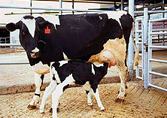
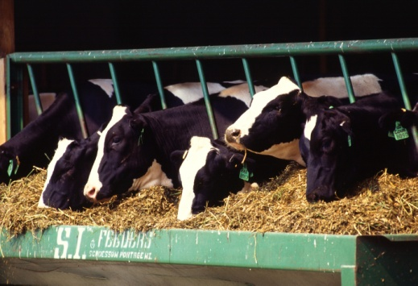
Topics
Genetic selection for health traits
6 new traits introduced in Aug 2018 net merit index (NM$)
Economic values of traits
How to estimate correct emphasis for each trait
Future traits
Age at first calving
Feed intake
Photos: USDA, ARS Image Gallery,
xycows (Lawrence Johnson) and
K7964-1 (Scott Bauer)

Slide 3
Index changes across time
Trait | Relative emphasis on traits (%)
 | PD$ 1971 | MFP$ 1976 | NM$ 1994 | NM$ 2000 | NM$ 2003 | NM$ 2006 | NM$ 2014 | NM$ 2017 | NM$ 2018
Milk | 52 | 27 | 6 | 5 | 0 | 0 | –1 | –1 | –1
Fat | 48 | 46 | 25 | 21 | 22 | 23 | 22 | 24 | 27
Protein | … | 27 | 43 | 36 | 33 | 23 | 20 | 18 | 17
PL | … | … | 20 | 14 | 11 | 17 | 19 | 13 | 12
SCS | … | … | –6 | –9 | –9 | –9 | –7 | –7 | –4
BWC | … | … | … | –4 | –3 | –4 | –5 | –6 | –5
UC | … | … | … | 7 | 7 | 6 | 8 | 7 | 7
FLC | … | … | … | 4 | 4 | 3 | 3 | 3 | 3
DPR | … | … | … | … | 7 | 9 | 7 | 7 | 7
CA$ | … | … | … | … | … | 6 | 5 | 5 | 5
HCR | … | … | … | … | … | … | 1 | 1 | 1
CCR | … | … | … | … | … | … | 2 | 2 | 2
LIV | … | … | … | … | … | … | … | 7 | 7
Health$ | … | … | … | … | … | … | … | … | 2

Slide 4
CDCB health trait data
Health event | Records* (no.) | Cows (no.) | Herds (no.) | Incidence per lactation (%)
Milk fever | 919,719 | 581,210 | 672 | 1.2
Displaced abomasum | 1,677,144 | 984,055 | 1,084 | 1.8
Ketosis | 1,171,915 | 702,729 | 760 | 3.9
Mastitis | 2,000,579 | 1,151,722 | 1,529 | 10.6
Metritis | 1,650,656 | 959,433 | 1,096 | 6.5
Retained placenta | 1,831,887 | 1,069,056 | 1,202 | 3.1
*Records used in CDCB evaluation as of August 2018

Slide 5
Health data editing
Minimum and maximum incidence constraints in place for herd-year reporting
Events must occur within specified time frame after calving (e.g., retained placenta must occur within 10 days of calving)
Holstein cows with acceptable ID
Lactations 1 through 5
DHI translates the many different ways that farmers code the same health events into a common format for CDCB

Slide 6

Data security at CDCB
Security of raw data is of utmost importance
Several levels of IT security in place
PTAs published by CDCB are based on data contributed to cooperator database
Raw data or related information never released to 3rd parties
Health records stored at CDCB (not at USDA)
Herd-based statistics not published

Slide 7
Health trait heritability, repeatability*
Health event | Heritability (%) | Repeatability (%)
Milk fever | 0.6 | 3.1
Displaced abomasum | 1.1 | 1.2
Ketosis | 1.2 | 4.5
Mastitis | 3.1 | 8.6
Metritis | 1.4 | 5.3
Retained placenta | 1.0 | 3.6
*Percentages of variance on observed scale

Slide 8
Reliability (REL)
 | Proven bulls |  |  |  | Young animals
Health event | Traditional REL (%) |  | Genomic REL (%) |  | Traditional REL (%) |  | Genomic REL (%)
Milk fever | 28 |  | 50 |  | 10 |  | 41
Displaced abomasum | 36 |  | 58 |  | 13 |  | 48
Ketosis | 34 |  | 55 |  | 13 |  | 45
Mastitis | 45 |  | 69 |  | 15 |  | 60
Metritis | 37 |  | 60 |  | 14 |  | 50
Retained placenta | 36 |  | 58 |  | 14 |  | 48

Slide 9
Presentation of trait PTAs
Initially available only for Holsteins
Need more data to evaluate other breeds
Health$ composite included in NM$ but not published separately
Health PTAs defined as disease resistance
Positive numbers favorable
Mastitis resistance, ketosis resistance, etc.
PTAs presented as percentage points of resistance above or below breed average

Slide 10
Example bulls
Bull A PTA = +3.0
Bull B PTA = –4.0
Resistance to clinical mastitis ≈ 90%
Incidence rate ≈ 10%
Expect 93% resistance to clinical mastitis among bull A’s daughters (7% incidence rate)
Expect 86% resistance to clinical mastitis among bull B’s daughters (14% incidence rate)

Slide 11
Correlations among health trait PTAs
Resistance to:* | Protein | PL | LIV | SCS | DPR | CCR | HCR
Milk fever | 0.18 | 0.15 | 0.19 | –0.29 | 0.003 | 0.01 | 0.02
Displaced abomasum | 0.23 | 0.35 | 0.47 | –0.13 | 0.32 | 0.28 | 0.24
Ketosis | 0.03 | 0.33 | 0.27 | –0.19 | 0.59 | 0.49 | 0.07
Mastitis | 0.06 | 0.39 | 0.22 | –0.68 | 0.20 | 0.21 | 0.06
Metritis | 0.05 | 0.32 | 0.26 | –0.09 | 0.46 | 0.41 | 0.23
Retained placenta | –0.03 | 0.17 | 0.13 | –0.10 | 0.14 | 0.13 | 0.12
*Milk fever and retained placenta included bulls born since 1990 with REL of ≥75%;
all other traits included bulls born since 1990 with REL of ≥ 90%

Slide 12

Economic considerations
Must avoid double counting or undercounting costs
NM$ uses recent price surveys
Liang et al., 2017, J. Dairy Sci. 100:1472–1486
Donnelly, 2017, M.S. thesis, Univ. of Minnesota
Direct treatment costs for each health event
Veterinary, farm labor, drugs, discarded milk
Does not include costs already accounted for in NM$ calculations (declines in production, fertility, longevity, etc.)

Slide 13
Lactation curve with abnormal test (or sick day)
Adjustment method:
Wiggans et al., 2003,
J. Dairy Sci. 86:2721–2724

Slide 14
Economic adjustments for sick days
Do yield trait PTAs fully account for reduced milk from health events?
Abnormal test-days (TD) defined as <60% or >150% of predicted TD yield, or cow coded as sick by owner
Lactation yields were computed with and without TD adjustments for a sample of animals
For most traits, only ∼$4 added to direct health costs/case to account for yield PTAs being adjusted for sick days
Larger differences for displaced abomasum
$19 yield adjustment added to direct treatment costs
Likely due to acute effects of displaced abomasum (for example, surgery)

Slide 15
Economic weights
Health event* | Estimated direct cost/case* | Yield adjustment | Total direct cost/case | Relative value (%)
 |  |  |  | Health$ | NM$
Milk fever | $38 | –$4 | $34 | 2.3 | 0.05
Displaced abomasum | $178 | +$19 | $197 | 23.3 | 0.54
Ketosis | $28 | $0 | $28 | 4.7 | 0.11
Mastitis | $72 | +$3 | $75 | 32.9 | 0.77
Metritis | $105 | +$7 | $112 | 26.5 | 0.62
Retained placenta | $64 | $4 | $68 | 10.3 | 0.24
*Liang et al., 2017; Donnelly, 2017

Slide 16
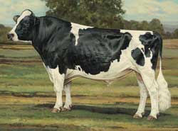
Genetic correlations with Health$*
Trait | Correlation with Health$ |  | Trait | Correlation with Health$
Milk | 0.03 |  | DPR | 0.42
Fat | 0.08 |  | CA$ | 0.33
Protein | 0.04 |  | HCR | 0.18
PL | 0.56 |  | CCR | 0.36
SCS | –0.44 |  | LIV | 0.55
BWC | –0.26
UC | –0.01
FLC | 0.02
*Based on Holstein bulls born since 1990
with REL of ≥90%
Photo: Modern ideal Holstein bull, Holstein Association USA

Slide 17
August 2018 NM$ revision
Mastitis included as direct measure reduced emphasis on SCS
SCS previously included premiums and correlated mastitis costs
Labor, drugs, discarded milk, milk shipments lost because of antibiotics, etc.
Indirect costs should have been only $4 instead of $20
Emphasis on SCS
2017: –6.5%
2018: –3.5% (with addition of mastitis resistance)

Slide 18

Relative trait emphasis (%) in 4 merit indexes
Trait | Net Merit | Cheese Merit | Fluid Merit | Grazing Merit
Milk | –0.7 | –7.9 | 18.4 | –0.7
Fat | 26.8 | 22.8 | 27.1 | 22.9
Protein | 16.9 | 20.9 | 0.0 | 14.4
PL | 12.1 | 10.3 | 12.2 | 6.6
SCS | –4.0 | –4.4 | –2.3 | –3.5
BWC | –5.3 | –4.5 | –5.3 | –5.8
UC | 7.4 | 6.3 | 7.5 | 7.4
FLC | 2.7 | 2.3 | 2.8 | 2.8
DPR | 6.7 | 5.7 | 6.8 | 17.8
CA$ | 4.8 | 4.1 | 4.8 | 4.5
HCR | 1.4 | 1.2 | 1.4 | 2.4
CCR | 1.6 | 1.4 | 1.7 | 4.3
LIV | 7.3 | 6.2 | 7.4 | 4.9
Health$ | 2.3 | 1.9 | 2.3 | 2.1
Photo: CreditDebitPro

Slide 19
Future adjustments for health traits
Health traits can be adjusted for unequal variance similar to adjustments used for other traits since 1991
Yield, SCS, calving traits, type traits, and livability
Variance higher when incidence higher
Herds with low incidence provide less information
Multitrait evaluation could use other correlated U.S. traits to improve accuracies of all 6 health traits

Slide 20

Mastitis evaluations from Interbull
MACE includes SCS and mastitis (since 2001)
Mastitis initially sent only by Scandinavian countries; now also sent
by Canada, France, Belgium, Netherlands, and Italy (mixed trait)
U.S. mastitis data submitted for September 2018 test run should improve U.S. reliability
Genetic correlations of domestic SCS with foreign mastitis already average 0.88 (SCS has been helpful as correlated trait)
MACE not yet available for other 5 health traits

Slide 21
What do others include in their index?

Slide 22
No emphasis better than too much emphasis
Suppose correct emphasis should be 90% for trait 1 and 10% for trait 2
Index A gives correct emphasis (90:10)
Index B gives no emphasis to trait 2 (100:0)
Index C gives twice the emphasis (80:20)
Index D gives triple the emphasis (70:30)
Economic progress as percentage of maximum possible =
correlation of incorrect index with correct index
100% progress from correct index A
99.4% progress from no emphasis in index B
99.1% progress from double emphasis in index C
95.7% progress from triple emphasis in index D
A B C D

Slide 23
Relative weighting in NM$ and DWP$

Slide 24
Extra progress from adding more traits
Year | Traits (no.) | Traits included | Correlation with previous index | Extra progress
1977 | 3 | Milk, fat, protein | … | …
1994 | 5 | PL, SCS | 0.84 | 19%
2000 | 18 | Linear type | 0.94 | 6%
2003 | 21 | DPR, calving ease | 0.98 | 2%
2006 | 23 | Stillbirth | 0.975 | 3%
2014 | 25 | HCR, CCR | 0.965 | 4%
2017 | 26 | LIV | 0.989 | 1%
2018 | 32 | Health traits* | 0.994 | 0.6%
*Zoetis claimed 21.5% extra progress from 6 health traits, but their
economic values actually result in slower (about –4% less) progress

Slide 25

Missing traits
Some ads claim animals not worth using if they are “missing” traits
Selection index requires PTA for each trait
Options for filling missing PTAs
Breed average for birth year
Parent average
Correlations with other evaluated traits
Genomic prediction
USDA and CDCB rank all bulls (foreign and domestic since 1995) by filling missing traits using correlations

Slide 26
Past and possible future traits evaluated in the U.S.
Year | Trait | Year | Trait
1926 | Milk & fat yields | 2006 | Bull conception rate²
1978 | Conformation (type) | 2009 | HCR, CCR
1978 | Protein yield | 2016 | LIV
1994 | PL | 2017 | Gestation length
1994 | SCS (udder health) | 2018 | Cow health (6 traits)
2000 | Calving ease¹ | 2019 | Age at first calving (research)
2003 | DPR | 2020 | Residual feed intake (research)
2006 | Stillbirth rate | 2021 | Heat tolerance (research)
¹Sire calving ease evaluated by Iowa State University (1978–99)
²Estimated relative conception rate evaluated by DRMS in Raleigh, NC (1986–2005)

Slide 27
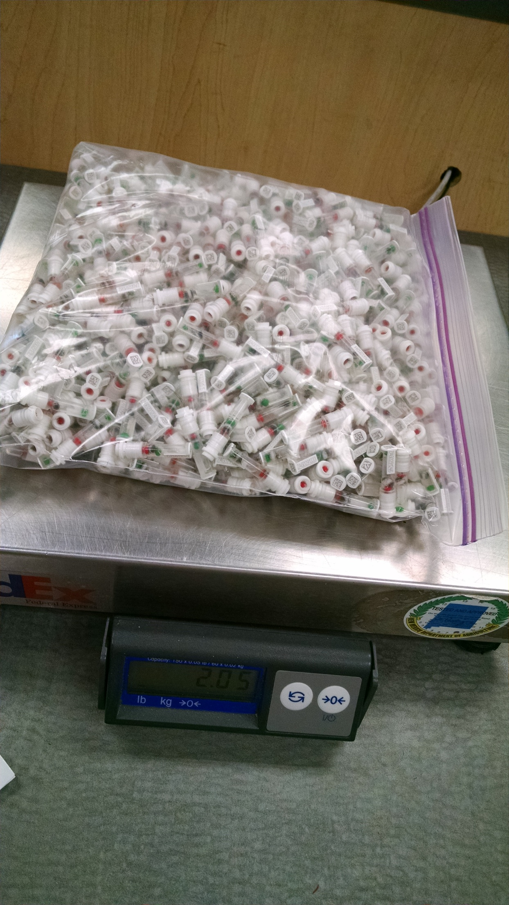
Why select for low-heritability traits?
Many students were taught to select for highly heritable traits and manage lowly heritable traits
Genomic selection now makes ranking animals for lowly heritable traits possible very early in their life
Health traits average >20% reliability gain from genomics
Predictions are accurate if database is large
Phenotyping costs shared among millions of animals
Photo: Zoetis

Slide 28
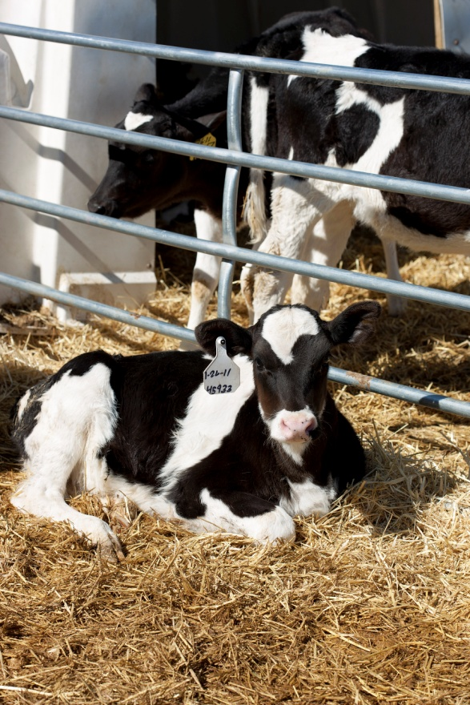
Age at first calving (AFC)
Heifers eat feed but produce no milk until calving
Earlier calving worth $2.50/day
Economic emphasis could be 3% of NM$
Removes some emphasis from HCR
Large database (23 million records) available for AFC
Heritability of 2.7%
PTA standard deviation only about 3 days
Genomic reliability of 66% for Holsteins
Photo: USDA, ARS Image Gallery, D2244-1 (Peggy Greb)

Slide 29
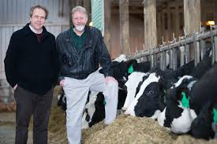
Feed intake data
Research herd | Cows | Records | Researchers
Univ. of Wisconsin & U.S. Dairy Forage Res. Ctr. | 1,390 | 1,678 | Weigel, Armentano
Iowa State Univ. | 953 | 1,006 | Spurlock
ARS, USDA (Beltsville, MD) | 534 | 834 | Connor
Univ. of Florida | 491 | 582 | Staples
Michigan State Univ. | 273 | 315 | VandeHaar, Tempelman
Purina Anim. Nutr. Ctr. (MO) | 151 | 184 | Davidson
Virginia Tech | 93 | 93 | Hanigan
Miner Agric. Res. Inst. (NY) | 58 | 58 | Dann
All | 3,965 | 4,823 | $5 million AFRI grant

Slide 30
Feed intake economic value
Statistic | Milk production (3.5% fat, 3.0% protein) | Body weight | Residual feed intake (RFI)
Lifetime income | $12,000 | $1,200 | …
Correlated feed cost | –$5,500 | –$1,900 | …
Net value | $6,500 | –$700 | …
Relative value (% of NM$) | 36% | –6% | –16%
NM$ has accounted for feed intake indirectly by subtracting feed costs correlated with yield since 1994 and BWC since 2000 (BWC is –6% of NM$)
RFI measures if cow ate more or less feed than expected from her yield and body weight (RFI independent of traits already included in NM$)

Slide 31
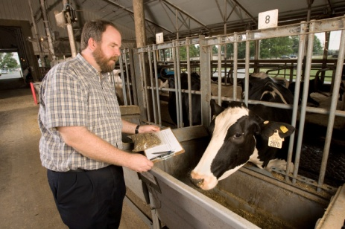
RFI reliability by animal group
Animal group | RFI REL (%)
 | Traditional |  | Genomic
3,965 cows with RFI phenotypes | 30 |  | 34
Top 10 sires with most RFI daughters | 78 |  | 85
Top 100 NM$ progeny-tested sires | 8 |  | 16
Top 100 NM$ young bulls | 3 |  | 12
Photo: USDA, ARS Image Gallery, D1526-1 (Peggy Kreb)

Slide 32
Feed intake summary
Producers and researchers have always wanted to measure and select for feed efficiency
RFI could get ∼16% of relative emphasis in NM$, but low reliability of ∼12% for young animals will limit progress
Higher reliability will require more research herds or international cooperation
Genomics can multiply feed intake information from a few herds to thousands of other herds

Slide 33
Heat tolerance
Genetic rankings may change if daughter climates differ
Bull A better than bull B in Wisconsin
Bull B better than bull A in Florida
Tested using 79 million lactations of 40 million U.S. cows
Differences in yield traits were significant, but small
Few differences found for SCS, longevity, and fertility
Predict foreign data slightly better (Canada is more like Wisconsin)
Little cost of evaluating heat tolerance for yield traits

Slide 34
Genetic trend for NM$

Slide 35
Conclusions
Genomic selection is very successful
For previously recorded traits with large databases
Gives accurate selection for new, less heritable traits
Selection index should avoid double-counting costs
Sick cows have lower yield, fertility, and productive life, and those traits already account for most of the expense
Treatment costs are smaller, and are included in NM$
Genetic gains are cumulative; progress is permanent

Slide 36
Acknowledgments & disclaimers
USDA-ARS project 8042-31000-002-00-D, “Improving Dairy Animals by Increasing Accuracy of Genomic Prediction, Evaluating New Traits, and Redefining Selection Goals” (AGIL funding)
CDCB and its industry suppliers for data
Agriculture and Food Research Initiative Competitive Grant #2011-68004-30340 from USDA National Institute of Food and Agriculture (feed intake funding)
USDA is an equal opportunity provider and employer
Mention of trade names or commercial products in this presentation is solely for the purpose of providing specific information and does not imply recommendation or endorsement by USDA

Slide 37
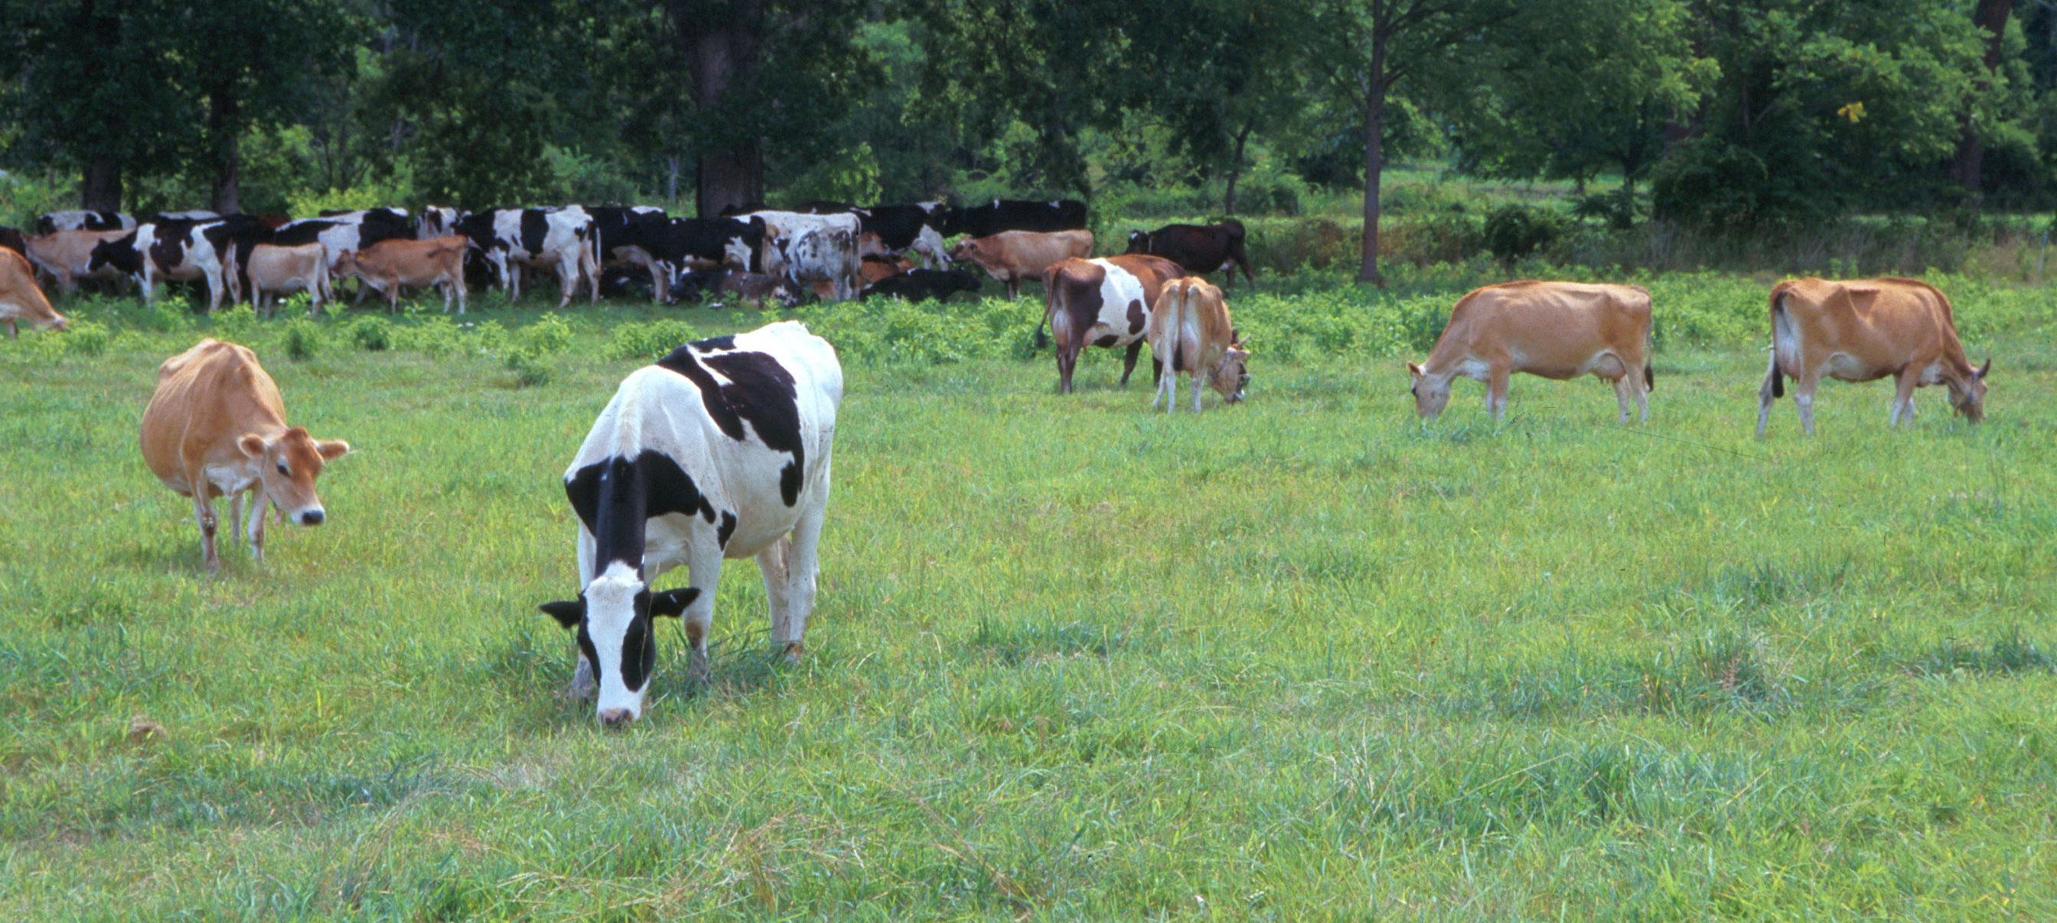
Questions?
AIP web site:
http://aipl.arsusda.gov
Holstein and Jersey crossbreds graze on American Farm Land Trust’s
Cove Mountain Farm in south-central Pennsylvania
Photo: USDA, ARS Image Gallery, K8587-14 (Bob Nichols)

