Slide 1
  Potential benefits from using a new reference map in genomic prediction
Dan Null*, Derek Bickhart, Paul VanRaden, John Cole, Jeff O’Connell, and Ben Rosen
USDA Animal Genomics and Improvement Lab,
Beltsville, MD 20705
Email: daniel.null@ars.usda.gov
Web site: https://aipl.arsusda.gov/

Slide 2
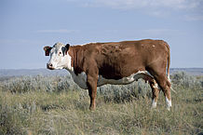
Topics
Importance and use of reference assemblies (maps)
Liftover strategies from one map to another
Compare previous UMD3 map to new ARS-UCD map
  Both maps assembled the genome using only Dominette DNA
  Inheritance and consistency of haplotypes across generations
  Imputation results from 5 breeds
  Alignment of Holstein sequence data to the Hereford maps
Plans to implement the ARS-UCD map

Slide 3
Reference maps
Why do researchers use the same map?
  Lets everyone track genetic differences using a common language
  Shows where genes are, and how the DNA encodes proteins (annotation)
Why switch to a new map?
  Many sections of the previous map were on wrong chromosome
  Improve imputation by large-scale rearrangements
  Improve annotation and alignment by small-scale refinements

Slide 4
Two assemblies: UMD3 and ARS-UCD
UMD3: Zimin et al. 2009 Genome Biology 10:R42
  University of Maryland and USDA-ARS research
  Used by most cattle genotyping and sequencing studies since 2009
  ‘Corrected’ version was used by AGIL after mis-mapped sections removed
ARS-UCD: Rosen et al. 2018 WCGALP, vol. Molecular Genetics 3, p. 802
  USDA-ARS, U. California-Davis, and several other researchers
  Used long reads to bridge across repeats, then short reads for polishing
  Annotation (gene structure) released by NCBI in May 2018

Slide 5
Liftover: Converting locations to a different map
Each chromosome may be longer or shorter than previous assembly
  Autosomes range from -4.3% shorter (chr12) to 0.6% longer (chr26)
  X chromosome 6.6% longer than UMD3, with more distinct PAR
Many insertions, deletions, inversions, translocations, SNPs vs. UMD3
  Official liftover tool developed by the UCSC Genome Browser (scaffolds)
  Or use probe from manifest or flanking sequence, align to new map
  Or simulate paired end reads from old map, align to new map (very fast)
  Or use partial matches within a single chromosome

Slide 6
PAR-X comparison
X
PAR
UMD3
X
ARS-UCD
PAR
Notes:
142 SNP changed chromosome (.24%)

Slide 7
Liftover of SNP locations
Probes used for genotyping SNPs on arrays
  A 50-base sequence extended to the right or left of SNP, such as
  [C/T]AGTCAGCTCTGTGGCCTGGGCAGGTTCCCAGGATATTCCAGCCAGAC
  Where was this located on the old map?
  Where is this located on the new map?
Difficulties
  Could have multiple locations in map or other SNPs within the probe
  Some read errors, or maternal vs. paternal chromosome of Dominette

Slide 8
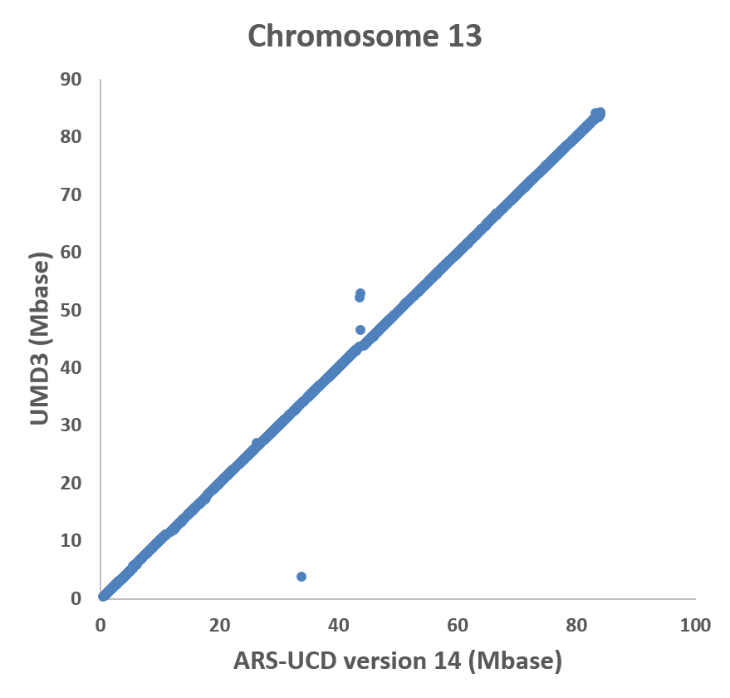
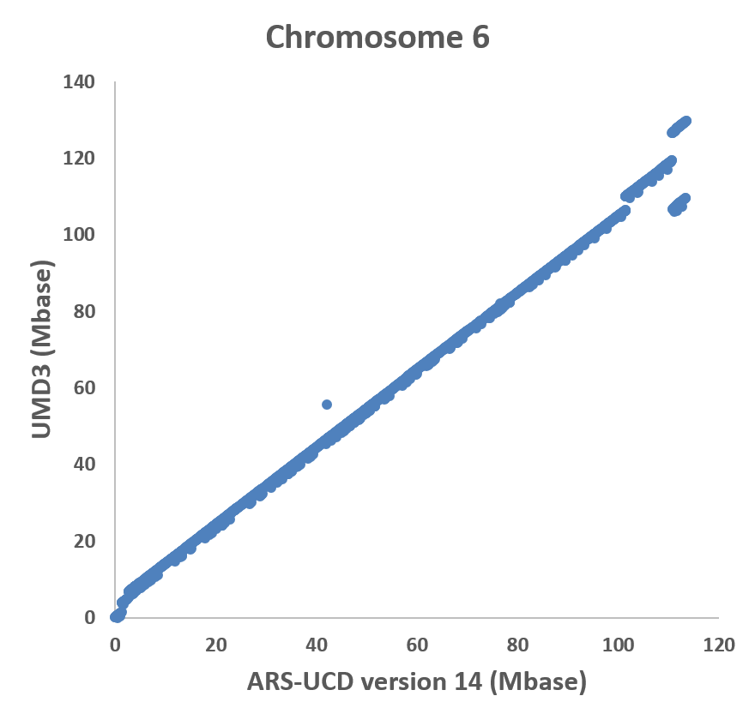
Best and worst chromosome matches
Notes:
Chrome 13 143 kb average change
Chrome 6 5 mb average change

Slide 9
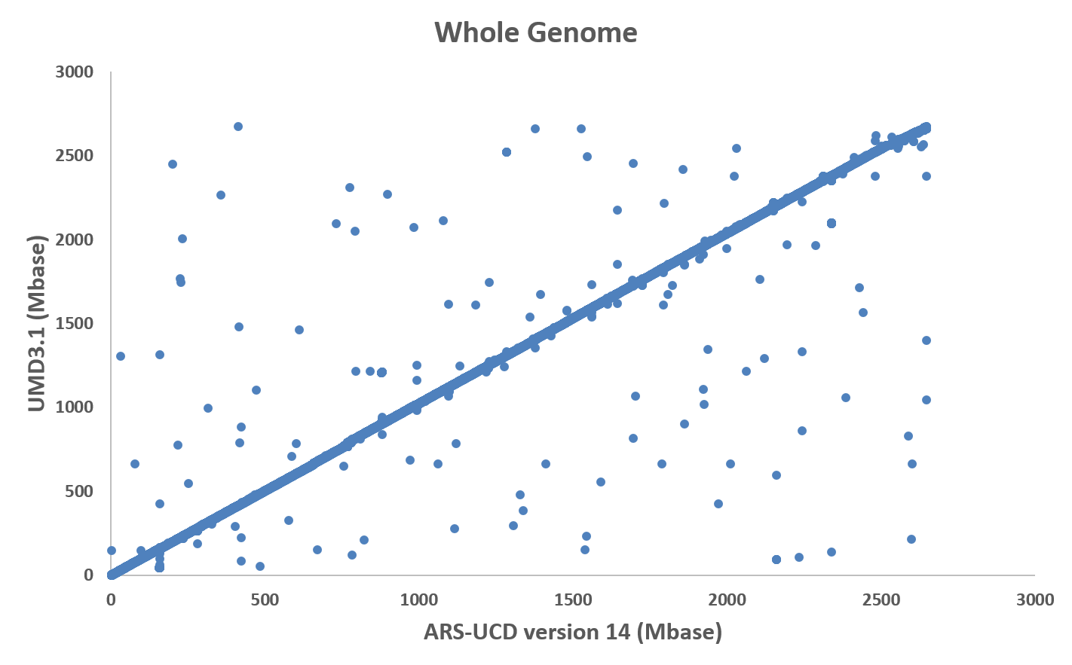
SNPs now located on different chromosomes
Notes:
142 SNP changed chromosome (.24%)

Slide 10
Imputation tests
Locations for the 60,367 usable SNPs were converted to ARS-UCD1
Genotypes were imputed to 60K from 30 chips of differing density
Genotypes from 5 breeds were imputed separately:
  1,748,453 Holsteins (HO)
  215,800 Jerseys (JE)
  32,724 Brown Swiss (BS)
  4,834 Ayrshires (AY)
  3,517 Guernseys (GU)

Slide 11
Imputation results – 1: Inheritance rate
Haplotypes with parent-progeny noninheritance (%)
Breed | UMD3 | ARS-UCD
HO | 3.7 | 3.1
JE | 4.4 | 3.9
BS | 1.4 | 1.2
AY | 2.5 | 1.5
GU | 1.5 | 1.4
Inherited haplotypes containing 1 mistake (%)
Breed | UMD3 | ARS-UCD
HO | 4.9 | 3.7
JE | 4.3 | 3.6
BS | 2.9 | 2.8
AY | 3.5 | 2.8
GU | 3.0 | 2.7

Slide 12
Imputation results – 2: Other properties
Average numbers of distinct haplotypes per segment decreased 5% for HO and from 1 to 30% for other breeds.
Many previous problem areas no longer have excess numbers of haplotypes, particularly on the X chromosome and the pseudoautosomal region of X.
Truly lethal haplotypes were more cleanly separated from false candidate haplotypes.
Only a few segments such as on the left end of chromosome 8 had poorer properties for all breeds.
Notes:
30% in AY

Slide 13
Alignment test
To test alignment of sequence data, paired-end reads from a HO bull were aligned to both maps
2.3% more paired reads aligned in the correct orientation within 5,000 base pairs

Slide 14
Steps needed for implementation
Provide the new SNP locations to national and international cooperators to promote adopting the ARS-UCD map
Choose new list of usable SNPs, increase from 60K to 80K
  Detected a few SNPs with different names, locations actually were same
Impute genotypes for all breeds and crossbreds
Check published haplotypes to ensure proper inheritance
Obtain prior allele effect estimates for all breeds, traits, and BBR
Implement during a full release, possibly December 2018

Slide 15
Conclusions
The ARS-UCD map fixes many defects in the UMD3 map
Mis-mapped regions of UMD3 are now usable on ARS-UCD
The new map has several better properties than previous:
  Marker locations, genotype imputation, haplotype inheritance, sequence alignment, and gene annotation
U.S. genomic evaluations may soon use the ARS-UCD map
Many other researchers should also switch to the new map

Slide 16
Acknowledgments
USDA-ARS project 1265-31000-101-00, “Improving Genetic Predictions in Dairy Animals Using Phenotypic and Genomic Information” (AGIL funding)
Council on Dairy Cattle Breeding (CDCB) and its industry suppliers for data

