Slide 1
Genomic predictability of single-step GBLUP for production traits in US Holstein
Y. Masuda¹, P. M. VanRaden², H. L. Bradford², A. Legarra³, I. Misztal¹, and T. J. Lawlor⁴
1 University of Georgia, USA; 2 AGIL, USDA, USA; 3 INRA, France; 4 Holstein Association USA, Inc., USA ADSA 2018, June 24-27, Knoxville, TN

Slide 2
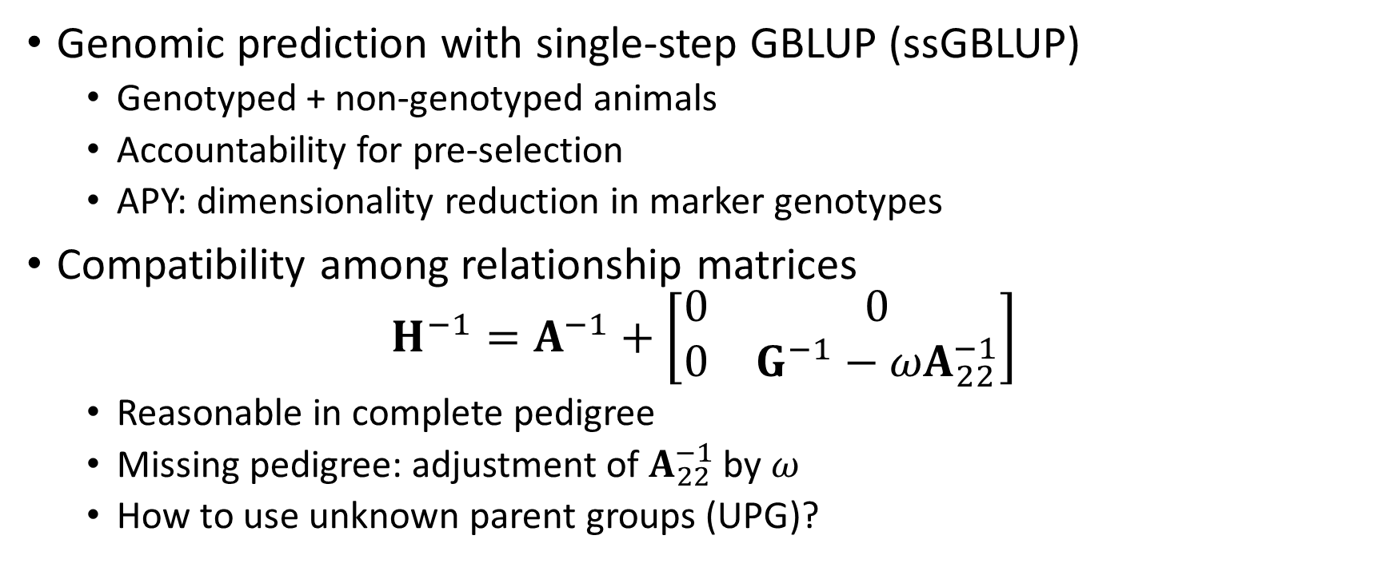
Background
Genomic prediction with single-step GBLUP (ssGBLUP)
Genotyped + non-genotyped animals
Accountability for pre-selection
APY: dimensionality reduction in marker genotypes
Compatibility among relationship matrices
$$H^{−1}=A^{−1}+\left[\begin{matrix}0 & 0 \\ 0 & G^{−1}−{ωA}_{22}^{−1}\end{matrix}\right]$$
Reasonable in complete pedigree
Missing pedigree: adjustment of $A_{22}^{−1}$ by $ω$
How to use unknown parent groups (UPG)?

Slide 3
Objectives
To validate genomic predictions for young bulls by different UPG configurations in US Holstein
To discuss possible models to handle UPG in ssGBLUP: a simulation study

Slide 4
Full data
 | Description | Number of records/animals
Phenotype | Milk, fat, and protein yield (305-d basis) for US Holstein cows recorded between Jan. 1990 and Apr. 2015 | 37,259,427
 | Cows with phenotype(s) | 15,891,366
Pedigree | Animals born in Apr. 2015 or earlier (3-gen. back from phenotyped cows) 185 UPGs | 22,963,255
Genotype | Animals born in Apr. 2015 or earlier (60,671 markers) | 764,029

Slide 5
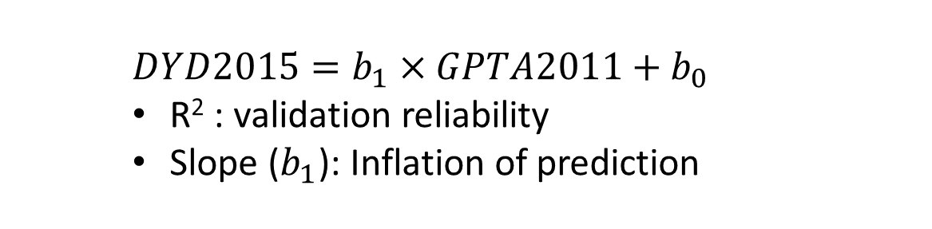
Validation study
2011 Dec.
2015 Apr.
Full
1990
2000
Validation Bulls: Genotyped young bulls with no tested daughters in 2011 but with at least 50 tested daughters in 2015 (N=3,797)
For Daughter Yield Deviation (DYD2015)
Phenotype
Pedigree
2011 Dec.
2015 Apr.
Trunc2011
1990
2000
For GPTA using ssGBLUP (GPTA2011)
Phenotype
Genotype
Pedigree
$DYD2015=b_{1}×GPTA2011+b_{0}$
R² : validation reliability
Slope ($b_{1}$): Inflation of prediction

Slide 6

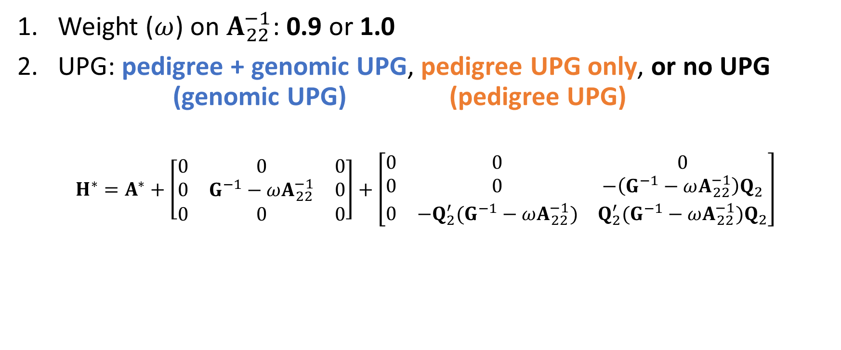
Different UPG in $H^{−1}$
Weight ($ω$) on $A_{22}^{−1}$: 0.9 or 1.0
UPG: pedigree + genomic UPG, pedigree UPG only, or no UPG (genomic UPG) (pedigree UPG)
$$H^{∗}=A^{∗}+\left[\begin{matrix}0 & 0 & 0 \\ 0 & G^{−1}−ωA_{22}^{−1} & 0 \\ 0 & 0 & 0\end{matrix}\right]+\left[\begin{matrix}0 & 0 & 0 \\ 0 & 0 & −\left(G^{−1}−ωA_{22}^{−1}\right)Q_{2} \\ 0 & −Q_{2}^{′}(G^{−1}−ωA_{22}^{−1}) & Q_{2}^{′}(G^{−1}−ωA_{22}^{−1})Q_{2}\end{matrix}\right]$$

Slide 7
DYD2015 vs GPTA2011 (Protein)
Data |  |  |  | R2 | b1
Official GPTA 2011 |  |  |  | 0.51 | 0.81
Data | UPG | ω=0.9 R2 | b1 | ω=1.0 R2 | b1
GPTA2011 | Genomic UPG | 0.39 | 0.74 | 0.32 | 0.51
 | different inb. | 0.39 | 0.75 | 0.34 | 0.51
 | different UPG |  |  | 0.32 | 0.50
 | Pedigree UPG | 0.50 | 0.96 | 0.52 | 0.78
 | No UPGs |  |  | 0.50 | 0.78

Slide 8
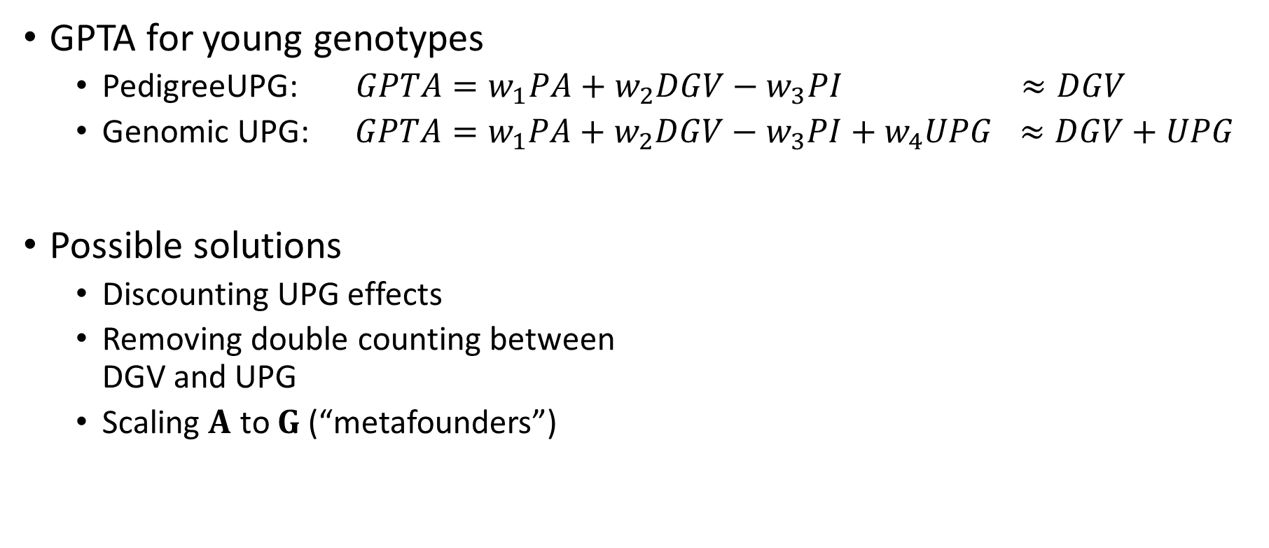
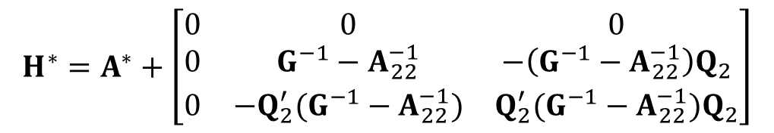
Low accuracy with exact UPG
GPTA for young genotypes
PedigreeUPG: $GPTA=w_{1}PA+w_{2}DGV−w_{3}PI$ $≈DGV$
Genomic UPG: $GPTA=w_{1}PA+w_{2}DGV−w_{3}PI+w_{4}UPG$ $≈DGV+UPG$
Possible solutions
Discounting UPG effects
Removing double counting between DGV and UPG
Scaling $A$ to $G$(“metafounders”)
Larger weights with many genotypes
Too large for young animals
$$H^{∗}=A^{∗}+\left[\begin{matrix}0 & 0 & 0 \\ 0 & G^{−1}−A_{22}^{−1} & −\left(G^{−1}−A_{22}^{−1}\right)Q_{2} \\ 0 & −Q_{2}^{′}(G^{−1}−A_{22}^{−1}) & Q_{2}^{′}(G^{−1}−A_{22}^{−1})Q_{2}\end{matrix}\right]$$

Slide 9
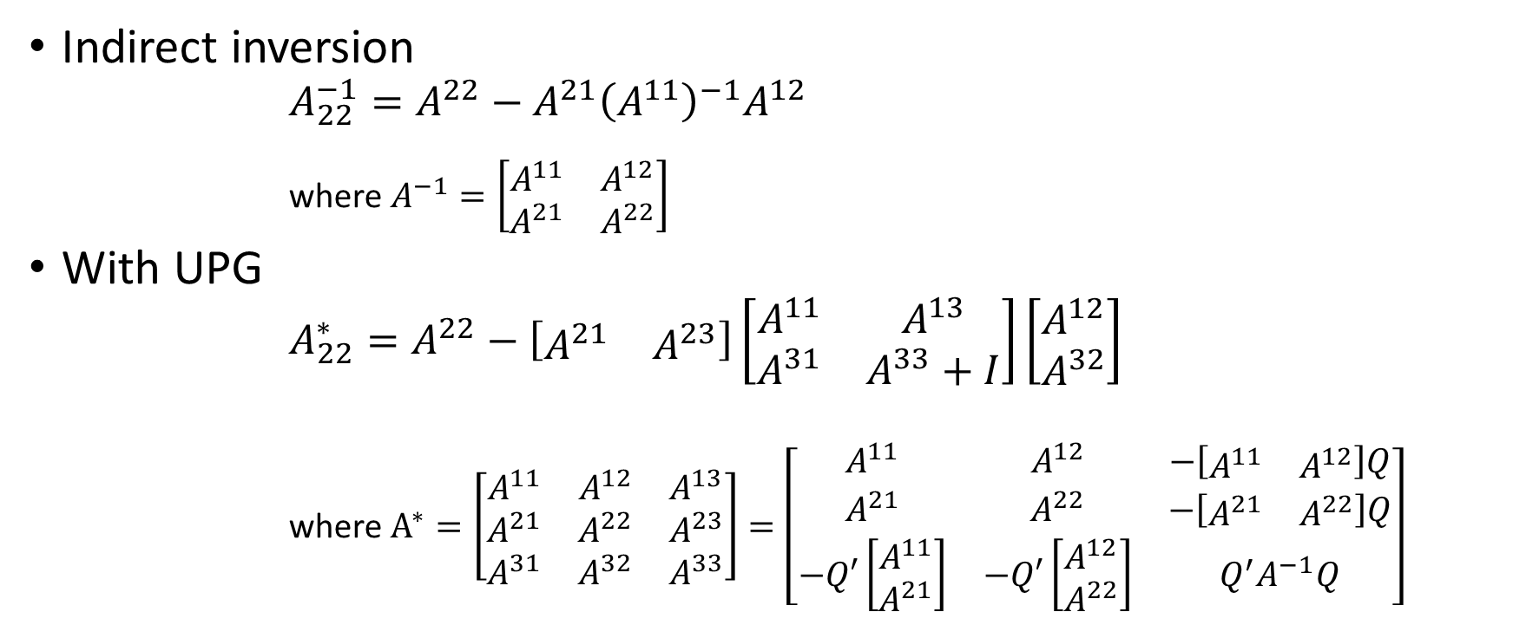

Modified $A_{22}^{−1}$ with UPG
Indirect inversion
$A_{22}^{−1}=A^{22}−A^{21}{\left(A^{11}\right)}^{−1}A^{12}$ where $A^{−1}=\left[\begin{matrix}A^{11} & A^{12} \\ A^{21} & A^{22}\end{matrix}\right]$
With UPG
$A_{22}^{∗}=A^{22}−\left[\begin{matrix}A^{21} & A^{23}\end{matrix}\right]\left[\begin{matrix}A^{11} & A^{13} \\ A^{31} & A^{33}+I\end{matrix}\right]\left[\begin{matrix}A^{12} \\ A^{32}\end{matrix}\right]$ where $A^{∗}=\left[\begin{matrix}A^{11} & A^{12} & A^{13} \\ A^{21} & A^{22} & A^{23} \\ A^{31} & A^{32} & A^{33}\end{matrix}\right]=\left[\begin{matrix}A^{11} & A^{12} & −\left[\begin{matrix}A^{11} & A^{12}\end{matrix}\right]Q \\ A^{21} & A^{22} & −\left[\begin{matrix}A^{21} & A^{22}\end{matrix}\right]Q \\ −Q′\left[\begin{matrix}A^{11} \\ A^{21}\end{matrix}\right] & −Q′\left[\begin{matrix}A^{12} \\ A^{22}\end{matrix}\right] & Q^{′}A^{−1}Q\end{matrix}\right]$

Slide 10
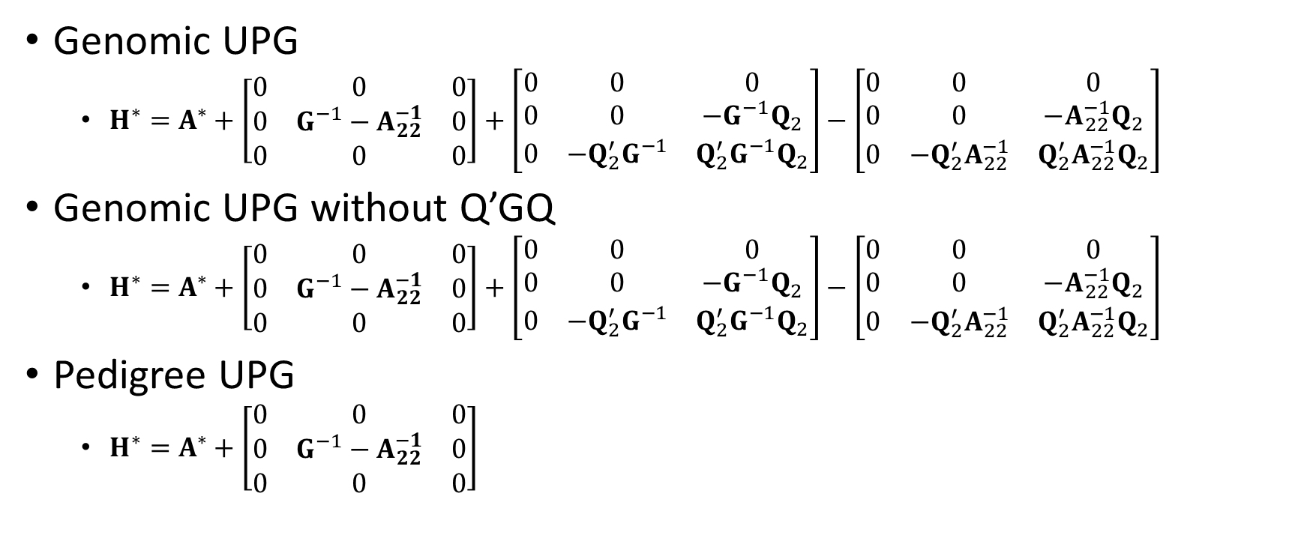
Missing parents in ssGBLUP
Genomic UPG
$H^{∗}=A^{∗}+\left[\begin{matrix}0 & 0 & 0 \\ 0 & G^{−1}−A_{22}^{−1} & 0 \\ 0 & 0 & 0\end{matrix}\right]+\left[\begin{matrix}0 & 0 & 0 \\ 0 & 0 & −G^{−1}Q_{2} \\ 0 & −Q_{2}^{′}G^{−1} & Q_{2}^{′}G^{−1}Q_{2}\end{matrix}\right]−\left[\begin{matrix}0 & 0 & 0 \\ 0 & 0 & −A_{22}^{−1}Q_{2} \\ 0 & −Q_{2}^{′}A_{22}^{−1} & Q_{2}^{′}A_{22}^{−1}Q_{2}\end{matrix}\right]$
Genomic UPG without Q’GQ
$H^{∗}=A^{∗}+\left[\begin{matrix}0 & 0 & 0 \\ 0 & G^{−1}−A_{22}^{−1} & 0 \\ 0 & 0 & 0\end{matrix}\right]+\left[\begin{matrix}0 & 0 & 0 \\ 0 & 0 & −G^{−1}Q_{2} \\ 0 & −Q_{2}^{′}G^{−1} & Q_{2}^{′}G^{−1}Q_{2}\end{matrix}\right]−\left[\begin{matrix}0 & 0 & 0 \\ 0 & 0 & −A_{22}^{−1}Q_{2} \\ 0 & −Q_{2}^{′}A_{22}^{−1} & Q_{2}^{′}A_{22}^{−1}Q_{2}\end{matrix}\right]$
Pedigree UPG
$H^{∗}=A^{∗}+\left[\begin{matrix}0 & 0 & 0 \\ 0 & G^{−1}−A_{22}^{−1} & 0 \\ 0 & 0 & 0\end{matrix}\right]$

Slide 11
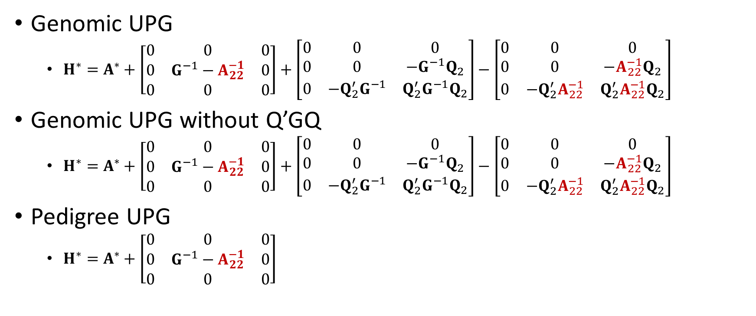

With $A_{22}^{∗}$
Genomic UPG
$H^{∗}=A^{∗}+\left[\begin{matrix}0 & 0 & 0 \\ 0 & G^{−1}−A_{22}^{−1} & 0 \\ 0 & 0 & 0\end{matrix}\right]+\left[\begin{matrix}0 & 0 & 0 \\ 0 & 0 & −G^{−1}Q_{2} \\ 0 & −Q_{2}^{′}G^{−1} & Q_{2}^{′}G^{−1}Q_{2}\end{matrix}\right]−\left[\begin{matrix}0 & 0 & 0 \\ 0 & 0 & −A_{22}^{−1}Q_{2} \\ 0 & −Q_{2}^{′}A_{22}^{−1} & Q_{2}^{′}A_{22}^{−1}Q_{2}\end{matrix}\right]$
Genomic UPG without Q’GQ
$H^{∗}=A^{∗}+\left[\begin{matrix}0 & 0 & 0 \\ 0 & G^{−1}−A_{22}^{−1} & 0 \\ 0 & 0 & 0\end{matrix}\right]+\left[\begin{matrix}0 & 0 & 0 \\ 0 & 0 & −G^{−1}Q_{2} \\ 0 & −Q_{2}^{′}G^{−1} & Q_{2}^{′}G^{−1}Q_{2}\end{matrix}\right]−\left[\begin{matrix}0 & 0 & 0 \\ 0 & 0 & −A_{22}^{−1}Q_{2} \\ 0 & −Q_{2}^{′}A_{22}^{−1} & Q_{2}^{′}A_{22}^{−1}Q_{2}\end{matrix}\right]$
Pedigree UPG
$H^{∗}=A^{∗}+\left[\begin{matrix}0 & 0 & 0 \\ 0 & G^{−1}−A_{22}^{−1} & 0 \\ 0 & 0 & 0\end{matrix}\right]$

Slide 12
Simulation study
Structure
h² = 0.3
Sex-limited trait (n = 90,000)
EBV selection
10 generations (n = 164,500)
Ne: 200 theoretical; 25 realized
Mean F in last generation: 0.11
Genotypes
18,674 total
5108 in gen. 10 for validation
Assignment of UPGs
UPG1 for generation 0-4
UPG2 for generation 5-7
UPG3 for generation 8-10
Category | Non genotyped | Genotyped
Top bulls | 0 | 0
Top cows | 5% (dam) | 0
Bottom bulls | 30% (dam) | 10% (dam)
Bottom cows | 30% (dam) | 10% (dam)

Slide 13
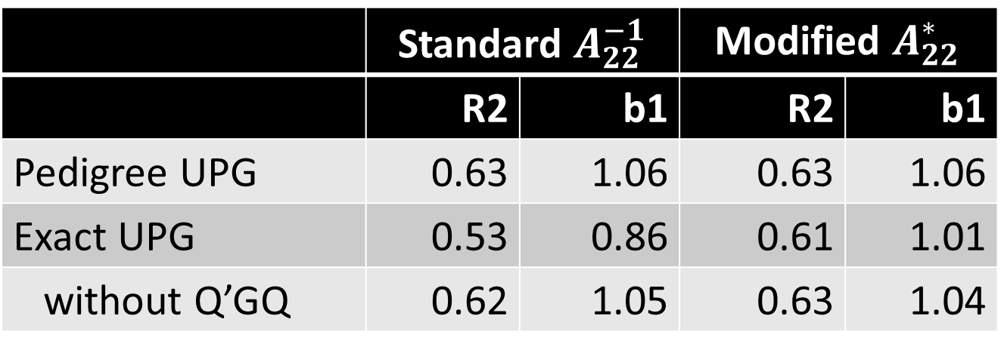
Results from simulation
 | Standard $A_{22}^{−1}$ |  | Modified $A_{22}^{∗}$
 | R2 | b1 | R2 | b1
Pedigree UPG | 0.63 | 1.06 | 0.63 | 1.06
Exact UPG | 0.53 | 0.86 | 0.61 | 1.01
without Q’GQ | 0.62 | 1.05 | 0.63 | 1.04
 | R2 | b1
Metafounders | 0.63 | 1.08
* Genotyped young animals without records

Slide 14
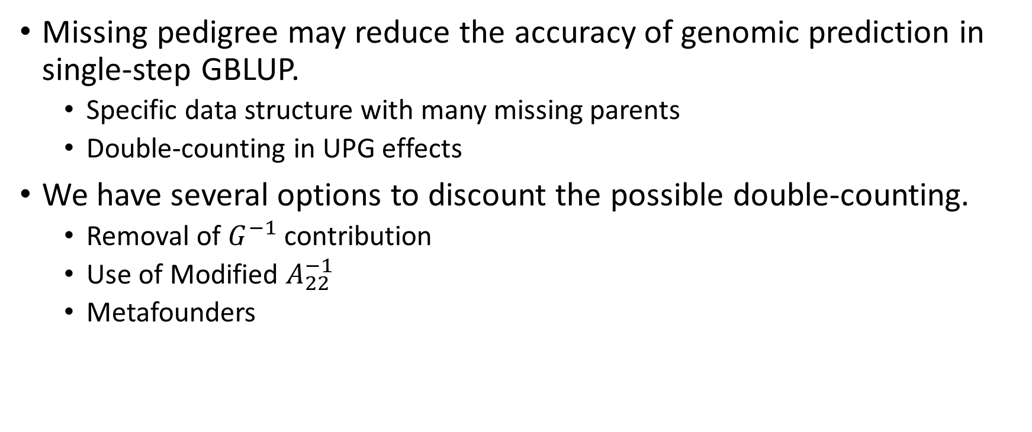
Summary
Missing pedigree may reduce the accuracy of genomic prediction in single-step GBLUP.
Specific data structure with many missing parents
Double-counting in UPG effects
We have several options to discount the possible double-counting.
Removal of $G^{−1}$ contribution
Use of Modified $A_{22}^{−1}$
Metafounders

Slide 15
Acknowledgement
USDA NIFA (2015-67015-22936) and Holstein Association USA for financial support.
Council of Dairy Cattle Breeding for phenotype, genotype, and pedigree data.
John Cole and Melvin Tooker (USDA-AGIL) for preparing the initial data sets and a computing environment.

