Slide 1
Genetic trends from single-step GBLUP and traditional BLUP for production traits in US Holstein
Y. Masuda¹, I. Misztal¹, P. M. VanRaden², and T. J. Lawlor³
1 University of Georgia, USA
2 AGIL, USDA, USA
3 Holstein Association USA, Inc., USA
ADSA 2017 Annual Meeting, June 25-28, Pittsburgh, PA

Slide 2
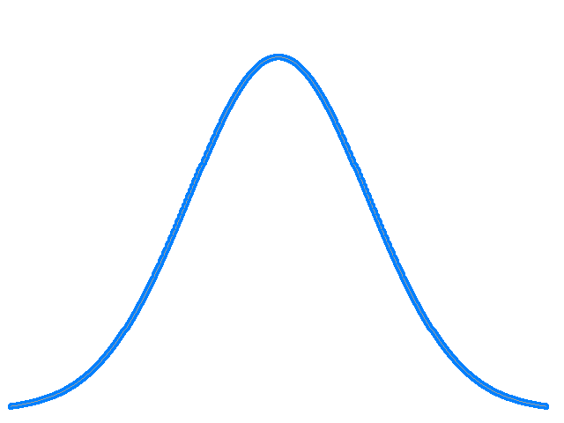
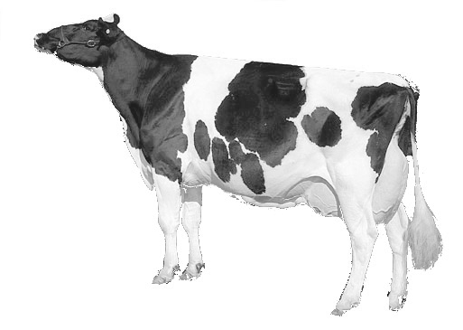
Bias in the traditional PTA
The traditional PTA is still used in multi-step genomic prediction.
PTA may be biased down due to genomic “pre-selection”.
  Mixed model theory: biased if MME lacks information used in selection.
All young animals
Genotyped animals
Pedigree
Animal
model
BLUP
Genomics
Genom.
Pred.
Pre-selected
Genomic
Value
Phenotype
Trad. PTA
Mendelian Sampling
Underestimated
Underestimated

Slide 3
Bias in the traditional PTA
The traditional PTA is still used in multi-step genomic prediction.
PTA may be biased down due to genomic “pre-selection”.
  Mixed model theory: biased if MME has no information used in selection.
All young animals
All animals
Genomics
Single-
step
GBLUP
Pedigree
Pre-selected
Phenotype
GPTA
Mendelian Sampling

Slide 4
Genetic trend
Single-step GBLUP (ssGBLUP) may account for the pre-selection.
  Hypothetical genetic trend:
Comparisons
  Single-step GBLUP GPTA vs the traditional PTA (Data up to 2015)
  Multi-step official GPTA vs the corresponding PTA (Published in 2016)
(G)PTA
ssGBLUP (GPTA)
Traditional BLUP (PTA)
Year

Slide 5
Data
Data | Description | Number of records
Phenotypes | Milk, fat, and protein yield from US Holsteins; from 1990 to 2015 | 50,970,954
Pedigree | 3 generations back from phenotyped cows or genotyped animals; 215 UPGs | 29,651,623
Genotypes | Both male and female; including young bulls and heifers (#SNPs = 60671) | 764,029

Slide 6
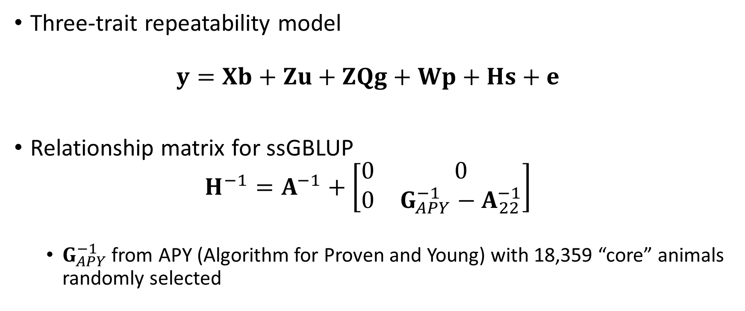
Model
Three-trait repeatability model
$y=Xb+Zu+ZQg+Wp+Hs+e$
Relationship matrix for ssGBLUP
$H^{−1}=A^{−1}+\left[\begin{matrix}0 & 0 \\ 0 & G_{APY}^{−1}−A_{22}^{−1}\end{matrix}\right]$
  $G_{APY}^{−1}$ from APY (Algorithm for Proven and Young) with 18,359 “core” animals randomly selected

Slide 7
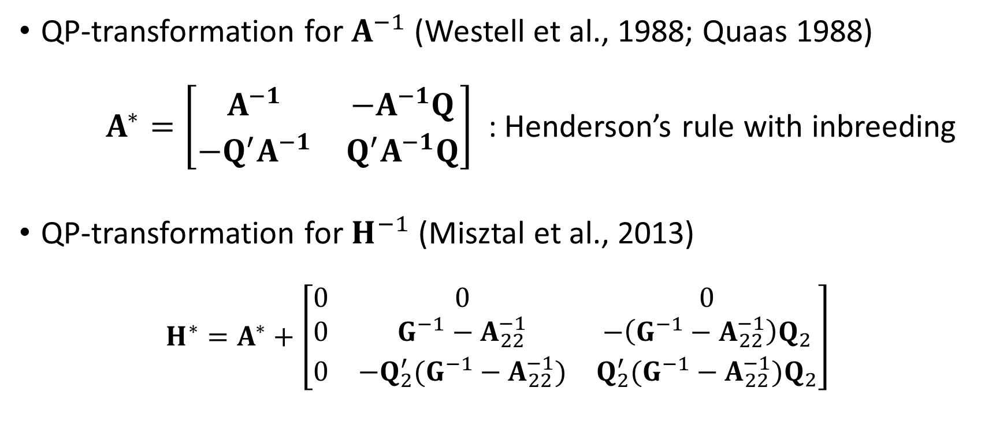
Inbreeding and UPGs
QP-transformation for $A^{−1}$ (Westell et al., 1988; Quaas 1988)
$A^{∗}=\left[\begin{matrix}A^{−1} & −A^{−1}Q \\ −Q^{′}A^{−1} & Q^{′}A^{−1}Q\end{matrix}\right]$ : Henderson’s rule with inbreeding
QP-transformation for $H^{−1}$ (Misztal et al., 2013)
$H^{∗}=A^{∗}+\left[\begin{matrix}0 & 0 & 0 \\ 0 & G^{−1}−A_{22}^{−1} & −\left(G^{−1}−A_{22}^{−1}\right)Q_{2} \\ 0 & −Q_{2}^{′}(G^{−1}−A_{22}^{−1}) & Q_{2}^{′}(G^{−1}−A_{22}^{−1})Q_{2}\end{matrix}\right]$

Slide 8
Cows : ssGBLUP vs traditional PTA (protein)
ssGBLUP
BLUP
10
Genotyped cows
5
PTA (kg)
0
All cows
-5
2000
2002
2004
2006
2008
2010
2012
Year of Birth
*Cows with record(s)

Slide 9
Cows : ssGBLUP vs traditional PTA (protein)
1.1 kg/yr
ssGBLUP
BLUP
0.4 kg/yr
10
Genotyped cows
1.2 kg/yr
5
PTA (kg)
0
All cows
-5
2000
2002
2004
2006
2008
2010
2012
Year of Birth
*Cows with record(s)

Slide 10
Cows : ssGBLUP vs traditional PTA (protein)
ssGBLUP
BLUP
Genotyped cows
80000
10
60000
5
PTA (kg)
Number of genotyped cows with record(s)
40000
0
All cows
20000
-5
0
2000
2002
2004
2006
2008
2010
2012
*Cows with record(s)
Year of Birth

Slide 11
Cows : ssGBLUP vs traditional PTA (protein)
ssGBLUP
BLUP
Genotyped cows
80000
10
60000
5
PTA (kg)
Number of genotyped cows with record(s)
Selective genotyping for high-producing cows
Genomic
pre-selection
40000
0
20000
-5
0
2000
2002
2004
2006
2008
2010
2012
*Cows with record(s)
Year of Birth

Slide 12
Cows: ssGBLUP vs traditional PTA
Milk
Fat
Protein
400
ssGBLUP
15
ssGBLUP
ssGBLUP
300
BLUP
BLUP
10
BLUP
Genotyped
cows
200
10
Genotyped
cows
Genotyped
cows
5
100
PTA (kg)
PTA (kg)
PTA (kg)
5
0
All cows
0
All cows
All cows
0
-100
-200
-5
-5
2000
2004
2008
2012
2000
2004
2008
2012
2000
2004
2008
2012
Year of Birth
Year of Birth
Year of Birth
*Cows with record(s)

Slide 13
Bulls: ssGBLUP vs traditional PTA (protein)
ssGBLUP
BLUP
14
12
PTA (kg)
10
8
6
2000
2002
2004
2006
2008
2010
Year of Birth
*Genotyped bulls with at least 10 daughters with record(s)

Slide 14
Bulls: ssGBLUP vs traditional PTA
400
Milk
18
Fat
Protein
ssGBLUP
ssGBLUP
14
ssGBLUP
BLUP
16
BLUP
BLUP
350
14
12
300
12
PTA (kg)
PTA (kg)
PTA (kg)
10
250
10
8
8
200
6
6
150
2000
2004
2008
2000
2004
2008
2000
2004
2008
Year of Birth
Year of Birth
Year of Birth
*Genotyped bulls with at least 10 daughters with record(s)

Slide 15
Cows: Official (G)PTA
Milk
20
Fat
Protein
300
msGBLUP
15
msGBLUP
10
msGBLUP
Trad-BLUP
Trad-BLUP
Trad-BLUP
200
10
100
5
PTA (kg)
PTA (kg)
PTA (kg)
5
0
0
0
-100
-5
-200
-5
2000
2004
2008
2012
2016
2000
2004
2008
2012
2016
2000
2004
2008
2012
2016
Year of Birth
Year of Birth
Year of Birth
*Cows with record(s)

Slide 16
Bulls: Official (G)PTA
Milk
15
Fat
Protein
10
200
msGBLUP
msGBLUP
msGBLUP
Trad-BLUP
Trad-BLUP
Trad-BLUP
10
8
100
6
PTA (kg)
PTA (kg)
5
PTA (kg)
4
0
2
0
0
-100
-5
-2
2000
2004
2008
2012
2000
2004
2008
2012
2000
2004
2008
2012
Year of Birth
Year of Birth
Year of Birth
*Genotyped bulls with at least 10 daughters with record(s)

Slide 17
Annual genetic gain (kg)
Animal | Year of Birth | Evaluation | Milk | Fat | Protein
Bulls | 2008 – 2010 | Single-step GPTA | 32 | 1.2 | 1.7
 |  | Traditional PTA | 19 | 0.5 | 1.3
 |  | Official GPTA 2016 | 23 | 1.1 | 1.4
 |  | PTA used for official GPTA | 23 | 0.9 | 1.4
Cows | 2009 – 2012 | Single-step GPTA | 29 | 1.0 | 1.1
 |  | Traditional PTA | 7 | 0.2 | 0.4
 |  | Official GPTA 2016 | 23 | 1.0 | 1.0
 |  | PTA used for official GPTA | 24 | 0.9 | 1.0

Slide 18
Adjustments on the official PTA
Milk
Official PTA adjusted by Wiggans et al. (2012)
  Cow trend aligned to bull trend
  (Reduction in bias for cows)
  Same trend for PTA and GPTA
Additional adjustments and data in the official evaluation
  Multi-breed
  Inbreeding adjustments
  All available historical data
  Foreign data
Unadjusted
PTA
16kg/yr
24kg/yr
= same to GPTA
Adjusted
(official) PTA

Slide 19
Summary
The traditional PTA for genotyped bulls and cows are likely underestimated.
Single-step GBLUP seems to at least partially account for the pre-selection bias.
The official PTA has a consistent genetic trend with the official GPTA because of adjustments.
Single-step GBLUP may not require the adjustments to give a reasonable genetic trend.

Slide 20
Acknowledgement
USDA NIFA (2015-67015-22936) and Holstein Association USA for financial support.
Council of Dairy Cattle Breeding for phenotype, genotype, and pedigree data.
John Cole and Melvin Tooker (USDA-AGIL) for preparing the initial data sets and a computing environment.

