Slide 1
Computation of Large-Scale Genomic Evaluations

Slide 2


Genomic prediction
Main idea: improve future traits by selection
Look at animal’s own measurable traits (used for hundreds or thousands of years)
Use pedigrees and phenotypes to compute estimates of genetic merit (done officially by USDA 1937-2008)
New idea: Why not look directly at the DNA?

Slide 3
USDA evaluation history
Year | Breeding program | Data sources added
< 1937 | Mass selection | Own phenotype
1937-1962 | Means of relatives | Daughters, dams
1962-1989 | Sire models | Herd-year-season
1989-present | Animal models | Full pedigrees
1995-present | MACE models | Foreign daughters
2009-present | Genomic models | Marker genotypes
2013-future | Biologic models | Causal mutations

Slide 4
New evaluation programs: Dec 2014
Replaced animal model programs used since 1989. New options include:
Multi-trait models, multiple class and regress variables, factors and weights differ by trait, random regressions, include foreign data, parallel processing
Developed for transition to single-step model (genotypes, phenotypes, pedigree)
Approx. G⁻¹ for >1 million genotypes?
Notes:
Renumber factors in same program

Slide 5
Current computation: multi-step
Steps | Time (hours) | Proc-essors | Memory (Gbytes)
Extract data and pedigree | 10 | 7 | 1
Inbreeding and heterosis | 8 | 2 | 5
Traditional EBVs, 8 traits | 24 | 8 | 40
Imputation (using priors) | 48 | 20 | 75
Genomic EBVs, 27 traits | 10 | 27 | 54
Compare G to A matrix | 6 | 20 | 75
Distribute final results | 5 | 1 | 1
Total | 111
Weekly (new animals only) | 1.4 | 10 | 50

Slide 6
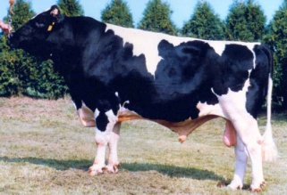
Growth of markers and animals
Year | Markers | Animals | Research partners
1991-2004 | 367 | 1,415 | USDA, Illinois, Israel (DNA from USA, CAN)
2007-2009 | 38,416 | 16,646 | USDA, Missouri, Canada, Illumina
2011-2013 | 636,967 | 161,341 | Added Italy, United Kingdom, high density
2012-2015 | 61,013 | 1,000,000 | Added Interbull (BSW) and Denmark (JER)
2015-future | 39,700,000 | 1,577 | Worldwide exchange in Australia

Slide 7
Early genomic theory
Nejati-Javaremi et al (1997) tested use of genomic relationship matrix in BLUP
Meuwissen et al (2001) tested linear and nonlinear estimation of haplotype effects
Both studies assumed that few (<1,000) markers could explain all genetic variance (no polygenic effects in model)
Polygenic variance was only 5% with 50,000 SNP (VanRaden, 2008), but 50% with 1,000

Slide 8
Multi-step genomic evaluations
Traditional evaluations (phenotype and pedigree) are used as input data to genomic equations
Allele effects estimated for 60,671 markers (Z) by multiple regression, using BayesA prior variance
Polygenic effect for 10% of genetic variation not captured by markers, assuming pedigree covariance
Selection index step combines genomic info with traditional info from non-genotyped parents
Applied to 33 yield, fitness, calving and type traits

Slide 9
Linear Estimates using Markers
Selection index equations for EBV
u^ = Cov(u,y) Var(y)⁻¹ (y – Xb)
u^ = Z Z’ [Z Z’ + R]⁻¹ (y – Xb)
R has diagonals = (1 / Reliability) - 1
BLUP equations for marker effects, sum to get EBV
u^ = Z [Z’R⁻¹Z + I k]⁻¹ Z’R⁻¹(y – Xb)
k = var(u) / var(m)

Slide 10
Non-linear vs Linear Models

Slide 11
Single-step genomic evaluation
Benefits of 1-step genomic evaluation
Account for genomic pre-selection
Expected Mendelian Sampling ≠ 0
Improve accuracy and reduce bias
Include many genotyped animals
Redesign animal model software used since 1989

Slide 12
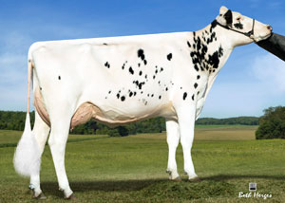
Animal model adjusts for
PTA rather than GPTA of mates
Top bulls mated only to top genomic females
PTA rather than GPTA of herdmates
Can underestimate recent genetic trend
PTA rather than GPTA of parents and progeny
Dams credited only for highly selected sons
Top heifers not milked, used as ET donors

Slide 13
Single-step GBLUP
Legarra-Ducrocq (2012) algorithm applied to USA Jersey yield traits by VanRaden (2012)
OK for JE, but did not converge for HO
Misztal et al (2014) algorithm applied to USA Jersey yield traits by Yutaka Masuda in 2015
Very similar results for JE, now can also process HO using approximate G⁻¹
Expect good CPU time, but more memory

Slide 14
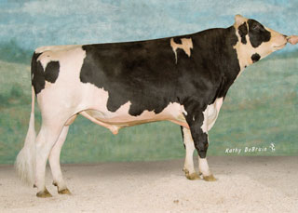
Pedigree: Parents, Grandparents, etc.
 |  | Manfred
 | O-Man
 |  | Jezebel
O-Style
 |  | Teamster
 | Deva
 |  | Dima
Notes:
We are all familiar with a traditional pedigree chart. Animal is expected to be an average of his parents.

Slide 15
O-Style Haplotypes chromosome 15

Slide 16
Expected Relationship Matrix¹
1HO9167 O-Style
 | PGS | PGD | MGS | MGD | Sire | Dam | Bull
Manfred | 1.0 | .0 | .0 | .0 | .5 | .0 | .25
Jezebel | .0 | 1.0 | .0 | .0 | .5 | .0 | .25
Teamster | .0 | .0 | 1.0 | . 0 | .0 | .5 | .25
Dima | .0 | .0 | .0 | 1.0 | .0 | .5 | .25
O-Man | .5 | .5 | .0 | .0 | 1.0 | .0 | .5
Deva | .0 | .0 | .5 | .5 | .0 | 1.0 | .5
O-Style | .25 | .25 | .25 | .25 | .5 | .5 | 1.0
¹Calculated assuming that all grandparents are unrelated

Slide 17
Pedigree Relationship Matrix
1HO9167 O-Style
 | PGS | PGD | MGS | MGD | Sire | Dam | Bull
Manfred | 1.053 | .090 | .090 | .105 | .571 | .098 | .334
Jezebel | .090 | 1.037 | .051 | .099 | .563 | .075 | .319
Teamster | .090 | .051 | 1.035 | .120 | .071 | .578 | .324
Dima | .105 | .099 | .120 | 1.042 | .102 | .581 | .342
O-Man | .571 | .563 | .071 | .102 | 1.045 | .086 | .566
Deva | .098 | .075 | .578 | .581 | .086 | 1.060 | .573
O-Style | .334 | .319 | .324 | .342 | .566 | .573 | 1.043

Slide 18
Genomic Relationship Matrix
1HO9167 O-Style
 | PGS | PGD | MGS | MGD | Sire | Dam | Bull
Manfred | 1.201 | .058 | .050 | .093 | .609 | .054 | .344
Jezebel | .058 | 1.131 | .008 | .135 | .618 | .079 | .357
Teamster | .050 | .008 | 1.110 | .100 | .014 | .613 | .292
Dima | .093 | .135 | .100 | 1.139 | .131 | .610 | .401
O-Man | .609 | .618 | .014 | .131 | 1.166 | .080 | .626
Deva | .054 | .079 | .613 | .610 | .080 | 1.148 | .613
O-Style | .344 | .357 | .292 | .401 | .626 | .613 | 1.157

Slide 19
Difference (Genomic – Pedigree)
1HO9167 O-Style
 | PGS | PGD | MGS | MGD | Sire | Dam | Bull
Manfred | .149 | -.032 | -.040 | -.012 | .038 | -.043 | .010
Jezebel | -.032 | .095 | -.043 | .036 | .055 | .004 | .038
Teamster | -.040 | -.043 | .075 | -.021 | -.057 | .035 | -.032
Dima | -.012 | .036 | -.021 | .097 | .029 | .029 | .059
O-Man | .038 | .055 | -.057 | .029 | .121 | -.006 | .060
Deva | -.043 | .004 | .035 | .029 | -.006 | .087 | .040
O-Style | .010 | .038 | -.032 | .059 | .060 | .040 | .114

Slide 20
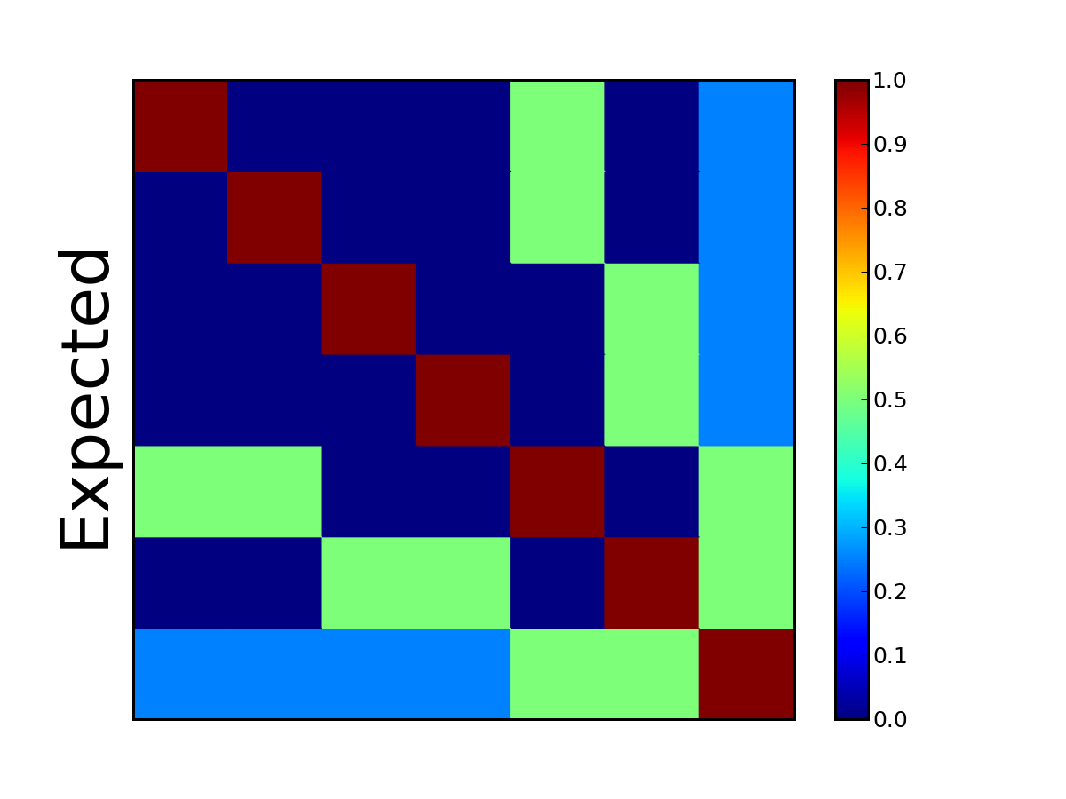
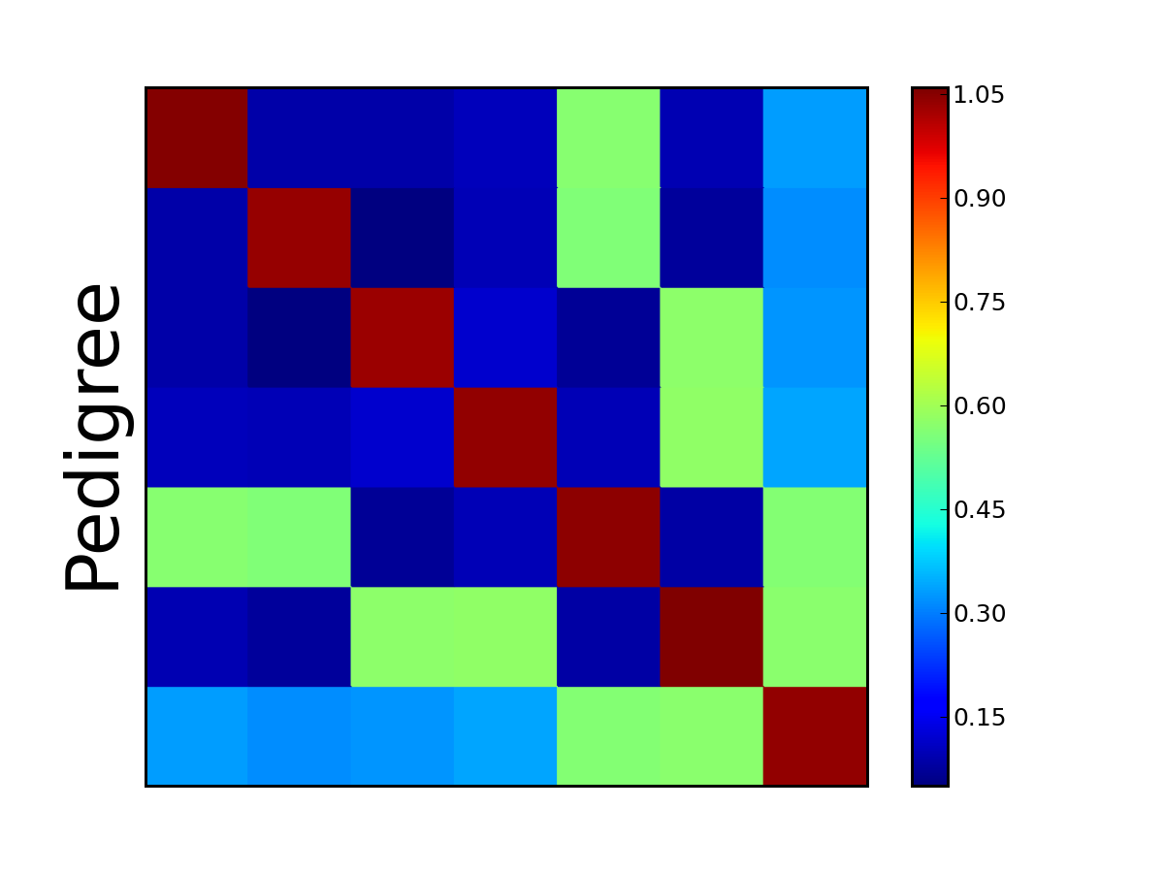

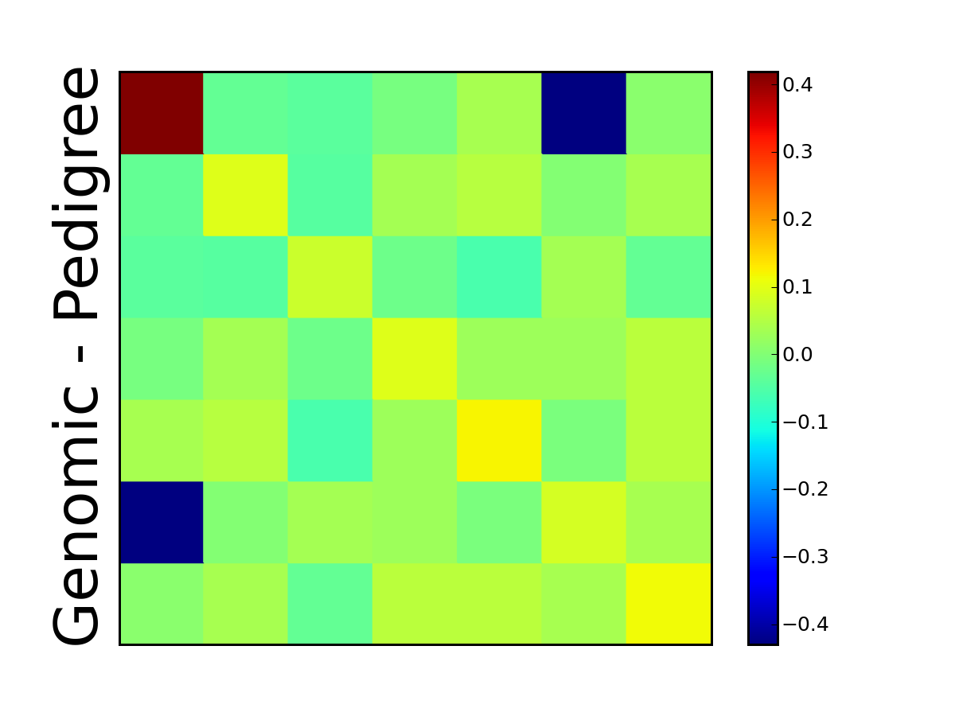
Pseudocolor Plots ― O-Style

Slide 21

Pedigree of sire of embryo (HOUSA73431994)
777K 777K
50K - - -
50K 50K
50K 50K
777K 777K
50K - - -
3K 777K
50K 50K
777K 777K
50K Imputed
Imputed 50K
50K Imputed
50K 777K
50K 50K
50K 777K
77K - - -
777K 777K
50K Imputed
Imputed 50K
50K Imputed
50K 777K
50K 50K
3K 777K
9K 50K
50K 777K
50K 50K
50K 777K
50K Imputed
777K 777K
50K - - -
Imputed 777K
50K

Slide 22
Pedigree of dam of embryo (HOCAN108535184)
777K 50K
50K - - -
50K 777K
50K Imputed
777K 777K
50K 50K
Imputed 777K
50K - - -
777K 50K
777K - - -
Imputed 777K
50K - - -
777K 777K
Imputed Imputed
Imputed 777K
77K 50K
777K 50K
777K - - -
Imputed 777K
50K - - -
777K 777K
Imputed - - -
Imputed 777K
77K 50K
777K 777K
777K 50K
50K 777K
50K - - -
50K 50K
50K 50K
50K 777K
50K

Slide 23
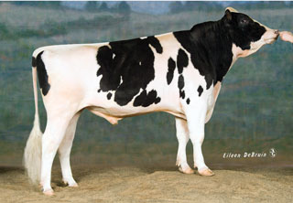
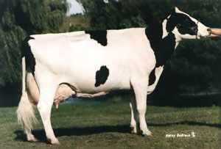
Pedigree or genomic mating?
Computer mating programs assign mates with fewer ancestors in common to reduce pedigree inbreeding
Such programs can instead assign mates with fewer alleles in common to reduce genomic inbreeding
Relationships of each genotyped female to genotyped AI males available since Aug 2014
Dominance effects tested, not yet distributed
Pedigree relationships
Genomic relationships

Slide 24
1 – Step Equations
Aguilar et al., 2010
Model: y = X b + W u + e
+ other random effects not shown
X’ R⁻¹ X X’ R⁻¹ W
W’ R⁻¹ X W’ R⁻¹ W + H⁻¹ k
b
u
X’ R⁻¹ y
W’ R⁻¹ y
=
H⁻¹ = A⁻¹ +
0 0
0 G⁻¹ – A₂₂⁻¹
Size of G and A₂₂ >1 million, increasing each year
Size of A is 60 million animals

Slide 25
Modified 1-Step Equations
Legarra and Ducrocq, 2011
To avoid inverses, add equations for γ, φ
Use math opposite of absorbing effects
X’R⁻¹X X’R⁻¹W 0 0
W’R⁻¹X W’R⁻¹W+A⁻¹k Q Q
0 Q’ -G/k 0
0 Q’ 0 A₂₂/k
b
u
γ
φ
X’ R⁻¹ y
W’ R⁻¹ y
0
0
=
Iterate for γ using G = Z Z’ / [ 2 Σp(1-p)]
Iterate for φ using A₂₂ multiply (Colleau)
Q’ = [ 0 I ] (I for genotyped animals)

Slide 26
Data for Small 1-Step Test
National U.S. Jersey data
4.4 million lactation phenotypes
4.1 million animals in pedigree
Multi-trait milk, fat, protein yields
5,364 male, 11,488 female genotypes
Deregressed MACE evaluations for 7,072 bulls with foreign daughters (foreign dams not yet included)

Slide 27
Jersey Results New = 1-step GPTA milk, Old = multi-step GPTA milk
Statistic | Animals
Corr(New, Old) | All bulls | 0.994
Corr(New, Old) | Genotyped bulls | 0.992
Corr(DYD_{g}, DYD) | Genotyped bulls | 0.999
Corr(New, Old) | Young genomic | 0.966
SD old PTA milk | Young genomic | 540
SD new PTA milk | Young genomic | 552
Old milk trend | 1995-2005 cows | 1644
New milk trend | 1995-2005 cows | 1430

Slide 28
1-Step vs Multi-Step: Results
Data cutoff in August 2008
Evaluation | Regression | Squared Correlation
Parent Average | .73 | .436
Multi-Step GPTA | .75 | .520
1-Step GPTA | .85 | .520
Expected | .93
Multi-step regressions also improved by modified selection index weights

Slide 29
Imputation Program: findhap.f90
Population haplotyping
Divide chromosomes into segments
List haplotypes by genotype match
Similar to FastPhase, IMPUTE, or long range phasing
Pedigree haplotyping
Look up parent or grandparent haplotypes
Detect crossovers, fix noninheritance
Impute nongenotyped ancestors

Slide 30
Coding of Alleles and Segments
Genotypes
0 = BB, 1 = AB or BA, 2 = AA, 5 = __ (missing)
Allele frequency used for missing
Haplotypes
0 = B, 1 = not known, 2 = A
Segment inheritance (example)
Son has haplotype numbers 5 and 8
Sire has haplotype numbers 8 and 21
Son got haplotype number 5 from dam

Slide 31
Population Haplotyping Steps
Put first genotype into haplotype list
Check next genotype against list
Do any homozygous loci conflict?
If haplotype conflicts, continue search
If match, fill any unknown SNP with homozygote
2nd haplotype = genotype minus 1st haplotype
Search for 2nd haplotype in rest of list
If no match in list, add to end of list
Sort list to put frequent haplotypes 1st

Slide 32
Check New Genotype Against List 1st segment of chromosome 15
Search for 1st haplotype that matches genotype:
022112222011221022021110220010110212202000102020120002021
5.16% 022222222020020022002020200020000200202000022022222202220
4.37% 022020220202200020022022200002200200200000200222200002202
4.36% 022020022202200200022020220000220202200002200222200202220
3.67% 022020222020222002022022202020000202220000200002020002002
3.66% 022222222020222022020200220000020222202000002020220002022
Get 2nd haplotype by removing 1st from genotype:
022002222002220022022020220020200202202000202020020002020
3.65% 022020022202200200022020220000220202200002200222200202222
3.51% 022002222020222022022020220200222002200000002022220002220
3.42% 022002222002220022022020220020200202202000202020020002020
3.24% 022222222020200000022020220020200202202000202020020002020
3.22% 022002222002220022002020002220000202200000202022020202220

Slide 33
Computation Required: Imputation
Impute 636,967 markers for 103,070 animals
Required 10 hours with 6 processors (findhap)
Required 50 Gbytes memory
Program FImpute from U. Guelph slightly better
Impute 1 million markers on 1 chromosome (sequences) for 1,000 animals
Required 15 minutes with 6 processors
Required 4 Gbytes memory

Slide 34
Net Merit by Chromosome Freddie - highest Net Merit bull

Slide 35
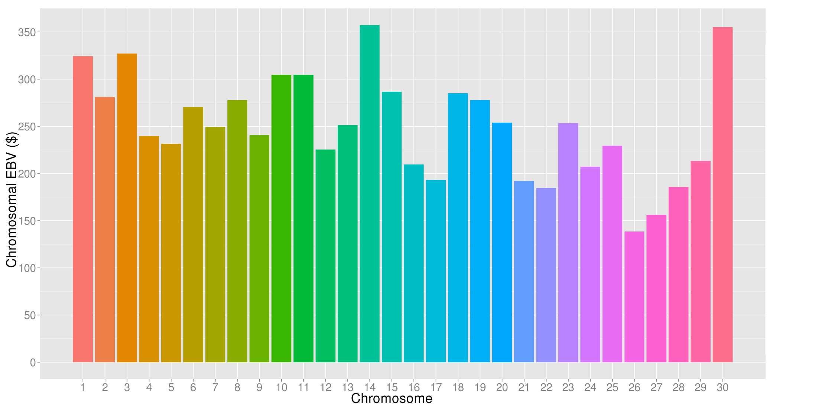
What’s the best cow we can make?
A “Supercow” constructed from the best haplotypes in the Holstein population would have an EBV(NM$) of $7515

Slide 36
Trend in Net Merit $

Slide 37
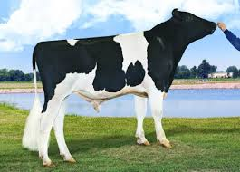
Top young bulls from Apr 2013 Now with > 1,000 daughters
 | Net Merit |  |  | Progeny (2016)
Bull | 2016 | 2013 | PA 2013 | Daus | AI Sons
Supersire | 936 | 694 | 395 | 3,820 | 244
Cabriolet | 852 | 666 | 331 | 1,028 | 6
AltaStacked | 617 | 611 | 439 | 1,308 | 1
Uno | 526 | 600 | 348 | 4,468 | 213
Puzzle | 538 | 584 | 370 | 1,240 | 0
Erdman | 679 | 574 | 362 | 3,351 | 11
Maurice | 642 | 571 | 501 | 1,760 | 26
Indy | 606 | 568 | 385 | 1,375 | 0
Galaxy | 497 | 564 | 501 | 3,146 | 23
Headliner | 701 | 562 | 395 | 1,485 | 26
Top 10 Avg | 721 | 599 | 438 | 2,298 | 80
(base adjusted values)

Slide 38
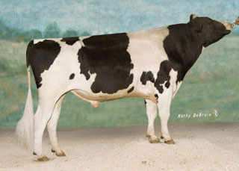
Top proven bulls from Apr 2013 Now with 1,000 daughters
 | Net Merit |  |  | Progeny (2016)
Bull | 2016 | 2013 | PA 2013 | Daus | AI Sons
Observer | 454 | 559 | 380 | 6,874 | 155
Freddie | 470 | 547 | 294 | 22,429 | 186
Awesome | 471 | 524 | 346 | 5,799 | 0
O-Style | 409 | 500 | 369 | 9,715 | 64
Planet | 475 | 494 | 169 | 63,551 | 364
Massey | 513 | 477 | 237 | 9,707 | 82
Levi | 422 | 468 | 181 | 18,800 | 16
Manifold | 589 | 465 | 223 | 39,498 | 5
Domingo | 406 | 452 | 182 | 6,999 | 5
Varsity | 457 | 445 | 92 | 1,597 | 0
Top 10 Avg | 467 | 493 | 247 | 18,497 | 124
(base adjusted values)

Slide 39
Largest genomic databases
 | 23andMe | Ancestry .com | CDCB / USDA
Genotypes | >1 million | 1.2 million | 1.2 million
Species | Human | Human | Cattle
Countries | 55 |  | 49
Genotyping cost | $199 | $99 | $37-135
Delivery (weeks) | 6-8 | 6-8 | 1-2
DNA generations | Few | Few | Many
EBV reliability | Low | Low | High
Reference: http://genomemag.com/davies-23andme/#.VdY722zosY1
Web sites: https://www.23andme.com/
http://dna.ancestry.com/
https://www.cdcb.us/
http://aipl.arsusda.gov/Main/site_main.htm

Slide 40
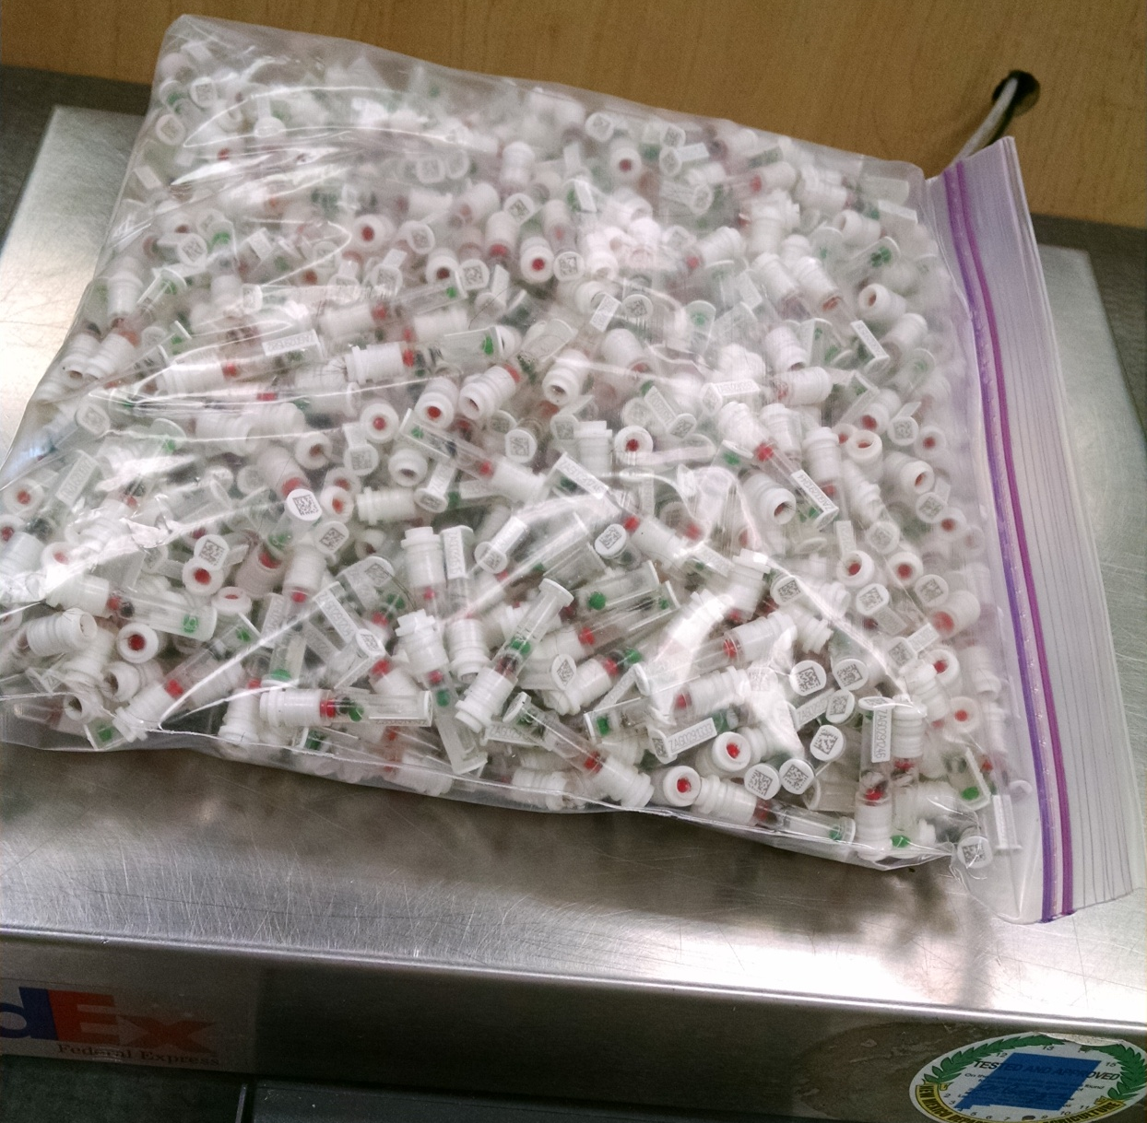
DNA samples from 1 farm, 1 day
Photo provided
by Zoetis

Slide 41
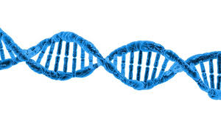
Sequence computation
Alignment reports the chromosome location that best matches the short (150-base) DNA segment to the reference map (2.7 billion).
Often both ends of a longer segment are read and these paired ends are located together.
Variant calling reports if each mapped segment contains a reference or alternate allele at any site. These variants could be previously known or newly discovered.

Slide 42
Previous strategies
Almost all programs do alignment, and then variant calling, instead of both together.
Program BWA was examined as a popular alignment strategy, and GATK for calling.
“Mapping reads to the reference is a first critical computational challenge whose cost necessitates that each read be aligned independently, guaranteeing that many reads spanning indels will be misaligned.” DePristo et al (2011) GATK paper

Slide 43
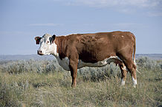
Benefits of new strategy
Most programs align only to Dominette’s DNA
Findmap can align using all known DNA differences among and within breeds
Error rate is reduced by separating known SNPs and indels from machine read errors
Locations are mapped back to the same common reference (UMD3.1)

Slide 44
Compare BWA and findmap
Computation required | BWA / GATK | findmap / findvar
CPU minutes / 1X, 1 thread | 629 | 11
CPU minutes / 1X, 10 threads | 63 | 2
Memory (Gbytes), 1 thread | 4.6 | 46
Memory (Gbytes), 10 threads | 46 | 46
Variant calling CPU / 1X, 1 thread | 201 | 1
Accuracy
Correctly placed segments overall | 90.5% | 92.9%
Both ends of pair correctly placed | 87.2% | 87.6%
Both ends wrong | 6.2% | 1.8%

Slide 45
USA use of 1,000 bull genomes
Sequence genotypes from 440 Holsteins
Imputed for 27,000 reference bulls
700,000 candidate loci + 300,000 HD SNPs
Largest 17K added to 60K routinely used
Average gain of 2.7% reliability across traits
Largest 5K added to next Zoetis chip

Slide 46
Conclusions
Models convert raw genotype, phenotype, and pedigree data into useful predictions
Rapid data growth (animals x variants) can make previous algorithms quickly obsolete
Imputation provides more data than can be used routinely, so variants must be selected
Choosing and validating models is difficult with changing breeding programs

Slide 47
Conclusions
Program findmap.f90 uses known variants
Alignment is 50X faster than BWA with 1 processor, 30X faster with 10 processors
2% more segments are mapped correctly
Output files are simpler and 3-10X smaller
Simulation, alignment, variant calling, and imputation programs available from: http://aipl.arsusda.gov/software

Slide 48
Acknowledgments
This research was part of USDA-ARS project 1265-31000-096-00, “Improving Genetic Predictions in Dairy Animals Using Phenotypic and Genomic Information.”
Members of the Council on Dairy Cattle Breeding provided data
Jan Wright, Mel Tooker, Tabatha Cooper, George Wiggans, Derek Bickhart, John Cole, and Jeff O’Connell assisted with computation
The variant list was from Daetwyler et al.
The reference map was from U. Maryland (Zimin et al.)

Slide 49
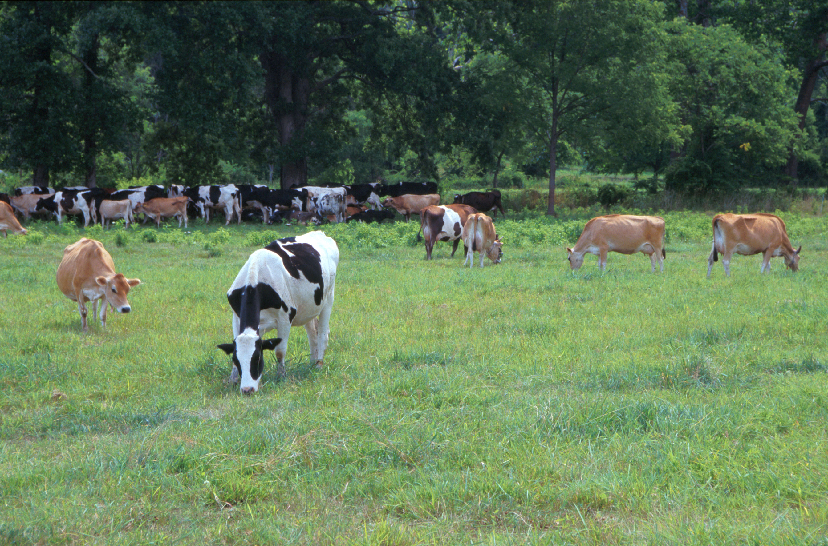
Questions?
AIP web site:
http://aipl.arsusda.gov
Holsteins, Jerseys, and crossbreds graze on American Farm Land Trust’s
Cove Mountain Farm in south-central Pennsylvania
Source: ARS Image Gallery, image #K8587-14; photo by Bob Nichols

