Slide 1
Strategies to choose from millions of imputed sequence variants

Slide 2
Introduction
Whole-genome sequencing costs are rapidly declining
Large numbers of animals will be sequenced in the next few years
How will WGS be used in genomic evaluations?

Slide 3
Applications of WGS data
Develop reference panels for imputation using SNP chip
Discover QTLs
Discover rare and de novo mutations with deleterious effects for surveillance
Build better SNP chips

Slide 4
WGS implementation considerations
Cost of higher density SNP chips to industry
Imputation cost for weekly/monthly genomic evaluations
Redesigning chip incurs cost of generating new data for imputation
  Build off the 60K chip

Slide 5
Project goal: Prepare for WGS
Develop programs to simulate genotypes and QTLs
Develop programs to process sequence data
Compare strategies for variant selection
Predict gains in reliability
Determine computational footprint for large populations

Slide 6
Data
26,984 HOL bulls in U.S. reference population
112,905 animals in the pedigree
30 million simulated variants, 10,000 QTLs
30 equal-length chromosomes (100 Mbases)
3 different chip densities (HD, MD, LD)
5 independent traits (same QTL locations)

Slide 7
Genotype simulation and pruning
Simulate 30 million genotypes plus QTLs in 1000 bulls using genosim.f90
Remove loci with MAF <0.01 or linkage disequilibrium >0.95
Keep 500K loci near QTLs (genes) + 600K chip + 60K chip
8,403,858 loci remain

Slide 8
QTL effect distribution (% variance)
Top QTLs | Trait |  |  |  |  | Avg
 | 1 | 2 | 3 | 4 | 5
1 | 3.7 | 13 | 3.9 | 3.5 | 5.6 | 5.9
10 | 20.0 | 34 | 21.0 | 23.0 | 29.0 | 25.4
100 | 57.0 | 63 | 59.0 | 57.0 | 62.0 | 59.6
1,000 | 90.0 | 92 | 92.0 | 92.0 | 93.0 | 91.8
10,000 | 100.0 | 100 | 100.0 | 100.0 | 100.0 | 100.0

Slide 9
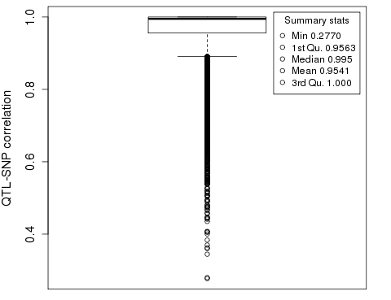
QTL correlation to 8M SNP set

Slide 10
Bull genotypes: Imputation findhap.f90
Bulls | Genotype density | Variants
1,000 | Sequenced pruned to | 8,403,858
773 | High density | 600,000
24,863 | Medium density | 60,000
348 | Low density | 12,000
26,984 | Total bulls, all imputed to | 8,403,858
17,896 | Phenotyped (old) | DYD
9,088 | Validation (young) | True BV

Slide 11
Computation required
Step | Proc-essors | Time (hours) | Memory (Gbyte) | Disk (Gbyte)
Simulate 30M | 1 | 56 | 210 | 32
Prune linkage | 10 | 1 | 27 | 10
Impute 8M | 20 | 38 | 13 | 220

Slide 12
Study1: Select 25K from 600K chip
Compare 60K and 600K REL using same data
Choose best markers from 600K, add to 60K
  Select largest 5,000 for each of 5 traits
  Multiple regression: By effect size, effect variance
  GWA: By p-value significance
  Merge and remove duplicates, adding ∼23K

Slide 13
Results: REL from PA, 60K, 85K, 600K
 |  |  | 60K + 25K
Trait | PA | 60K | GWA | Size | Var | 600K
1 | 24.4 | 77.9 | 79.2 | 81.6 | 81.3 | 80.3
2 | 31.2 | 77.9 | 79.3 | 81.4 | 81.2 | 80.1
3 | 32.7 | 78.3 | 79.5 | 81.3 | 81.5 | 80.4
4 | 23.3 | 76.6 | 77.7 | 80.2 | 79.8 | 78.6
5 | 30.4 | 78.3 | 80.0 | 82.5 | 82.2 | 81.2
Avg | 28.4 | 77.8 | 79.1 | 81.4 | 81.2 | 80.1

Slide 14
Genome-wide association
Single SNP regression within mixed model that accounts for the polygenic effect using pedigree kinship
  Y= Xb + SNP + a + e
Multiple testing adjustment leads to stringent cutoffs for significance
Focus on estimation rather than prediction

Slide 15
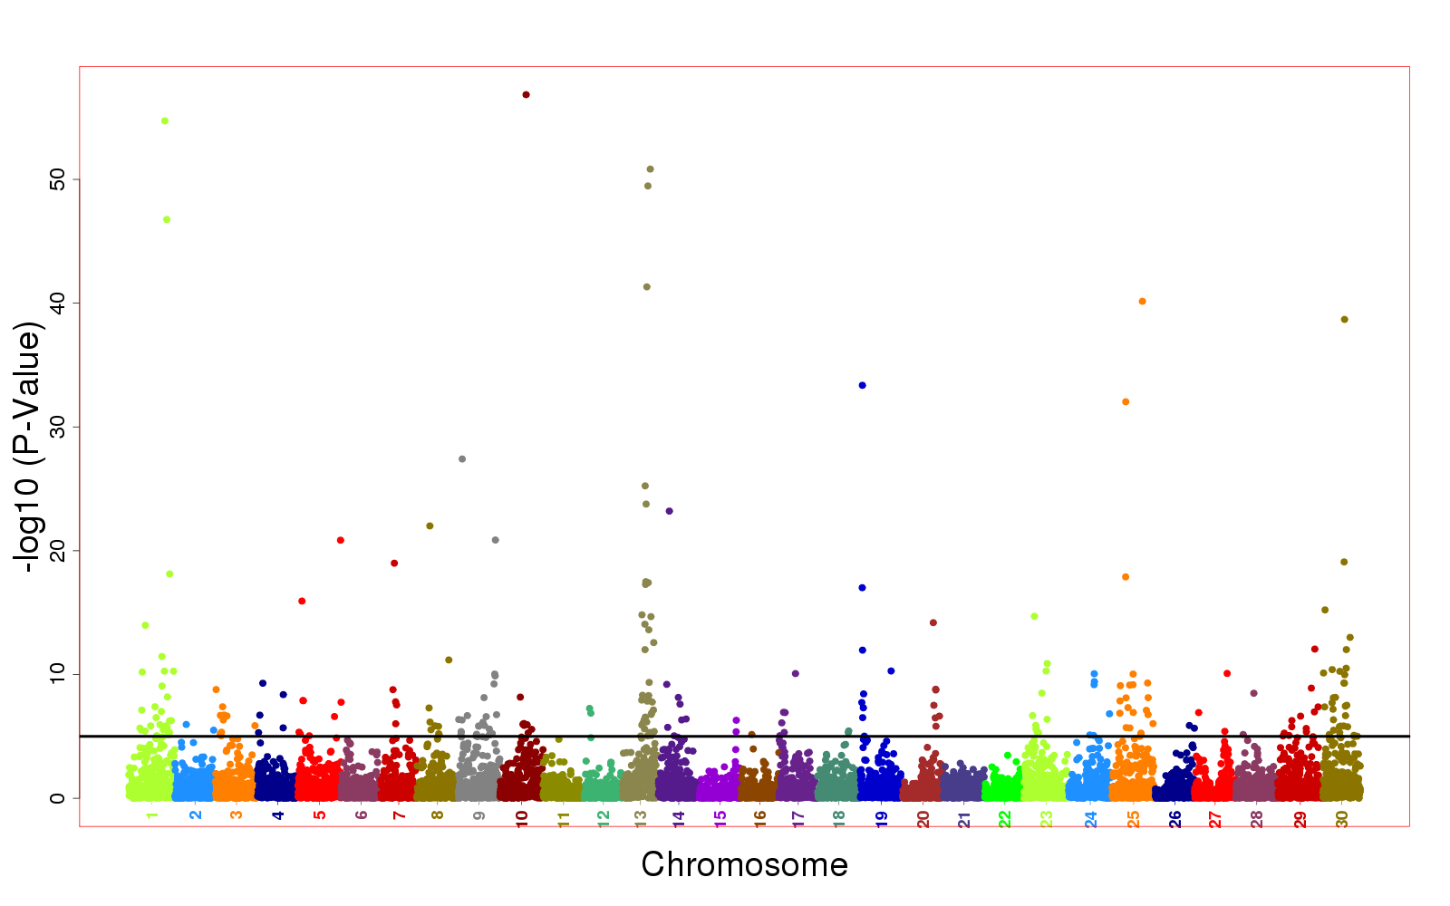
GWA trait 2 imputed QTLs
<5% QTL < 10e-5

Slide 16
Study 2: Select sequence variants
8M – search everywhere
1M – search by bioinformatics using 2.5kb window on QTL
QTLs – perfect functional knowledge
Include 60K chip for imputation, but assign all or most prior variance to the selected variants
  Selection of variants may affect optimal shape/ choice of prior distribution

Slide 17
REL from 1M, 60K+1M subset, QTLs
 |  | 1 million near QTLs |  |  |  | Include QTLs
Trait | 600K | 60K+25K |  | All 1M |  | 60K+10K |  | 10K
1 | 80.3 | 85.4 |  | 86.7 |  | 84.6 |  | 87.2
2 | 80.1 | 85.3 |  | 87.7 |  | 84.9 |  | 87.7
3 | 80.4 | 84.9 |  | 86.1 |  | 85.0 |  | 87.8
4 | 78.6 | 83.5 |  | 84.8 |  | 82.9 |  | 85.9
5 | 81.2 | 86.0 |  | 87.6 |  | 85.2 |  | 87.5
Avg | 80.1 | 85.0 |  | 86.4 |  | 84.5 |  | 87.2

Slide 18
Computation required
Step | Proc-essors | Time (hours) | Memory (Gbyte) | Disk (Gbyte)
Simulate 30M | 1 | 56 | 210 | 32
Prune linkage | 10 | 1 | 27 | 10
Impute 8M | 20 | 38 | 13 | 220
Predict 1M | 5 | 22 | 20 | <1
Select 25K from 8M | 30 | 0.5 | <1 | <1

Slide 19
Conclusions
Selection of variants requires several steps
Potential gains from sequence are large
Still requires very large reference population
Methods scalable to more sequences
Bioinformatics can narrow the search
GWA is scalable to larger data but multiple regression give higher reliability

Slide 20
Current directions
Evaluate several additional SNP selection criteria including priors for GWA
Apply methods to real data from 1000 Bulls Project
Evaluate bovine bioinformatics resources for functional annotation

Slide 21
Acknowledgments
JRO supported by USDA SCA 58-45-14-070-1

