Slide 1
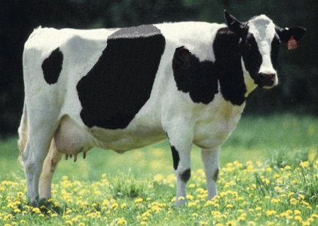
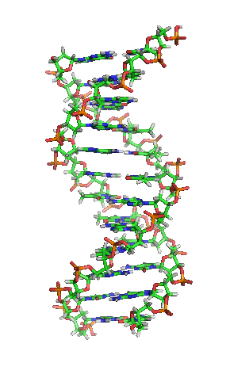
Animal Improvement Program
A research project of the Animal Genomics and Improvement Laboratory (AGIL)

Slide 2
AGIL mission
Improve health and production efficiency of dairy cattle and small ruminants through genomic evaluation, genetic selection, and fundamental genomics-based research
4 research areas
  Develop methods for genetic evaluation of dairy cattle
  Develop genomic resources and bioinformatic tools
  Enhance feed efficiency in dairy cows
  Improve resistance to gastrointestinal parasites in small ruminants

Slide 3

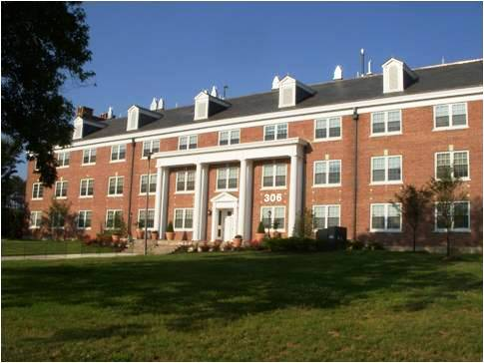
AGIL creation
April 2014
Merge of Animal Improvement Programs Laboratory (AIPL) and Bovine Functional Genomics Laboratory (BFGL)
All animal bioinformatics research at Beltsville now in same management unit
  Better utilization of resources
  Encourages collaboration
AIPL, Bldg. 005, BARC-West
BFGL, Bldg. 306, BARC-East

Slide 4

AGIL staff
Dr. Erin E. Connor, Research Leader
11 senior scientists
4 postdoctoral associates
8 support scientists
2 chemists
5 laboratory technicians
4 computer specialists
3 administrative assistants
Visiting scientists and students

Slide 5
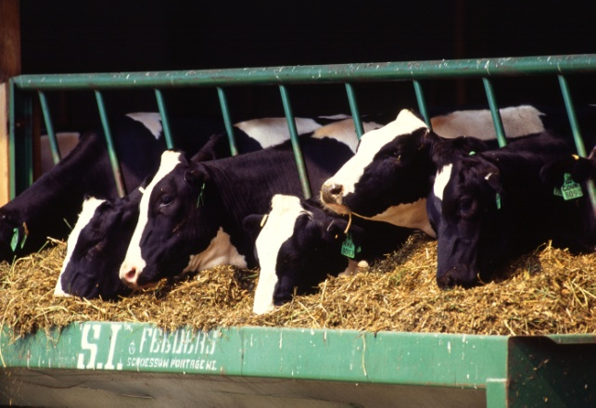
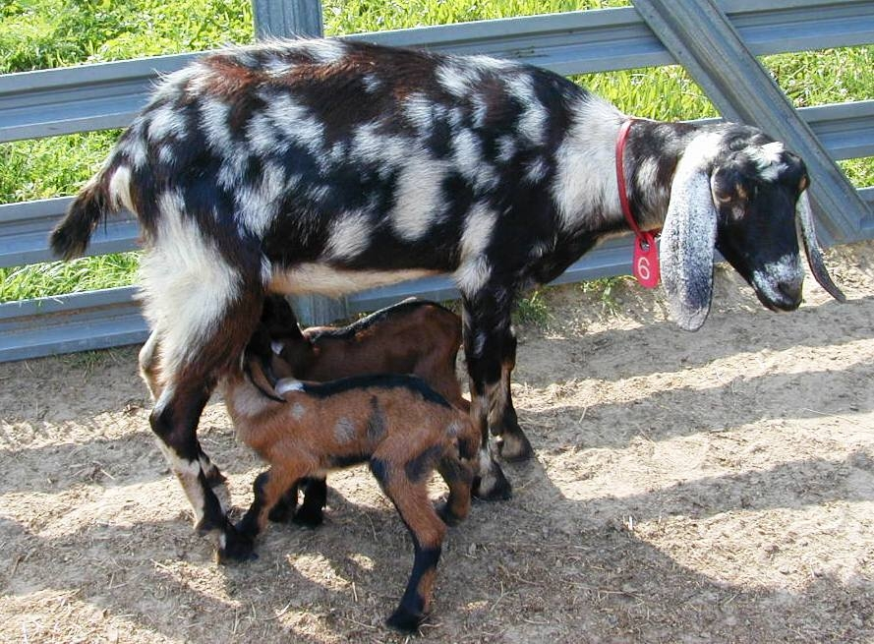
Accomplishments
Genetic evaluations for more than 30 traits of U.S. dairy cows and goats
Genetic-economic indexes to help dairy farmers choose parents of future generations
Genomic mating programs for dairy cattle

Slide 6


Accomplishments (continued)
Low-cost genotyping tools for genomic predictions of genetic merit
Gene expression profiling for nutrient-gene interactions and regulation
Identification of gene mutations for cow fertility and thermo-tolerance
Identification of genetic mechanisms for rumen development and parasite resistance

Slide 7

AIPL history
Start of USDA Dairy Herd Improvement program (1908)
AIPL created (1972)
AIPL celebrates 100 years of research and service to dairy industry (2008)
Transition begins (2012)
  AIPL (research only)
  Council on Dairy Cattle Breeding (service)

Slide 8
Animal Improvement Program (AIP)
Former main AIPL research project
Web site: http://aipl.arsusda.gov/
Primary objective:
  Improve productive efficiency of dairy animals for traits of economic interest through genetic evaluation and management characterization so that the U.S. and other countries can meet dietary needs of their populations

Slide 9
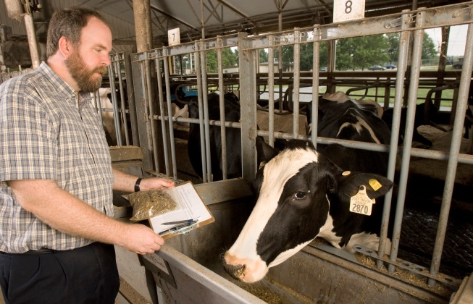
AIP specific objectives
National and international collection of phenotypic and genotypic data
More accurate genomic evaluation with combined pedigrees, genotypes, and phenotypes for all animals
  Economic analysis to maximize genetic progress and financial benefits for selection of healthy, fertile animals with high lifetime production
  Herd management practices
  Optimal genetic improvement
  New traits (e.g., feed efficiency)
  Economic values of individual traits

Slide 10




AIP staff
4 senior scientists
6 support scientists
4 computer specialists
1 administrative assistant
Visiting scientists and students
Dr. George Wiggans
Dr. Paul VanRaden
Dr. John Cole
Dr. Derek Bickhart

Slide 11

AIP U.S. collaborators (2014–15)
American Jersey Cattle Association
Baylor College of Medicine
Cofactor Genomics
Colorado State University
Cornell University
Council on Dairy Cattle Breeding
Dairy Records Management Systems
Department of Defense
Holstein Association USA
Iowa State University
Michigan State University
National Assoc. of Animal Breeders
Natl. Ctr. for Genetic Resources Preserv.
National DHIA
Neogen/GeneSeek
North Carolina State University
Pennsylvania State University
Purdue University
Recombinetics
Sexing Technologies
University of California
University of Connecticut
University of Florida
University of Maryland
University of Minnesota
University of Missouri
University of Puerto Rico
University of Vermont
University of Virgin Islands
University of Wisconsin
U.S. Meat Animal Research Center
Virginia State University
Virginia Tech
Washington State University

Slide 12

AIP international collaborators (2014–15)
Australia
Austria
Belgium
Brazil
Canada
China
Croatia
Denmark
France
Germany
Israel
Italy
Mexico
Netherlands
New Zealand
Norway
Sweden
Switzerland
United Kingdom
Venezuela

Slide 13
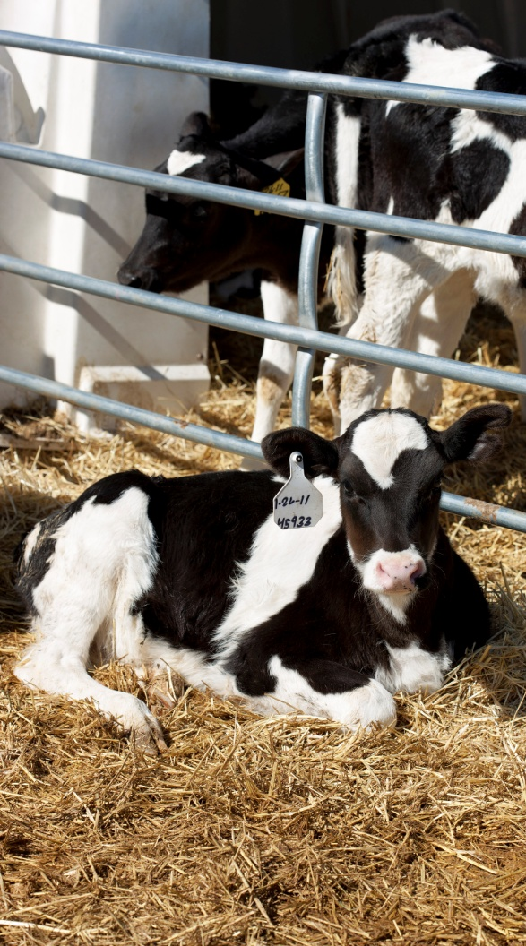
Traits studied
Yield (milk, fat, protein)
Longevity (productive life)
Fertility (conception rate, pregnancy rate, calving interval)
Calving (calving ease, stillbirth)
Health (somatic cell score, disease resistance, heat stress)
Feed efficiency

Slide 14
History of genomic evaluations
BovineSNP50 BeadChip available Dec. 2007
First unofficial evaluation released Apr. 2008
Official evaluations for Holsteins and Jerseys Jan. 2009
Official evaluations for Brown Swiss Aug. 2009
Monthly evaluation Jan. 2010
Official 3K evaluations Dec. 2010
BovineLD BeadChip available Sept. 2011
Official evaluations for Ayrshires Apr. 2013
Weekly evaluation Nov. 2014
Notes:
14

Slide 15

Genotype chips
Chip | SNP (no.) |  | Chip | SNP (no.)
50K | 54,001 |  | ZLD | 11,410
50K v2 | 54,609 |  | ZMD | 56,955
3K | 2,900 |  | ELD | 9,072
HD | 777,962 |  | LD2 | 6,912
Affy | 648,875 |  | GP3 | 26,151
LD | 6,909 |  | ZL2 | 17,557
GGP | 8,762 |  | ZM2 | 60,914
GHD | 77,068 |  | GH2 | 139,480
GP2 | 19,809

Slide 16
Laboratory quality control
Each SNP evaluated for
  Call rate
  Portion heterozygous
  Parent-progeny conflicts
Clustering investigated if SNPs exceeds limits
Number of failing SNPs indicates genotype quality
Target of <10 SNPs in each category

Slide 17
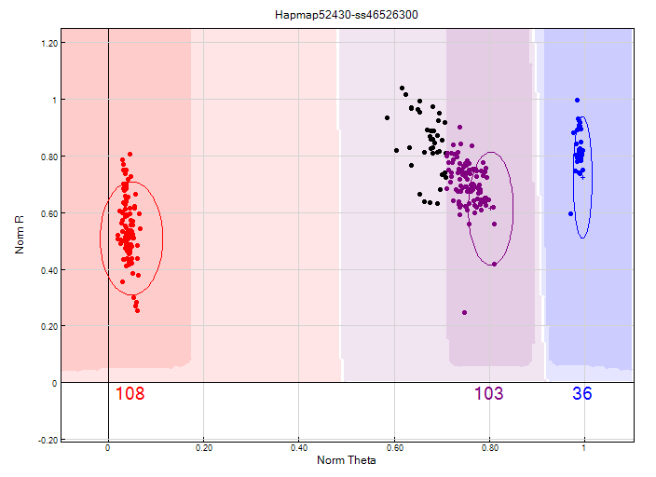
Before clustering adjustment
86% call rate

Slide 18
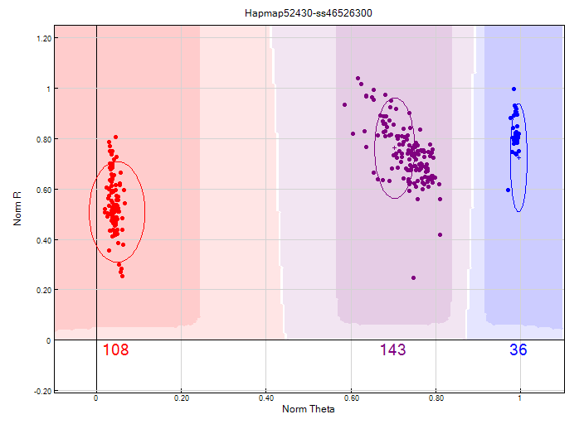
After clustering adjustment
100% call rate

Slide 19
Current SNP set for genomic evaluations
60,671 SNP used after culling on
  Minor allele frequency
  Parent-progeny conflicts
  Percentage heterozygous (departure from HWE)
SNP for HH1, BLAD, DUMPS, CVM, polled, red, and mulefoot included
  JH1 included for Jerseys
Some SNP eliminated because incorrect location  haplotype non-inheritance

Slide 20

Parentage validation and discovery
Parent-progeny conflicts detected
  Animal checked against all other genotypes
  Reported to breeds and requesters
  Correct sire usually detected
Maternal grandsire checking
  SNP at a time checking
  Haplotype checking more accurate
Breeds moving to accept SNP in
place of microsatellites
Who’s your daddy?
Notes:
20

Slide 21
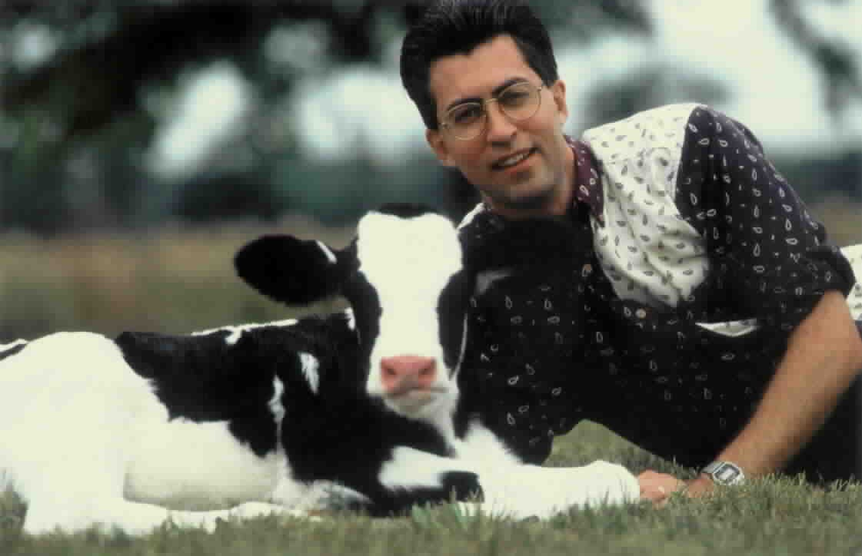
Benefits of genomic evaluation
Determine value of animal at birth
Increase accuracy of selection
Reduce generation interval
Increase selection intensity
Increase rate of genetic gain

Slide 22
Recent evaluation changes
New software for traditional PTAs
  Programs used since 1989 rewritten
  Multitrait evaluation
  Input data for pregnancy rate changed
Base change for all traits (December 2014)
Net merit revision with more traits (December 2014)
Weekly instead of monthly service (December 2014)
Added 140,000-marker chip

Slide 23
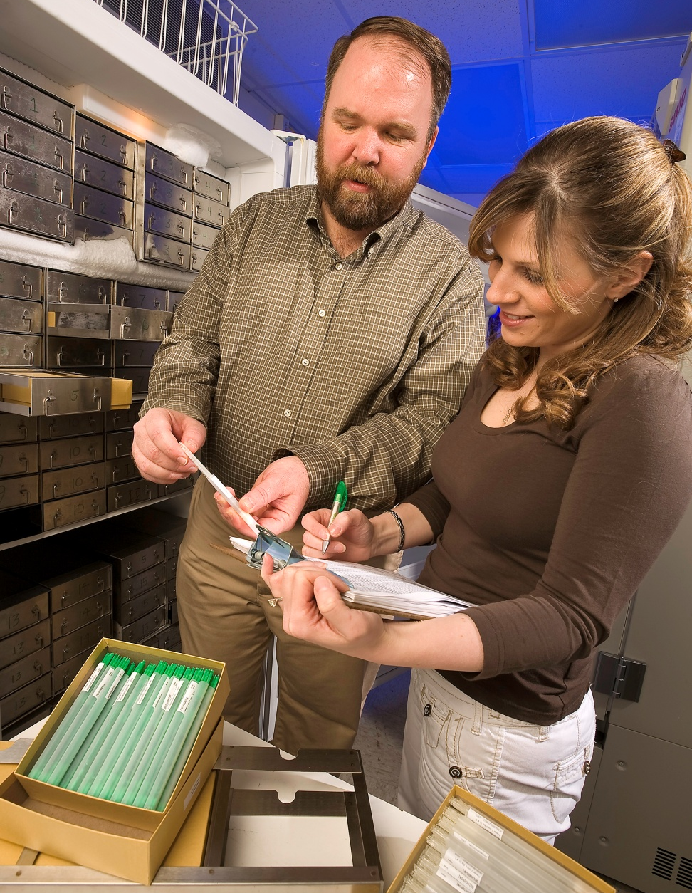
New phenotypes being studied
Dairy cattle health
Hoof health
Embryonic development
Immune response
Methane production
Milk fatty acid composition
Persistency of lactation
Rectal temperature
Residual feed intake
Notes:
23
23

Slide 24
Other research
Imputing low-coverage sequence
Predicting genetic-environmental interactions: Heat stress PTA
Including foreign genotypes in reference populations
Monitoring preselection bias
Solving 1-step genomic models
Crossbred genomics

Slide 25
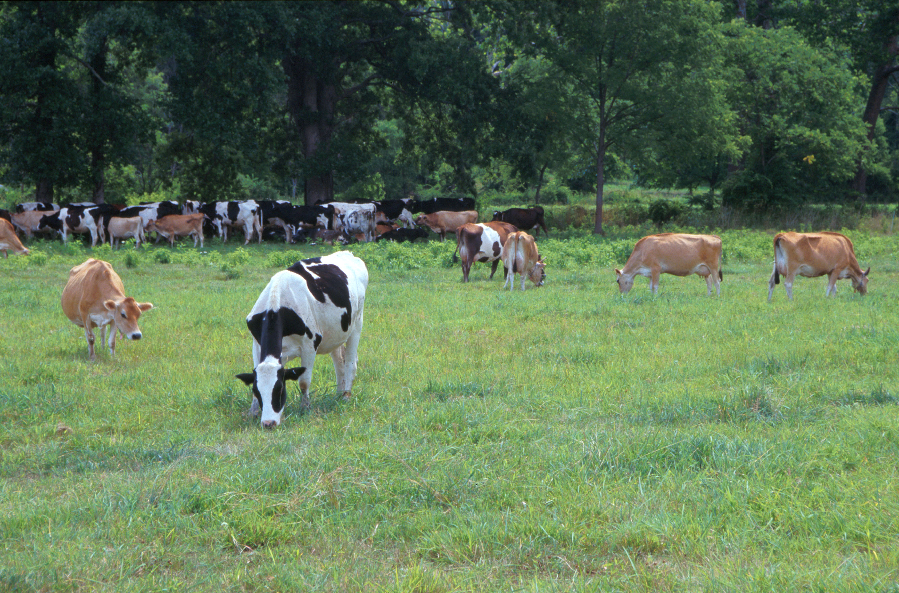
Questions?
AIP web site:
http://aipl.arsusda.gov
Holstein and Jersey crossbreds graze on American Farm Land Trust’s
Cove Mountain Farm in south-central Pennsylvania
Source: ARS Image Gallery, image #K8587-14; photo by Bob Nichols

