Slide 1




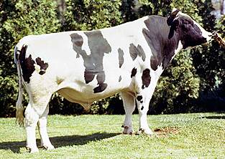
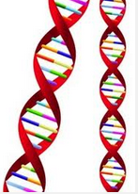
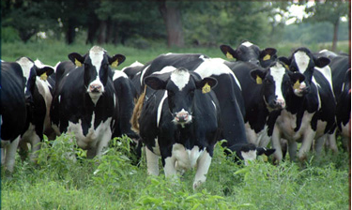


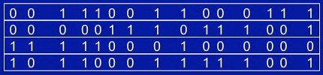


An Efficient Method of Generating Whole Genome Sequence for Thousands of Bulls
Chuanyu Sun¹ and Paul M. VanRaden²
¹National Association of Animal Breeders, USA, Columbia, MO
²Animal Improvement Programs Laboratory, Agricultural Research Service, USDA, Beltsville, MD, USA.
INTRODUCTION
Genome sequence will help to accelerate understanding of the biologic mechanisms and has application in many practical fields such as disease detection, drug development, and genomic selection for animal/plant breeding. Given the current costs of sequencing, it is still not viable to deeply sequence a large number of individuals. An alternative strategy is to implement imputation, i.e. some individuals are sequenced and others are genotyped using high-density (HD) single-nucleotide polymorphism (SNP) arrays, and then impute from SNP array to whole genome sequence using computer algorithms (Druet et al., 2013). Therefore, accurate genotype calling and imputation are important steps of eliminating the barrier for large scale application of sequence.
Simulated bull and actual human sequence (The 1000 genomes project, 2012) data was employed to test the new method. Different combinations among reference population size, sequence read depth and error rate were investigated to determine the accuracy of genotype call and imputation. Our method will directly impute from sequence reads depth instead of calling genotypes first and then imputing, which is more accurate especially if read depth is low or error rate is high.
Results
Table 1. The accuracy of genotype calling and imputation using different reference population size, sequence read depth and one percent error rate for simulated data.
Bulls | Read depth | Genotype calling | Imputation
1,000 | 16 | 99.9 | 99.2
 | 8 | 99.5 | 99.1
 | 4 | 97.8 | 98.2
 | 2 | 95.9 | 96.5
 | 1 | 93.8 | 93.8
500 | 16 | 99.9 | 98.4
 | 8 | 99.2 | 98.1
 | 4 | 97.0 | 96.7
 | 2 | 94.1 | 94.1
250 | 16 | 99.9 | 95.3
 | 8 | 98.7 | 95.0
 | 4 | 95.8 | 93.1
MATERIALS AND METHODS
Aligned reads
Figure 1. Accuracy of genotype calling and imputation based on same total cost. Total cost = population size times sequence read depth
Sequence read depth
Conclusions
An effective method for simultaneous genotype calling and imputation was developed and implemented in findhap version 3 software
Given the total sequencing effort, high read depth is desired if the goal is direct investigation of the sequenced individuals; lower depth and large population is desired for imputation but read depth lower than four will decrease efficiency
Our software features outstanding computing time and memory, with accuracy slightly less than Beagle (popular imputation software) but about 400 times faster.
18D00D800A0A0A088009H1800608400A5170600AA0085070C860318044080A0718062008B00909900805312009B0800B2X800B0
(Note: A to Z represents number of 10 to 35, each locus has two numbers for allele A and B)
High accuracy
Save cost
Very fast
Genotype calling and imputation
Sequence
>$1000
Based on human sequence data, the genotype call and imputation accuracy were 99.6% and 97.3%, respectively.
Reference
Druet T, Macleod IM, Hayes BJ. (2013). Toward genomic prediction from whole-genome sequence data: impact of sequencing design on genotype imputation and accuracy of predictions. Heredity 112: 39–47.
The 1000 Genomes Project Consortium. 2012. An integrated map of genetic variation from 1,092 human genomes. Nature, 491, 56–65.
Chips
$200

