Slide 1
Research of the Animal Improvement Program

Slide 2
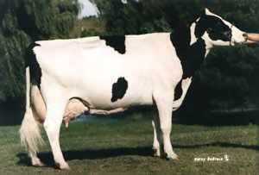
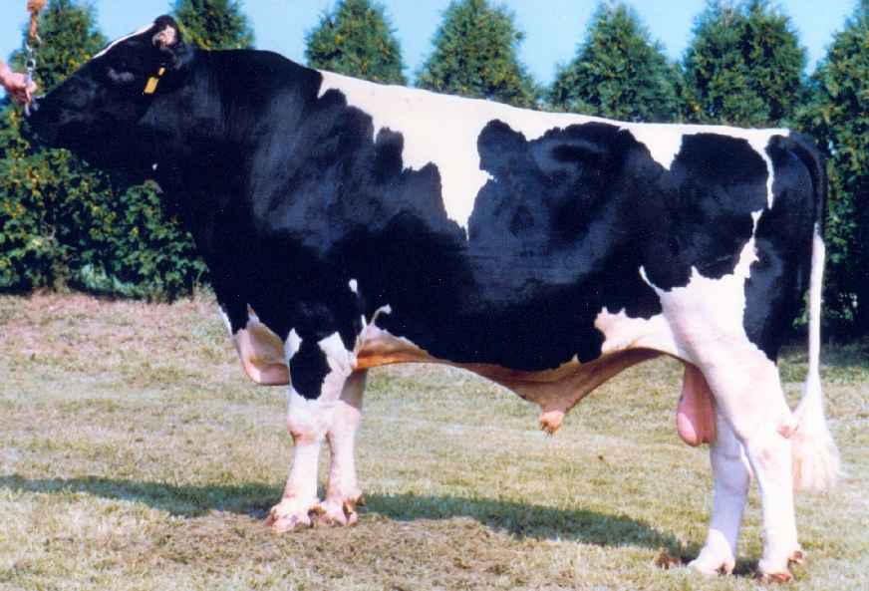
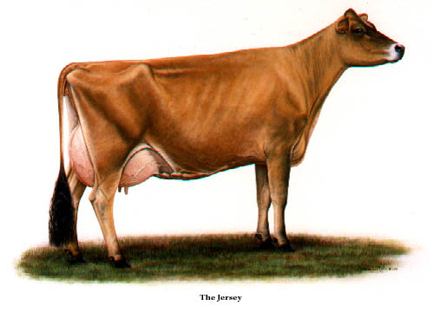
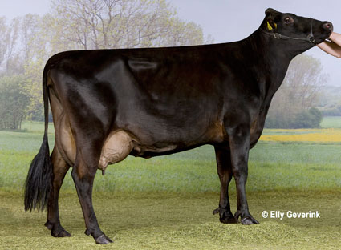
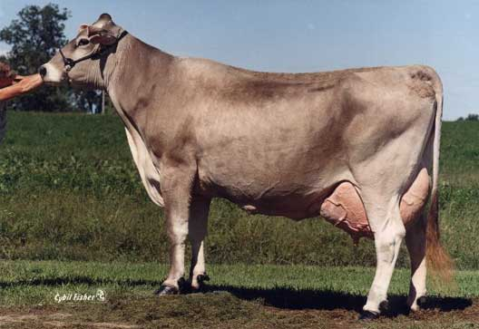
CRIS Objectives:
Expand national and international collection of phenotypes, genotypes
Develop more accurate genomic evaluations for dairy cattle
Use economic analysis for new traits

Slide 3
AGIL Lab History
1908 | USDA Dairy Herd Improvement Program (AIPL) began
1991 | Gene Evaluation and Mapping Lab (GEML) formed from Reproduction Lab and Avian Physiology Lab
1994 | GEML added scientists and staff from Milk Secretion and Mastitis Lab (previously Genetics and Management Lab)
2003 | Bovine Functional Genomics Lab (BFGL) and Animal Biosciences and Biotechnology Lab reorganized from GEML and Growth Biology Lab.
2013 | AIPL service duties began transfer to the Council on Dairy Cattle Breeding (CDCB)
2014 | BFGL and AIPL merged into AGIL

Slide 4
Animals and Markers Used
Year | Markers | Animals | Researchers
1991-1999 | 174 | 1,068 | Illinois, Israel, AIPL
1994-2004 | 367 | 1,415 | GEML, AIPL, Illinois, Israel
2007-2008 | 38,416 | 16,646 | BFGL, AIPL, Missouri, Canada, Illumina
2011-2013 | 636,967 | 161,341 | AIPL, BFGL, Canada, Italy, UK
2014-future | 30,000,000 | 500 | Worldwide exchange

Slide 5
Value of Incoming Data
Data Received FY14 | Annual Value
Phenotypes from DHI
4 million cows x $1.25 / cow / mo | $60 million
Genotypes from CDCB
15,000 medium density x $125 | $2 million
258,000 low density x $45 | $12 million
Whole genome sequence data (FY15)
200+ bulls x $1,000 (AGIL data) | $0.2 million
1,000+ bulls x $3,000 (World data) | $3 million

Slide 6
Sources of genotypes used
 | Phenotyped |  | Young
Continent | Female | Male | Female | Male | Totals
N. America | 93,345 | 23,598 | 329,780 | 76,786 | 523,509
Europe | 0 | 12,218 | 36,055 | 17,753 | 66,026
Oceania | 0 | 338 | 3,232 | 1,733 | 5,303
S. America | 0 | 3 | 2,720 | 333 | 3,056
Asia | 0 | 0 | 284 | 35 | 319
Africa | 0 | 0 | 281 | 3 | 284
Totals | 93,345 | 36,157 | 372,352 | 96,643 | 598,497
Notes:
As of March, 2014

Slide 7

Genotype chips
Chip Name | No. of SNP |  | Chip Name | No. of SNP
50K | 54,001 |  | GHD | 77,068
50K V2 | 54,609 |  | GP2 | 19,809
3K | 2,900 |  | ZLD | 11,410
HD | 777,962 |  | ZMD | 56,955
Affy | 648,875 |  | ELD | 9,072
LD | 6,909 |  | LD2 | 6,912
GGP | 8,762 |  | GP3 | 26,151

Slide 8
Nuc
Genetic Variation
How genomes change over time
Single nucleotide variations – SNP (millions of variants)
Indels – Small Insertions / Deletions (1 bp – 1000 bp)
Mobile Elements – SINE, LINE Transposition (300bp - 6 kb)
Genomic structural variation (1 kb – 5 Mb)
  Large-scale Insertions/Deletions (Copy Number Variation: CNV)
  Segmental Duplications (> 1kb, > 90% sequence similarity)
  Chromosomal Inversions, Translocations, Fusions.
Chr
Notes:
Variation of genetic sequence between two individuals can encompass smaller sequence-based events or larger scale, cytogenetic events.
Starting on the small scale, SNPs comprise a significant variation of sequence between individuals. On the human side, dbSNP has over 60 million recorded SNPs.
Insertions and deletions that range in size from 1bp to 50bp are a larger form of variation, though these are less frequent than SNPs
SINE, LINE transpositions and duplications are larger events still, ranging in size from 300 bp to 6 kb
The largest genetic variants are called Structural variants due to their massive size. The intra-chromosome insertions and deletions that range in size from 1kb to 5 Mb are termed copy number variations. Duplications of sequential sequence are termed segmental duplications (SDs). Data from the 1000 genomes project pilot study suggests that CNVs and SDs are predicted to generate the largest size of variable DNA among individuals, even more so than SNPs. Currently, 60,000 CNVs have been identified in humans, with more unique and infrequent events to be discovered in the near future.
CNVs = younger, still segregating
SDs = ancient, fixed events
George’s
As a biologist, we really think about genome differences or variations in term of understanding the relationship between the genotype and phenotype. For last several decades, our perspectives at the global level have being one of the cytogenetics. Looking at the big things moving along the genome. Such as the most common type of Robertsonian translocation in cattle is the t(1;29), which is a fusion of chr1 with 29. With the human, cow or other genome available, we have an opportunity now to look at the other direction: from the sequence up.
One of the important things to remember is that not all differences are single nucleotide variations or SNP. There are a lot of other types of mutation that occurred in the genome over the evolutionary time. Here are some of them which is larger than SNP in size: small insertion/deletion events, movement of mobile repetitive elements and many large-scale events.
We term those large-scale events as genomic structural variations (ranging from 1 kb to 5Mb). By structural, we do not mean the 2-d or 3d structure, but instead a 1-D segment of DNA sequences. They include larger-scale insertion/deletion (CNV), segmental duplication of sequences, inversion and translocation and so on. We defined: The copy number of a piece of DNA segment is the number of times this piece occurs in the genome.
Human studies have discovered ~66,000 CNV and majority of them are innocent. They are associated with 17% of phenotypic changes in gene expression and a subset of them contributed to individual health and disease. We are the first to report the existence, frequency and impact of such CNV in cattle (1%).
SegDup: Segmental duplications exist in many species and are defined as stretches of DNA sequence >=1-5 kb in length with >= 90% sequence conservation that are present in more than one location in a genome. These sequences make up 5.5%, 2.9%, 1.2% and 0.6% of the human, rat, mouse and dog genomes, respectively. The extent of segmental duplication in the bovine genome is 3%.
*Human studies: 66,741 CNVs, 18% phenotype, health & disease-related

Slide 9

Economics of fertility defect HH1
Pawnee Farm Arlinda Chief (born 1962)
  Contributed 14% of global Holstein genes
  $25 billion value of increased milk yield
  $0.4 billion cost of HH1 mid-term abortions

Slide 10
Global Bulls with USA Sires

Slide 11
Genetic Evaluation Programs
Use all pedigree relationships (1988)
  Single-trait milk, fat, and protein
  PL, SCS added in 1994, DPR in 2003
  All-breed animal model – 2007
  Genomic multiple-step model - 2009
Future: One-step evaluations
  Genotypes evaluated together with all breeds, traits, and foreign data

Slide 12
New for December 2014
New software for traditional PTAs
  Rewrote programs used since 1989
  Multi-trait evaluation
  Change input data for pregnancy rate
Base change for all traits
Net merit revision with more traits
Weekly instead of monthly service

Slide 13
Changes in trait selection across time
Trait | Relative emphasis in USDA index (%)
 | PD$ 1971 | MFP$ 1976 | NM$ 1994 | NM$ 2000 | NM$ 2003 | NM$ 2006 | NM$ 2010 | NM$ 2014
Milk | 52 | 27 | 6 | 5 | 0 | 0 | 0 | -1
Fat | 48 | 46 | 25 | 21 | 22 | 23 | 19 | 22
Protein | … | 27 | 43 | 36 | 33 | 23 | 16 | 20
Longevity | … | … | 20 | 14 | 11 | 17 | 22 | 19
SCS | … | … | –6 | –9 | –9 | –9 | –10 | –7
Udder | … | … | … | 7 | 7 | 6 | 7 | 8
Feet/Leg | … | … | … | 4 | 4 | 3 | 4 | 3
Body Size | … | … | … | –4 | –3 | –4 | –6 | –5
Preg Rate | … | … | … | … | 7 | 9 | 11 | 7
Calving | … | … | … | … | 4 | 6 | 5 | 5
Heifer CR | … | … | … | … | … | … | … | 2
Cow CR | … | … | … | … | … | … | … | 1
Notes:
13
13

Slide 14
Novel phenotypes studied recently
Dairy cattle health (Parker Gaddis et al., 2013)
Hoof health (Van der Linde et al., 2010)
Embryonic development (Cochran et al., 2013)
Immune response (Thompson-Crispi et al., 2013)
Methane production (de Haas et al., 2011)
Milk fatty acid composition (Soyeurt et al., 2011)
Persistency of lactation (Cole et al., 2009)
Rectal temperature (Dikmen et al., 2013)
Residual feed intake (Connor et al., 2013)
Notes:
14
14

Slide 15
Data collected on farms
Dairy Records Processing
Centers
Analytical
laboratories
Genetic evaluation center
National database
Milk processing
plants
Data trapped in on-
farm systems
Data on non-milk
recording farms

Slide 16
Other Projects
Genomic mating (released August)
Imputing low coverage sequence
Predicting GxE: Heat stress PTA
Examining foreign genotypes
Monitoring pre-selection bias
Solving 1-step genomic models

Slide 17
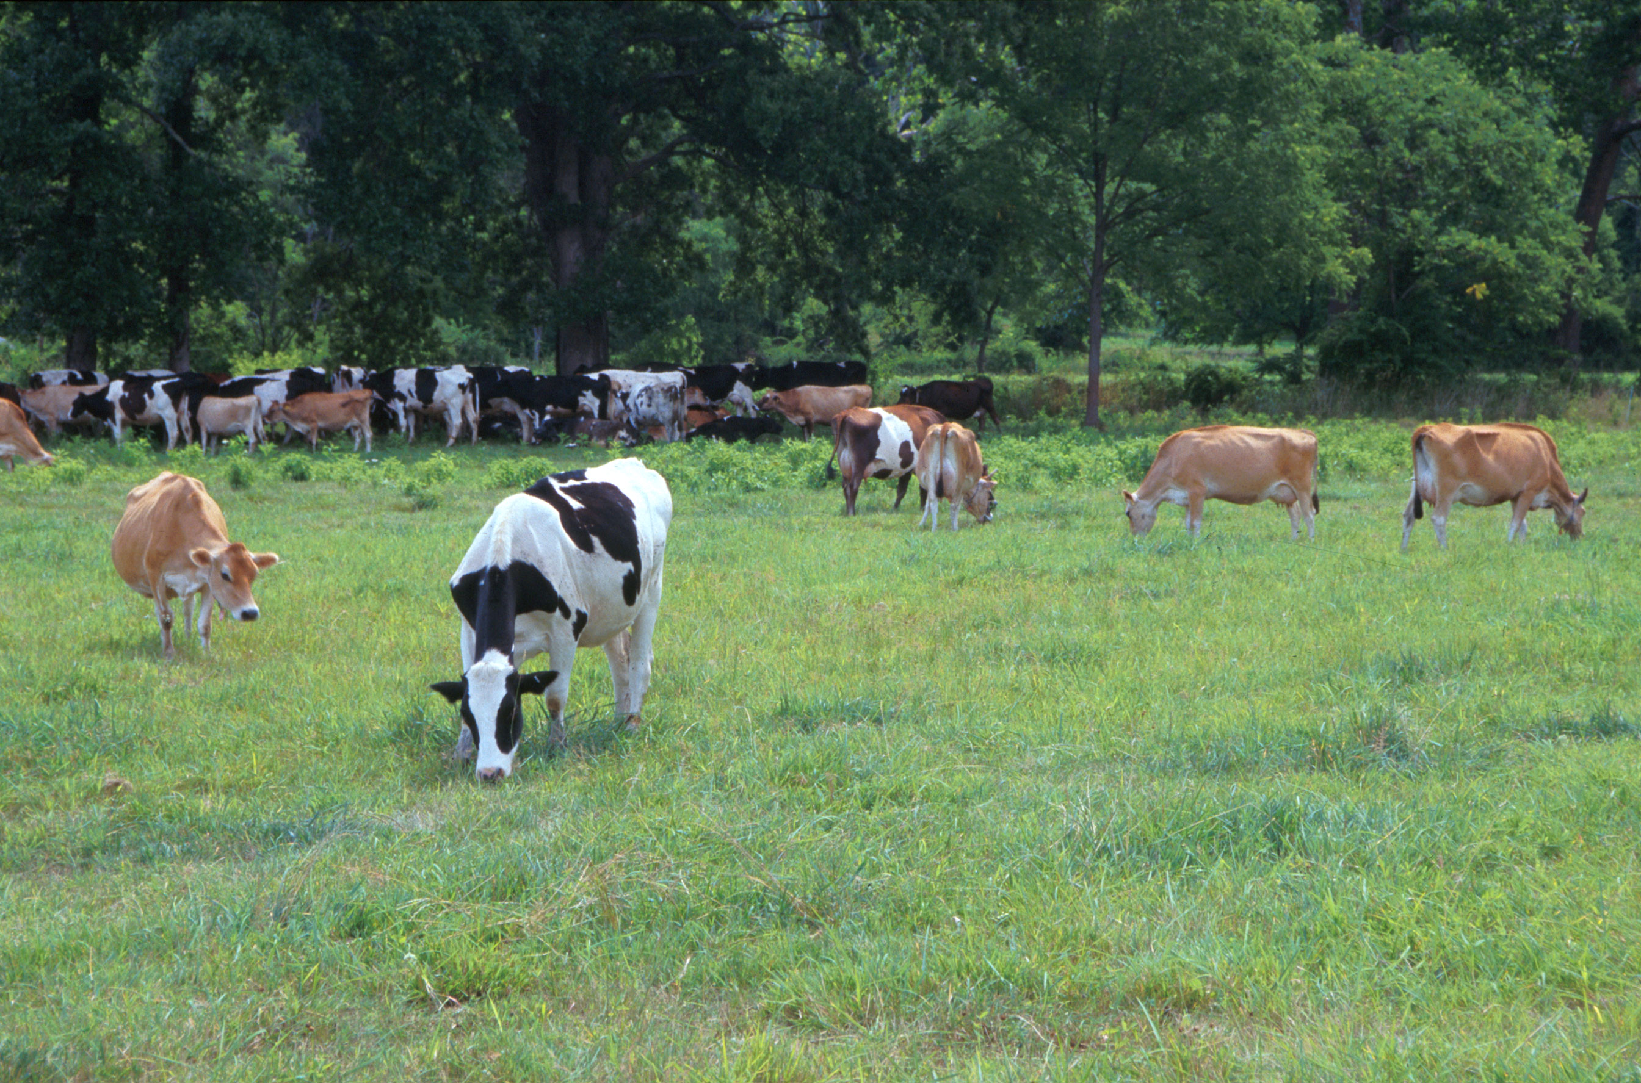
Questions?
AIP web site:
http://aipl.arsusda.gov
Holstein and Jersey crossbreds graze on American Farm Land Trust’s
Cove Mountain Farm in south-central Pennsylvania
Source: ARS Image Gallery, image #K8587-14; photo by Bob Nichols

