Slide 1
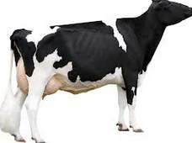


Mating Programs Including Genomic Relationships and Dominance Effects
Chuanyu Sun (NAAB)
Paul VanRaden (AIPL)

Slide 2
Introduction
Computerized mating programs have helped breeders reduce pedigree inbreeding by identifying matings between animals with fewer ancestors in common than average
In genomic era, dense single nucleotide polymorphism (SNP) markers across the whole genome have been widely used for genomic selection
Pedigree relationship
Genomic relationship

Slide 3
Introduction
Inbreeding should be controlled on the same basis as used to estimate breeding values (Sonesson et al. 2012)
Pedigree-based inbreeding control with traditional pedigree-based method estimated breeding values
Genome-based inbreeding control with genome-based estimated breeding values
New programs to minimize genomic inbreeding by comparing genotypes of potential mates should be developed and implemented by breed associations, AI organizations, and on-farm software providers

Slide 4
Introduction
Dominance effects could also be included in mating programs to estimate inbreeding losses more precisely
However, dominance effects have been rarely included in genetic evaluations
Computational complexity
Lack of statistical reliability for estimates of variance components
Most countries only genotyped bulls and a few females
Estimation of dominance effects of SNP requires the availability of direct phenotypes (i.e., genotypes and phenotypes for the same individuals)

Slide 5
Introduction
Objective
Develop a method of rapid delivery of genomic relationships from central database to the industry
Mating program:
Two kinds of relationship matrix A and G
Three mating strategies for maximizing expected progeny value
linear programming (LP)
sequential selection of least-related mates (Pryce et al., 2012, SM)
random mating (RD)
Extension to include dominance effect

Slide 6
Materials and Methods
Numbers of animals used for calculating the genomic relationship matrix and dominance effect and used in mating programs by breed
Animals | Brown Swiss | Jersey | Holstein
Genotyped population | 7,623 | 28,618 | 233,482
Animals in pedigrees of genotyped animals | 35,193 | 138,247 | 656,079
Marketed males | 80 | 287 | 1,518
Genotyped cows | 1,343 | 21,767 | 165,540
Genotyped cows with phenotypes for dominance estimation | — | 8,323 | 30,583
Mating programs
Males | 8 | 50 | 50
Cows | 79 | 500 | 500

Slide 7
Materials and Methods
Potential options for providing the genomic relationship matrix required for a genomic mating program include
1
Computation of relationships between all genotyped animals and then extraction sub-matrix.
2
Computation of relationships of all genotyped females with each marketed genotyped bull (e.g., >160,000 females and >1,500 bulls for Holsteins) and then extraction sub-matrix
3
Computation of relationships only between requested females and bulls via a web query.

Slide 8
Materials and Methods
Mean expect progeny values (EPV)
GLNM is Genomic lifetime net merit
B_{LNM} is defined as the loss of LNM per 1% inbreeding,
EFI is expected future inbreeding,
G_{sire,dam} is the genomic relationship between sire and dam

Slide 9
Materials and Methods
Linear mixed models were used to estimate additive and dominance variance components:
GBLUP
Predict SNP effects:
SNP-GBLUP

Slide 10
Materials and Methods
The dominance effect for each progeny was obtained by summing over all loci and the 3 genotype probabilities, giving
Mean EPV for milk yield

Slide 11
Materials and Methods
Mating strategies
LP vs SM vs RD
Matings were limited to 10 females per bull and 1 bull per female.
female
Bulls
 |  |  |  | EPV_{ij}

Slide 12
Results
Computation times and disk storage required for the genomic relationship matrix (G) for genotyped cows and marketed bulls and computation times for extraction or recalculation of G for a subset of animals
Breed | G for genotyped cows and marketed bulls |  |  |  | G for subset of genotyped cows and marketed bulls
 | Computation time (h:min:s) |  | Disk storage (Mbytes) |  | Animals (no.) |  | Computation time²
 |  |  |  |  |  |  | Extraction (h:min:s) |  | Recalculation (s)
Brown Swiss | 00:00:13 |  | 31 |  | 338 |  | 00:00:01 |  | 4
Holstein | 16:22:42 |  | 425,855 |  | 1,817 |  | 01:58:06 |  | 31
Jersey | 00:17:11 |  | 7,422 |  | 585 |  | 00:01:46 |  | 6

Slide 13
Results – without dominance
Selected bulls | Mating method | Mate EBV source | Mate inbreeding source | EPV ($) |  |  |  | Progeny inbreeding (%)
 |  |  |  | Brown Swiss | Holstein | Jersey |  | Brown Swiss | Holstein | Jersey
Top 50 for GLNM | LP | GLNM | G | 205 | 494 | 358 |  | 6.94 | 5.17 | 3.72
 |  |  | A | 184 | 462 | 326 |  | 7.87 | 6.58 | 5.12
 | SM | GLNM | G | 181 | 474 | 333 |  | 7.97 | 6.03 | 4.78
 |  |  | A | 175 | 450 | 312 |  | 8.27 | 7.09 | 5.70
 | RD | — |  | 138 | 422 | 255 |  | 9.83 | 8.31 | 8.17
Top 50 for TLNM | LP | TLNM | G | 158 | 393 | 307 |  | 6.11 | 4.87 | 3.41
 |  |  | A | 136 | 363 | 274 |  | 7.07 | 6.15 | 4.82
 | SM | TLNM | G | 127 | 372 | 278 |  | 7.45 | 5.79 | 4.66
 |  |  | A | 124 | 350 | 263 |  | 7.60 | 6.72 | 5.32
 | RD | — | — | 107 | 314 | 214 |  | 8.36 | 8.30 | 7.43
Random 50 | LP | GLNM | G | 64 | 70 | 78 |  | 6.64 | 4.46 | 3.65
 |  |  | A | 43 | 40 | 42 |  | 7.56 | 5.77 | 5.22
 |  | TLNM | G | 64 | 70 | 78 |  | 6.64 | 4.46 | 3.65
 |  |  | A | 45 | 40 | 41 |  | 7.49 | 5.78 | 5.26
 | SM | GLNM | G | 37 | 36 | 46 |  | 7.83 | 5.97 | 5.04
 |  |  | A | 27 | 21 | 29 |  | 8.26 | 6.58 | 5.76
 |  | TLNM | G | 32 | 39 | 46 |  | 8.05 | 5.84 | 5.05
 |  |  | A | 22 | 24 | 27 |  | 8.47 | 6.48 | 5.86
 | RD | — | — | 0 | 0 | 0 |  | 9.30 | 7.51 | 7.04

Slide 14
Results – without dominance
For all methods and groups of bulls, EPV was higher when genomic rather than pedigree relationship was used as the mate inbreeding source.
For each group of bulls, EPV was higher for linear programming than the sequential method, and both of those methods were better than random mating.
When mates were from the top 50 bulls for genomic LNM, EPV was higher than when mates were from the top 50 for traditional LNM or random bulls.
Mean genomic inbreeding of progeny was lowest when genomic relationship was used other than pedigree relationship
LP is better than SM and RD on control inbreeding of progeny

Slide 15
Results – with dominance
Dominance variances were 4.1% and 3.7% of phenotypic variance for Holsteins and Jerseys, respectively.
Selected bulls | Mating method | Dominance effect included | Mate inbreeding source | EPV (kg) |  |  |  | Progeny inbreeding (%)
 |  |  |  | Holstein |  | Jersey |  | Holstein |  | Jersey
Top 50 for GPTA milk | LP | Yes | G | 964 |  | 732 |  | 5.38 |  | 4.34
 |  |  | A | 957 |  | 719 |  | 5.72 |  | 4.96
 |  | No | G | 878 |  | 680 |  | 4.62 |  | 3.63
 |  |  | A | 763 |  | 604 |  | 6.11 |  | 5.11
 | SM | Yes | G | 889 |  | 662 |  | 5.85 |  | 4.98
 |  |  | A | 881 |  | 649 |  | 6.11 |  | 5.48
 |  | No | G | 793 |  | 612 |  | 5.60 |  | 4.83
 |  |  | A | 714 |  | 578 |  | 6.66 |  | 5.62
 | RD | — | — | 618 |  | 537 |  | 7.92 |  | 6.46
Random 50 | LP | Yes | G | 319 |  | 252 |  | 5.52 |  | 4.10
 |  |  | A | 313 |  | 237 |  | 5.83 |  | 4.84
 |  | No | G | 214 |  | 198 |  | 4.62 |  | 3.39
 |  |  | A | 134 |  | 122 |  | 5.92 |  | 4.92
 | SM | Yes | G | 220 |  | 155 |  | 6.08 |  | 5.08
 |  |  | A | 208 |  | 142 |  | 6.34 |  | 5.44
 |  | No | G | 112 |  | 120 |  | 6.10 |  | 5.06
 |  |  | A | 65 |  | 92 |  | 6.74 |  | 5.61
 | RD | — | — | 0 |  | 0 |  | 7.57 |  | 7.51

Slide 16
Results – with dominance
Regardless of bull group, mating method, and inbreeding source, EPV for milk yield of Holsteins and Jerseys was higher when dominance effects were included
Progeny inbreeding can be decreased by using linear programming instead of the sequential method and using genomic rather than pedigree relationships for the mating program with a dominance effect included.
Progeny inbreeding did not decrease by including a dominance effect. A possible reason may be selection for dominance effects diluted the attempt to minimize genomic inbreeding.

Slide 17
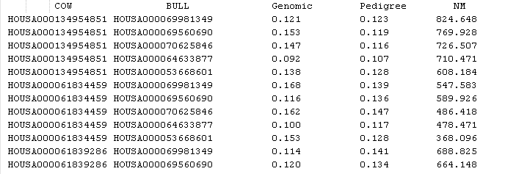

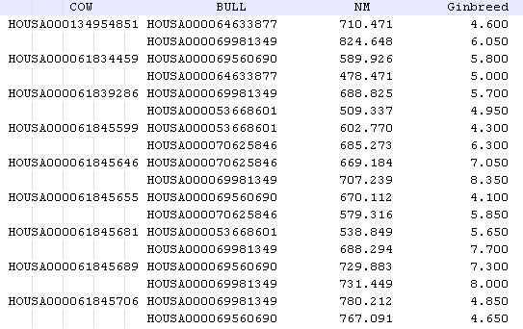
Results
Inputs
HOUSA000069981349
HOUSA000069560690
HOUSA000070625846
HOUSA000064633877
HOUSA000053668601
HOUSA000134954851
HOUSA000061834459
HOUSA000061839286
HOUSA000061845599
HOUSA000061845646
HOUSA000061845655
HOUSA000061845681
HOUSA000061845689
HOUSA000061845706
HOUSA000061845722
HOUSA00035SHE7944
HOUSA00035SHE7943
HOUSA00035SHE7948
HOUSA00035SHE7949
Outputs

Slide 18
Conclusions
Mating programs including genomic relationships were much better than using pedigree relationships
Extra benefit was gained when dominance effects were included in the mating program.
Combining LP and genomic relationship was always better than other methods regardless of the selection done and whether dominance effect was included or not.
A total annual value of ($494 − $462)(120,989) = $3,871,648 when applied to 120,989 females genotyped in the last 12 months (ending June 2013) for HO
Developed mating software is ready for service

Slide 19
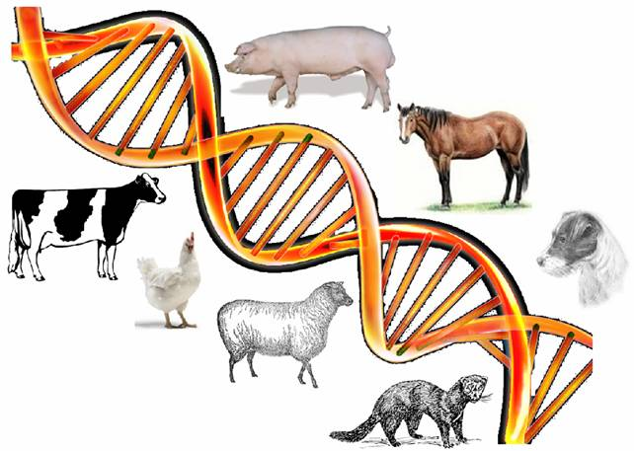
Thank you

