Slide 1
Reliability Increases from Combining 50,000- and 777,000-Marker Genotypes from 4 Countries

Slide 2
Topics
Effect of foreign bulls on U.S. reliability (REL)
  Model foreign as single-trait (ST) or multitrait (MT)
  Addition of CAN, GBR, and ITA Holsteins (HOL)
  Addition of CHE, DEU, and AUT Brown Swiss (BSW)
Compare high-density (HD) with 50K predictions
  1,510 HD genotypes for HOL bulls
  ST USA, CAN, GBR, ITA

Slide 3

Multitrait Model
Foreign genomic information could outweigh domestic data (GxE or GxG)
  Low genetic correlations because of environment
  (traits are really different between countries)
  Poor ties between domestic and foreign animals (genetic distance)
Genetic correlation
  Average correlation for all foreign bulls (MT)
  Assume MACE EBV are correlated by 1.0 (ST)

Slide 4
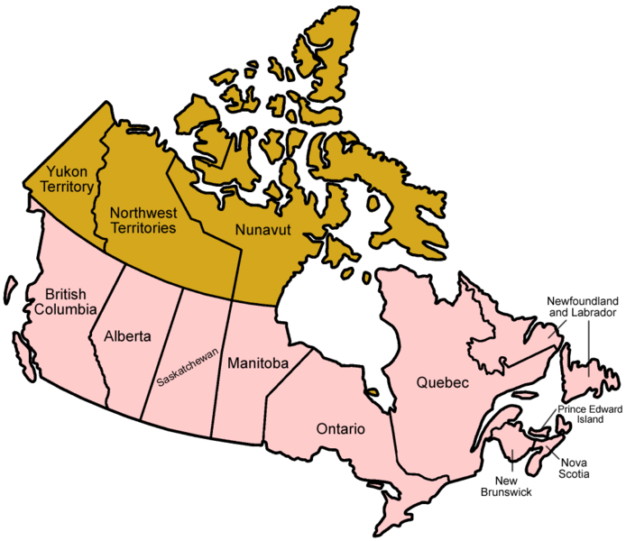
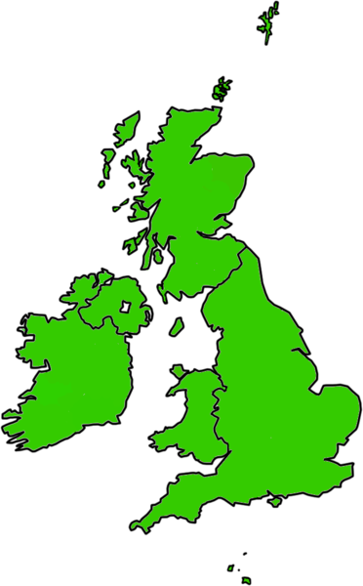
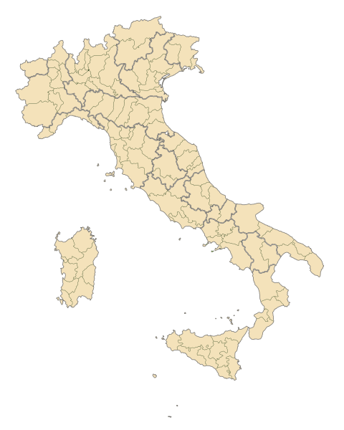
Foreign Holstein Reference Bulls
3,593 (28% of total bulls) had no U.S. daughters in 2008
CAN
1,321 bulls
GBR
247 bulls
ITA
1,677 bulls

Slide 5
Reference Genotypes
Animals genotyped | BSW |  |  |  | HOL
 | Male |  | Female |  | Male |  | Female
May 2012 data | 2,125 |  | 971 |  | 59,705 |  | 122,528
Reference population | 1,682 |  | 374 |  | 18,508 |  | 22,800
Foreign reference | 870 |  |  |  | 7,974
August 2008 data
Reference population | 1,473 |  | 171 |  | 10,718 |  | 5,124
Foreign reference | 732 |  |  |  | 3,593
U.S. validation bulls | 115 |  |  |  | 3,404

Slide 6
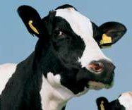
REL – REL_{PA} (HOL)
Trait | Foreign excluded | ST | MT
Average (9 traits) | 21.9 | 24.6 | 24.5
Milk | 26.6 | 28.7 | 28.6
Fat | 29.0 | 31.3 | 31.1
Protein | 20.2 | 22.5 | 22.3
Productive life | 19.5 | 21.8 | 22.2
SCS | 23.7 | 27.2 | 27.2
Daughter pregnancy rate | 17.5 | 21.3 | 21.2
Final score | 22.2 | 24.0 | 24.1
Stature | 29.4 | 34.0 | 33.9
Sire calving ease | 8.8 | 10.4 | 9.7

Slide 7
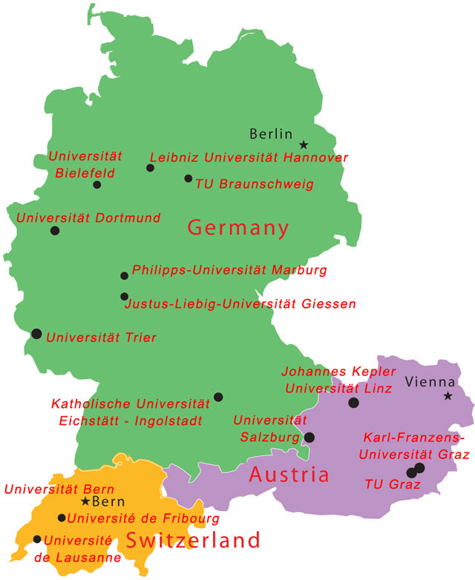
Foreign Brown Swiss Reference
More arriving soon from InterGenomics
DEU
318 bulls
AUT
52 bulls
CHE
403 bulls

Slide 8
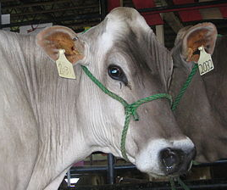
REL – REL_{PA} (BSW)
Trait | Foreign excluded | ST | MT
Average (9 traits) | 8.5 | 11.7 | 13.1
Milk | 15.6 | 20.9 | 20.6
Fat | 10.3 | 11.4 | 12.5
Protein | 13.5 | 16.2 | 16.6
Productive life | 4.9 | 6.5 | 7.5
SCS | 5.0 | 4.2 | 6.6
Daughter pregnancy rate | 9.8 | 6.8 | 7.3
Final score | 2.7 | 9.3 | 15.7
Stature | 12.8 | 21.5 | 24.2
Sire calving ease | 1.9 | 8.7 | 6.6

Slide 9
HD Genotypes
1,510 HOL Illumina BovineHD
  460 ITA bulls
  305 USA bulls and 172 USA cows
  284 GBR bulls
  93 CAN bulls
  196 bulls from other countries
Earlier studies of 342 or 1,078 HD

Slide 10
HD REL Gains (HOL)
Trait | REL_{50K} REL_{PA} | REL_{HD} REL_{50K} | HD_{nonlinear} HD_{linear}
Average (28 traits) | 31.5 | 0.4 | 0.8
Milk | 28.7 | 0.3 | 1.2
Fat | 31.3 | 0.2 | 1.8
Protein | 22.5 | 0.5 | 0.3
Productive life | 21.8 | 1.6 | 1.3
SCS | 27.2 | 0.5 | 0.4
Daughter pregnancy rate | 21.3 | 0.7 | 0.4
Final score | 24.0 | 0.2 | 0.1
Stature | 34.0 | 1.8 | 0.7
Sire calving ease | 10.4 | 2.3 | 1.9

Slide 11
Preliminary HD Studies
Average REL gain of HD compared with 50K across 28 traits
  0.5% decrease using 342 HD
  0.5% increase using 1,074 HD
  0.4% increase using 1,510 HD
Imputation accuracy tested using simulated chromosome and same population structure as actual

Slide 12
Imputation Accuracy (% correct)
Markers | Animals | Findhap all |  | FImpute
 |  |  |  | All |  | 2-step¹
330,000 | 1,112 | 99.89 |  | 99.96 |  | 99.96
41,250 | 72,532 | 99.0 |  | 99.3 |  | 99.3
5,130 | 1,000 | 94.6 |  | 94.7 |  | 96.1
2,550 | 38,441 | 90.5 |  | 91.1 |  | 93.7
0² | 3,295 | 93.5 |  | 95.1 |  | 96.7
¹Imputing lower densities to 41,250 and then imputing to
330,000 in a second step instead of all together
²Dams imputed from 4 progeny

Slide 13
Conclusions
REL improved with foreign bulls and ST methods
  2.6% for HOL and 3.2% for BSW
  Actual gains larger
    Multicountry bulls counted as domestic
    More recent HOL bulls are foreign
  MT added 1.4% REL only for BSW
HD only 0.4% higher REL than 50K
  Imputation accurate with 1,000 HD
  FImpute more accurate than findhap

Slide 14
Acknowledgments
Genotype exchanges coordinated by Marj Faust, Brian Van Doormaal, Gordon Doak, and Dan Gilbert
Genotypes provided by
  Cooperative Dairy DNA Repository (USA)
  Canadian Dairy Network (CAN)
  Italian Ministry of Agriculture (MIPAAF) Innovagen project (DM 10750-7303-2011) and ANAFI (ITA)
  Defra and Ruminant Genetic Impr. Network (GBR)
  Swiss Brown Cattle Breeders’ Federation (CHE)
  Bavarian State Research Center for Agriculture (DEU)

Slide 15
Acknowledgments (continued)
HD bulls to genotype selected by
  Kent Weigel (University of Wisconsin)
  Ezequiel Nicolazzi (Parco Tecnologico Padano, Italy)
HD genotypes edited and assembled by USDA’s Animal Improvement Programs Laboratory (AIPL) and Bovine Functional Genomics Laboratory (BFGL )
  George Wiggans (AIPL)
  Lillian Bacheller (AIPL)
  Mel Tooker (AIPL)
  Tabatha Cooper (AIPL)
  Tad Sonstegard (BFGL)
  Erin Connor (BFGL)
  Alicia Beavers (BFGL)

