Slide 1
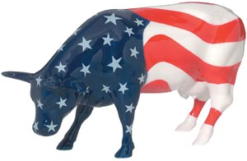
The U.S. genetic evaluation system

Slide 2
U.S. dairy population and milk yield
Data sources: http://www.nass.usda.gov/Quick_Stats/index.php http://www.census.gov/prod/www/abs/decennial/

Slide 3
U.S. DHI dairy statistics (2011)
9.1 million U.S. cows
~75% bred AI
47% milk recorded through Dairy Herd Information (DHI)
  4.4 million cows
    86% Holstein
    8% crossbred
    5% Jersey
    <1% Ayrshire, Brown Swiss, Guernsey, Milking Shorthorn, Red & White
  20,000 herds
  220 cows/herd
  10,300 kg/cow
Data sources: http://www.nass.usda.gov/Quick_Stats/index.php
National Association of Animal Breeders, 573-445-4406
http://aipl.arsusda.gov/publish/dhi/part.html
http://aipl.arsusda.gov/publish/dhi/herd.html

