Slide 1
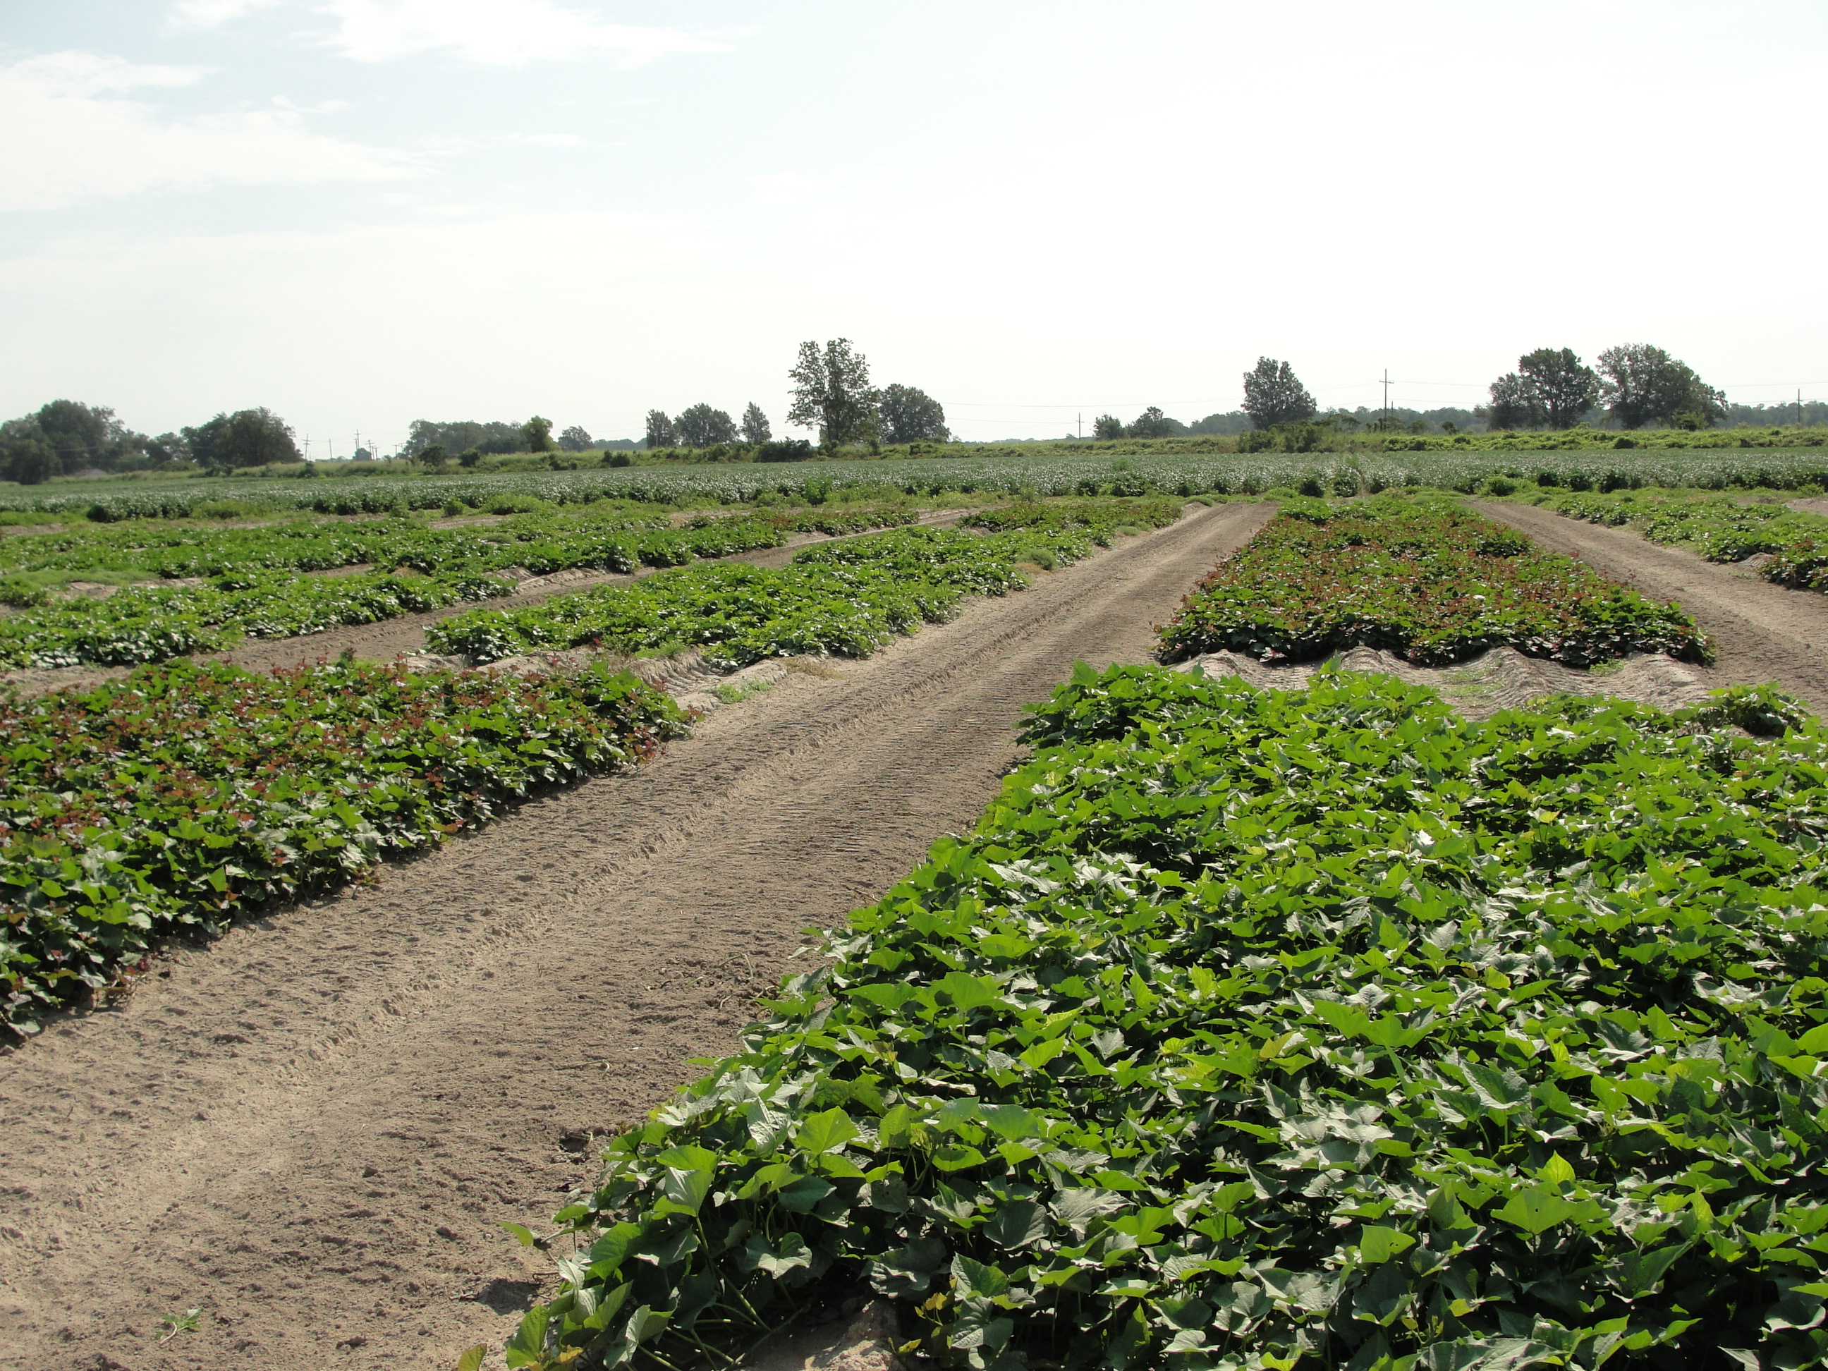
2011 Product Evaluation and Varietal Differences for Reniform Nematode
Suppression in Mississippi Delta Sweetpotato Production
Larry Adams and Randy Luttrell
USDA, ARS, SIMRU
Stoneville, MS
Introduction
The reniform nematode, Rotylenchulus reniformis, can cause significant losses in sweetpotato, Ipomoea batatas, production in the Mississippi Delta. Reniform nematode is a microscopic plant parasite that feeds on sweetpotato roots causing severe stunting of root growth. Reduction in yield due to the presence of above threshold populations has been documented across historical sweetpotato producing areas of the United States. Reniform nematodes can cause significant economic loss if managed improperly. Traditionally, high numbers of reniform nematodes are encountered in sandy/silt loam delta soils where sweetpotato production follows cotton acreage.
In 2011 researchers at the USDA, ARS, Southern Insect Management Research Unit (SIMRU) compared five treatments for control of the reniform nematode in Mississippi Delta sweetpotato fields. In a second study during 2011 SIMRU scientist compared three sweetpotato varieties, Beauregard 63, Covington and Evangeline, in an area with a moderately high reniform nematode population. Sweetpotato plots with and without a nematicide and sweetpotato plots with and without a soil incorporated insecticide before transplanting of sweetpotato slips were evaluated. In both studies soil samples were taken twice during the season to assess reniform populations. Yield, quality and insect damage were recorded and analyzed. Significant yield increases were recorded in the K-Pam, Telone II and NemOut .9 lbs/A treatments when compared to the untreated control plots.
2011 Product Evaluation Study
Materials and Methods
Research Plot Design
Sweetpotato plots were replicated four times with four rows x 25’ (RCB). Spring nematode samples were taken on 4/25/2012. Reniform nematode counts were 2800/pint of soil. Recommended herbicides were applied before and after transplanting. B63 sweetpotato slips were transplanted using a two row transplanter at 12” spacing on 40” rows on 6/1/2011. Plots were harvested on 10/3/2011 at 114 days after transplanting. Irrigation was applied as needed to all plots.
Insect Sampling
Sweep net samples were taken weekly using a 15” net with 25 sweeps in four locations randomly across the field. Insect populations were recorded and treatments applied as needed.
Nematicide Treatments Applied in the Product Evaluation Study
Untreated
*K-Pam HL @ 8 Gal/A 3 weeks before transplanting
*Telone II @ 6 Gal/A 2 weeks before transplanting
*NemOut @ .6 lbs/A 2 weeks before transplanting
*NemOut @ .9 lbs/A 2 weeks before transplanting
Mocap 6EC @ 1 Gal/A 2 weeks before transplanting
Insecticide Treatments
*Nematicide treatment plots included Lorsban @ 64 oz/A (Incorporated).
A foliar insecticide treatment of Intrepid 2F @ 0.156 ai/A plus Capture 2 EC @ .03 ai/A was applied to all treatment plots on 8/10/2011
Soil Sample Dates
Mid-Season nematode samples were taken on 7/20/2011 & Pre-Harvest nematode samples were taken on 9/15/2011.
2011 Varietal Differences Study
Materials and Methods
Research Plot Design
Sweetpotato plots were replicated four times with four rows x 25’ (RCB). Spring nematode samples were taken on 4/25/2012. Reniform nematode counts averaged 1800/pint of soil (±SEM). Recommended herbicides were applied before and after transplanting. B63, Covington and Evangeline variety sweetpotato slips were transplanted using a two row transplanter at 12” spacing on 40” rows on 6/2/2011. Plots were harvested on 10/4/2011 at 114 days after transplanting. Irrigation was applied as needed to all plots.
Insect Sampling
Sweep net samples were taken weekly using a 15” net with 25 sweeps in four locations randomly across the field. Insect populations were recorded and treatments applied as needed.
Nematicide Treatments Applied in the Product Evaluation Study
Control Treated – B63
Control Untreated – B63
Control Treated – Covington
Control Untreated – Covington
Control Treated – Evangeline
Control Untreated – Evangeline
*K-Pam HL Treated – B63
*K-Pam HL Untreated – B63
*K-Pam HL Treated – Covington
*K-Pam HL Untreated – Covington
*K-Pam HL Treated – Evangeline
*K-Pam HL Untreated
*K-Pam HL @ 8 Gal/A applied 3 weeks before transplanting.
Insecticide Treatments
The Control & K-Pam HL treated plots included Lorsban @ 64 oz/A (Incorporated).
A foliar insecticide treatment of Intrepid 2F @ 0.156 ai/A plus Capture 2 EC @ .03 ai/A was applied to all treatment plots on 8/10/2011.
Soil Sample Dates
Mid-Season nematode samples were taken on 7/20/2011 & Pre-Harvest nematode samples were taken on 9/15/2011.
Summary
The mid-season nematode samples in the product evaluation study indicated a decrease in the reniform nematode population in all treatments except Mocap when compared to the untreated control (Chart 1). The Telone II treatment continued to suppress the reniform nematode population in the pre-harvest nematode samples (Chart 1). K-Pam, Telone II and NemOut .9 lbs/A treatment yields were significantly higher than the untreated control (Chart 2). All treatments in the varietal differences study showed a response to the K-Pam treatment in the mid-season and pre-harvest nematode samples with the exception of the K-Pam TRT B63 and the Control TRT B63 treatments at mid-season (Chart 3). There was no indication that Lorsban treatment with or without K-Pam application was contributing to suppression of reniform nematode populations in this study (Chart 3). The Evangeline Control UnTRT and TRT with Lorsban showed a higher number of reniform nematodes than the Covington and B63 Control UnTRT and TRT with Lorsban in the mid-season nematode samples (Chart 3). In the pre-harvest nematode samples, all of the K-Pam Evangeline and K-Pam Covington treatments were above or approaching the fall threshold population of reniform nematodes while the K-Pam B63 treatments were still below threshold (Chart 3). All varieties in the Control treatments were above the fall threshold number for reniform nematodes in the pre-harvest nematode samples (Chart 3). Yield results from the varietal differences study showed the K-Pam treatments higher than the Control treatments, in all varieties, with the exception of the Control TRT Evangeline treatment (Chart 4). Only the K-Pam TRT Covington treatment yield was significantly different from all other treatments (LSD, P=0.05). Covington and Evangeline varieties yielded more than B63 in both the Control and K-Pam treatments although only the yield of Control UnTRT Covington, Control TRT Evangeline, K-Pam TRT Covington and K-Pam UnTRT Covington were significantly different from all other treatments (Chart 4).
Acknowledgement
We thank Chris P. Johnson, USDA, ARS, SIMRU, for his assistance in field plot preparation, maintenance and harvest and Debbie Boykin, USDA, ARS, Statistician, for assistance with the statistical analysis of the data in this study.

