Slide 1
Landraces: Infra-specific Diversity & Adaptive Divergence
Of an
Endangered Evolutionary Link
[2]

Slide 2
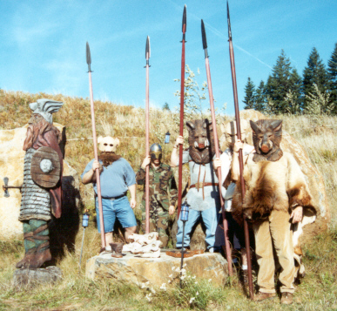
Why abandon a “comfortable” way of life??

Slide 3
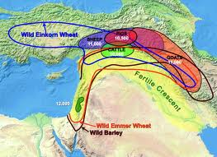
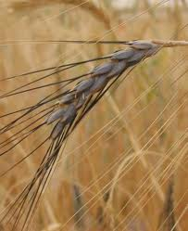
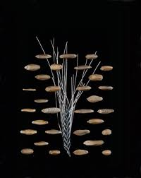
Wheat Domestication

Slide 4
A Very Special Wheat

Slide 5
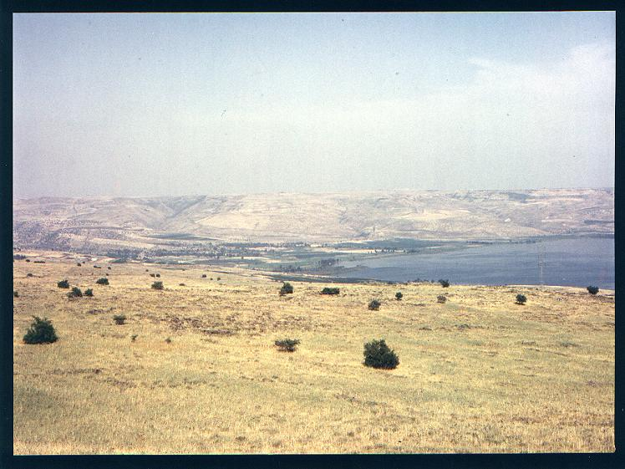
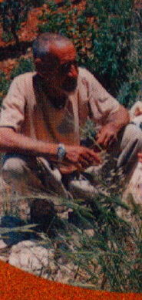
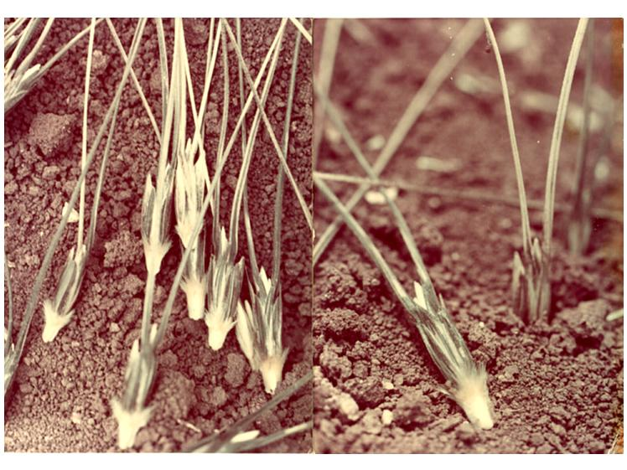
Thanks to those farmer who, over the centuries and out of curiosity, or probably neglect, managed to give wild emmer wheat a chance to persist and flourish.

Slide 6
Classification of cultivated wheats and closely related wild species
(Feldman, 1995)
Species Genomes Wild Cultivated
Hulled Hulled Free Threshing
Diploid (2n=14)
Aegilops speltoides S(G) All
Ae. bicornis Sb All
Ae. longissima Sl All
Ae. searsii Ss All
Ae. squarossa D All
T. urartu A All
T. monococcum A var boeoticum var monococcum var sinskajae
(wild einkorn) (cult. einkorn)
Tetraploid (2n=28)
T timopheevi AG var araraticum var timopheevi var militinae
T turgidum AB var dicoccoides var dicoccum var durum
(wild emmer) (cult emmer) var polonicum
var carthlicum
var turanicum
Hexaploid (2n=42)
T aestivum ABD var spelta var aestivum
var macha var compactum
var vavilovii var spharococcum

Slide 7
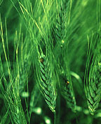
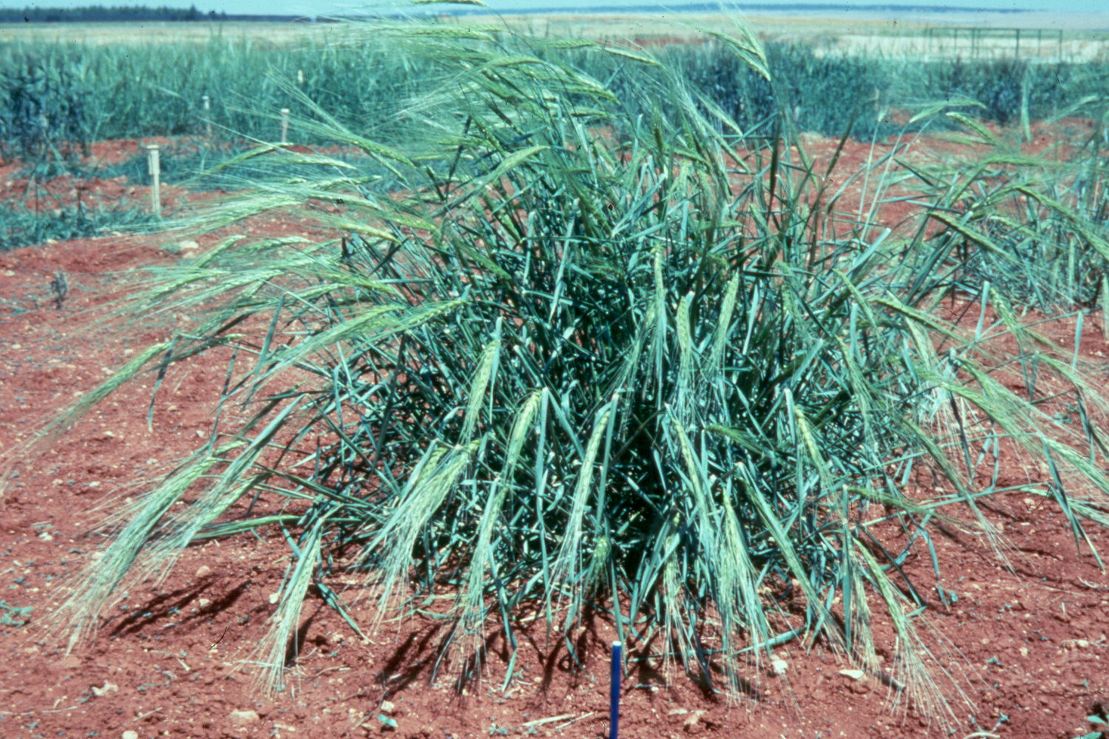
Domestication syndrome
Selection towards erect type
Synchronous tillering
Uniform ripening
High fertility (more seeds/spikelet)
Reduction of awns, glume thickness, and more grain investment (HI).

Slide 8
Four Thousand Years!! From T. monococcum to T.aestivum

Slide 9
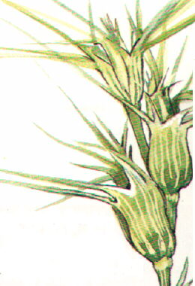
Contributions to the D genome
Multiple contributions of Ae. tauschii
Ae. tauschii & Ae. strangulata (subspecies)
Chromosome 2D played a critical role in the evolution of free threshing T. aestivum.
q Q [L5A] & Tg tg [S2D]
Q by itself is NOT enough to cause free-threshing habit.

Slide 10
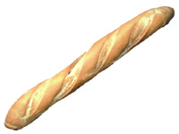
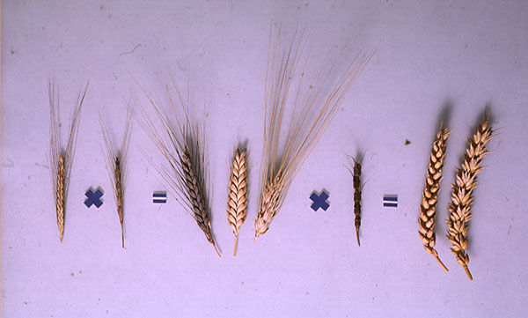
AA x BB = AABB x DD = AABBDD

Slide 11
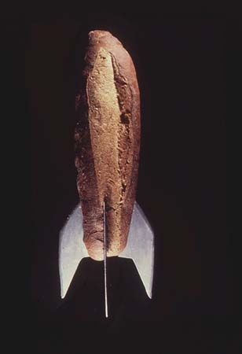
Man (woman) was “forced” to discover agriculture!!

Slide 13
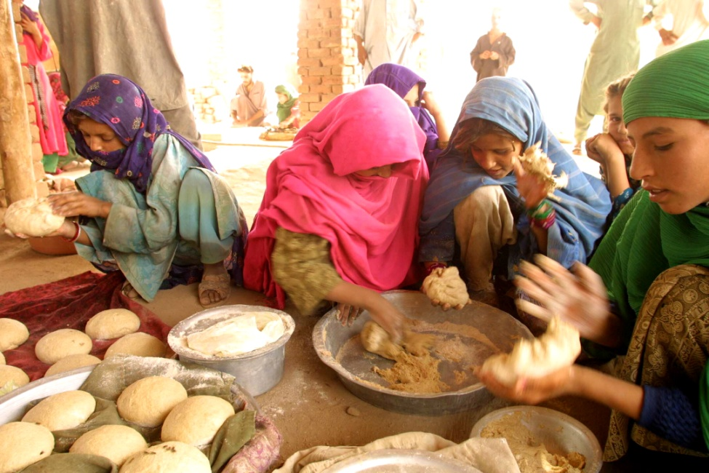
The history of cultivated wheat and that of human civilization have been closely interwoven!

Slide 14




