Slide 1

Next-Generation Genetic and Genomic Information for World Food Security
Jack K. Okamuro
National Program Leader for Plant Biology,
Crop Productoin & Protection, USDA-ARS
ARS Administrator’s Council Meeting
December 5, 2012
Beltsville, MD

Slide 2
Challenge
Food Security & Sustainability
Climate Change & Adaptability
Renewable & Sustainable Energy Production
Nutrition & Food Safety

Slide 3
Revolution
Unleash natural diversity for crop improvement using next generation genetic and genomic technologies
Expanded “open access " to global genomic and genetic information, tools and data
Globalization of genetic and genomic resources for global food security

Slide 4
Model
Maize represents 79% of US grain production and 34% of global grain production; 30% of calories for more than 4.5 billion people in 94 developing countries

Slide 5
Diversity
Over 10,000 years of adaptation to diverse environments
Genetic manipulation of flowering allows rapid access to diversity evolved elsewhere

Slide 6
Application
Utilize next generation genomic technologies to accelerate and engineer simple and complex traits
Evaluate Natural Variation
Mathematically Model Genotype to Phenotype
Predict Phenotype
Facilitates Rapid Breeding Progress
Modified from Ed Buckler

Slide 7
Progress
8-fold increase in yield over 80 years
USDA-NASS; Troyer 2006 Crop Sci. 46:528–543; Duvick 2005 Maydica 50:193-202

Slide 8
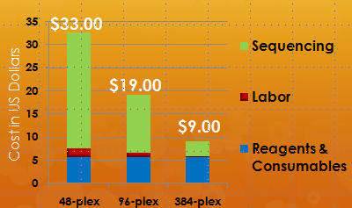
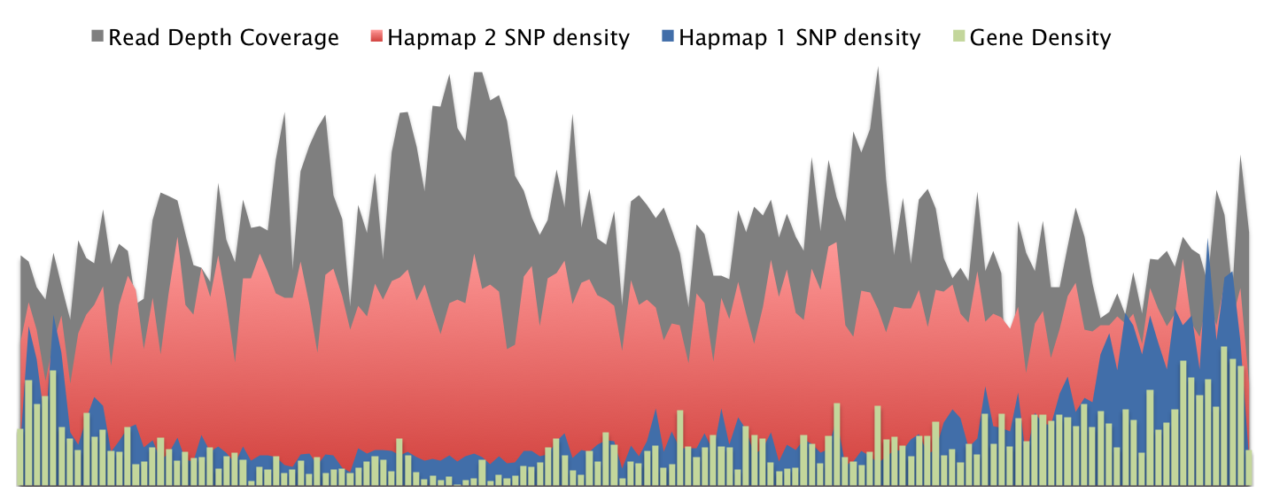
Acceleration
DNA sequencing drives the revolution
Next generation $15/$4,000 genotype/genome sequence
Genotyping by sequencing provides effective SNP coverage
GBS reveals genome-wide variation in genome structure (RDV)
Log2 ratios of RDV across Chr6

Slide 9
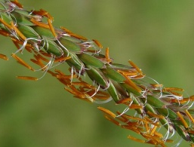
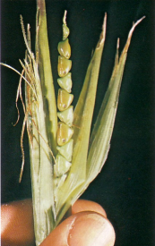
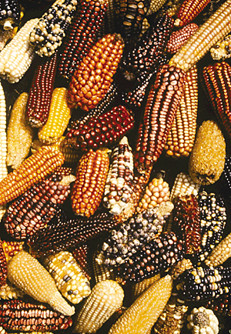
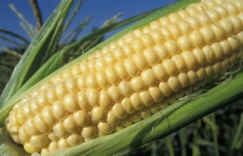
A time machine
GBS provides researchers with a molecular time machine
103 lines sequenced, over 1 trillion basepairs generated
Tripsacum dactyloides
1 sample
Teosinte (Zea Mays ssp. Mexicana)
2 Inbred lines
Teosinte (Zea Mays ssp. Parviglumis)
17 Inbred lines
Maize Landraces
23 Inbred lines
Maize Improved Varieties
60 Inbred lines
Modified from Jer-Ming Chia & Doreen Ware

Slide 10
Map, analyze, model target traits
Nested Association Mapping (NAM)
Crossed and sequenced 25 diverse maize lines to capture a substantial portion of world’s breeding diversity
Derived 5000 inbred lines from the crosses
Grew millions of plants, multiple locations/seasons
Largest genetic dissection system ever
NC358
P39
M37W
IL14H
McMullen et al 2009 Science
Tx303
B97
B73
CML52
B73
P39
Mo18W
Ki11
NC350
Ky21
Oh7B
Ki3
F1
F1
CML103
Oh43
MS71
Hp301
M162W
Tzi8
⊗
⊗
CML52
…
…
CML322
CML228
CML277
CML247
CML333
CML69
RIL₁
RIL₂
RIL₁₉₉
RIL₂₀₀
RIL₁
RIL₂
RIL₁₉₉
RIL₂₀₀
Modified from Ed Buckler

Slide 11
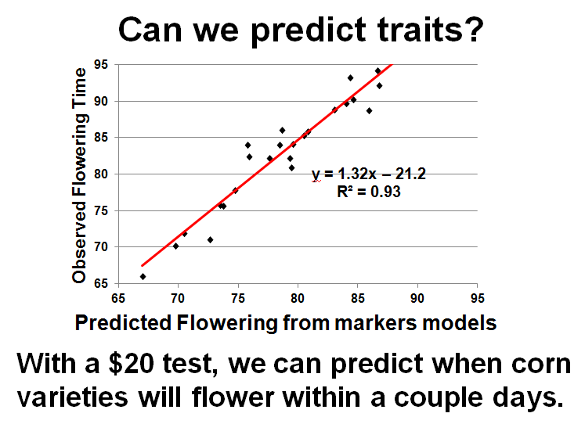
Trait models
Genotype-based trait prediction NAM based models enable
Increase Flowering Time
Number of Alleles
Decrease Flowering Time
Significant QTL
12h
24h
36h
NAM data enables researchers to predict traits based on genotype.
Develop new models that incorporate weighted loci
Flowering is controlled by more than 50 genes, each with small effects

Slide 12
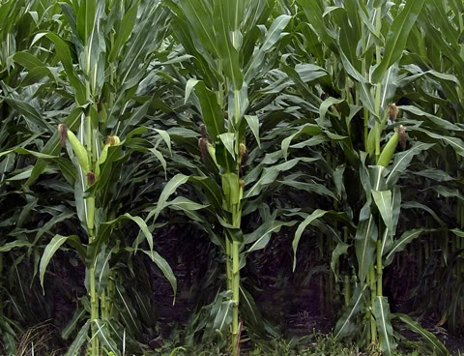
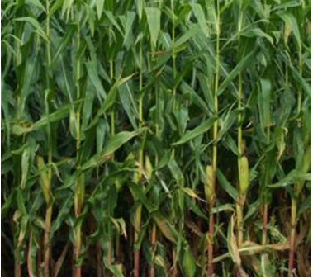
Applications
Determine the genetic basis for complex traits
Example: Altered leaf morphology allowed increased planting density. Newer hybrids have upright leaves (Duvick 2005)

Slide 13
Trait models
Models accurately predict complex traits if the right relatives are measured. Focus on high value traits.
Upper Leaf Angle
Leaf Length
Leaf Width
Significant alleles
Significant alleles
Significant alleles
Pos alleles
Neg alleles
96% of significant alleles display <2.5° effect
93% of significant alleles display <18mm effect
95% of significant alleles:display <3mm effect
R²=0.78
R²=0.84
R²=0.81
Notes:
30-40 genes control each aspect of the leaf Each gene has a small effect.

Slide 14
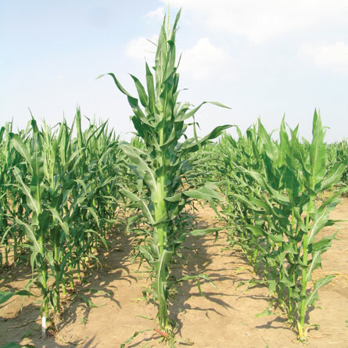
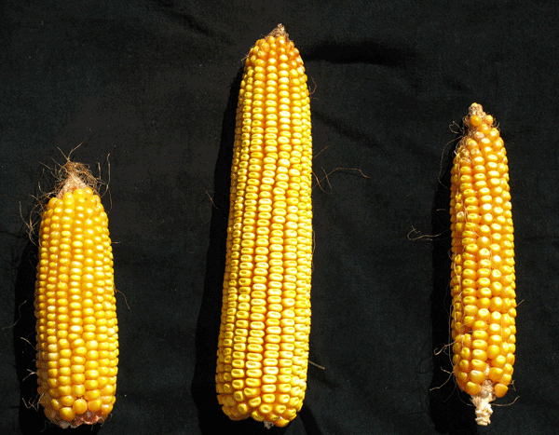
Hybrid vigor
Bad mutations occur all the time
Genomic mixing (recombination) is necessary to remove these
Regions with low recombination benefit from being in a hybrid state (i.e. cover for each other)
Hybrid
Index of Hybrid Vigor
Index of Recombination
Hybrid
Jun Cao and Patrick S. Schnable
Genomic Position
Competing models of hybrid vigor are almost 70 years old
University of Nebraska-Lincoln, 2004
Practical use began in 1920s

Slide 15
Conclusions
Trait variation is predictable
Common adaptive alleles selected by breeders are rare variants in wild populations; e
Environment determines the frequency and fitness of polymorphisms.
High impact of the adoption of genomic technologies for crop improvement

Slide 16
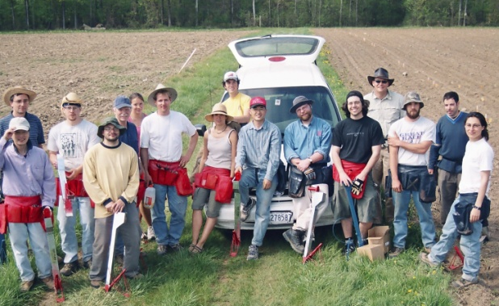



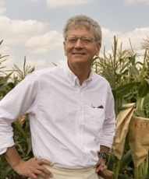

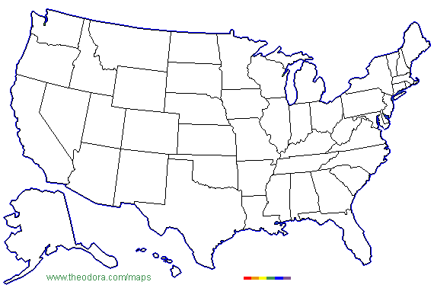

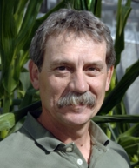
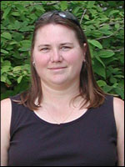

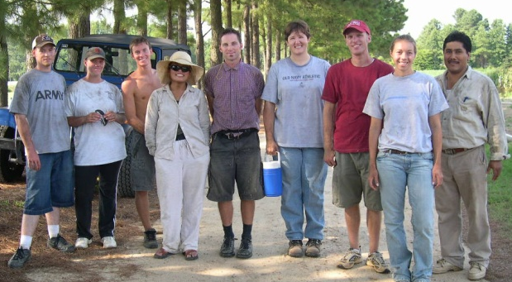
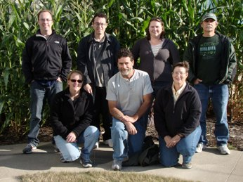
One team of many
www.panzea.org

Slide 17
Important challenge
How to accelerate and expand the adoption of next generation genomic technologies for crop improvement?
Target developing economy countries
IWGPG NPGI Workshop, PAG Saturday, 12 January 2013
  What tools and resources are needed that are not currently available?
  What tools and resources are needed that will enable translation of basic research for agriculture? For basic research in plant genomics?
  What information and resource repository needs are not currently being met?
  What opportunities do you see for leveraging investments through international coordination?
  ARS Big Data Workshop, February 2013
  G8 Open Data Research Collaboration Platform Workshop, April 2013

Slide 18

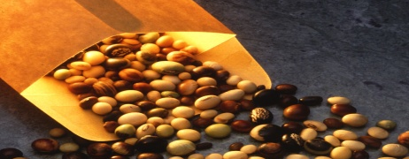

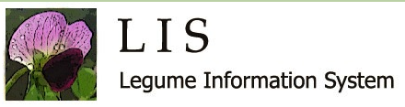

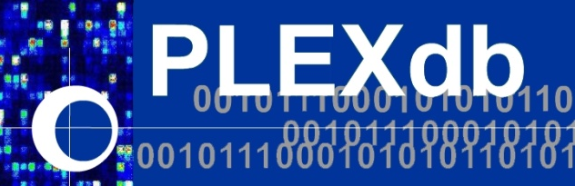

Globalize open data access
ARS provides open access system for global crop information system crop researc
Collaborators
ASPB
CIMMYt
Cold Spring Harbor Lab
Cornell University
Ensembl
European Bioinf Inst
Genome Institute
iPlant Collaborative
ICRISAT
IRRI
JCVI
KEGG
Knowledgebase
MIPS
Monsanto
Oryzabase
Phytozome
Plant Ontology Consortium
PLAZA
Syngenta
TAIR
GRIN-Global
panzea
Notes:
IWGPG coordination (NSF, DOE, NIFA, ARS coordination EU partners)
GRIN-Global
iPlant, XSEDE (National Science Foundation, ARS)
Knowledgebase (Department of Energy, ARS)
100% open access system sequence data, germplasm and genetic resources
Build on existing systems and expertise, e.g. Panzea, Gramene, MaizeGDB, Ensembl (European Bioinformatics Institute)
Switch to maize diversity image
Genotype to phenotype
Genetic and genomic toolbox
Sustainable
Global integration
Authoritative
Expert curators
Customers & Stakeholders
International stakeholders
USDA database system
Examples (SoyBase, LIS)
Access HPC: iPlant, XSEDE (National Science Foundation), Knowledgebase (Department of Energy)
IWGPG coordination (NSF, DOE, NIFA, ARS coordination EU partners)
100% open access system sequence data, germplasm and genetic resources
Build on existing systems and expertise, e.g. Panzea, Gramene, MaizeGDB, Ensembl (European Bioinformatics Institute)

Slide 19
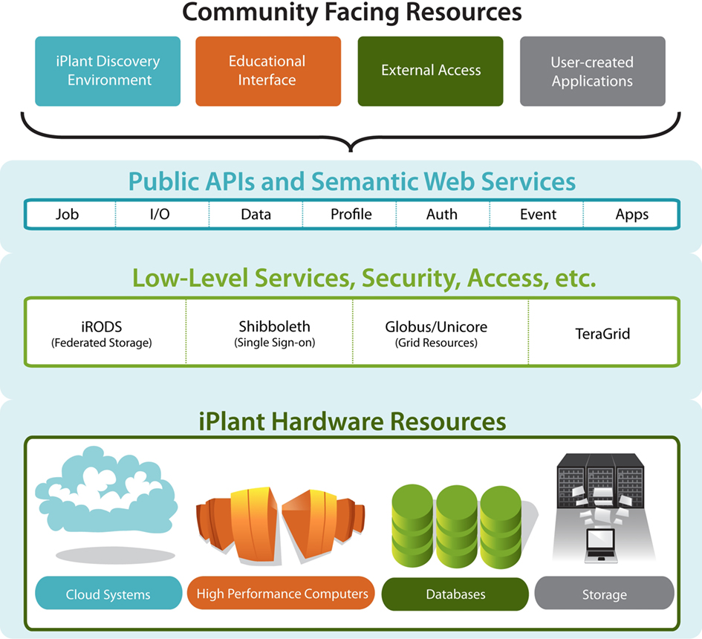


Expand open access to community tools & services through the iPlant Collaborative
End
Users
Computational
Users
TeraGrid
XSEDE
Multi-level
User
Access
From Eric Lyons
Notes:
iPlant layer cake of resources and services.
Bottom->Up: Hardware->low-services/middleware->APIs

Slide 20
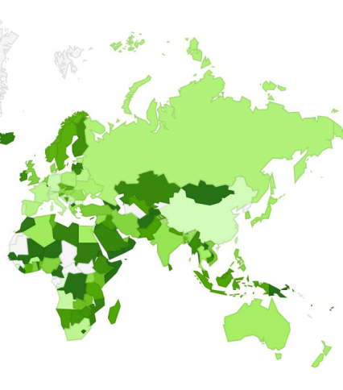
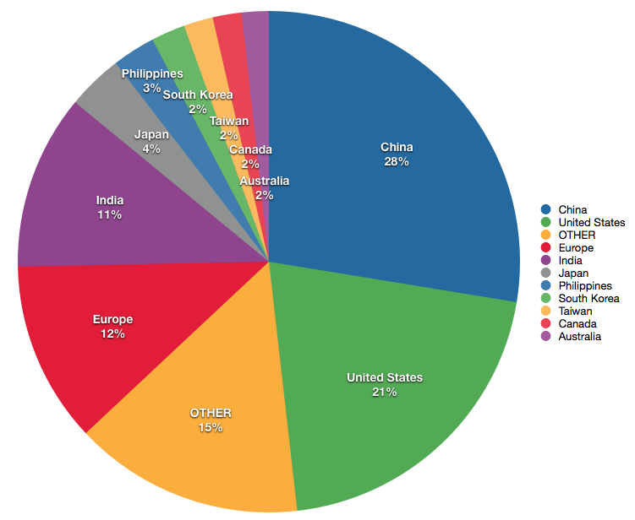
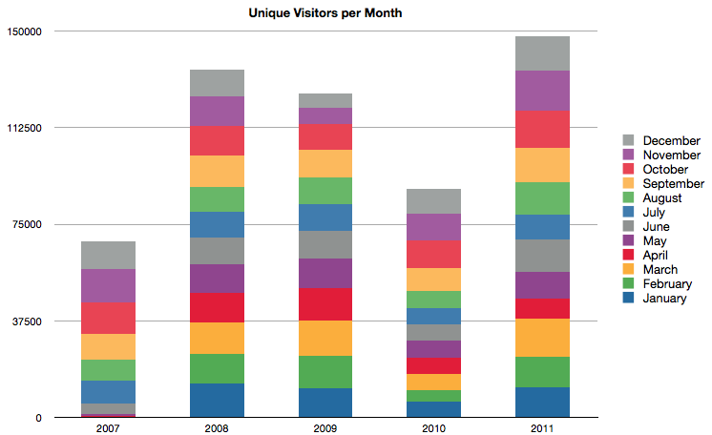
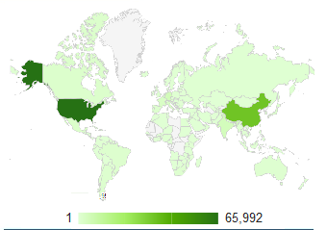
Globalization
2012 New User Map
Notes:
TWO DIFFERENT DATASETS! One is cooperator location (names/emails of people we send notifications and things like that to) the other is site usage from logs! We are tied in!
ARS Crop Database System Supports Global Public and Private Trait Development And Research
Greater than 500,000 user visits per year.
Gramene usage by country 20% US, 2% Korea, 10% Europe (parner with EBI Ensemble Plants)
Single researchers, collaborative projects, other databases
Private industry: Monsanto, Syngenta, Dow, Dupont/Pioneer, Bayer Crop Science, Orion Genomics, Roche, Ceres

Slide 21

Deliver
G8/G20 Alliance for Open Data for Agriculture
G-8 countries agreed to share relevant agricultural data available from G-8 countries with African partners
WORKSHOP. To convene an international conference on Open Data for Agriculture
GLOBAL PLATFORMS. To develop options for the establishment of a global platform to make reliable agricultural and related information available to African farmers, researchers and policymakers, taking into account existing agricultural data systems.
PILOT. Explore options for establishing a pilot to make genetic and genomics data openly available; integrate genetics and genomics data with geo-spatial, agro-ecological, weather, and other relevant data to make practical and useful information available to African farmers,

Slide 22
Global partnerships CIMMYT
Notes:
Shows the locations where CIMMYT maize researchers are based.

Slide 23
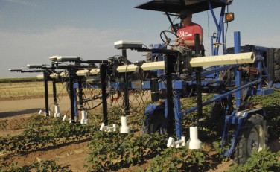
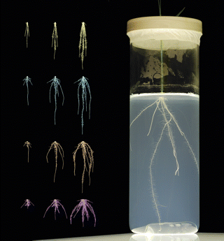
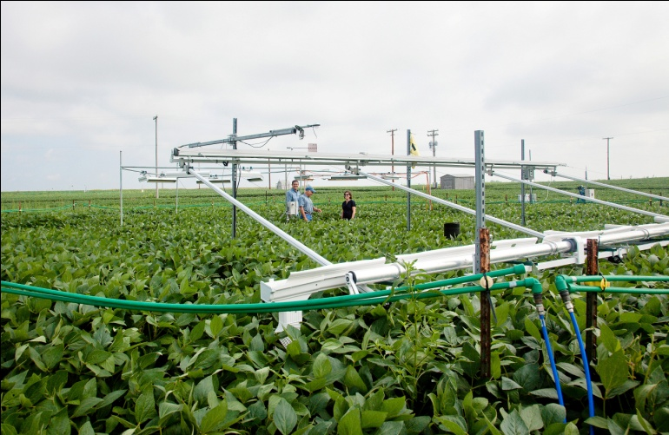
Innovation
New technologies needed
A new generation of plant breeders, bioinformaticists, programmers, IT specialists
Long term data storage & curation
Field-Based Phenotyping
Three-dimensional root architecture phenotyping
SoyFACE Global Change Research Facility
Notes:
Randy T. Clark et al. (2011). Three-Dimensional Root Phenotyping with a Novel Imaging and Software Platform. Plant Physiology 156, 455-465.
Add a cornFACE image

Slide 24
Challenge
Food Security & Sustainability
Climate Change & Adaptability
Renewable & Sustainable Energy Production
Nutrition & Food Safety
Notes:
Our challenge in agriculture is to accelerate crop breeding for
Administration, Secretary, Under Secretary priorities
Focus on today on maize as one example of how ARS, university
Cooperation & coordination

Slide 25
Acknowledgements
Maize Diversity Project Team
ARS Database Teams (Albany, Ames, Ithaca, Cold Spring Harbor
IWGPG
ARS National Programs

